Slide 1
Welcome & Introductions Approve Sept. Minutes

Slide 2
Agenda Item 2 Discussion & Action Modification of Council Mission Statement

Slide 3
2. Modification of Mission
Current Mission Statement with Previous Suggestion
Advise, support and make recommendations to MnGeo and act as a coordinating body for the Minnesota geospatial community, for improving services statewide through the coordinated, affordable, reliable, and effective use of geospatial technology.

Slide 4
2. Modification of Mission
Proposal from Leadership Team
Mission: Act as a coordinating body for the Minnesota geospatial community to improve services statewide.
Examples of Coordination:
Advising, supporting and making recommendations to MnGeo
Setting and Creating, endorsing and advocating for standards
Defining policy requirements and driving policy decisions
Representing the geospatial community
Advocating for project priorities

Slide 5
Agenda Item 3 Discussion & Action Committee Reporting Relationships

Slide 6
3. Committee Reporting Relationships
Proposal from Leadership Team
Review and update charter and workplan templates
Discuss, and if ready, approve the following items

Slide 7
3. Committee Reporting Relationships
Who do the committees and workgroups serve? The geospatial community as represented by the GAC
From whom do committees and workgroups get their mission and purpose? Or who must approve them? The mission and purpose could be generated by the GAC or it could come from a grass roots effort and be approved by the GAC.

Slide 8
3. Committee Reporting Relationships
What must committees and workgroups do to be able to call themselves a committee or workgroup of the MN Geospatial Advisory Council? Examples:
Submit a charter to the GAC for approval with a clear statement of mission and how it supports the MN geospatial community and/or the effective use of geospatial technology in MN
Submit an annual/semi annual work plan to the GAC for approval
Periodically update the GAC on status
Accept revisions to their work plan and charter if directed by and approved by the GAC

Slide 9
3. Committee Reporting Relationships
Who decides if a committee or workgroup should cease to be a committee or workgroup of the MN Geospatial Advisory Council? The GAC makes this decision. Typically this would be done based on a recommendation of the Committee or workgroup.
Who decides if a new MN GAC committee or workgroup should exist? The GAC decides this, but it may be initiated by a self-forming group.

Slide 10
Agenda Item 4 Discussion & Action Changes to Committees and Workgroups

Slide 11
4. Committee & Workgroup Changes
Proposal from Leadership Team
Ask the Outreach Committee to convene. Ask them to review and potentially revise their charter/mission, based on discussion at last GAC meeting and the new role of the GAC.
Sunset the Geocoding Workgroup based on the recommendation of the Chair
Sunset the Geospatial Commons Workgroup based on the recommendation of the Chair

Slide 12
Break – Networking

Slide 13
Agenda Item 6 Discussion New Committees or Workgroups

Slide 14
6. New Committees or Workgroups
Free and open data policies and practices
Advocating for its value
Educating
Making policy recommendations or endorsements
Governance of the Geospatial Commons
Guiding the implementation/support team on policy or governance questions
Identifying potential enhancements or modifications that could help the broader geospatial community participate

Slide 15
Agenda Item 7 Discussion & Action Rebranding as MN GAC

Slide 16
7. Rebranding as MN GAC
Proposal from Leadership Team
Call ourselves the Minnesota Geospatial Advisory Council
Background
The legislation that created us uses “Statewide Geospatial Advisory Council”.
Name created to distinguish from defunct state agency council.
“Statewide” intended to mean including membership beyond state agencies.
However, does “statewide” convey geography more than organizational inclusion?
Is “Minnesota Geospatial Advisory Council” a clearer name?

Slide 17
8. Legislative update
Hal Watson and Dan Ross

Slide 18
8. Vegetation Buffer Mapping Project
http://www.dnr.state.mn.us/buffers/index.html

Slide 19
8. National Geospatial Data Act
Hatch, Warner - Bipartisan Geospatial Data Act (Senate File S.740 - https://www.congress.gov/bill/114th-congress/senate-bill/740/text)
The Geospatial Data Act will:
Codify and strengthen OMB Circular A-16 – delivery of the NSDI
Require federal agencies to implement international consensus standards,
Assist in eliminating duplication,
Avoid redundant expenditures,
Accelerate the development of electronic government to meet the needs and expectations of citizens and agency programmatic mandates,
Improve the efficiency and effectiveness of public management,
Provide a clear definition for geospatial data and metadata,
Require an accounting of the costs associated with the acquisition or creation of geospatial data,
Improve government transparency and availability to public information.

Slide 20
8. National Geospatial Data Act
Looking for:
Additional sponsors in the Senate
Support from the Geospatial Community
Support from the States
MN – Contacted Senator Klobuchar
Follow-up letter
Asking this Council to show support for this bill
Outreach Committee?

Slide 21
9. Updates on Major Initiatives
Dan Ross

Slide 22
9. NSGIC Membership
State Council Membership for Minnesota
Goals:
Keep this Council and the broader geospatial community more informed and aware of activities occurring at National level and in other states
Encourage members of the Council to become engaged in NSGIC activities
Committees
Conferences
Webinars

Slide 23

9. Next Generation 9-1-1 GIS Project Status Update 12/2/2015

Slide 24
9. NG9-1-1 GIS Project Update
Project Newsletter – November issue
Initial NG9-1-1 GIS Data Collection
FirstNet – needs all Public Safety Entity boundaries for reporting purposes
MnGeo – inventory existing NG9-1-1 GIS data, develop internal processes, attribute field mapping (local vs NENA schemas)
GIS Data Assessment and Preparation
MSAG/GIS Synchronization Project
Pilot regions (Metro and NE)
Repository and Workflow Planning
Minnesota NG9-1-1 GIS Standards

Slide 26
9. Parks and Trails
Two Projects
Both Legacy funded
Both through DNR
Partnerships with Met Council, Greater MN Parks and Trails Commission, MnGeo, U of MN
Discussions seem to moving toward combining efforts
Outcomes – common tools, data standards, and access

Slide 27
9. Other Priority Projects
Aerial Imagery Master Contract
Vendor review
Parcel Data Collection and Aggregation
Still requesting parcels from local partners
No standardization, aggregation of data due to resource constraints
Parcel standard ready to go to Standards Committee

Slide 28
9. Other Priority Projects
Drainage Records Modernization
On schedule
Creates standard data model for public drainage ditches
Statewide Address Points
Collection, standardization, aggregation
Part of Next Generation 9-1-1

Slide 29
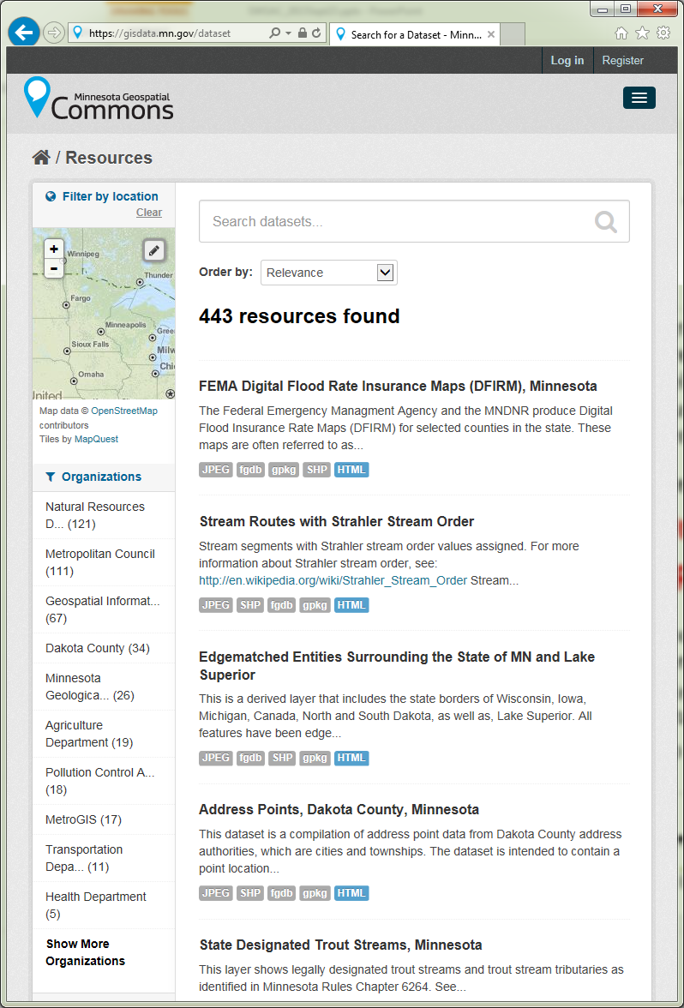















MN Geospatial Commons
Status
Focus - Migration of all significant state geospatial resources to the Geospatial Commons
Published resources accessible
15 Organizations
497 Resources
The site is now open to broader participation
Integrating partners who want to represent their data via the Geospatial Commons
Setting up Metadata Training

Slide 30
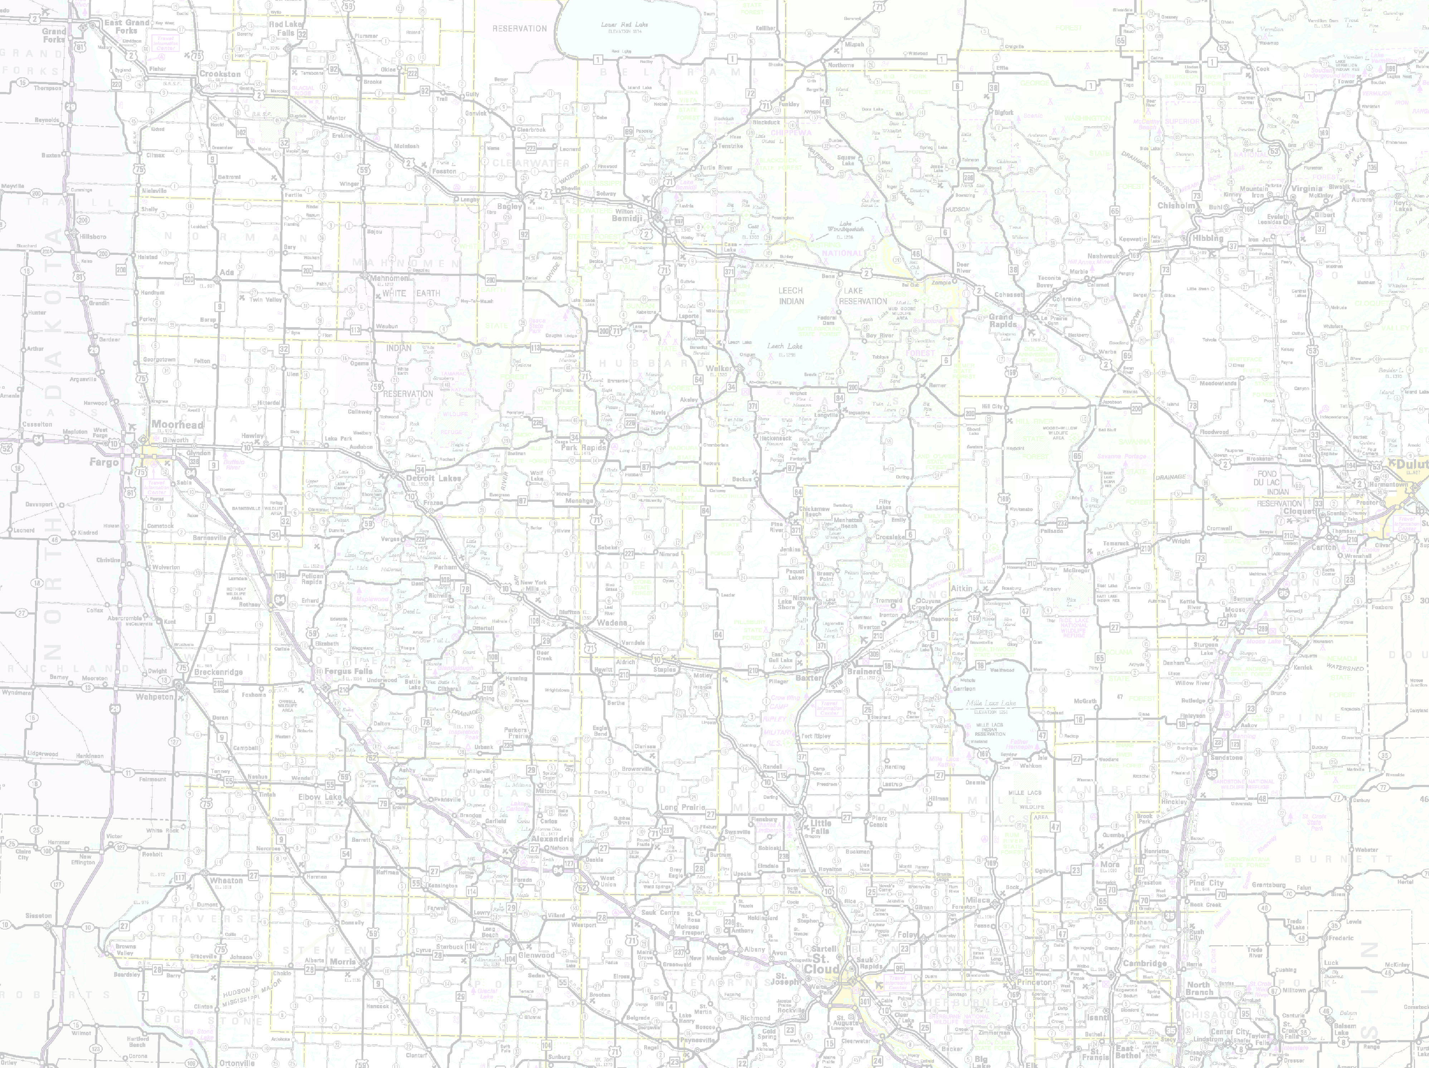









MnDOT instance of Esri Roads and Highways in production
Moving toward conflation of non-state data (Ramsey and Carver)
Align with Metro counties GIS Centerlines, Next Generation 9-1-1 efforts
Focus is on data flow from non-state road authorities
Statewide Centerline Initiative
To develop, test, refine, publish and perpetuate a single state- wide roadway dataset that meets the needs of a diverse user community…

Slide 31
State Agency Collaboration
Kari Geurts

