Slide 1
Welcome
- Introductions
- Update on Members
- Approve Agenda
- Approve September Minutes

Slide 2
Agenda Item 2
Discussion & Action
Statewide Project Prioritization
Mark Kotz

Slide 3
Why Prioritize Projects?
Part of our Mission:
  Statutes 16E.30, subd. 8: The Geospatial Advisory Council must advise the Minnesota Geospatial Information Office regarding the improvement of services statewide through the coordinated, affordable, reliable, and effective use of geospatial technology.
MnGeo can align limited resources to the projects most valuable to the community and most likely to succeed

Slide 4
Why Prioritize Projects?
Can identify valuable projects that can move forward with minimal or no MnGeo resources = GAC committee/ workgroup
Can identify gaps in the likelihood of success for high value projects and recruit accordingly
Informs work plans for next year

Slide 5
Project Prioritization Process
Create a list of proposed projects
  Existing and GAC member input
Assess the value of each
  GAC members advocate for sectors
  100% response!
Assess likelihood of success
Preliminary priority calculation
GAC discusses and adjusts

Slide 6
Likelihood of Success
What is the estimated effort?
Is funding needed? Available
Does a committed project owner exist?
Project team?
High level champion?
Score factors in a prioritization matrix
Review draft scores

Slide 7
Setting Priorities Today
Review preliminary scoring in matrix
Adjust likelihood of success factors
Discuss gaps
Create GAC priorities
Limit list to a realistic number of projects

Slide 8
Agenda Item 3
Break – Networking

Slide 9
Agenda Item 4
Discussion
Review and Accept Committee and Workgroup Summaries

Slide 10
Agenda Item 5
Discussion
LiDAR/Hydrography Panel and Results from GIS/LIS Conference
Gerry Sjerven

Slide 11
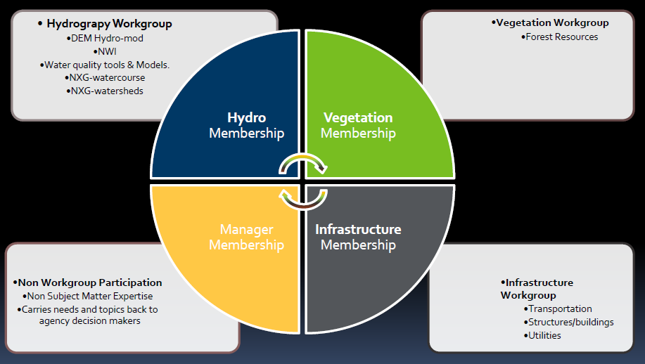

Slide 12
Agenda Item 6
Discussion
Outreach Committee Update on Open Data Survey
Len Kne and Kari Geurts

Slide 13
Minnesota Geospatial Advisory Council
Outreach Committee
Free + Open Geospatial Data Survey
& “Narratives of Success”
Brad Anderson, City of Moorhead
Kari Geurts, Minnesota DNR, Outreach Committee Co-Chair
Len Kne, University of Minnesota, Outreach Committee Co-Chair
Geoff Maas, MetroGIS Coordinator
Michelle Trager, Rice County

Slide 14
What we’ll cover:
Part I: Context
Part II: Survey Results
Part III: Trends from the results
Part IV: Narratives of Success
Part V: What’s next?

Slide 15
Part I:
Context

Slide 16
Minnesota Geospatial Advisory Council
Mission: Act as a coordinating body for the Minnesota geospatial community.
http://www.mngeo.state.mn.us/councils/statewide/index.html

Slide 17
Mission of the Outreach Committee:
“Promote the value and importance of the geospatial infrastructure by actively engaging public policy makers and stakeholders”
Notes:
Reconstituted in December 2015
Find and document compelling geospatial stories useful to government (all levels), private sector, professional associations, related professions, and citizens of the state;
Tell those stories in venues where they can inform and influence policy makers and others seeking to improve government operations, economic development, and quality of life in Minnesota.
Committee Members:
Brad Anderson
Will Craig
Scott Freburg
Kari Geurts (co-chair)
Andrew King-Scribbins
Len Kne (co-chair)
Geoff Maas
John Mackiewicz
Victoria Reinhardt
Cory Richter
Gerry Sjerven
Alison Slaats
Michelle Trager
Annette Theroux

Slide 18
Free + Open Data: Not uniform in Minnesota
Purposes of the Survey:
Understand and document the full range of
issues and concerns of the data producer community;
Document success stories of GIS used to make government more efficient;

Slide 19
The Survey:
>> Developed in July/August
>> Sent out in late August
>> Closed on Sept 30, 2016
>> 59 of 87 Counties* (~68% response rate)
>> October: Compiled the results
*Some counties had both their GIS and survey staff respond;
Notes:
We worked with the Association of Minnesota Counties to also send the survey to county administrators and county board chair.

Slide 20
Results Available:
MN GIS/LIS Conference (Oct 26-28)
Government IT Symposium (Dec 5-6)
Report available soon

Slide 21
Part II:
Survey Results

Slide 22
The Questions:
Differed slightly between counties;
Depending on open and not open
Structured questions, plus the opportunity to provide detailed written comments;

Slide 23
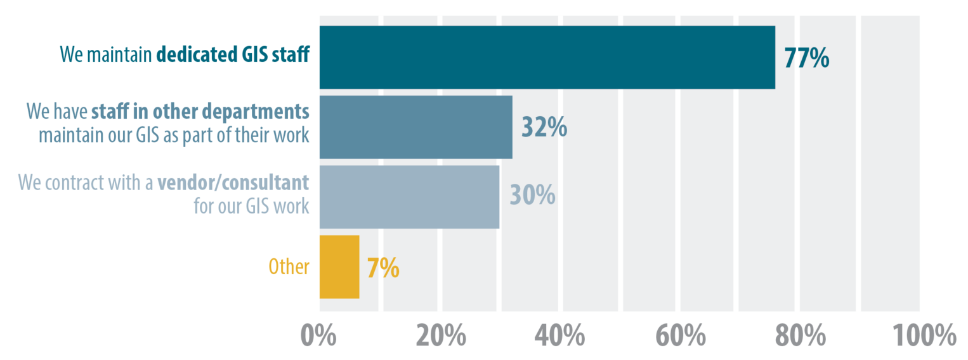
Question 1:
Does your county maintain a staff commitment to geospatial work? (Check all that apply)

Slide 24
Question 1 (Other)
Does your county maintain a staff commitment to geospatial work? (Check all that apply)
We have one (1) GIS specialist;
Business areas maintain data plus central/enterprise staff;
GIS falls under County Administrator duties;
Some GIS is done by the County, some is outsourced;
Notes:
Other can be worked into defined response categories.

Slide 25
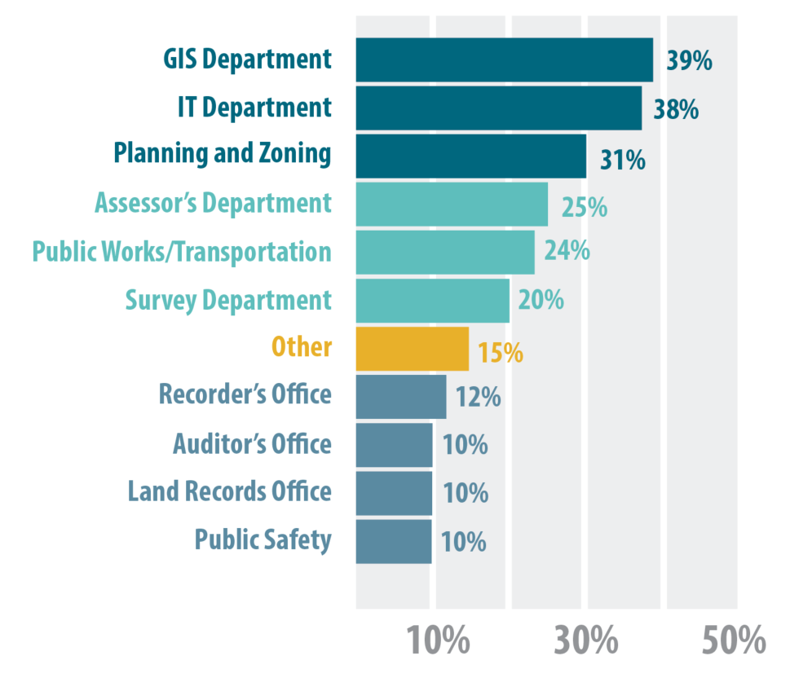
Question 2:
Which department in your county is a steward of your geospatial data?
(Check all that apply)

Slide 26
Question 2 (Other)
Which department in your county is a steward of your geospatial data? (Check all that apply)
Environmental Services (x3)
County Administrator’s Office (x2)
Community Works
Human Services
Health
Drainage Administration
Natural Resource Management
Notes:
Leave alone

Slide 27
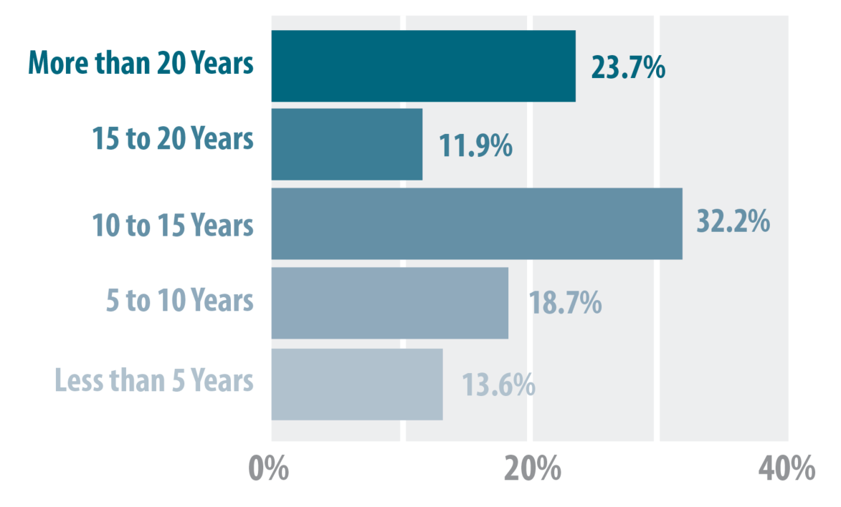
Question 3: How long has your county created and maintained geospatial data?

Slide 28
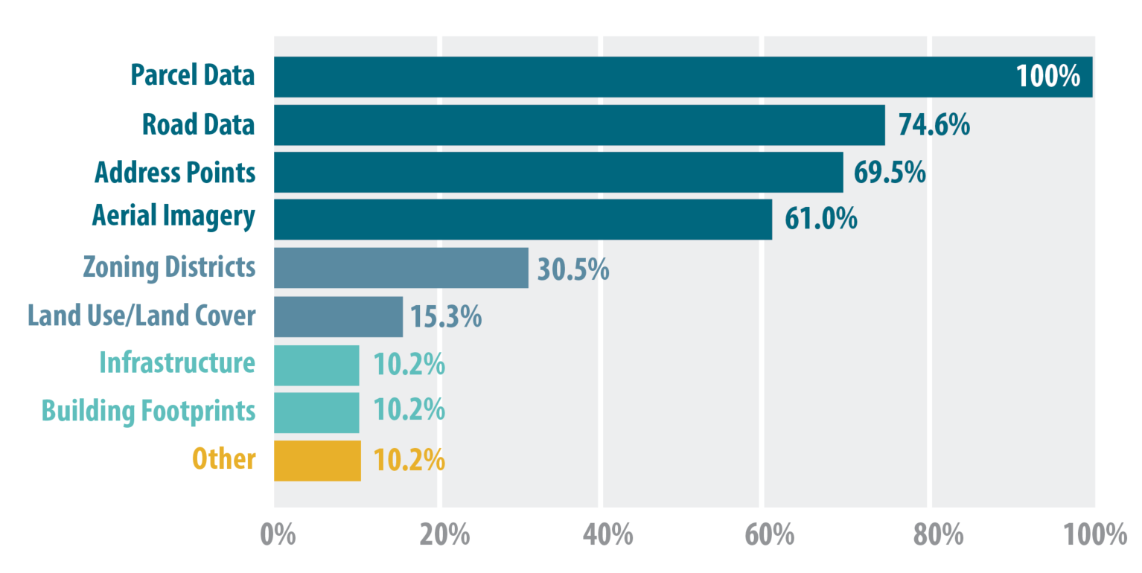
Question 4:
What types of GIS data are commonly requested? (Check all that apply)

Slide 29
Question 4 (Other)
What types of GIS data are commonly requested?
County Drainage
County Ditch Systems
Public Drainage Watersheds and Tile Centerlines
PLSS corners
Land surveying data

Slide 30
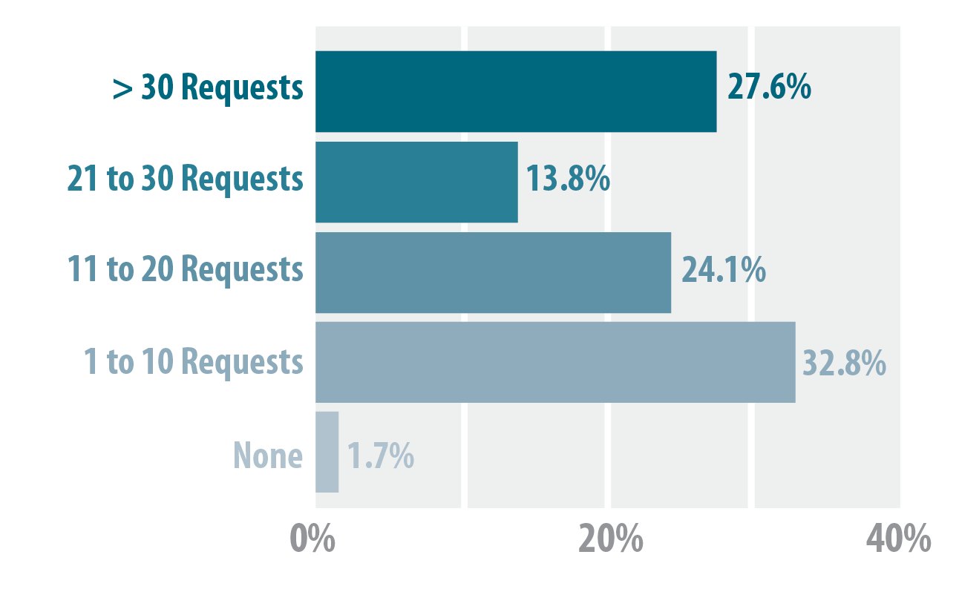
Question 5: Please estimate the number of non-government requests you receive each year for your geospatial data.

Slide 31
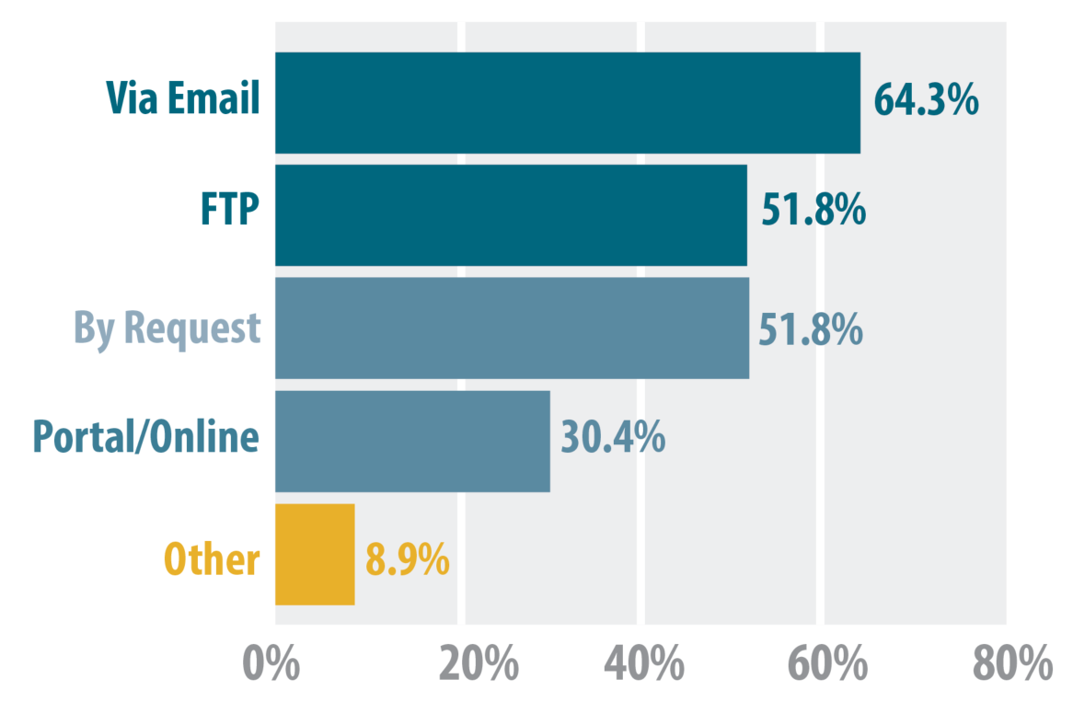
Question 6: How do you distribute your GIS data?

Slide 32
Question 6 (Other)
How do you distribute your GIS data?
Minnesota Geospatial Commons (x2)
Moving to an Open Data Portal (ArcGIS Online Site)
Via Dropbox
Web site downloads
Notes:
Move to other response categories

Slide 33
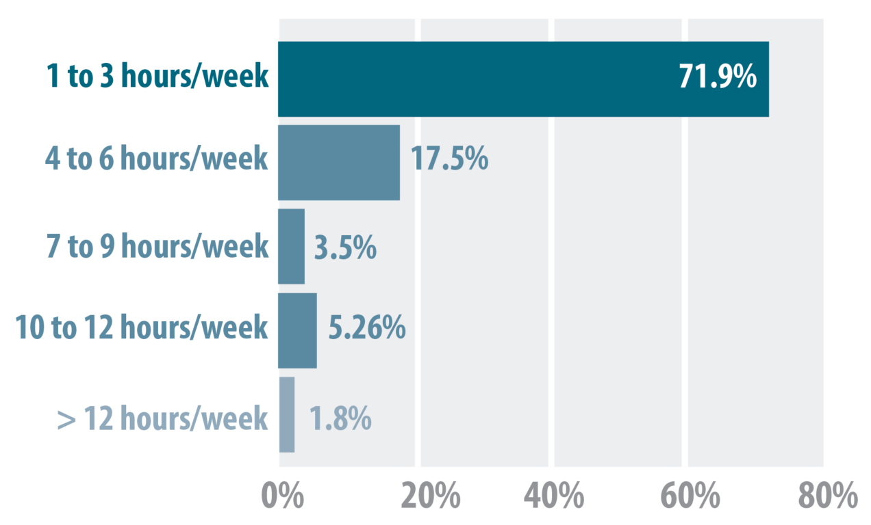
Question 7: Please estimate the number of hours county staff or vendors spend each week preparing data for external requests.

Slide 34
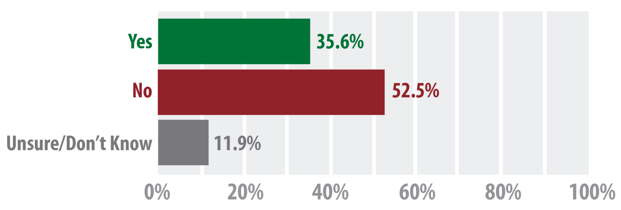
Question 8: Does your county provide its geospatial data freely and openly?

Slide 35
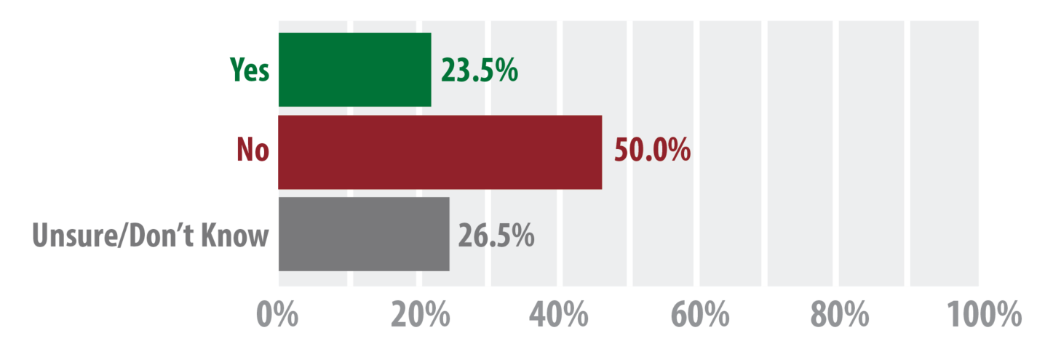
Question 9: Is your county considering making its geospatial data freely available in the near future?

Slide 36
Question 9 (Additional Comments)
Is your county considering making its geospatial data freely available in the near future?
RANGE OF ANSWERS RECEIVED:
No, not an issue;
No, it generates revenue;
No, staff supports it, leadership doesn’t support it
Some data is free, other data we sell;
Yes, we are considering it;
Yes, we are actively moving toward opening up;

Slide 37
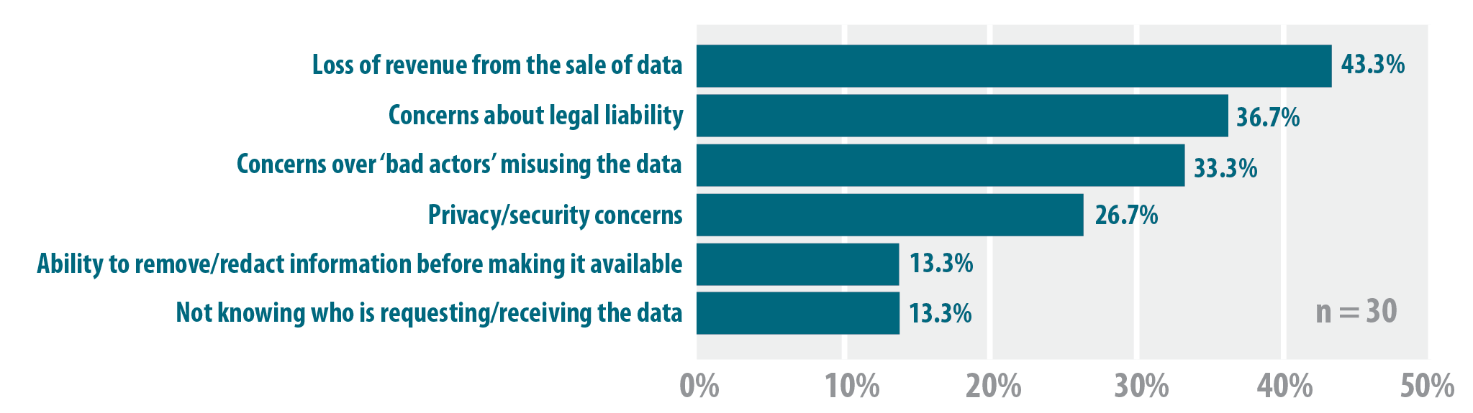
Question 10: What concerns does your county have about making its geospatial data freely and openly available?
Notes:
Concerns over loss of revenue from the sale of data 13 43.3%
Concerns over legal liability for the geospatial data we produce 11 36.7%
Concerns over not knowing who is requesting or receiving the data 4 13.3%
Concerns over ‘bad actors’ acquiring and misusing the data 10 33.3%
Concerns over privacy and/or security 8 26.7%
Ability to redact or remove certain attributes before making data available 4 13.3%
N=30

Slide 38
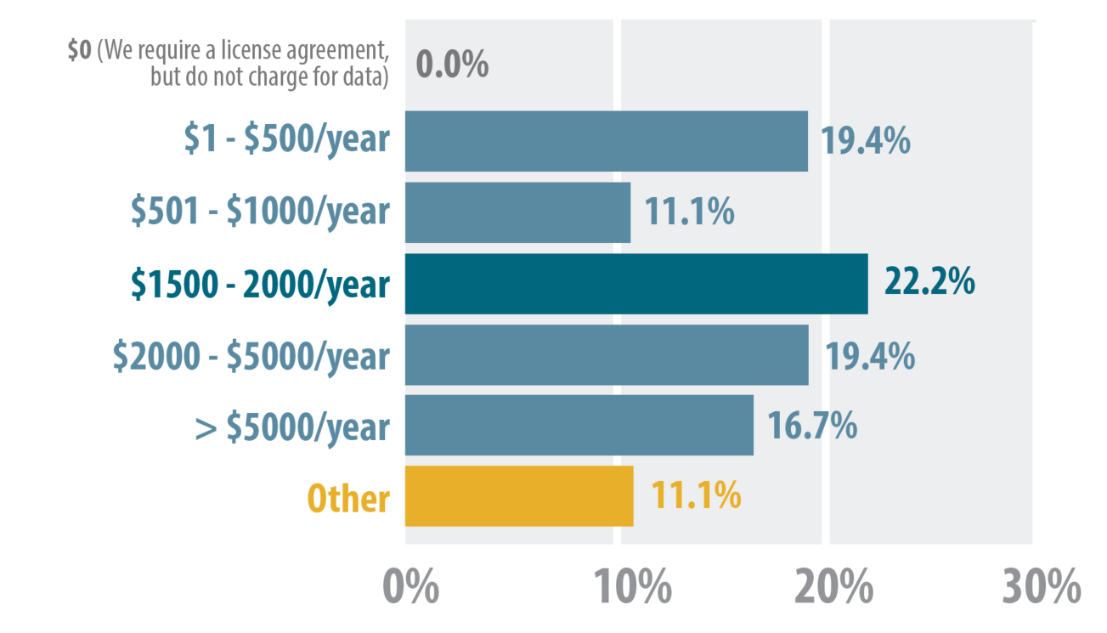
Question 11: Please estimate the amount of revenue generated from the sale of data each year.

Slide 39
Question 11 (Additional Comments)
Please estimate the amount of revenue generated from the sale of data each year
Nothing for sale yet;
Price depends upon the request;
Respondents provided costs of their
various datasets;

Slide 40
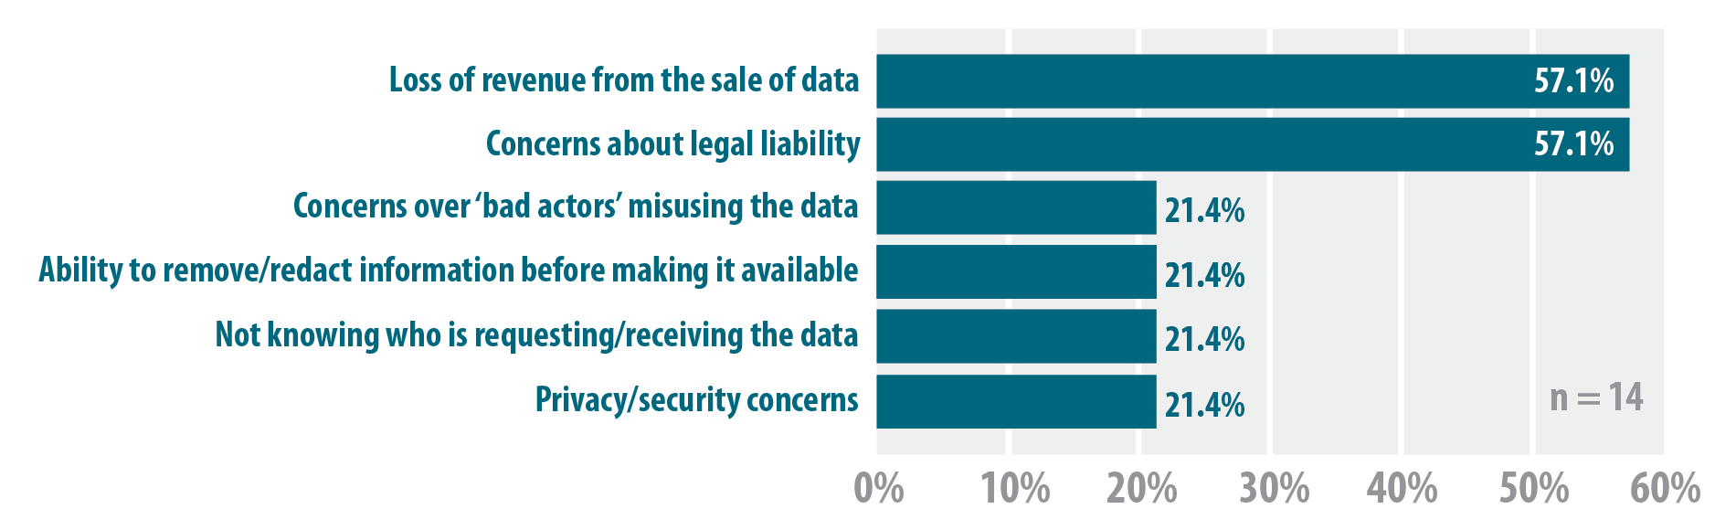
Question 12: What kinds of issues or obstacles did your county work through to make its GIS data freely and openly available?
Notes:
Concerns over loss of revenue from the sale of data 8 57.1%
Concerns over legal liability for the geospatial data we produce 8 57.1%
Concerns over not knowing who is requesting or receiving the data 3 21.4%
Concerns over ‘bad actors’ acquiring and misusing the data 3 21.4%
Concerns over privacy and/or security 3 21.4%
Ability to redact or remove certain attributes before making data available 3 21.4%
N=14

Slide 41
Part III:
Trends from the results

Slide 42
Major themes from the survey:
# 1 ) A significant commitment has been made to GIS at the County level in Minnesota;
Dedicated staff to GIS
67% of respondents: GIS for 10 or more year

Slide 43
Major themes from the survey:
# 2 ) The broad reach and extensive use of GIS at the county level;
12+ departments acting as data stewards or creating data at the county government level;

Slide 44
Major themes from the survey:
# 3 ) What data is being asked for from counties;
Parcel data
Road data
Address point data
Aerial imagery
“The Big Four”

Slide 45
Major themes from the survey:
# 4 ) Uncertainty & Wide Range of Practices
>> Open Data
>> Some data is free; some is sold/licensed
>> All data sold/licensed
>> Staff support for open data
>> Unclear to leadership how to move

Slide 46
Major themes from the survey:
# 5 ) Key Concerns about Open Data:
Address these specifically in Part V
Loss of Revenue
Legal Liability
‘Bad actors’ misusing the data
Privacy and security concerns

Slide 47


State Agencies: Issues with Non-Open Data
Data published under a non-open license takes a significant amount of resources to manage. We have to store the data in a restricted folder and ensure that each data user understands and commits to the restrictions imposed by the license.
Even though we can use the data under a non-open license, it is of lower value because of the license terms. We need to create a data product that we can distribute to the public, but can't base it on the non-open data because that would violate the terms of use. Instead, it will cost us a lot more to build it from scratch.
David Fawcett
Spatial Database Administrator
Minnesota Pollution Control Agency
Notes:
Some licenses specify the data as Trade Secret or Non-Public under the Minnesota Data Practices Act.
· Managing data acquired under a non-open license takes significant resources. We have to store the data in a restricted folder, grant access individually to staff who have a business need for the data, and we have to ensure that each data user understands and commits to the restrictions imposed by the license.
· Some county licenses have stated that the licensee treat the data as Trade Secret or Non-Public under the Minnesota Data Practices Act. This sets a very high, rigorous, and resource intensive standard for the management of the data.
· Under most non-open licenses, we have been able to use the data internally, but not re-distribute the data. This significantly reduces the value of the data to an agency. For example, most of the sites that the Minnesota Pollution Control Agency is interested in can be defined by their parcel boundaries. The agency would like to generate site boundaries off of the parcels, but they need to be able to map and publish the data for boundaries, and this is not allowed under many licenses.

Slide 48
Part IV:
Narratives of Success

Slide 49
Free and Open GIS data status:
At present:
Twenty (20) counties are making their data freely and openly available;
Since February 2014:
Ten (10) County Boards have adopted
Free + Open Data Resolutions
Notes:
So real quick before we get into the survey results, here the current status of free and open data at the county level.

Slide 50
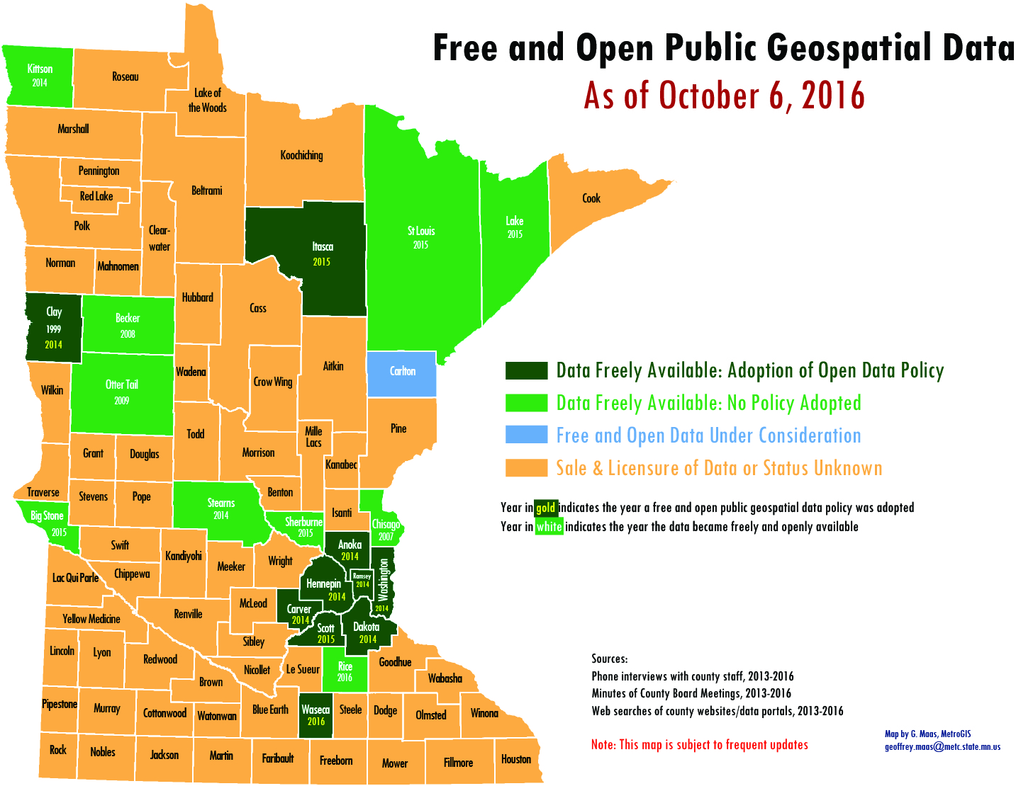

Slide 51
Benefits of Free and Open GIS data
from the Metro Counties open data experience
> Less time/effort for data producers;
> Pro-active government;
> Ease of access to data to entire consumer community;
> Fostering entrepreneurship/business development;
> Transparency of government operations;
> Faster decision making;
> Maximizes public investment in GIS;
Notes:
Move this to after the survey?

Slide 52
Question 13: Are you experiencing benefits from making your geospatial data freely and openly available?
If so, please summarize or describe those benefits.
No managing of license agreements
Public able to acquire the data themselves (self-service)
Saves our staff time
Reduced administrative burden
Frees up time for other projects
Requests directed to staff are definitely down
Staff can focus on data quality and data management

Slide 53
Question 13: Are you experiencing benefits from making your geospatial data freely and openly available?
If so, please summarize or describe those benefits.
“Organizations like Zillow, Black Knight, CoreLogic have already been directed to get their data from the Commons. Our tax folks are wishing to publish CAMA and tax information tables to the Commons for use with the parcel GIS layer to further cut down on requests coming to their offices”;

Slide 54


Business Community: Benefits of Free and Open GIS data
NorthstarMLS provides Real Estate listing services to it's subscribers who provide great benefit to both buyers and sellers of real property throughout Minnesota and Wisconsin.
Having free and open parcel GIS data allows NorthstarMLS to confirm and improve the geo-positional accuracy as well as the characteristics of the data of over 42,000 currently active Real Estate listings in 103 counties in Minnesota and Wisconsin.
Without free and open data, listing accuracy is compromised and this results in inaccurate searches and delays for buyers and sellers alike. Having access to free and open GIS data allows us to better serve the general public in as large an area as possible.
Curt Carlson,
GIS Coordinator
NorthstarMLS

Slide 55


Public Health: Benefits of Free and Open GIS data
During the 2015 highly pathogenic avian influenza outbreak, timely access to locational data was essential for an effective and efficient response. Lessons learned from this animal disease response and ongoing preparation for future animal disease emergencies highlight the need for the best locational data available. In Minnesota, having up-to-date parcel GIS data accessible is extremely important to the Board of Animal Health for the ability to identify landowners with livestock and poultry.
With this information, we can contact producers to provide information and enable a swift response to animal disease emergencies.
Linda Glaser,
Senior Veterinarian

Slide 56

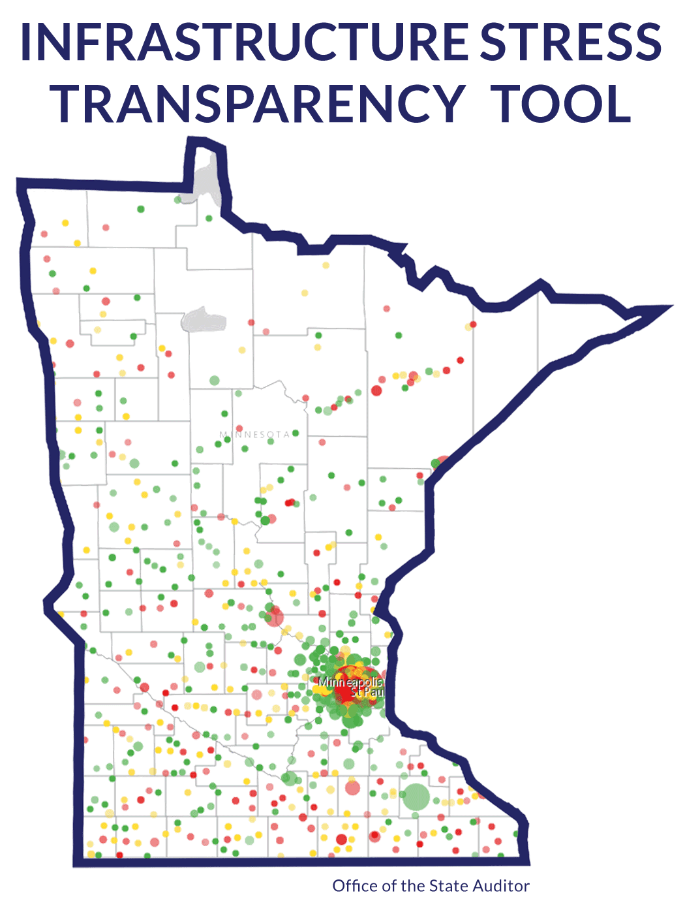

Office of the State Auditor: Benefits of Free and Open Data
The goal of these comprehensive maps is to improve public policy/long-term financial planning and asset-management planning for our civil infrastructure throughout Minnesota's 853 cities and other local governments. By improving transparency of our infrastructure needs, all residents, local elected officials, legislators and governors will have a more comprehensive understanding of the total need over the next few decades statewide. This understanding can accelerate better planning, stabilize rates for users, and avoid major service disruptions due to inaction.
Rebecca Otto
MN State Auditor

Slide 57


Counties: Benefits of Free and Open GIS data
We receive many data requests for GIS data, especially from other government entities and contractors. Parcels, road centerlines, address points and imagery are the most commonly requested layers.
I requested that our county share our data so I could spend less time filling requests, and still help other entities meet their business needs. In August, we received permission to go ahead with Free and Open Data. I am working with MnGeo to add data to the Minnesota Geospatial Commons.
I am looking forward to being able to spend time working on other tasks like updating and creating ArcGIS Online maps.
Michelle Trager
GIS Coordinator
Rice County

Slide 58



Cities: Benefits of Free and Open GIS data
As a creator, maintainer, and provider of GIS data for the City of Moorhead, I find most requests prefer a County-wide set of data. We have nightly tasks that exchange GIS and tax ownership data back and forth with Clay County.
City specific data requests typically include underground utilities, parcels, elevation, easements, zoning/land use, flood mitigation, and miscellaneous historical data.
I plan to setup an Open Data Portal to reduce my time spent filling requests,….. the only caveat being that I like to know how the data is being used AND receiving feedback on any errors so that I can make our data better. Which would benefit everyone.
Brad Anderson
GIS Manager
City of Moorhead

Slide 59


Non-Profit Sector: Benefits of Free and Open GIS data
We use geospatial science to address and resolve social justice and natural resource conservation issues.
The usefulness and efficiency of the spatial analyses that we perform is tied directly to the availability and quality of data that we can obtain for their implementation.
Having public GIS data that is readily available is imperative to our mission of advocating for the sustainability of our common resources.
Andra Bontrager
GIS Specialist
Minnesota Center for Environmental
Advocacy

Slide 60


Academia: Benefits of Free and Open GIS data
My GIS students are primarily pursuing graduate-level degrees in Urban and Regional Planning and Public Policy.
Having unfettered access to government geospatial data at all levels (city, county, regional, state and federal) is a vital component to not only their ability to use GIS and perform spatial analysis but to fully understand the functions and operation of government.
Being able to access and use the geospatial data as prepared by its authoritative sources is crucial for providing an authentic and valuable educational experience.
Geoff Maas
Lecturer
Humphrey School of
Public Affairs,
University of Minnesota

Slide 61
Part V:
What’s next?

Slide 62
Technology is not the issue

Slide 63
Addressing the Specific Concerns
Raised by Survey Respondents
Loss of Revenue
Legal Liability
‘Bad actors’ misusing the data
Privacy and security concerns

Slide 64
Loss of Revenue
Revenue generated from the sale of data;
Vs.
Staff time committed to fulfilling requests;
Time taken away from other work;

Slide 65
Legal Liability
Chapter 466.03, Subd. 21
Under state law: As long as you
provide a disclaimer with your data
you are exempt from liability;

Slide 66
‘Bad actors’ misusing the data
Privacy and security concerns
The data contained in parcel data are public information:
Owner, address, value of land and improvements
and the taxes paid;
Affirmed in several places in state statue;
Chapter 13, also §389.02, §505.04;

Slide 67
‘Bad actors’ misusing the data
Privacy and security concerns
Protection of the location and identity
of women’s shelters;
‘Safe At Home’ Law (§13.045)
These data are redacted/stripped out prior to entering the GIS data stream;

Slide 68
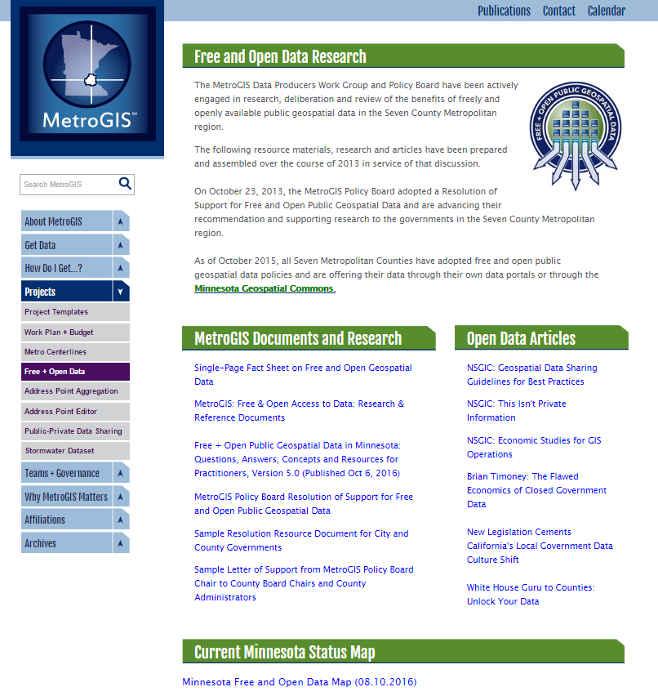
Resources:
metrogis.org > Projects > Free + Open Data
Single Page Fact Sheet
“White Paper I”
Statutes, Disclaimers
Law Case Summaries
Interviews with practitioners
“White Paper II”
FAQs
Resources for practitioners
Links to government sites
Notes:
Also new resources coming from the GAC Outreach committee

Slide 69
What’s next?
Questions
Comments
Discussion

Slide 70
Agenda Item 7
Discussion
Geospatial Community Calendar and Discussion Forum – GIS/LIS Board Feedback
Gerry Sjerven

Slide 71
Agenda Item 8
Discussion
Legislative Updates
Dan Ross

Slide 72

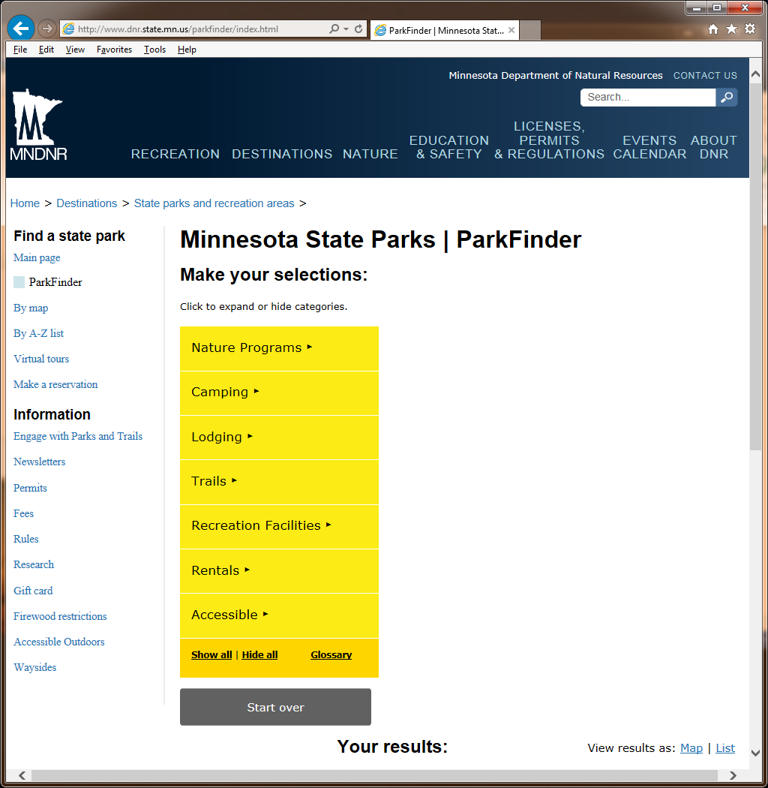
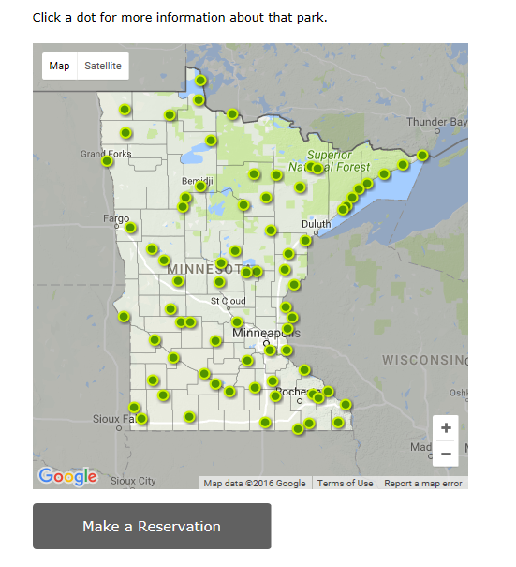
Legislative Updates
Clean Water Fund Language
  Approved to move forward
Parks and Trails Legacy Fund (U of M)
  Current focus is on data standard
Responsive Website for Parks and Trails (DNR)
  Survey to help determine website design
    Click here to take the survey
  Buffer Mapping Project – updated data

Slide 73
Agenda Item 9
Discussion
Announcements or
Other Business

