Slide 1

Minnesota Geospatial Advisory Council
May 31, 2017

Slide 2
Welcome
Introductions
Approve agenda
Approve March minutes

Slide 3
Agenda
Time | Topic
11:15 | Accept committee summaries; approve Parcels and Land Records Committee work plan
11:25 | LiDAR funding and update on emerging Hydro-Elevation Committee
11:45 | MnGeo boundaries project update and possible role of GAC
11:55 | Break, networking
12:25 | Sector reports
12:45 | Standards update: address points, parcels, etc.
1:05 | Emergency management damage assessment data standard
1:15 1:35 | MN GAC priority projects NSGIC with 2018 GIS/LIS conference
1:45 | Announcements

Slide 4
Agenda Item 2
Review, discuss and accept committee summaries
Review, discuss and approve Parcels and Land Records Committee work plan

Slide 5
Agenda Item 3
LiDAR funding and emerging Hydro-Elevation Committee (Sjerven, others)

Slide 6
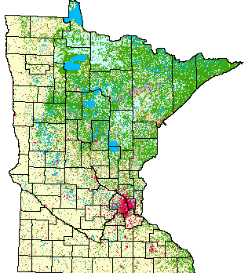
Agenda Item 4
Boundary Update Project (Ross)
Background – MN boundary data layers are out of date and need to be updated. More current and accurate authoritative information is available.
MnGeo will lead an effort to identify stakeholders, authoritative data stewards, and resources required to develop, document and evaluate a process for updating, aligning and maintaining statewide geospatial boundary data layers going forward.
Outcomes – stakeholders and authoritative data identified, process, updated PLSS, process for other related layers
Discussion - What role can the GAC play?
  Committee or Workgroup?

Slide 7

Break - Networking

Slide 8
Agenda Item 6
Sector reports
K12 Education: Freburg
Private Sector: Hackett

Slide 9

MN GAC
K12 Education Report
Scott Freburg
K12 Education Sector

Slide 10
K12 GIS Education
Minnesota’s Undiscovered Resource
Q1: Does K12 even know what GIS is?
The K12 environment has many standards, different software types, various curriculum entities. GIS is just one more piece in an already large puzzle. How can we bring GIS to Teachers and students.
Q2: How best to communicate GIS and MN GAC?
Partnerships, listservs, MDE resources, Newsletters, Nonpublic and Charter communications, Social Media

Slide 11
The approach that I am taking as MN GAC’s K12 representative is to collaborate with other agencies, education and partners to bring GIS to the classroom.
Collaboration / Communication
  MN GIS/LIS Consortium Board of Directors
  MN Alliance for Geographic Education (MAGE)
  MnGeo
  MN Dept. of Education
  Individual Partners, i.e. GIS professionals, geo-mentors
  Business Partners
  Nonpublic School Association
  MN Association of Charter Schools
  MN Home Schoolers Alliance
  Others . . .

Slide 12
Short History:
Started as an MDE idea that has blossomed into a three year collaboration between local, county and state GIS professionals, individual school districts, several Counties, the Minnesota GIS/LIS Consortium and several secondary institutions.
Between 2014 and 2017 and continuing . . . .
> 400 teachers received FREE GIS training to support their efforts to teach GIS in their classrooms.
55 separate half-day and full-day workshops
4 Grants totaling $20K for GIS Workshops
15 different Minnesota cities
>25 GIS professionals volunteered time to teach these classes
Increase ArcGIS Licenses from 2 to 75
Increase ArcGIS Online Licenses from 5 to 240…ALL FREE

Slide 13
How we are doing it:
Start with an idea – FREE GIS workshops to other GIS professionals. Engage and employ. MN-Esri ELA 2013.
Collaborate – Creating partnerships is key for a statewide employment of free workshops. We have engaged the following: statewide GIS professionals, MN GIS/LIS Consortium, public and private secondary institutions, several school districts and many private companies
Implementation – engage GIS professionals to teach workshops in their area of the State, for K12 teachers.
Funding – Support from MN GIS/LIS Consortium in the form of annual funding for K12 activities starting in 2017!
Surveys…Make sure that we are meeting K12 teachers’ needs
Face-to-Face – Hold annual FREE K12 Educator Day, bringing in educators for all-day hands-on instruction. Substitute pay included!

Slide 14
Who did it:
Collaborative Partners!!!
Scott Freburg, MN.IT @ Education
Doug Paulson, MDE Academic Standards
John C. Olson, MDE Academic Standards
Jessica Winkelaar, Minnesota Historical Society
Collaboration …
Volunteers …
Donations …
Students learning life skills … Priceless!

Slide 15
What difference did it make:
Collaboration …Volunteers …Donations …
Students learning life skills … Priceless!
Teacher Comments:
- “I had a student struggling in all subjects … with GIS, she excelled…and loved it”
- “Two students started but within a week, fifteen more came in to do after school GIS activities for the Contest”
- “The students and I are learning together…amazing!”
Student Comments:
- “Best thing I did all year”
- “Where else could I study, map Bigfoot sightings and win a cash prize”
- “With my partner, We had FUN”
- “I guess tugboats are cleaner than I thought”
- “I can’t wait to tell my parents I came to the USA to research and map fast food restaurants”
- “GIS Rocks”

Slide 16
Where does MN-GAC Fit:
Website and Minutes are communicated to:
District Superintendents through MDE weekly email
Non-publics and Charters
ArcGIS Online ORG Admins
Is Communication Working?
To some degree .. “Yes” .. Some comments are received from the K12 level but mainly the word hasn’t spread yet. I believe it will as we continue to grow GIS at the K12 level….
Questions??

Slide 17
Agenda Item 6
Sector reports: Hackett – Private Sector
Sector Overview
  What is the “Private Sector” representative
  Represent clients or private business or both?
How is GAC relevant to your sector?
  Projects to support clients’ needs, business needs
What is your strategy for communicating?
  Everyday contact with clients
  Idea! Meetup for just private sector geo-professionals

Slide 18
Agenda Item 7
Standards Committee Update (Maas)

Slide 19

Geospatial Advisory Committee
Standards Committee Update
Geoff Maas, GISP
MetroGIS Coordinator
Chair, Standards Committee

Slide 20
Four things:
>> Purpose of the Standards Committee
>> Current status of standards
>> Quick re-cap of the standards process
>> What’s on the horizon

Slide 21

Purpose of the
Standards Committee

Slide 22
Purpose of the Standards Committee
To provide a transparent and inclusive process by which geospatial data standards can be proposed, discussed, refined, developed, communicated, adopted, and revised to the benefit of the geospatial profession in the State of Minnesota;
To develop materials, resources, and paths of communication to promote the development, adoption and use of standards within the geospatial community of Minnesota;
To advise the state geospatial community about relevant standards issues and facilitate the creation and adoption of such standards within Minnesota;
To serve as liaisons to standards initiatives at the Federal government level;

Slide 23
Standards
Not a mandate (GAC Standards)
Standards are a resource:
Importance of stakeholder input:
>> Able to meet range of business needs
>> More-readily used by the stakeholder community
>> Stakeholder ‘ownership’

Slide 24
Standards - Compliance
Compliance Statement
Specific to that standard

Slide 25
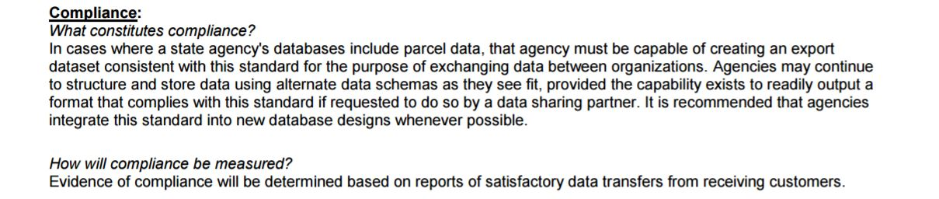
Standards - Compliance
Compliance Statement
Specific to that standard
Example from the Draft Parcel Data Transfer Standard

Slide 26

Standards
Development process:
>> Transparent & inclusive
>> Build on the full range of use and experience
>> Understand the full range of shared needs

Slide 27

Standards
Development process:
>> Transparent & inclusive
>> Build on the full range of use and experience
>> Understand the full range of shared needs
Benefits:
>> Efficiency/speed of use
>> Time/effort/cost savings
>> Communication
>> Inter-operability
>> Long-term consistency

Slide 28

Current status of
Standards in Minnesota

Slide 29
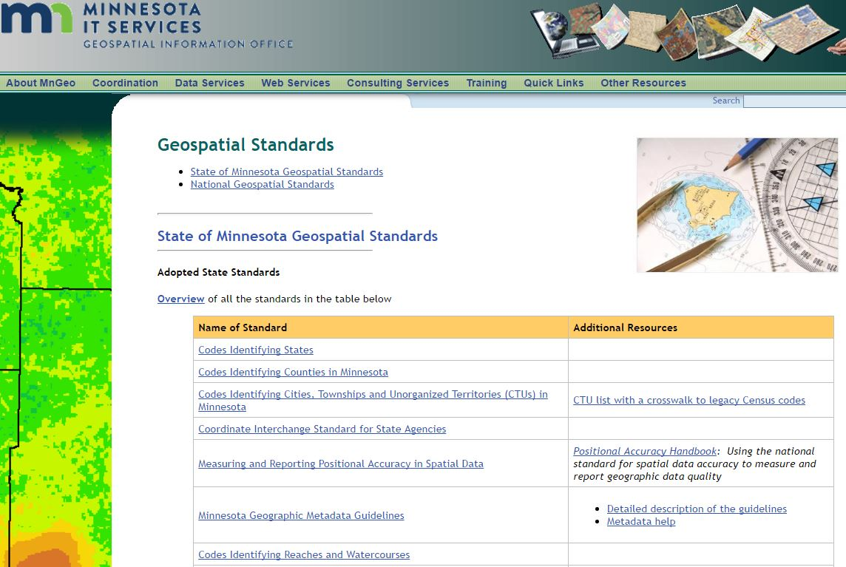
Standards in Minnesota
http://www.mngeo.state.mn.us/committee/standards/standards_adopted_devel.html

Slide 30
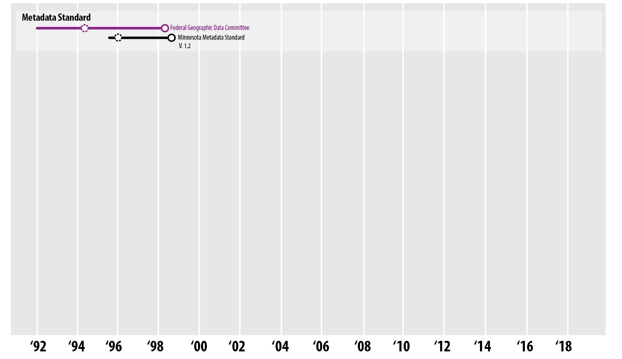

Slide 31
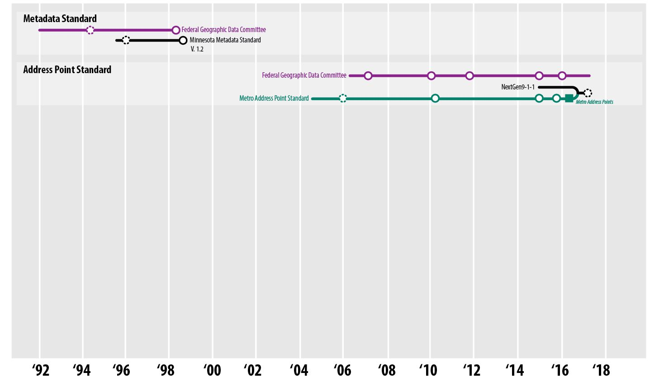

Slide 32
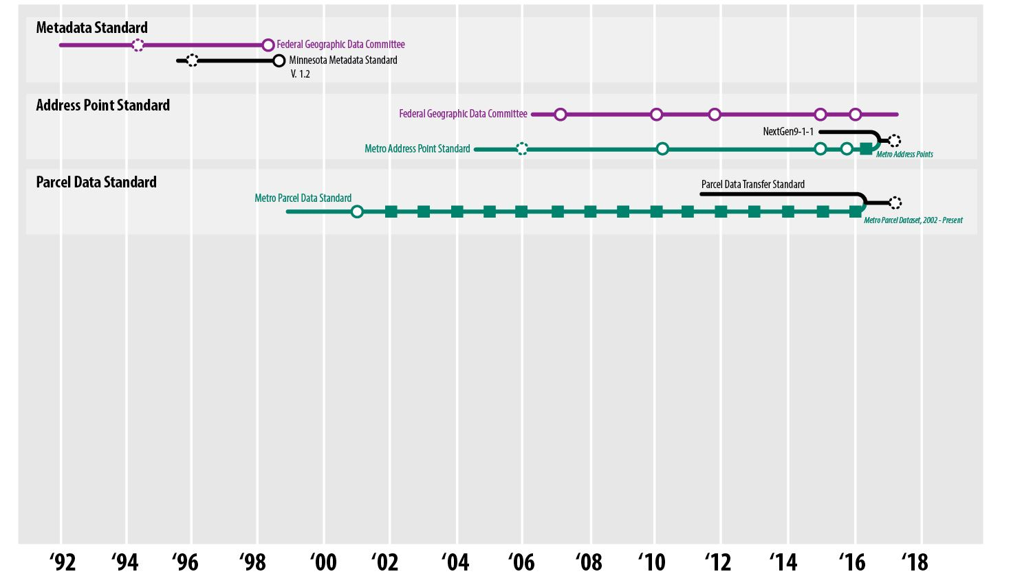

Slide 33
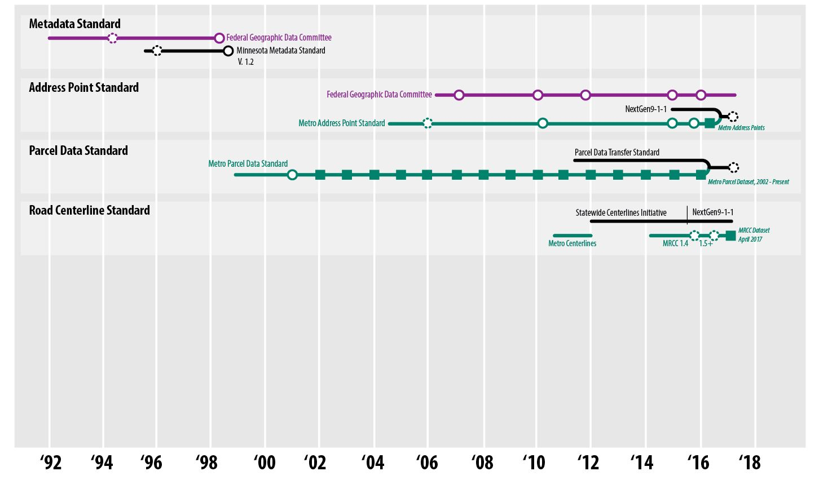

Slide 34
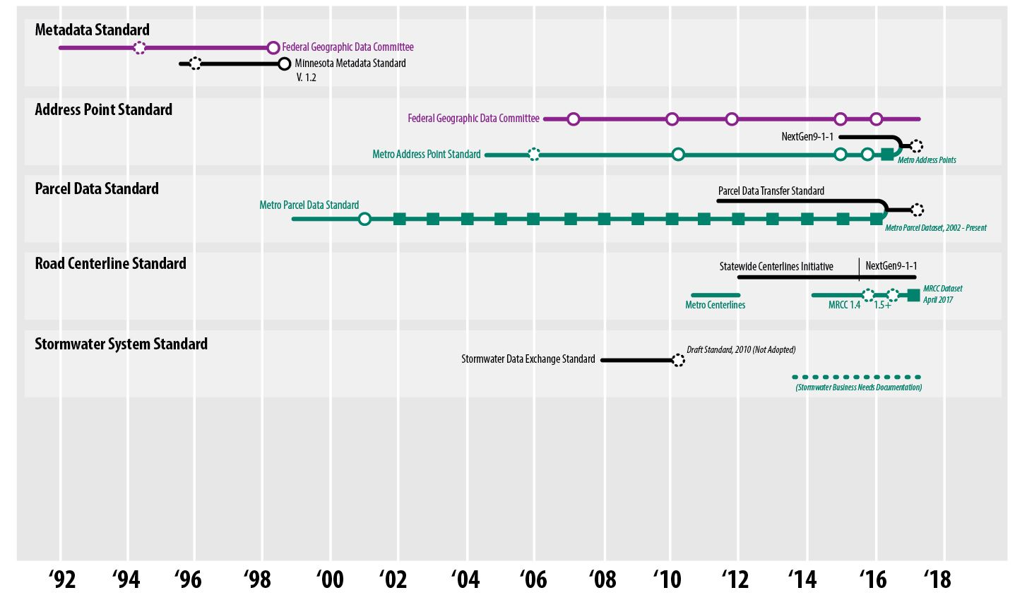

Slide 35
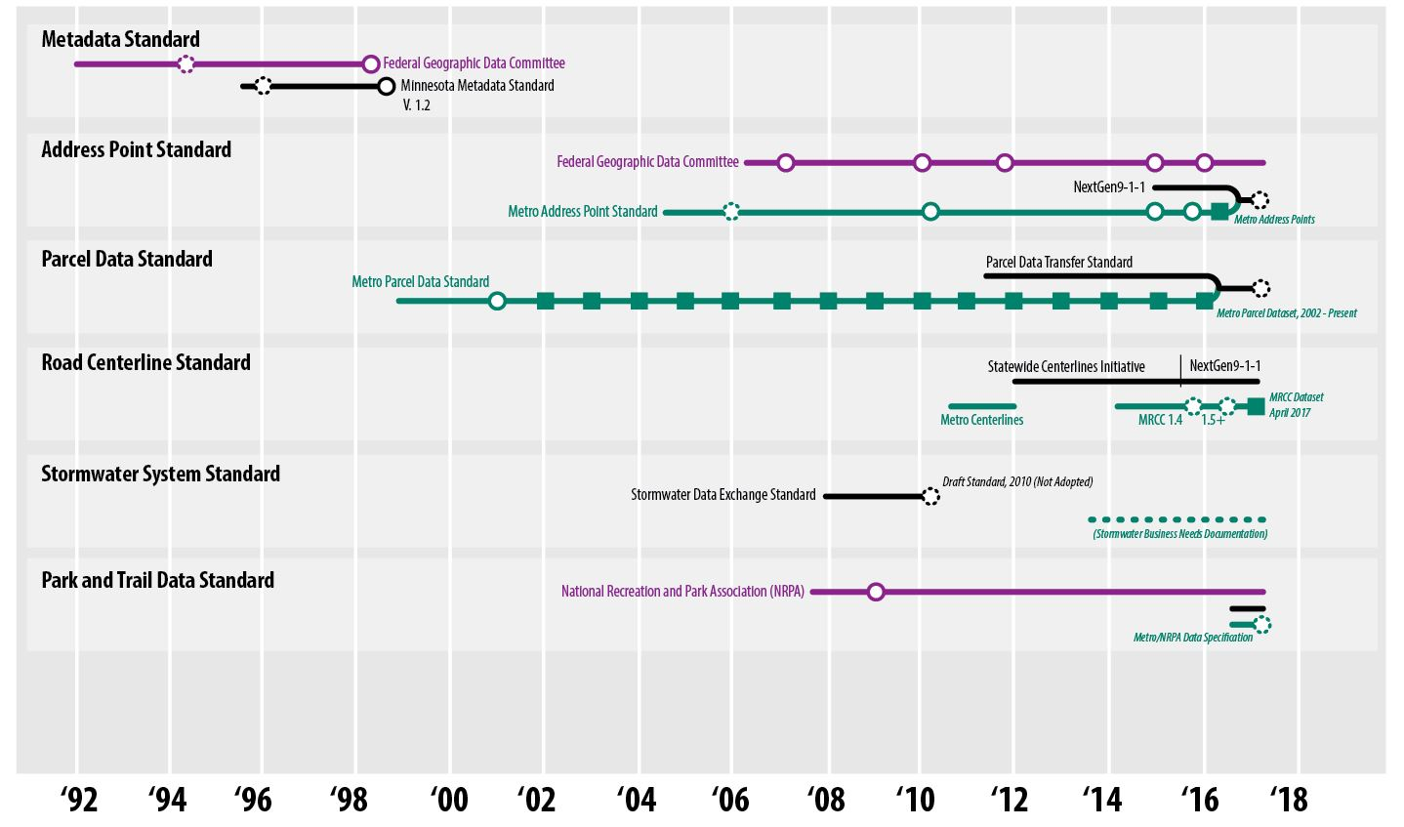

Slide 36
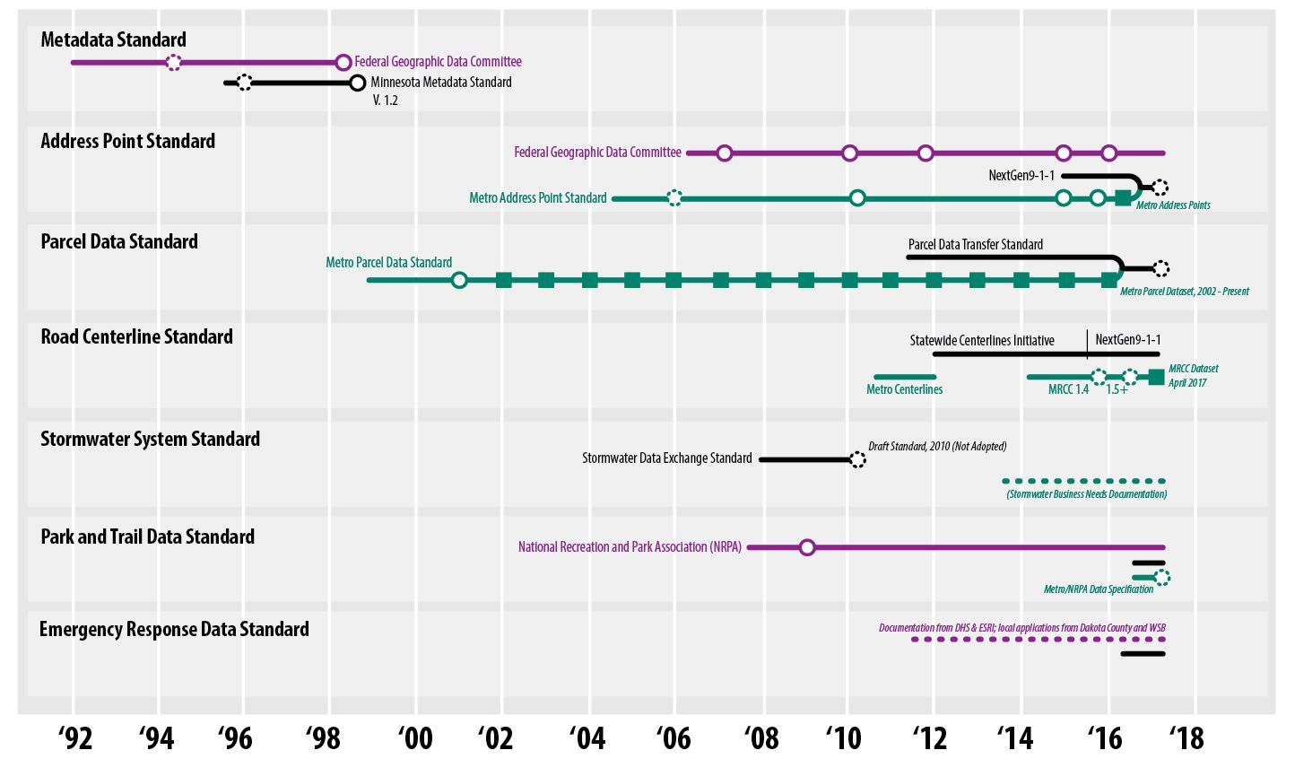

Slide 37

The Key to Standards Development
#1 - Clear purpose & business need
When a business need emerges…
>> Who else shares that need?
>> Shared definition of the need

Slide 38
The Key to Standards Development
#1 - Clear purpose & business need
When a business need emerges…
>> Who else shares that need?
>> Shared definition of the need;
#2 – Leverage existing work
Is there already a specification/standard?
Federal Geographic Data Committee (FGDC);
National Emergency Numbering Association (NENA);
Vendor-developed solution(s);
Other states/jurisdictions have something we can use;

Slide 39
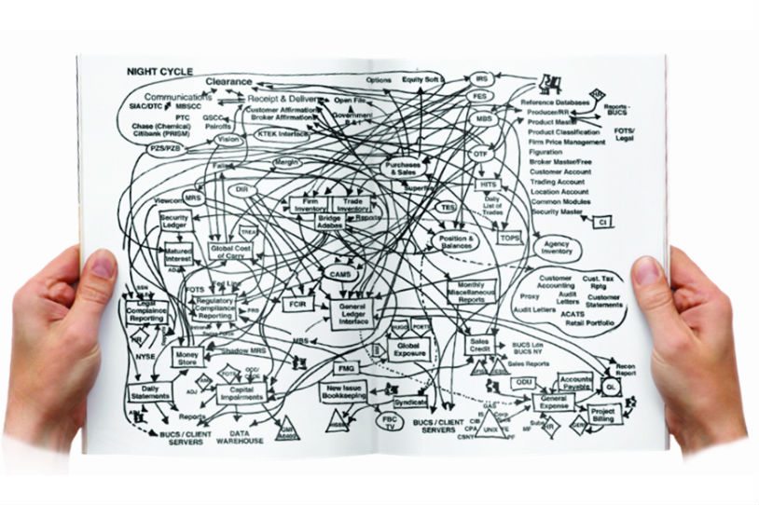
The Standards Process

Slide 40
Standards Development Process
Business need for a standard
Determine if others share the need
Existing standards exist as resource?
Develop a draft standard
Stakeholder review + input
Review of input by committee(s)
Determination:
Approval
Revision and approval
Revision and more input

Slide 41
Standards Development Process
Business need for a standard
Determine if others share the need
Existing standards exist as resource?
Develop a draft standard
Stakeholder review + input
Review of input by committee(s)
Determination:
Approval
Revision and approval
Revision and more input

Slide 42
Standards Development Process
Business need for a standard
Determine if others share the need
Existing standards exist as resource?
Develop a draft standard
Stakeholder review + input
Review of input by committee(s)
Determination:
Approval
Revision and approval
Revision and more input

Slide 43
Standards Development Process
Business need for a standard
Determine if others share the need
Existing standards exist as resource?
Develop a draft standard
Stakeholder review + input
Review of input by committee(s)
Determination:
Approval
Revision and approval
Revision and more input

Slide 44
Standards Development Process
Business need for a standard
Determine if others share the need
Existing standards exist as resource?
Develop a draft standard
Stakeholder review + input
Review of input by committee(s)
Determination:
Approval
Revision and approval
Revision and more input

Slide 45
Standards Development Process
Business need for a standard
Determine if others share the need
Existing standards exist as resource?
Develop a draft standard
Stakeholder review + input
Review of input by committee(s)
Determination:
Approval
Revision and approval
Revision and more input

Slide 46
Standards Development Process
Business need for a standard
Determine if others share the need
Existing standards exist as resource?
Develop a draft standard
Stakeholder review + input
Review of input by committee(s)
Determination:
Approval (to GAC for approval)
Revision and approval
Revision and more input

Slide 47
Standards Development Process
Business need for a standard
Determine if others share the need
Existing standards exist as resource?
Develop a draft standard
Stakeholder review + input
Review of input by committee(s)
Determination:
Approval (to GAC for approval)
Revision and approval
Revision and more input

Slide 48
Standards Development Process
Business need for a standard
Determine if others share the need
Existing standards exist as resource?
Develop a draft standard
Stakeholder review + input
Review of input by committee(s)
Determination:
Approval (to GAC for approval)
Revision and approval
Revision and more input

Slide 49
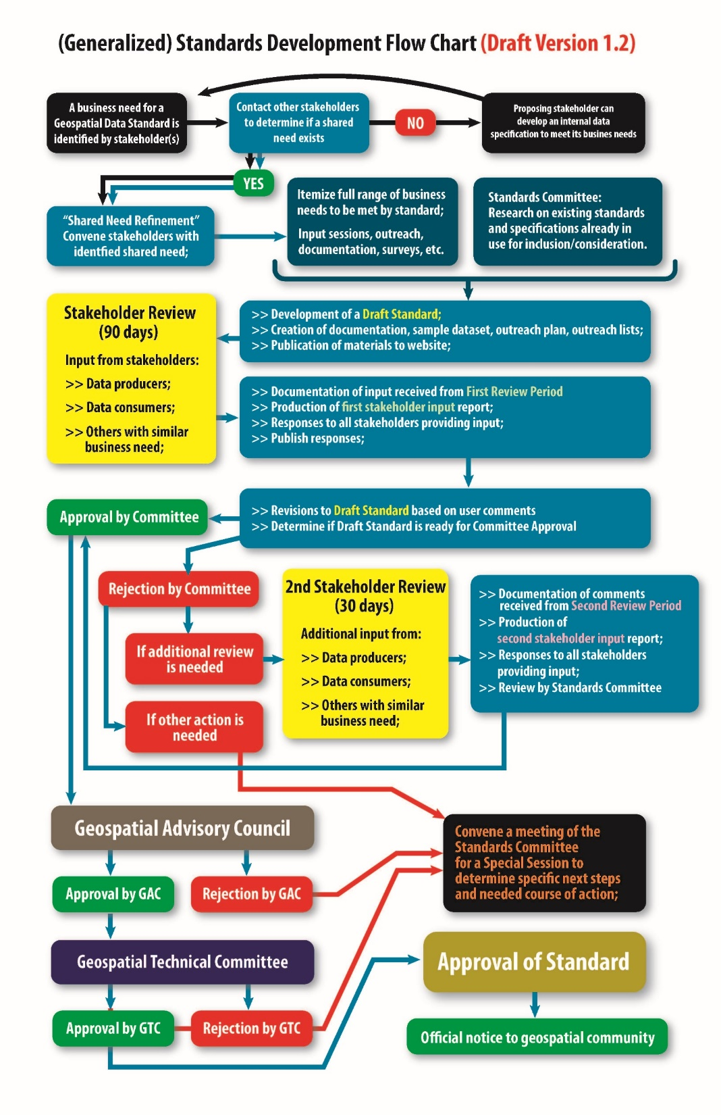
Standards
Development
Process (V. 1.2)
Documentation:
Excel (w/domains)
FAQ document
Sample dataset(s)
Other supporting materials

Slide 50

What’s on the horizon…

Slide 51
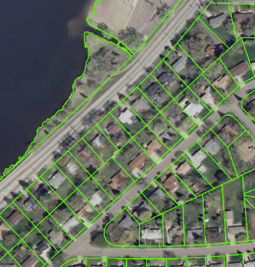
Parcel Data Transfer Standard
Oct 2016 – Jan 2017: Formal review
Feb-Mar 2017: Publication of comments
Significant public comment received:
Re-arrangement/re-naming of attributes
Addition of more attributes
Question the need for so many attributes
Align with other standards contents
Parcel and Land Records Committee:
ON HOLD pending the Address Point Standard

Slide 52
Parcel Data Transfer Standard
Oct 2016 – Jan 2017: Formal review
Feb-Mar 2017: Publication of comments
Significant public comment received:
Re-arrangement/re-naming of attributes
Addition of more attributes
Question the need for so many attributes
Better align with other standards contents
Parcel and Land Records Committee:
ON HOLD: pending the Address Point Standard

Slide 53
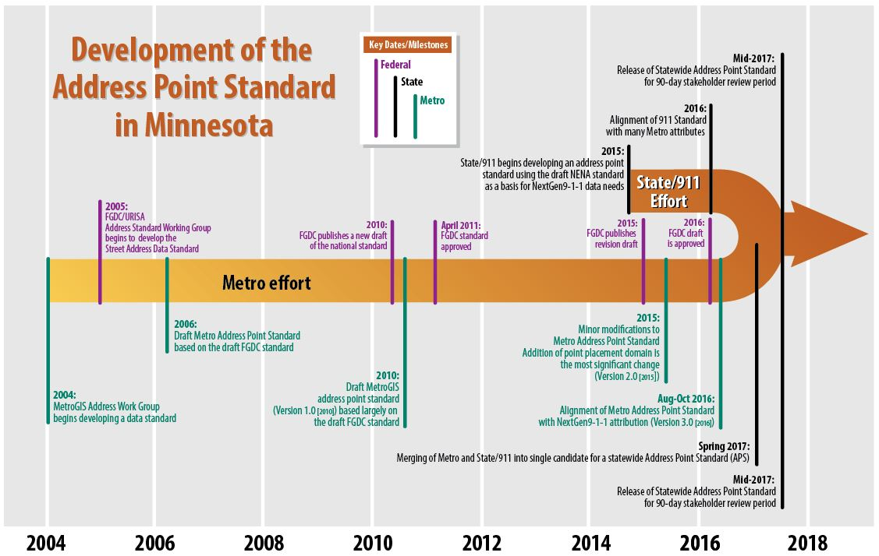
Address Point Standard
Existing Metro Address Point Standard (b. 2004 [2010 v.1] [2015, v.2] [2016, v.3])
NextGen9-1-1 effort (b. 2015)

Slide 54
Address Point Standard
NextGen9-1-1:
Current effort: Collection of input through June 2
Metro Address Work Group:
Modified existing metro standard to align with
NextGen9-1-1 needs in Aug-Oct 2016
Advancing standard as a statewide candidate
June 21 – Standards Committee will decide
If green-lighted: publish and begin a 90-day review period

Slide 55
Road centerlines
Two data specifications:
Metro Regional Centerlines Collaborative (MRCC)
Began in May 2014
MRCC “V. 1.5+” agreed upon in late 2016
First dataset published on April 21, 2017
911/CAD needs are a key part of the MRCC attributes
NextGen9-1-1
Began in 2015
Under review until June 2

Slide 56
Stormwater Data Standard
On-going, low-level metro effort; (#7 priority for MetroGIS)
Continuing to document business needs;
Possible stakeholder gathering this fall (mid/late Oct);
Make use of Existing Draft Exchange Standard (2010)
Fit with documented business needs;

Slide 57
Standards Committee
Next Meeting: June 21st
> Address Point Standard
> Review the process
> Discuss any needs not being met

Slide 58
Thanks!
Questions?
Geoffrey Maas, GISP
MetroGIS Coordinator
geoffrey.maas@metc.state.mn.us
651.602.1638

Slide 59
Agenda Item 8
Emergency Management Damage Assessment Standard (Anderson, Richter)

Slide 60
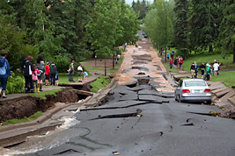
Damage Assessment Standards Workgroup
The need for a data standard for collecting rapid ‘post-event’ damage assessment information was included in the GAC survey for MnGeo Priority Projects for 2017.
It scored 8th out of 17 projects in the survey.
Several local government representatives on the Council expressed interest in this project, there is definitely a need for a data standard that would help them to quickly deploy a mobile data collecting solution that would satisfy FEMA requirements.
An initial Workgroup was formed early in January.
Duluth, MN 2012

Slide 61
Damage Assessment Standards Workgroup
Workgroup Purpose:
The workgroup’s purpose is to recommend and develop damage assessment data standards to guide local government entities in data collection that is required to support a request for State or Federal assistance in the event of a disaster.
The Damage Assessment Standards Workgroup:
Brad Anderson, City of Moorhead Project Owner
Cory Richter, City of Blaine Project Co-Chair
Todd Lusk, Dakota County Project Co-Chair, Champion
Adam Snegosky, Washington County
John Mackiewicz, WSB & Associates
Matt Taraldsen, ESRI
Philip Nagel, City of Waseca
Steve Swazee, Emergency Preparedness Committee Chair
Geoff Maas, MetroGIS

Slide 62
Damage Assessment Standards Workgroup
Not in the Scope of this Workgroup:
Applications for damage assessment
Operating procedures and best practices
Digital Forms
Making datasets available

Slide 63
Damage Assessment Standards Workgroup
We have had four meetings:
  January 10th 2017
  February 13th 2017
  March 7th 2017
  May 25th 2017
The group has collected requirements, documents, and best practices from a variety of sources, such as FEMA, HSEM, AMEM, and NSGIC.
An abstract has been submitted for a panel discussion at the Minnesota GIS\LIS Conference this fall in Bemidji.
  Panelists:
  Brad Anderson, GIS Manager, City of Moorhead
  Cory Richter, GIS Coordinator, City of Blaine
  John Mackiewicz, IS Group Manager, Principal, WSB & Associates
  Matt Taraldsen, Solutions Engineer, Esri
  Darryl Holman, Resource Information Specialist, US Forest Service

Slide 64
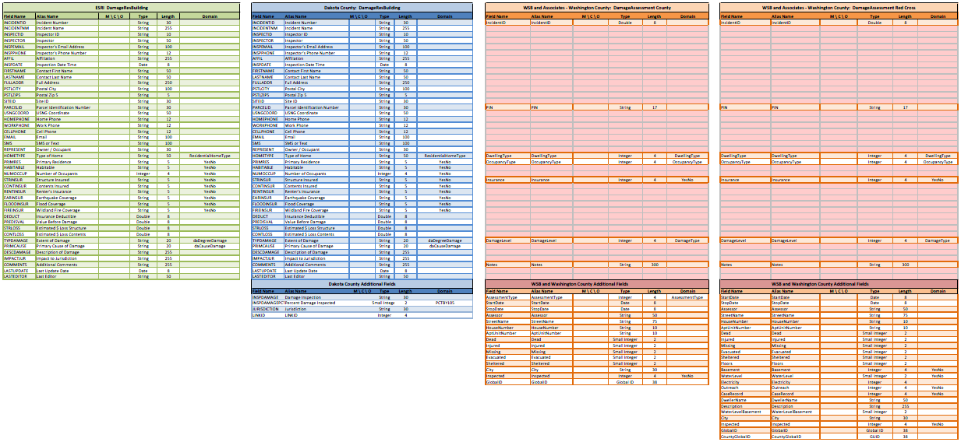
Damage Assessment Standards Workgroup
Known existing data schemas and domain values for damage assessment collection programs were entered into a spreadsheet for comparison. These include Esri, Dakota County, and Washington County (WSB & Associates) schemas. The very first draft of the Minnesota Damage Assessment Data Standard is currently being compiled in the spreadsheet.

Slide 65
Agenda Item 9
Updates on MN GAC priority projects and initiatives
GAC Rank | Project or Initiative Description | Status | Project Owner | Champ
1 | All Data Free and Open | Active | Len Kne | Ross
2 | Image Service - Sustain | Active | Mike Dolbow | Ross
3 | LiDAR Committee - Move Forward | Proposed | Sean Vaughn?
4 | Image Service - HTTPS, Tiling, Etc. | Active | Mike Dolbow | Ross
5 | Parcel Data | Active | George Meyer
6 | Address Points Data | Active | Adam Iten | Ross
7 | Street Centerline Data | Active | Adam Iten | Ross
8 | EM Damage Assess Data Standard | Active | Brad Anderson | Lusk
9 | Basemap Services | Active | Sonia Dickerson | Ross
10 | Geocoding Service | Active | Mike Dolbow | Ross
11 | Parks and Trails Data Standard | Active | Jim Bunning | Ross

Slide 66
Agenda Item 10
NSGIC with 2018 GIS/LIS conference (Sjerven)
NSGIC conference team visiting Duluth June 1-2
Competing against New Orleans and San Antonio
Decision to be made by end of summer

Slide 67
Agenda Item 11
Announcements or other business

Slide 68
Thank you!
Next meeting is TUESDAY, September 19, 2017

