Slide 1

Minnesota Geospatial Advisory Council
December 6, 2017

Slide 2
Welcome
Introductions
Approve agenda
Approve September minutes

Slide 3
Agenda
Time | Topic
11:15 | Accept committee summaries
11:20 | Approve Minnesota Address Point Data Standard
11:35 | Proposed changes to sectors: Higher education and metro regional government
11:40 | Committee collaboration
11:45 | Geospatial Data Act update
11:50 | Potential Changes to the National Agriculture Imagery Program
11:55 | Sector report – Metro cities
12:05 | Break, networking
12:35 | 2018 projects and initiatives prioritization exercise
1:05 | DEM hydro-modification (hDEM)
1:30 | Approve 3D Geomatics Committee work plan
1:35 | Updates on GAC priority projects and initiatives
1:45 | Announcements

Slide 4
Agenda Item 2
Review, discuss and accept committee summaries

Slide 5
Agenda Item 3
Request for approval of
Minnesota Address Point Data Standard
Geoffrey Maas, GISP
Chair, Standards Committee

Slide 6
Agenda Item 3
Minnesota Address Point Data Standard
>> Significant effort;
>> Many individuals and agencies involved;
>> Important resource;
>> ‘Benchmark’ for our other standard;
(Parcels, road centerlines)

Slide 7
Agenda Item 3
Minnesota Address Point Data Standard
2004: Origin: Metro-level effort – FGDC standard
2010: First metro-level standard;
Early 2015: NextGen9-1-1 effort – NENA standard
Fall 2016: Metro standard revised;
Early 2017: Single standard developed;
June 2017: Standards Committee approved a
stakeholder review;

Slide 8
Agenda Item 3
Minnesota Address Point Data Standard
Public review period;
Geospatial community: local, state, regional, federal
Emergency services; NextGen9-1-1
League of Minnesota Cities
MN Association of Clerks and Fiscal Officers

Slide 9
Agenda Item 3
Jul 24-Sep 2017: Public review period;
Sept-Oct 2017: Revisions based on input;
October 25, 2017: Standards Committee meeting
Nov 7, 2017: Standards Committee voted approval
Nov 8-22, 2017: Minor modifications acknowledged
Nov 30, 2017: Standards Committee voted to advance it
December 6, 2017: Offered to the GAC for approval

Slide 10
Agenda Item 3
Minnesota Address Point Data Standard
>> A resource built to meet our expressed needs
>> Developed within and by our community
>> Blends aspects of FGDC and NENA
>> Reviewed and revised by our community
>> Enjoys wide-spread support
>> Attribution to carry through/inform other standards

Slide 11
Agenda Item 3
Minnesota Address Point Data Standard
>> 48 attributes
>> Address components
>> Landmarks, mailable address, USNG, 911
>> Management elements (source, effective date, etc.)

Slide 12
Agenda Item 3
Minnesota Address Point Data Standard
Request to the
Geospatial Advisory Council
to approve the proposed
Address Point Data Standard

Slide 13
Agenda Item 4
Proposed changes to sectors:
Higher education and metro regional government
Mark Kotz

Slide 14
Proposed Changes to Sectors
Change U of M and MN State to 2 Higher Education
  Why? Inclusion of other higher education organizations
Change Met Council to Metro Regional Government
  Why? Inclusion of other metro regional government, consistency with other sectors

Slide 15
Agenda Item 5
Committee collaboration
David Brandt

Slide 16
Agenda Item 6
Geospatial Data Act update
Dan Ross

Slide 17
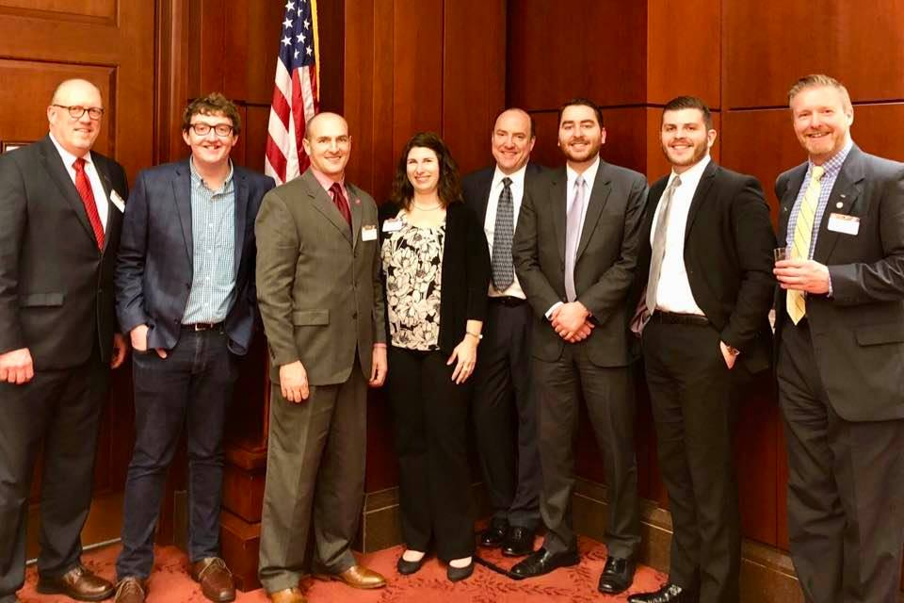
Geospatial Data Act
Introduced in both the House (HR 4395) and Senate (S.2128) - GIS Day
Senator Klobuchar (co-sponsor)
Kickoff held in Washington DC
  Many organizations present
Looking for additional support
  GAC, GIS/LIS, U of M, Minnesota State University System
American Association of Geographers (AAG)
American Geosciences Institute (AGI)
Association of Research Libraries (ARL)
Blue Raster, LLC
Boundless Spatial, Inc.
Cartegraph Systems, Inc.
Cartography and Geographic Information Society (CaGIS)
Cityworks – Azteca Systems, LLC
Davey Resource Group, Inc.
Dewberry
DigitalGlobe
Esri
GeoComm, Inc.
GIS Certification Institute
GISinc
Geographic and Land Information Society (GLIS)
Geospatial Information & Technology Association (GITA)
InfoGeographics, Inc.
International Association of Assessing Officers (IAAO)
MDA Information Systems, LLC
MidAmerica GIS Consortium (MAGIC)
National Association of Counties (NACo)
National Association of State Chief Information Officers (NASCIO)
National League of Cities (NLC)
National States Geographic Information Council (NSGIC)
National Tribal Geographic Information Support Center (NTGISC)
1Spatial, Inc.
SharedGeo
Tesla Government, Inc.
United States Geospatial Intelligence Foundation (USGIF)
University Consortium for Geographic Information Science (UCGIS)
Urban and Regional Information Systems Association (URISA)
Women in GIS (WiGIS)

Slide 18
Agenda Item 7
NAIP Imagery Possible Licensing
Jeff Bloomquist

Slide 19
NAIP
National Agriculture Imagery Program (NAIP) program is considering moving to a licensed model. If FSA does move to that model, it will likely have a significant impact on the availability of imagery for Minnesota.
Why a potential move?
  Cost-saving measure
    Cost-share partners have been $3.1M short
    over the past few years
Removing NAIP from the public domain will have impacts to other agencies
    Licensed data cannot be shared with other departments
    or the public

Slide 20
NAIP
More info on possible changes to NAIP program:
https://www.gislounge.com/naip-aerial-imagery-might-moved-public-domain-licensing-model/
https://www.fgdc.gov/organization/coordination-group/meeting-minutes/2017/november/naip-2019-cg-20171114.pdf
https://www.fgdc.gov/organization/coordination-group/meeting-minutes/2017/november/naip-2019-cg-20171114.pdf

Slide 21
Agenda Item 8
Sector report:
Metro Cities
Cory Richter

Slide 22
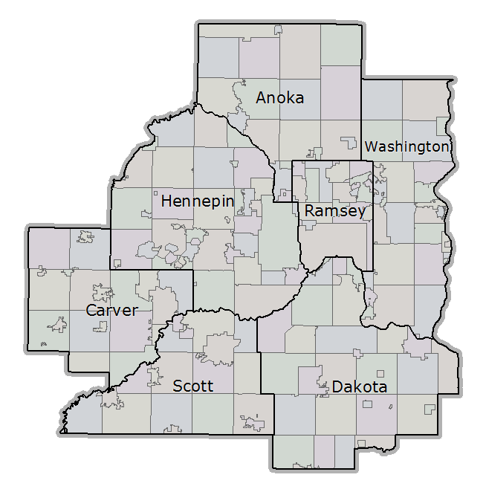
Quick Look
182 communities
3 million+ people
2016 pop. estimates
  45 communities < 1,000 people
  Top ten communities 1,298,919 people
Image courtesy Metropolitan Council
Notes:
124 communities have less than 10,000 people
More than 100 languages are spoken in the state
Minneapolis 419952
St. Paul 304442
Bloomington 88299
Brooklyn Park 80450
Plymouth 75452
Woodbury 68349
Eagan 68223
Maple Grove 66401
Blaine (Anoka Co. part) 64188
Eden Prairie 63163

Slide 23
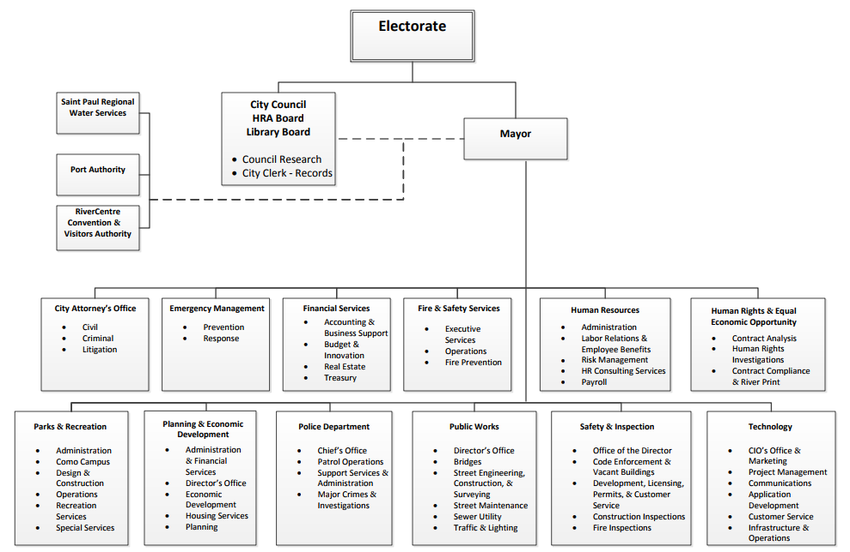





Sometimes finding them is a challenge
Notes:
There is a lot of variability in how many GIS people are at a city and where they are housed in the org structure. Many cities have 3rd party vendors or use the County as their GIS dept.

Slide 24
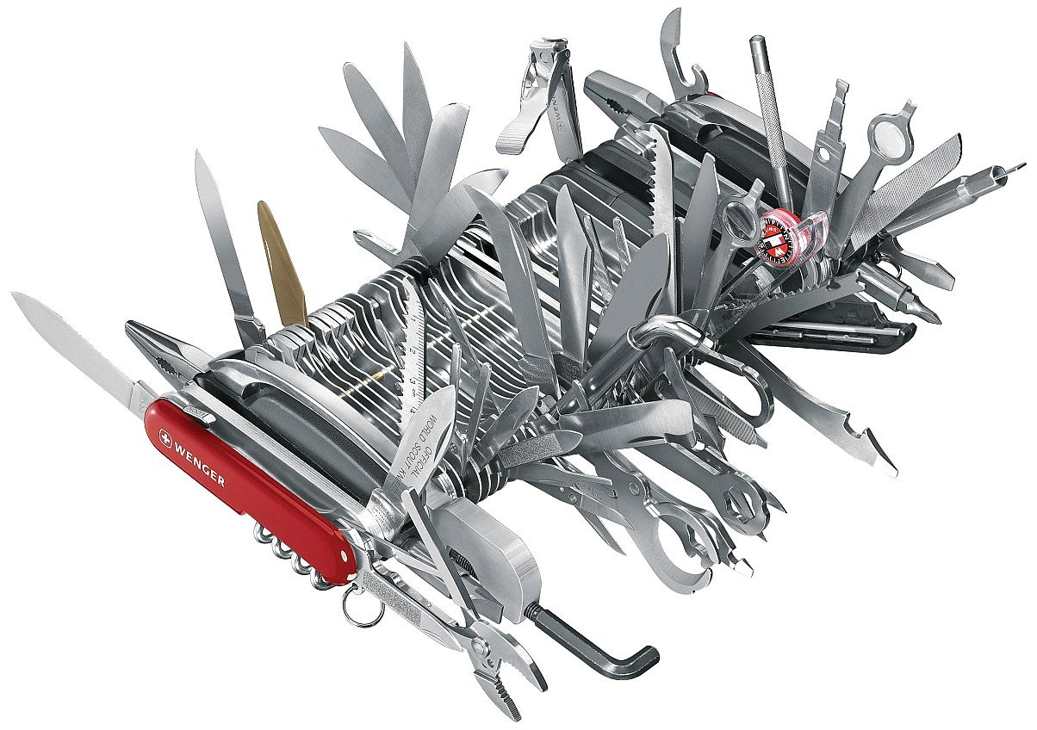

GIS folks in cities are like Swiss Army Knives

Slide 25
More than just maps…
Dataset creation and maintenance
Data Analysis
Server administration
Application Development
Strategic planning and project management
Supporting many functions in municipal government
Public relations
Community involvement
…and yes, they still make maps

Slide 26
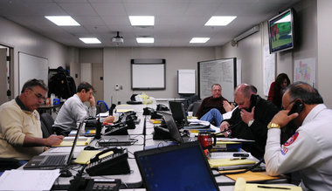
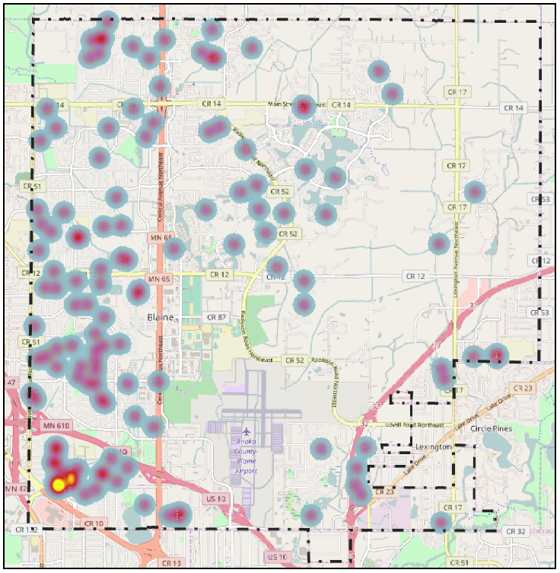


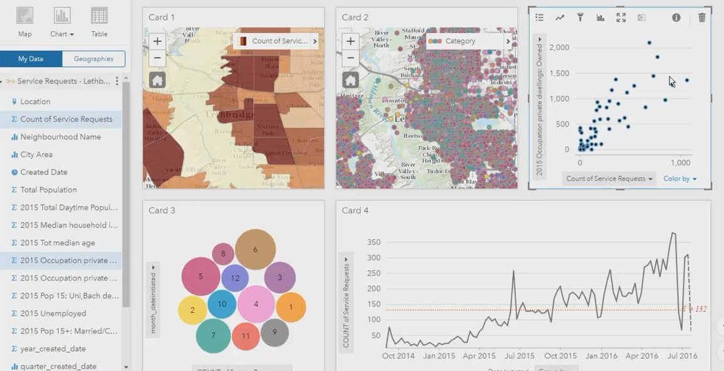
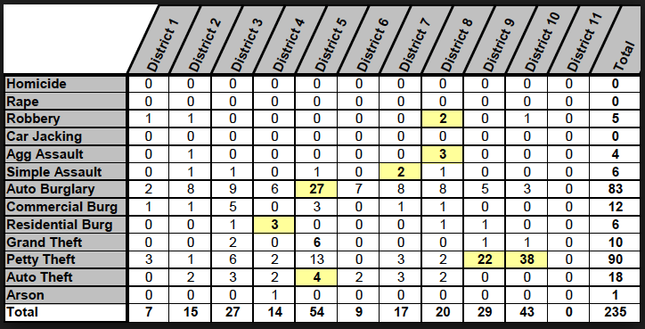


Crime Analysis & Emergency Management

Slide 27
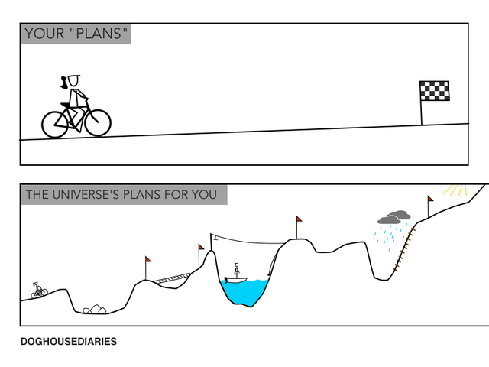

Slide 28
Facing Obstacles
  GAC Guiding Principles
  Promote effective investments in geospatial information
  Promote geospatial information as a shared public resource
  Support the establishment and use of geospatial standards and best practices
  Champion collaboration among geospatial practitioners and related stakeholders
  Educate and inform policymakers about the value and use of geospatial technology
  Provide a forum for ideas and issues to be shared and acted upon by the geospatial community
  Encourage all council sectors to contribute to the state geospatial infrastructure
  Encourage all council members to communicate outcomes with relevant stakeholders
  Encourage geospatial education at all levels
Budget
People
Training
Technology
Lack of data and/or data with missing attributes
Communication
Notes:
Budget
People
Training
Technology
Lack of data and/or data with missing attributes
Communication

Slide 29

Break - Networking

Slide 30
Agenda Item 10
2018 projects and initiatives prioritization exercise
Mark Kotz

Slide 31
Why Create Priorities?
To create a voice for the MN geospatial community
To direct work plans of the GAC and its committees
To recommend to MnGeo
To allow other organizations to compare priorities and align efforts
To inform outreach and policy related efforts

Slide 32
GAC Priorities Process
Create a list of proposed projects and initiatives
  Existing and new
Assess the value of each – degree of business need
  GAC members advocate for sectors
  100% response!
Assess likelihood of success (owner, team, champion, funding)
Preliminary priority calculation
GAC discusses and adjusts

Slide 33
Value Score
Project or Initiative Name | Value Score | Ave | H | M | L | N
All Data Free and Open | 51 | 2.32 | 10 | 9 | 3 | 0
Image Service - Sustain | 48 | 2.18 | 7 | 12 | 3 | 0
Updated & Aligned Boundary Data | 46 | 2.09 | 8 | 8 | 6 | 0
Parcel Data | 44 | 2 | 5 | 13 | 3 | 1
Address Points Data | 43 | 1.95 | 5 | 11 | 6 | 0
Street Centerline Data | 39 | 1.77 | 3 | 12 | 6 | 1
Image Service - Dozens of Years | 39 | 1.77 | 3 | 11 | 8 | 0
EM Damage Assess Data Standard | 36 | 1.64 | 2 | 12 | 6 | 2
Basemap Services | 36 | 1.64 | 1 | 12 | 9 | 0
Image Service Enhancements | 35 | 1.59 | 3 | 8 | 10 | 1
Archiving Policy/Procedure | 34 | 1.55 | 2 | 9 | 10 | 1
LiDAR data and related standards | 33 | 1.5 | 1 | 12 | 6 | 3
Geocoding Service (public) | 32 | 1.45 | 0 | 11 | 10 | 1
Current Wetland/Hydro Data | 31 | 1.41 | 2 | 8 | 9 | 3
Parks and Trails Data Standard | 26 | 1.18 | 1 | 4 | 15 | 2
Real-Time Assess/Planning Tool | 18 | 0.82 | 0 | 4 | 10 | 8
Fall Leaf Color Infrared Imagery | 17 | 0.77 | 1 | 2 | 10 | 9

Slide 34
Likelihood of Success
Project or Initiative Name | Priority Score | Value Score | Success Score | Owner Exists | Work Team Exists | Active Champ Exists | $$ Exists | Est $$ | Easy Score | Effort | Project Owner | Champ
All Data Free and Open | 561 | 51 | 11 | 3 | 2 | 2 | 2 | $0 | 2 | Med | Len Kne | Ross
Image Service - Sustain | 528 | 48 | 11 | 3 | 2 | 2 | 2 | $0 | 2 | Med | Mike Dolbow | Ross
Address Points Data | 430 | 43 | 10 | 3 | 2 | 2 | 2 | $0 | 1 | High | Adam Iten | Ross
Street Centerline Data | 390 | 39 | 10 | 3 | 2 | 2 | 2 | $0 | 1 | High | Adam Iten | Ross
Image Service Enhancements | 385 | 35 | 11 | 3 | 2 | 2 | 2 | $0 | 2 | Med | Mike Dolbow | Ross
Archiving Policy/Procedure | 374 | 34 | 11 | 3 | 2 | 2 | 2 | $0 | 2 | Med | Ryan Matke | many
Parcel Data | 352 | 44 | 8 | 3 | 2 |  | 2 | $0 | 1 | High | George Meyer
Image Service - Dozens of Years | 351 | 39 | 9 | 3 | 2 | 2 |  | some | 2 | Med | Mike Dolbow | Ross
EM Damage Assess Data Standard | 324 | 36 | 9 | 3 | 2 |  | 2 | $0 | 2 | Med | Anderson/Richter
LiDAR data and related standards | 297 | 33 | 9 | 3 | 2 |  | 2 | $0 | 2 | Med | Gerry Sjerven
Basemap Services | 288 | 36 | 8 | 3 | 2 | 2 |  | some | 1 | High | Sonia Dickerson | Ross
Parks and Trails Data Standard | 260 | 26 | 10 | 3 | 2 | 2 | 2 | $0 | 1 | High | Jim Bunning | Ross
Updated & Aligned Boundary Data | 92 | 46 | 2 |  |  |  |  |  | 2 | Med
Current Wetland/Hydro Data | 62 | 31 | 2 |  |  |  |  |  | 2 | Med
Real-Time Assess/Planning Tool | 36 | 18 | 2 |  |  |  |  |  | 2 | Med
Fall Leaf Color Infrared Imagery | 34 | 17 | 2 |  |  |  |  |  | 2 | Med
Geocoding Service (public) | 32 | 32 | 1 |  |  |  |  | some | 1 | High

Slide 35
Agenda Item 11
DEM hydro-modification
Sean Vaughn, Co-Chair 3D Geomatics Committee

Slide 36
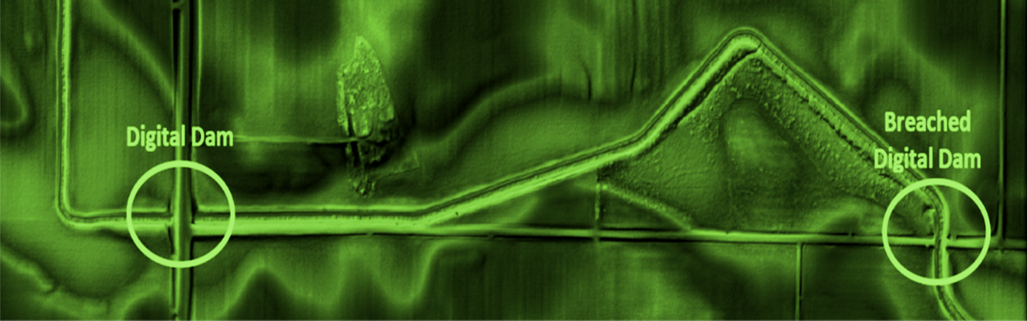

DEM HYDRO-MODIFICATION
An Introduction
Sean Vaughn | GIS Hydrologist – LiDAR Data Steward

Slide 37
Agenda

Slide 38
Agenda
Time | Duration (min) | Topic
1:05 - 1:10 | 5 | Introduction
1:10 - 1:25 | 15 | DEM Hydro-modification
1:25 -1:30 | 5 | Question & Answer Session
Introduction
  4-Things
  Me – My Background
LiDAR
Digital Dams
DEM Hydro-modification
  What is it
  Why is it required
  hDEM Standard
Water Quality Framework
Takeaways

Slide 39
Introduction

Slide 40
Introduction
What Brings Me Here Today …

Slide 41

Introduction
Introduction
Attending the GAC Meetings for the Last Year
Four Topics Have Come Up
DEM Hydro-modification (hDEM)
DEM-derived Hydrography Generation
  LCCMR Proposal & Letter of Support
DNR Culvert Application
3D Geomatics Committee Development

Slide 42
Introduction
Attending the GAC Meetings for the Last Year
Four Topics Have Come Up
DEM Hydro-modification (hDEM)
DEM-derived Hydrography Generation
  LCCMR Proposal & Letter of Support
DNR Culvert Application
3D Geomatics Committee Development

Slide 43
Introduction
Attending the GAC Meetings for the Last Year
Four Topics Have Come Up
DEM Hydro-modification (hDEM)
DEM-derived Hydrography Generation
  LCCMR Proposal & Letter of Support
DNR Culvert Application
3D Geomatics Committee Development
Be poised to provide support for a second funding attempt at NXG-Hydro

Slide 44
Introduction
Attending the GAC Meetings for the Last Year
Four Topics Have Come Up
DEM Hydro-modification (hDEM)
DEM-derived Hydrography Generation
  LCCMR Proposal & Letter of Support
DNR Culvert Application
3D Geomatics Committee Development
Be poised to provide support for a second funding attempt at NXG-Hydro
Topics for future presentations

Slide 45
Introduction
Attending the GAC Meetings for the Last Year
Four Topics Have Come Up
DEM Hydro-modification (hDEM)
DEM-derived Hydrography Generation
  LCCMR Proposal & Letter of Support
DNR Culvert Application
3D Geomatics Committee Development
Be poised to provide support for a second funding attempt at NXG-Hydro
Topics for future presentations

Slide 46
Me

Slide 47
Introduction
Before DEMs, Let’s Talk About Me…

Slide 48
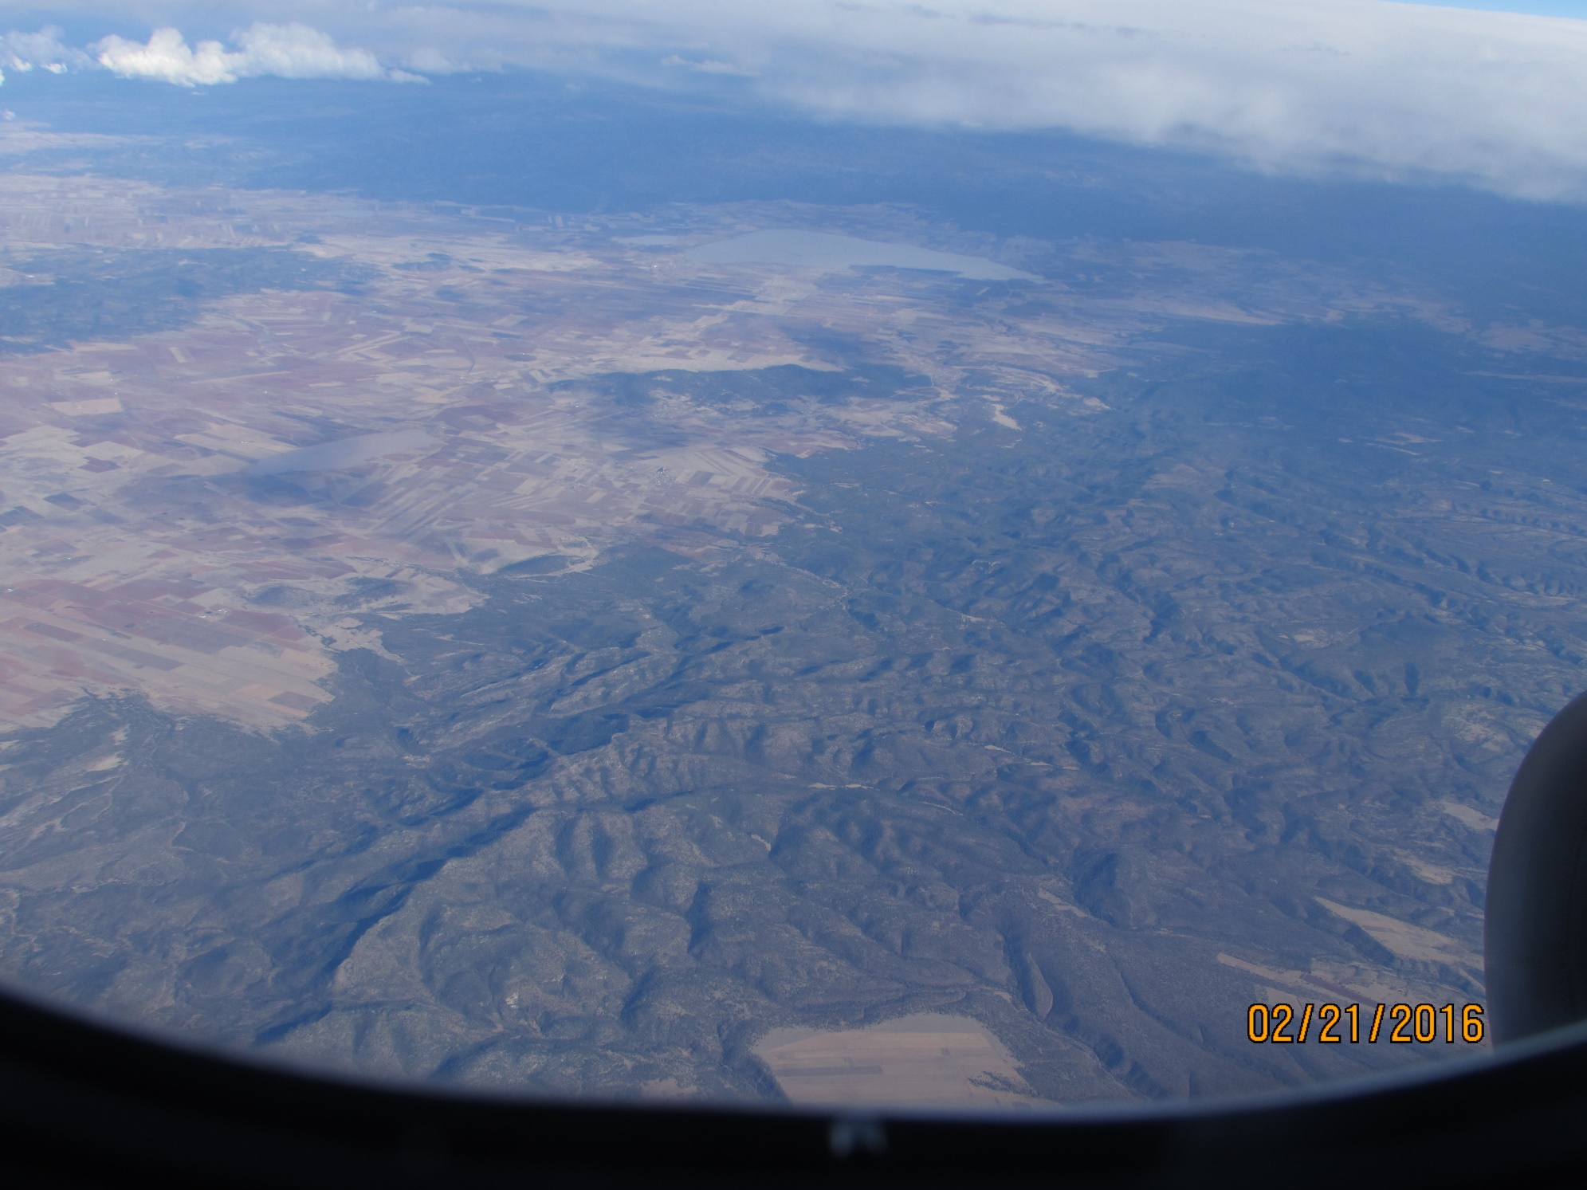
Sean Vaughn - Background
30+ Years of Looking Down from Above, 27+ Years with DNR
  Determining where water flows on the landscape
Map Making for DNR Since 1990 | GIS Since 1994
  First GIS Job - U of MN, Green Hall, Digitizing Soils Data
Early Developer of FEMA Flood Map Digitization (1997)
Created the DNR Watershed Delineation Project (1998 – 2010)
  New Watersheds for Minnesota | 60K Edits to Watercourses | Updated WBD
Active Member of former Elevation and Hydrography Committees (1999 – 2011)
Chair of the LiDAR Research and LiDAR Committee

Slide 49
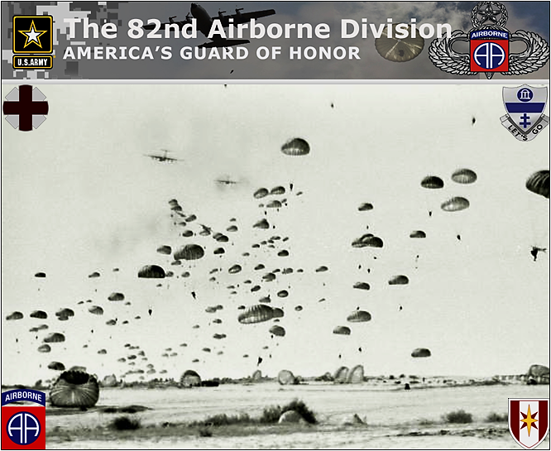
Sean Vaughn - Background
December is my Anniversary Month with DNR
  Fresh out of the Army, walked into Cambridge DNR in December 1989 to volunteer
The Army teaches you about topography
I also learned what the landscape looks like from above…

Slide 50
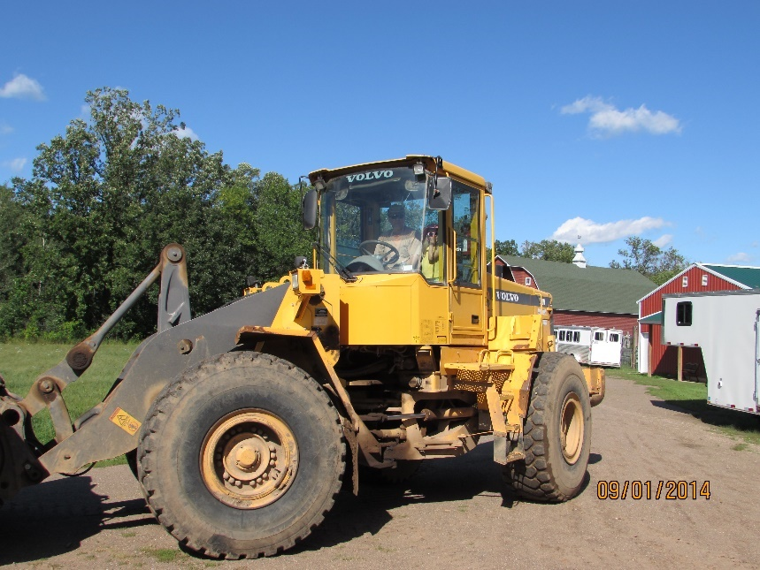
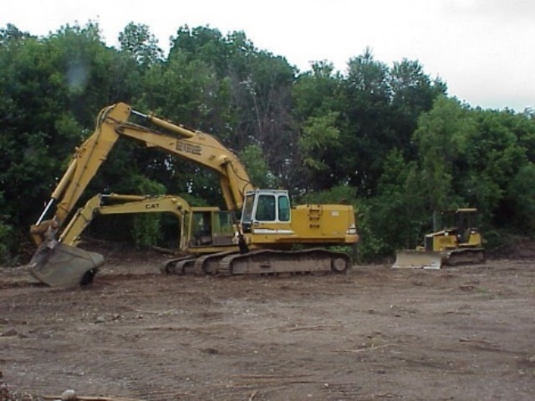
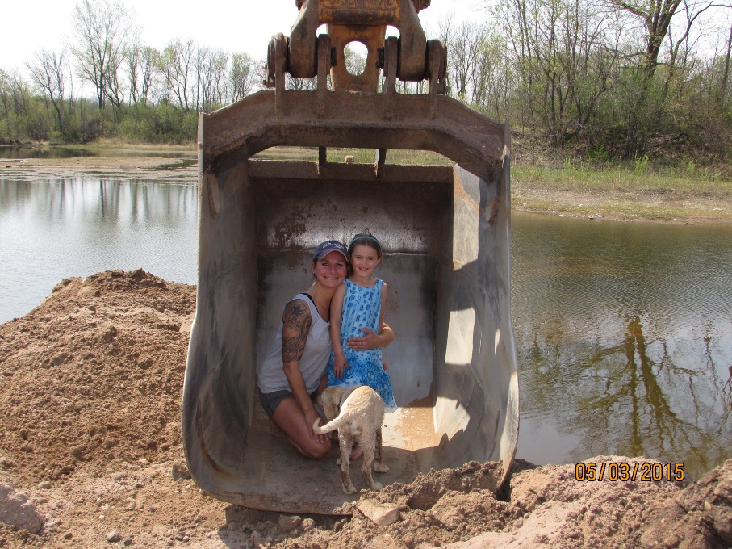
Sean Vaughn - Background
Landscape Alteration
Family has been in the Gravel Mining Business Since 1917.
Family owns 657 Acres of Land
Family has owned/operated MPCA Regulated Landfill since 1990
Water Routing
Excavation
Dewatering
Wetland Mitigation

Slide 51
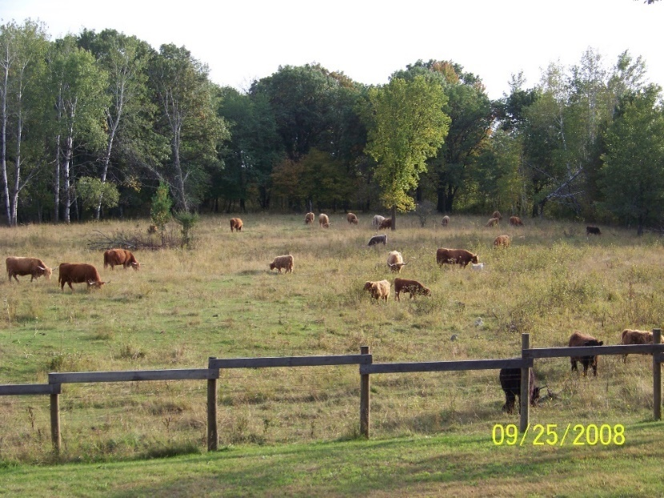
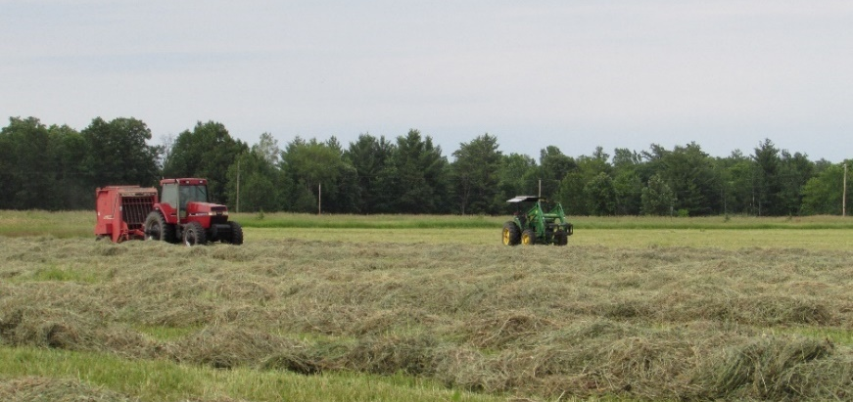
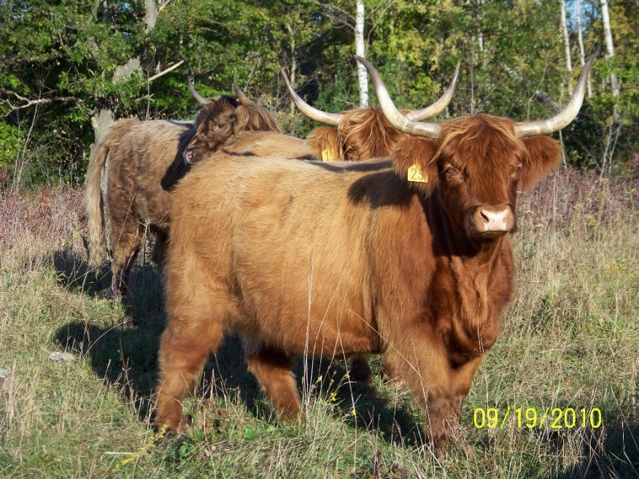
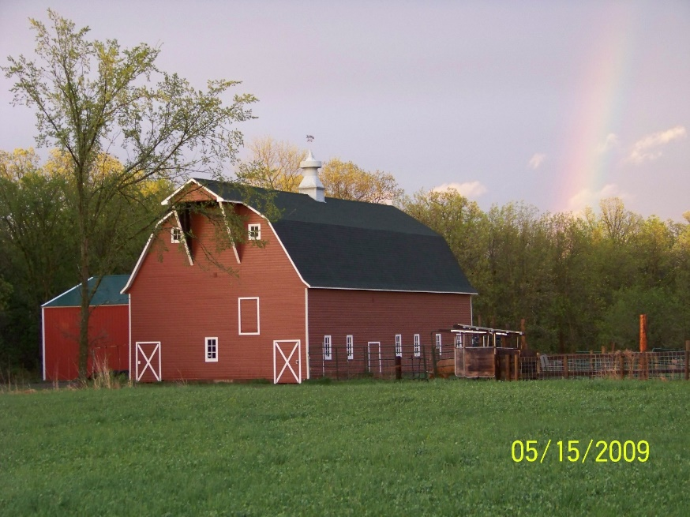
Sean Vaughn - Background
An Understanding of Cattle and Agriculture Production
Profit? - The Bottom Line in Ag Production and Conservation Practices.
Cattle Impacts on
soil structure
Cost Share Programs
Manure
Management
Erosion

Slide 52
Personal Evolution

Slide 53
Introduction
Personal Evolution…

Slide 54
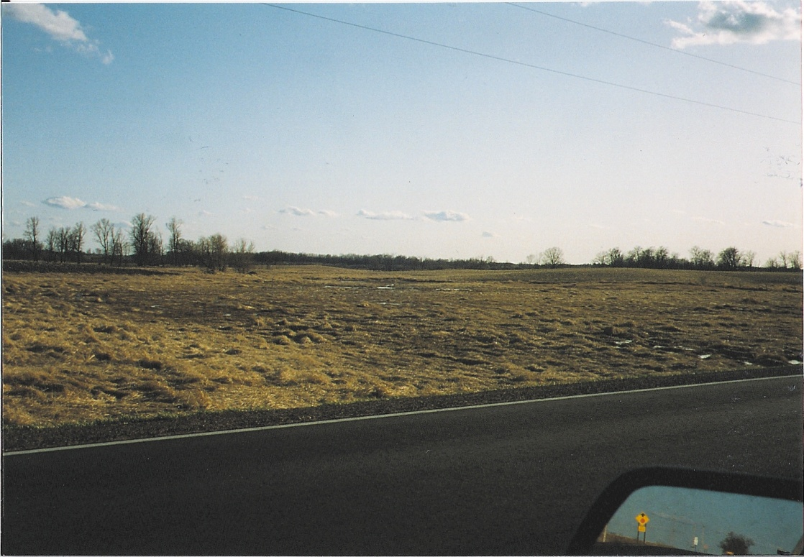
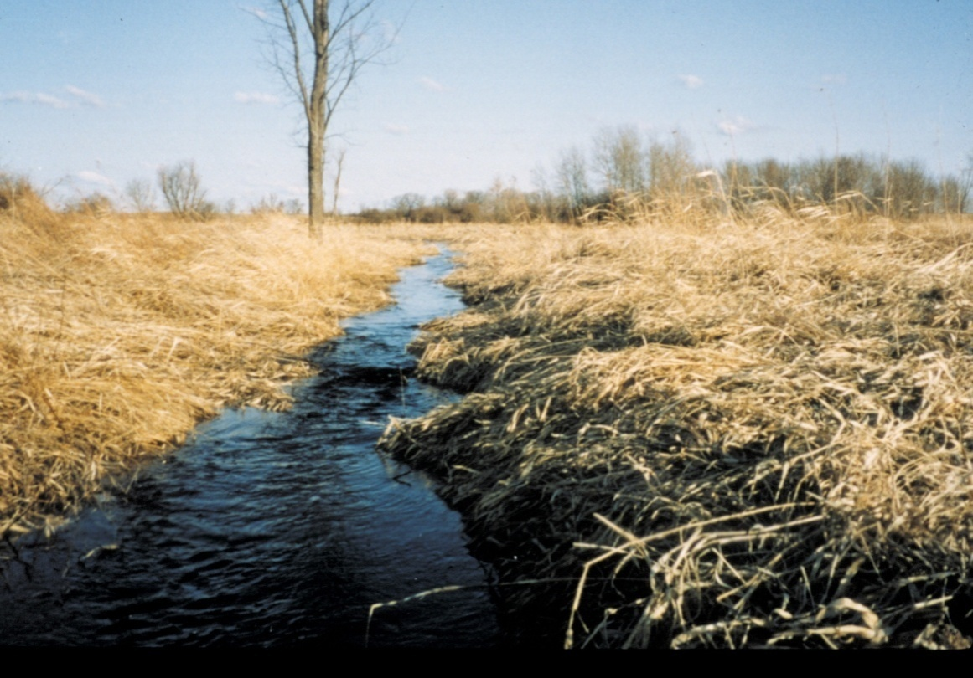
Sean Vaughn - Background
Field Inspection – Groundtruthing (1992)
Depressions & Impressions
Drainage Discoveries

Slide 55
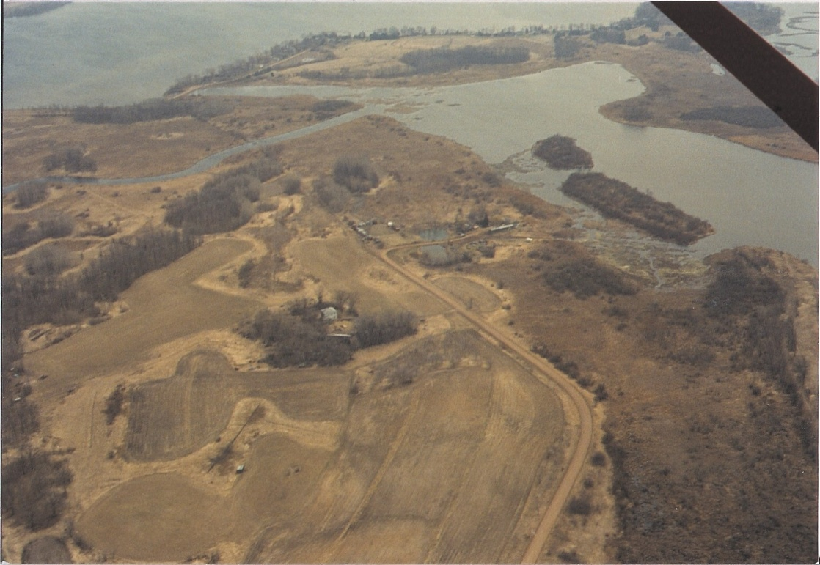
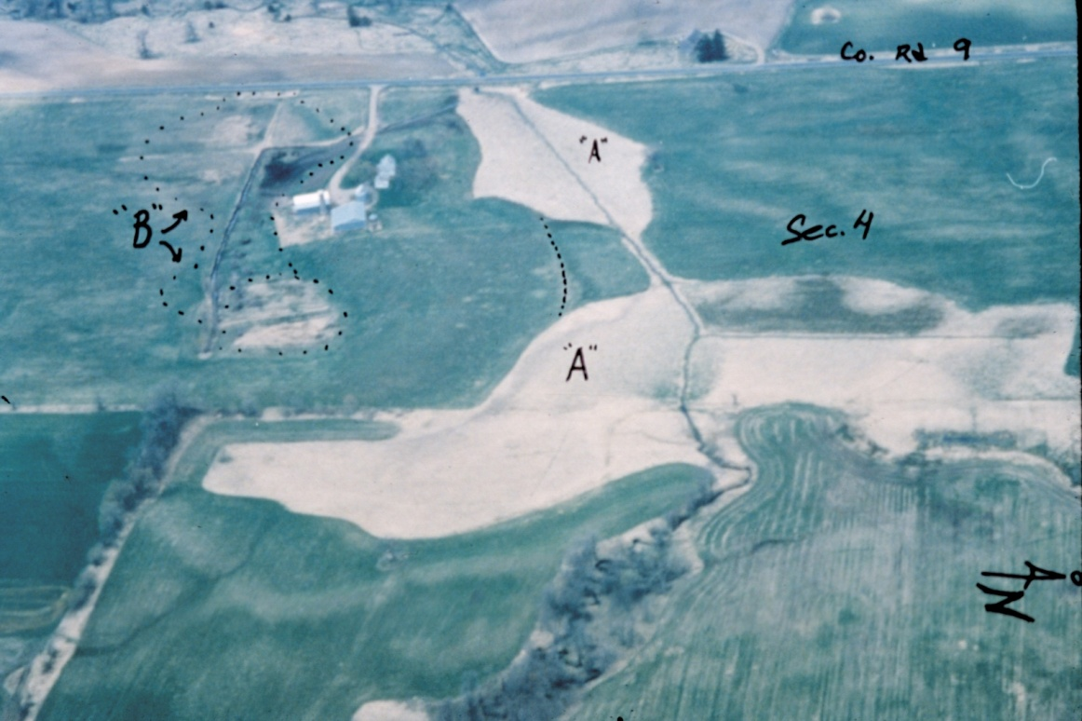
Sean Vaughn - Background
Field Inspection – Aerial Review (1992)
Oblique Photos Indicate Linear Signatures of Ditching
LiDAR Captures this Detail

Slide 56
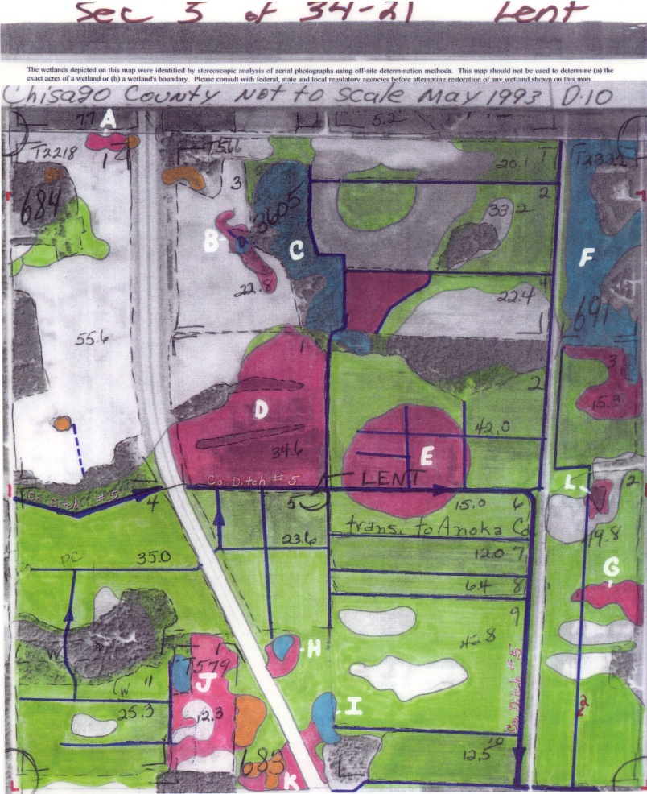
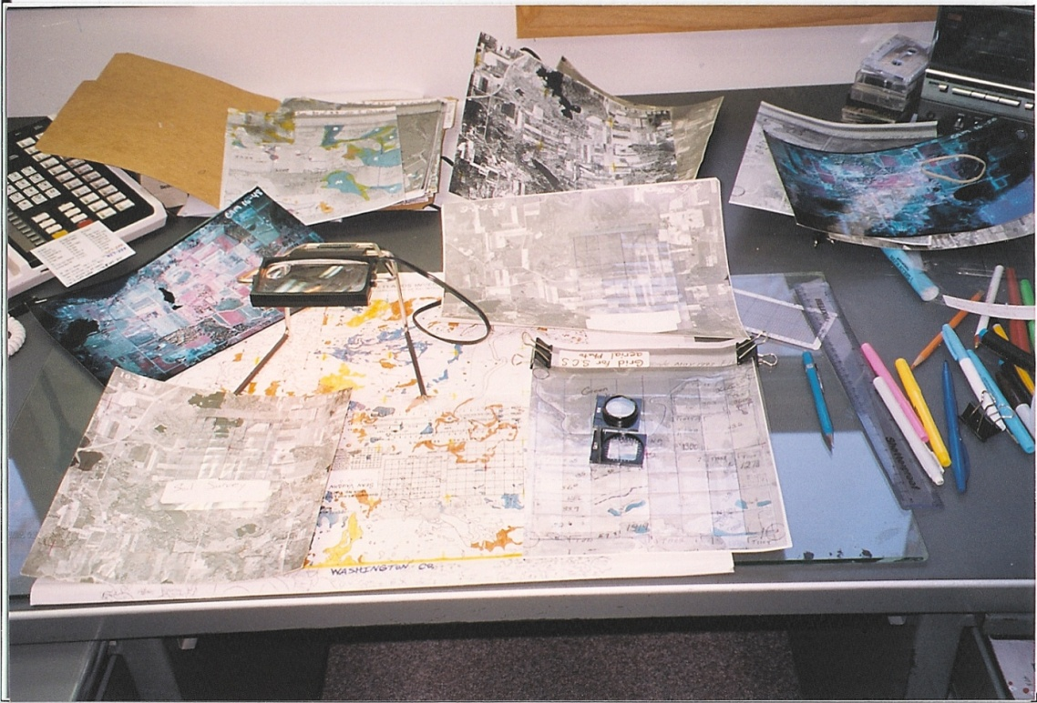
Sean Vaughn - Background
One Dimensional Planar View – Manual GIS (1992 - 1994)
Manual Illustration
Manual Interpretation

Slide 57
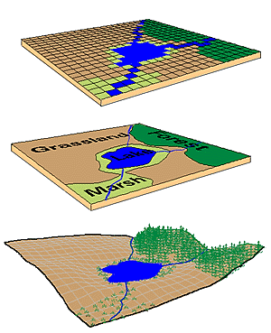
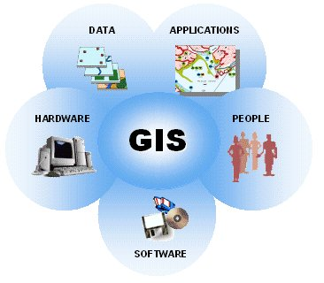
Sean Vaughn - Background
GIS Brings It All Together – (1994)
Raster
Vector
GIS – Innovation
Landscape
U of MN – Green Hall

Slide 58
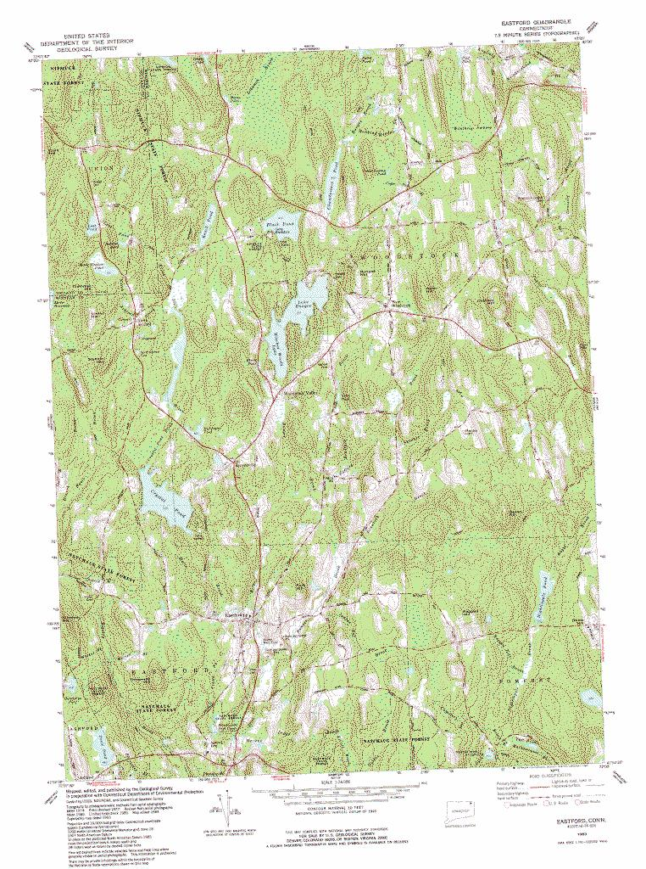
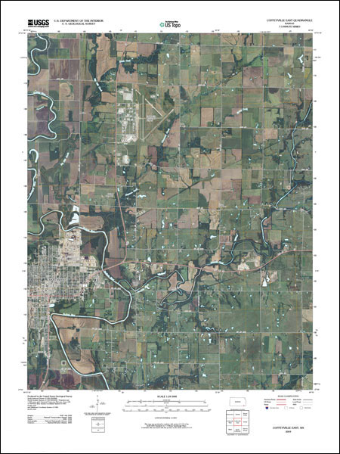
Sean Vaughn - Background
Field Inspection – DRGs & DOQs (Mid 1990’s – Mid 2000’s)

Slide 59
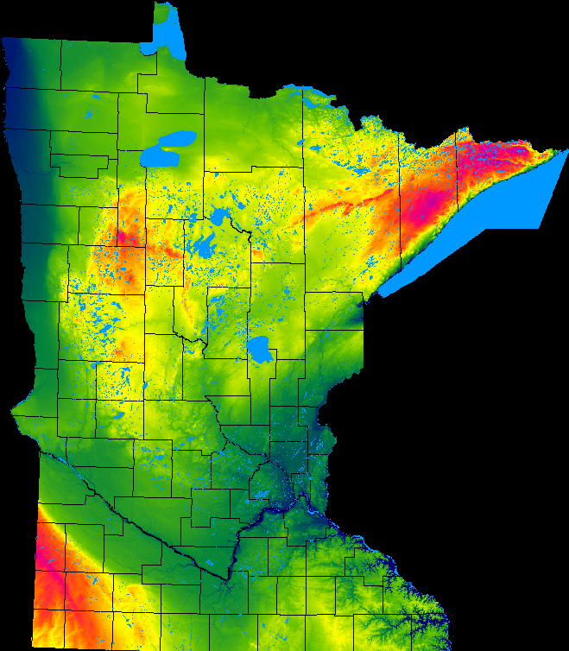
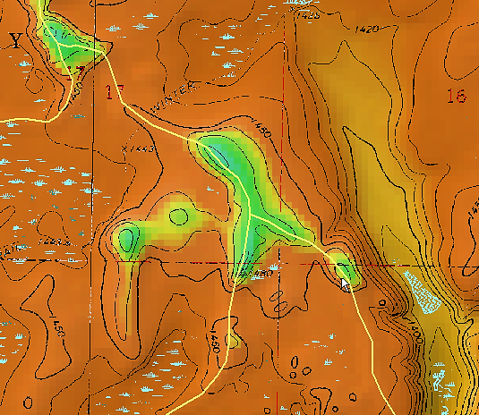
Sean Vaughn - Background
Creation of the 30-meter DEM
  The 30-meter DEM was used to create the DOQs

Slide 60
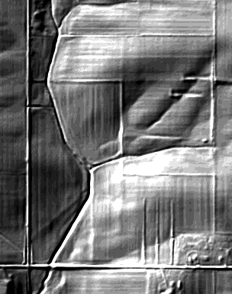
Sean Vaughn Hydro Background | Hydrography → LiDAR → Point Cloud → DEM → Hydrography
LiDAR products allow me identify all of those hydrography features from one high accuracy data set

Slide 61

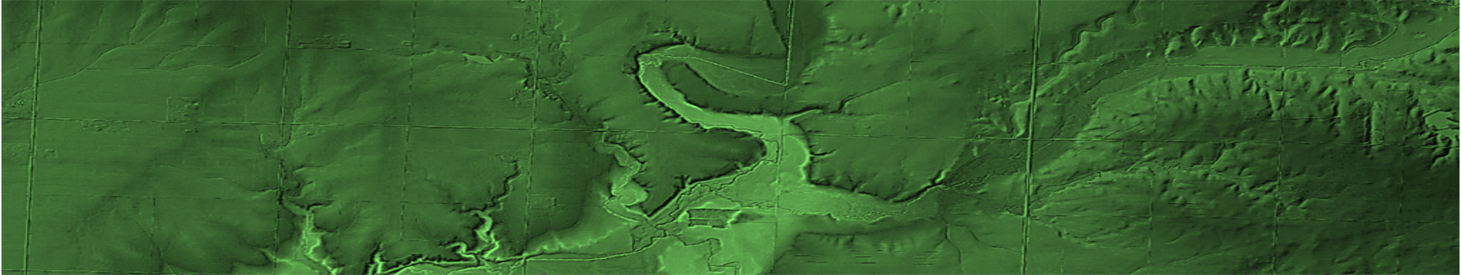
Sean Vaughn Hydro Background | Hydrography → LiDAR → Point Cloud → DEM → Hydrography
I’m a Clean Water Funded position
Provide GIS hydrography data development and subject matter expertise in support of Clean Water Funded Projects.
Knowledge of my background sets the platform for future informative presentations and discussions

Slide 62
LiDAR

Slide 63
Introduction
LiDAR…

Slide 64
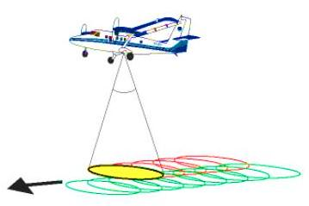
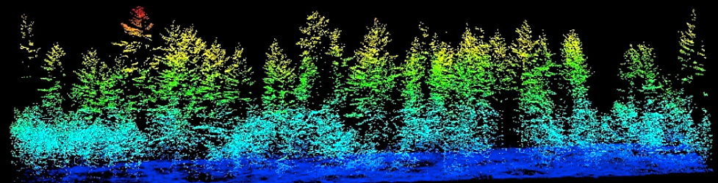
LiDAR → Point Cloud
  LiDAR is the Great Educator for Helping Resource Managers Convey the Conservation Message to Customers/Citizens.
LiDAR Point Cloud

Slide 65
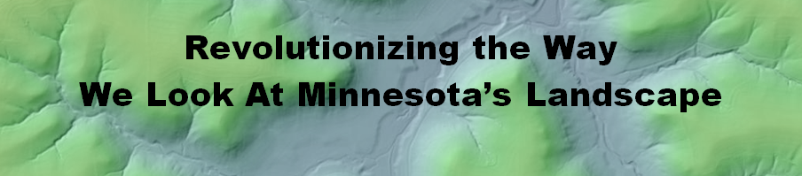
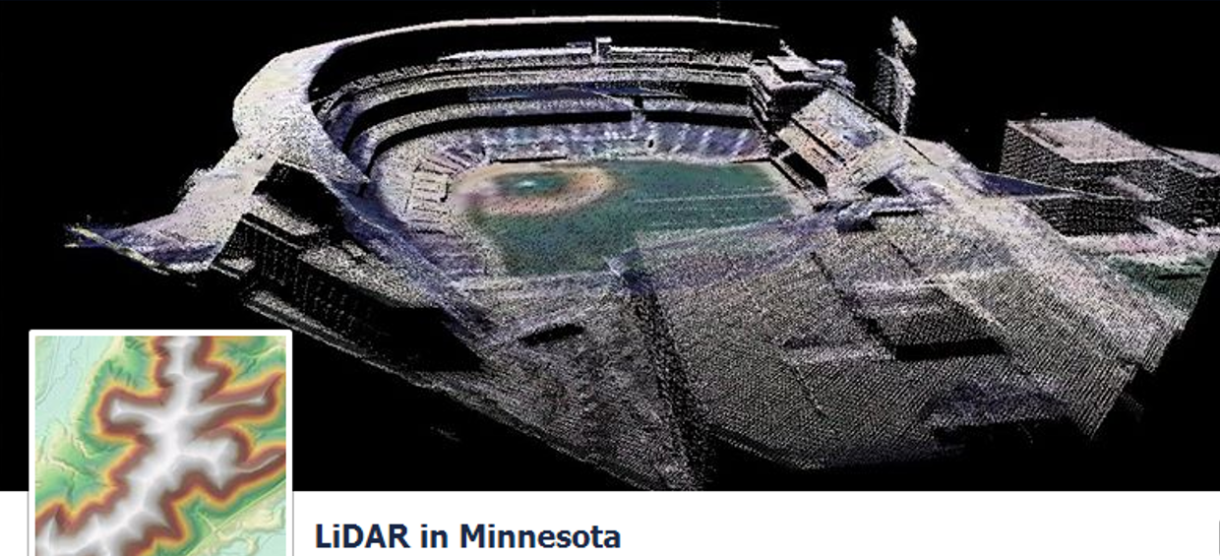
LiDAR → Point Cloud

Slide 66
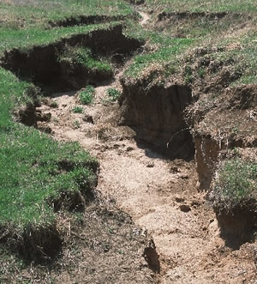
LiDAR
Features of hydrologic Significance.
  Nickpoint
  Fluvial Processes
  Soil Degradation
We Do this With Digital Elevation Models (DEM)
Where does the watercourse begin ?
Where concentrated flow begins. LiDAR captures these landforms.

Slide 67
Introduction
DEM…

Slide 68
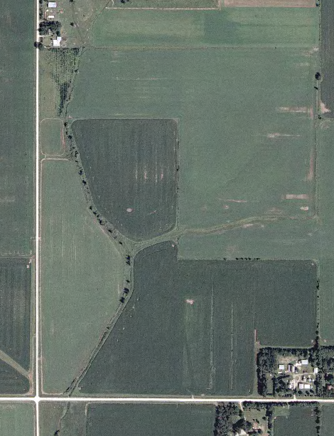
LiDAR → Point Cloud → DEM
High Quality DOQ
3 Meter DEM

Slide 69
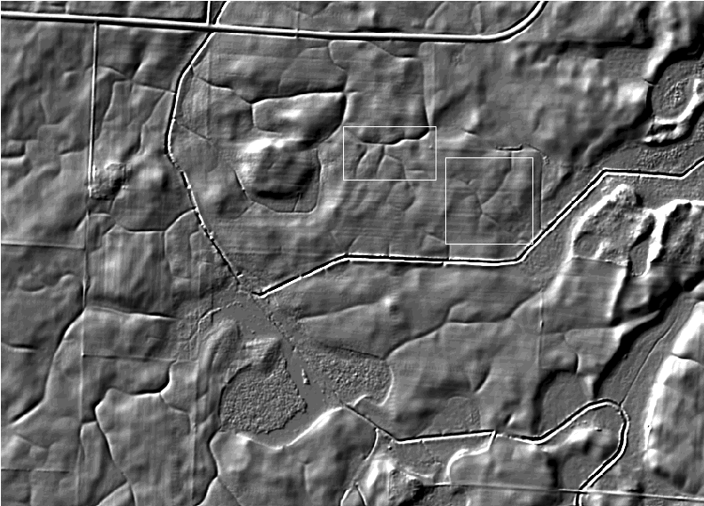
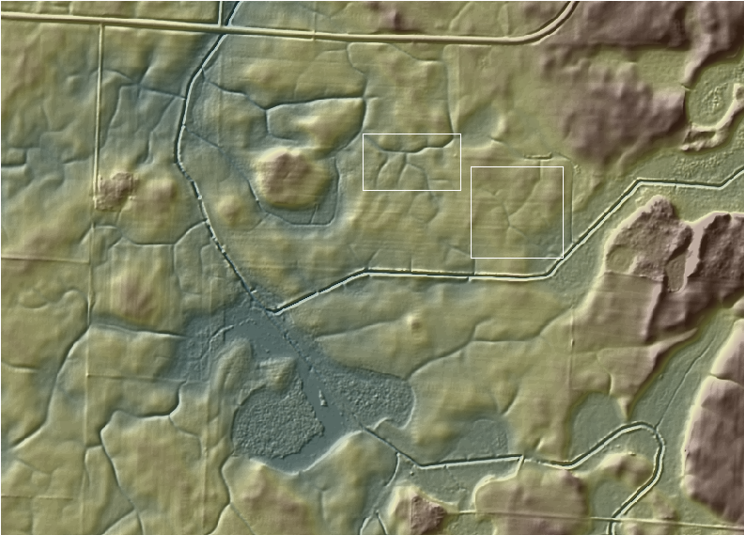
LiDAR → Point Cloud → DEM
Hillshaded DEM
DEM Draped on Hillshade

Slide 70
LiDAR
Digital Dams

Slide 71
Introduction
What Are Digital Dams…

Slide 72
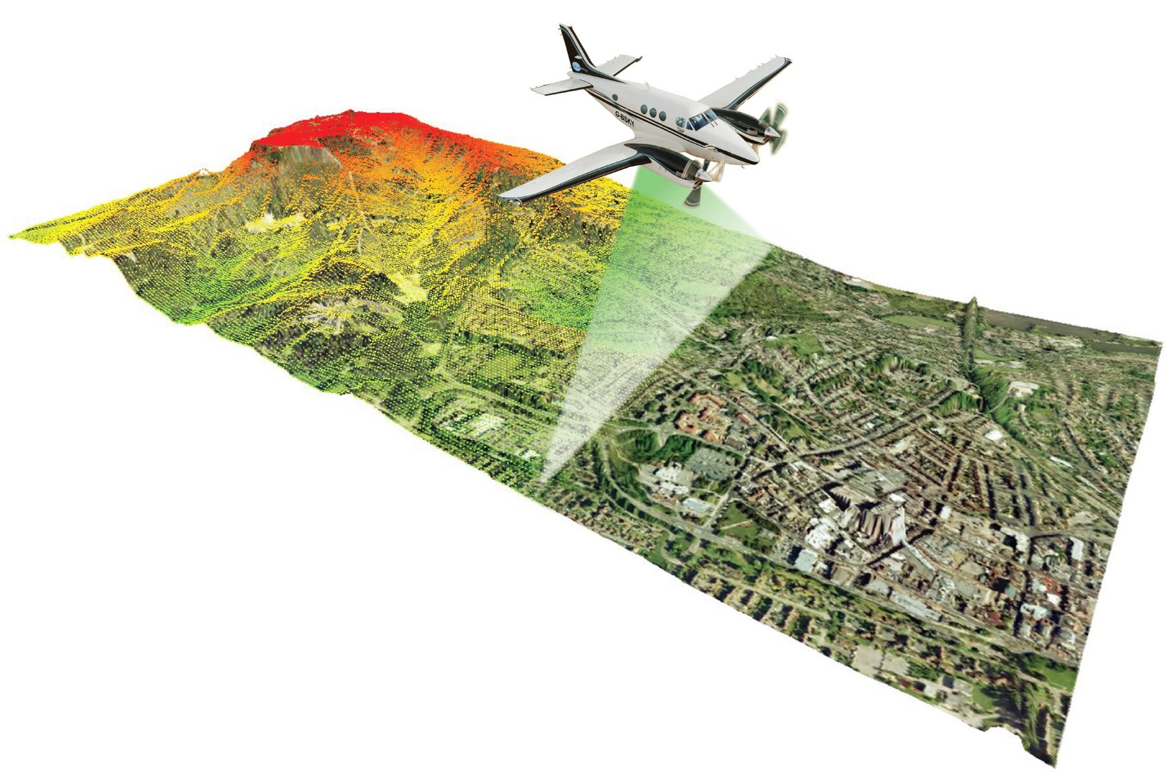
LiDAR → Point Cloud → DEM → Digital Dams
  LiDAR did its job.
Millions of elevation data points
LiDAR captures terrain and features (roads, dams, bridges) without regard to pass through conveyance of water (e.g., culverts).
Creates Digital Dams in the DEM
Not unique to Minnesota

Slide 73
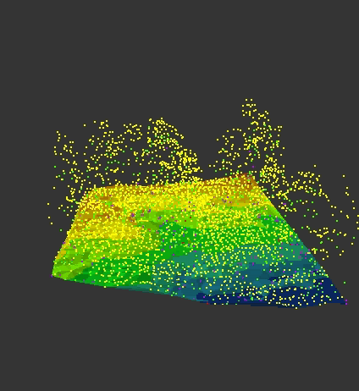
LiDAR → Point Cloud → DEM → Digital Dams
      Water does not “flow” within the DEM
      Most common problems with DEMs used in water resource applications
LiDAR 3D Point Cloud
LiDAR-derived 3D Digital Elevation Model (DEM)

Slide 74
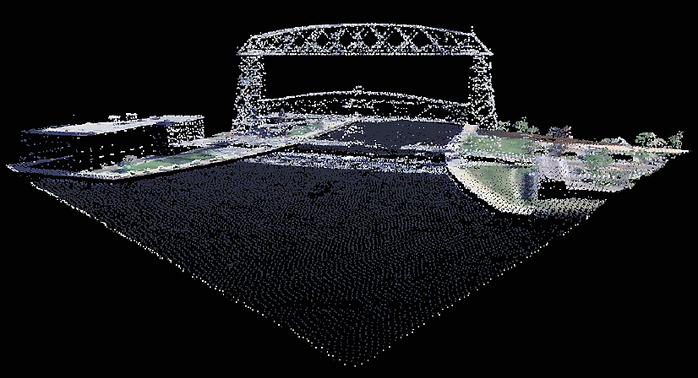
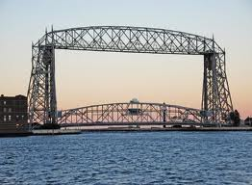
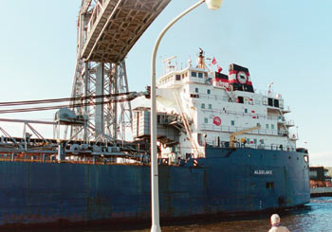
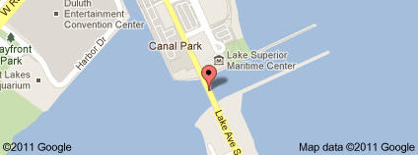
LiDAR → Point Cloud → DEM → Digital Dams
      Bridges are digital dams
Point Cloud of the Aerial Lift Bridge - Duluth, MN

Slide 75
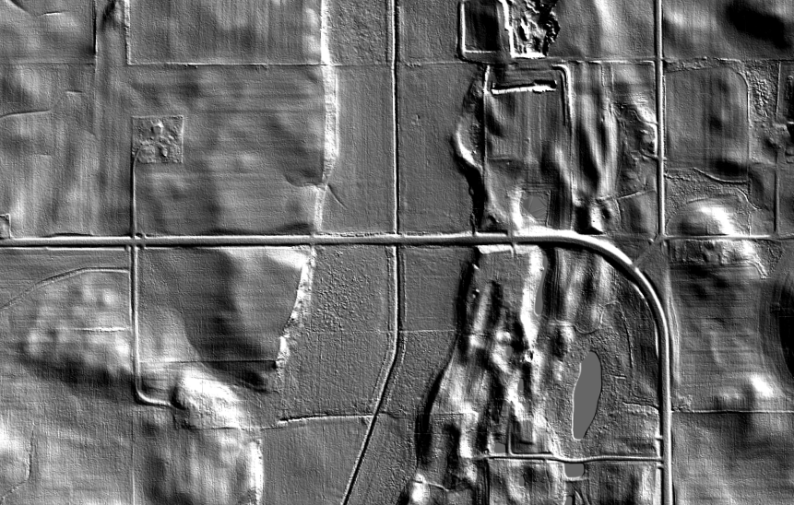
LiDAR → Point Cloud → DEM → Digital Dams

Slide 76
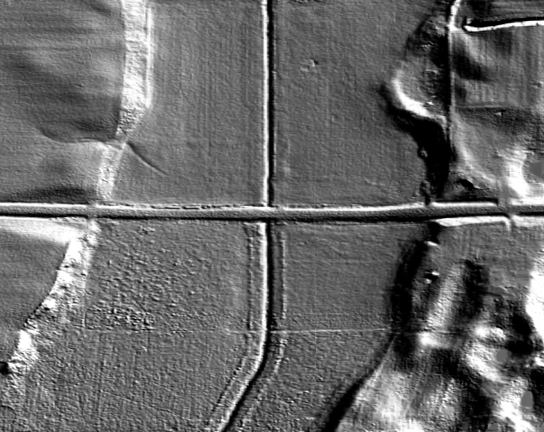
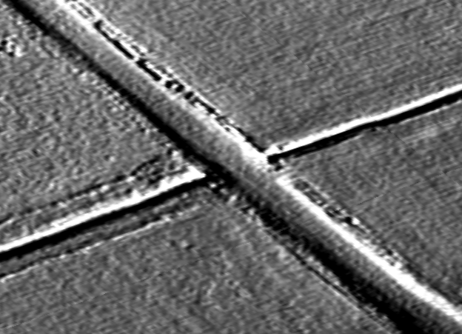




LiDAR → Point Cloud → DEM → Digital Dams
An oblique Perspective

Slide 77
DEM Hydro-modification

Slide 78
Introduction
What is DEM Hydro-modification…

Slide 79
LiDAR → Point Cloud → DEM → Digital Dams → DEM Hydro-modification → hDEM
DEM
Hydro-modification
- is -
Digital Dam
Removal

Slide 80

LiDAR → Point Cloud → DEM → Digital Dams

Slide 81
Introduction
Filling: What Happens without DEM Hydro-modification…

Slide 82

LiDAR → Point Cloud → DEM → Digital Dams

Slide 83

LiDAR → Point Cloud → DEM → Digital Dams
Digital Dam Not Removed
Filled Landform
Ditch

Slide 84
LiDAR → Point Cloud → DEM → Digital Dams
      LiDAR-derived DEMs are an authoritative representation of the water conveyance landforms on Earth’s surface.
      LiDAR-derived DEMs require some amount of hydro-modification for most hydro-terrain analysis and hydrologic modeling.
      Evaluation of DEM hydro-modification is based on how well the hDEM replicates the water conveyance landforms on Earth’s surface
      Accurate and detailed DEM hydro-modification can produce authoritative watercourses.

Slide 85
Introduction
Water Conveyance Landforms…

Slide 86




Landscape Hydrology – It’s in the Channels
    Flow
    Some Flow
    No Flow (event/seasonal)

Slide 87

DEM Hydro Modification
hDEM Level-1 Hydro-flattened
hDEM Level-2 Hydro-enforced
hDEM Level-3 Hydro-conditioned

Slide 88
Introduction
Water Quality Framework…

Slide 89
Water Quality Framework

Slide 90

Water Quality Framework
The Interagency Water Management Framework lays out a planning cycle that coordinates water management efforts across agencies, with a focus on supporting local implementation. This Framework acknowledges that implementation activities on the ground are ongoing while providing a systematic, step-by-step process for improving implementation in the context of the 10-year watershed approach.

Slide 91
Water Quality Framework
ONGOING LOCAL IMPLEMENTATION is at the heart of the state’s overall strategy for clean water. Actions must be prioritized, targeted, and measurable in order to ensure limited resources are spent where they are needed most. The rest of the cycle supports effective implementation.
MONITORING AND ASSESSMENT determines the condition of the state’s ground and surface waters and informs future implementation actions. The state’s “watershed approach” systematically assesses the condition of lakes and streams on a 10‐year cycle. Groundwater monitoring and assessment is more varied in space and time.
WATER RESOURCE CHARACTERIZATION AND PROBLEM INVESTIGATION delves into the science to analyze and synthesize data so that key
interactions, stressors, and threats are understood. In this step,
watershed and groundwater models and maps are developed to help
inform strategies.
Foundational Data
(Tool/Model Inputs)

Slide 92



Water Quality Framework
Foundation Data Application
hDEM
Foundation Data Development
DEM, hDEM
HPI
Foundation Data Development
DEM, hDEM
HPI
MnTOPO
  Data Development – Data Dissemination – Data Application

Slide 93
3 Takeaway Messages

Slide 94
Introduction
Closing | Takeaway Messages…

Slide 95
Takeaway Messages
LiDAR did its job
hDEMs are foundational data (Point Cloud, DEMs)
Proper replication of landscape hydrology in DEMs is required
Tools & Models have dependencies on foundational hydrography data.
Build awareness for discussion - Continue to build recognition and support for statewide foundational NXG-Hydro derived from LiDAR.
Hydro-modified DEMs support One Watershed – One Plan projects
95
Notes:
LiDAR did its job
hDEMs are foundational data
Proper replication of landscape hydrology in DEMs
Tools & Models have dependencies on foundational hydrography data.
Build awareness for disscussion - Continue to build recognition and support for statewide foundational NXG-Hydro.

Slide 96
Introduction
NXG-Hydrography Handout…

Slide 97
Packet
NXG-Hydro

Slide 98


GAC Meeting Packet -

Slide 99

Thank You!
Sean Vaughn
sean.vaughn@state.mn.us
763-689-7100 x226

Slide 100
Agenda Item 12
Approve 3D Geomatics Committee work plan
Gerry Sjerven, Co-Chair 3D Geomatics Committee

Slide 101


3DGeo Committee

Slide 102


3DGeo Committee

Slide 103

3DGeo Committee

Slide 104
Agenda Item 13
Updates on MN GAC priority projects and initiatives
GAC Rank | Project or Initiative Description | Status | Project Owner | Champion
1 | All Data Free and Open | Active | Len Kne | Ross
2 | Image Service - Sustain | Active | Mike Dolbow | Ross
3 | LiDAR Committee - Move Forward | Proposed | Sean Vaughn?
4 | Image Service - HTTPS, Tiling, Etc. | Active | Mike Dolbow | Ross
5 | Parcel Data | Active | George Meyer
6 | Address Points Data | Active | Adam Iten | Ross
7 | Street Centerline Data | Active | Adam Iten | Ross
8 | EM Damage Assess Data Standard | Active | Brad Anderson
9 | Basemap Services | Active | Sonia Dickerson | Ross
10 | Geocoding Service | Active | Mike Dolbow | Ross
11 | Parks and Trails Data Standard | Active | Jim Bunning | Ross

Slide 105
Agenda Item 14
Announcements or other business

Slide 106
Thank you!
Next meeting is Wednesday, March 28, 2018

