Slide 1

Minnesota Geospatial Advisory Council
September 5, 2018

Slide 2
Welcome
Introductions
Approve agenda
Approve May minutes

Slide 3
Agenda
Time | Topic
11:15 | Review and accept committee summaries
11:20 | Approve updated charter for Parcels and Land Records Committee
11:25 | Approve new Archiving Workgroup
11:35 | Road Centerline Data Standard update
11:40 | Adopting previously approved GCGI standards and standardizing
11:55 | Update on GIS/LIS and NSGIC conferences
12:00 | Break, networking
12:30 | 3D Geomatics Committee update and 3D Nation
12:45 | Update on NAIP and Landsat
12:50 | Sector reports: Bendickson (National Guard GEOINT), Mavis (Surveying)
1:10 | Removing priority #9 from priorities list
1:20 | Updates on MN GAC priority projects and initiatives
1:40 | Legislative updates
1:45 | Announcements

Slide 4
Agenda Item 2
Review and accept committee summaries

Slide 5
Agenda Item 3
Approve updated charter for Parcels and Land Records Committee
Mark Kotz

Slide 6
Agenda Item 4
Approve new Archiving Workgroup
Ryan Mattke

Slide 7
Agenda Item 5
Road Centerline Data Standard update
Geoff Maas

Slide 8
Agenda Item 6
Adopting previously approved Governor’s Council on Geographic Information standards and standardizing their formats
Geoff Maas, Mark Kotz

Slide 9
Standardizing Standards
10 standards approved by the Governor’s Council on Geographic Information
1994 to 2009
Also approved by state government
Some wording specific to state government sector
Purpose of the Standard
…It is intended to be used primarily when data are being transferred between a state agency and external customers.
Posted on MNIT site

Slide 10
Standardizing Standards
2 standards approved by the GAC, more coming
New standard format
Sector neutral language
Purpose of the Standard
…It is intended to be used when data are being transferred between organizations a state agency and external customers.
Posted on GAC site

Slide 11
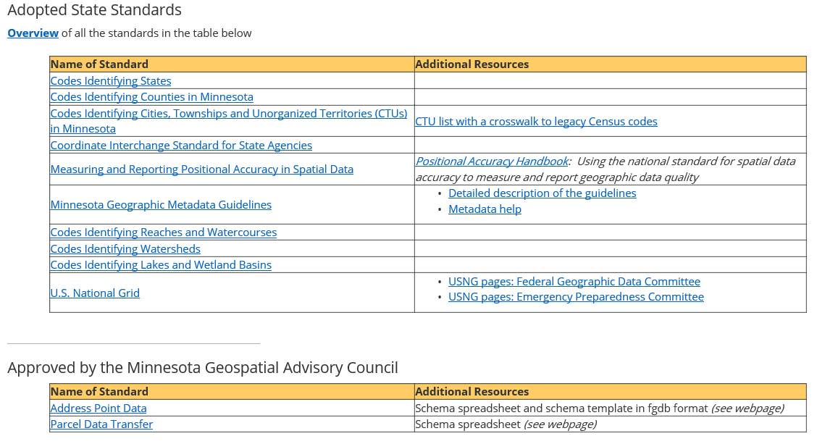
Standardizing Standards

Slide 12
Standardizing Standards
Standards Committee desires:
To have standards that are approved by and represent the entire MN geospatial community
To encourage all organizations and sectors to adopt the standards
To convey that all sectors are equally relevant/important to the GAC
To have consistent language across all standards

Slide 13
Standardizing Standards
Asking for GAC OK to move forward:
Move old GCGI standards into new GAC format
Remove sector specific language = sector neutral
Update any out-of-date references, links, etc.
Standardize language across all standards
If any significant change to standard, have a public review period
Have GAC approve all updated standards (a few at a time)
Post all on GAC site

Slide 14
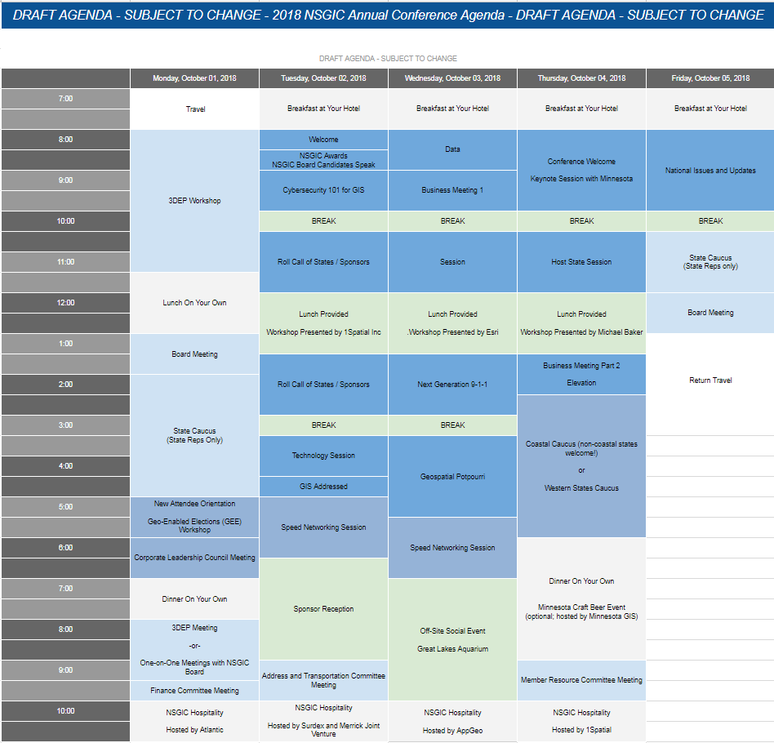
Agenda Item 7
Update on GIS/LIS and NSGIC conferences
Ryan Stovern, Dan Ross

Slide 15

Break - Networking

Slide 16
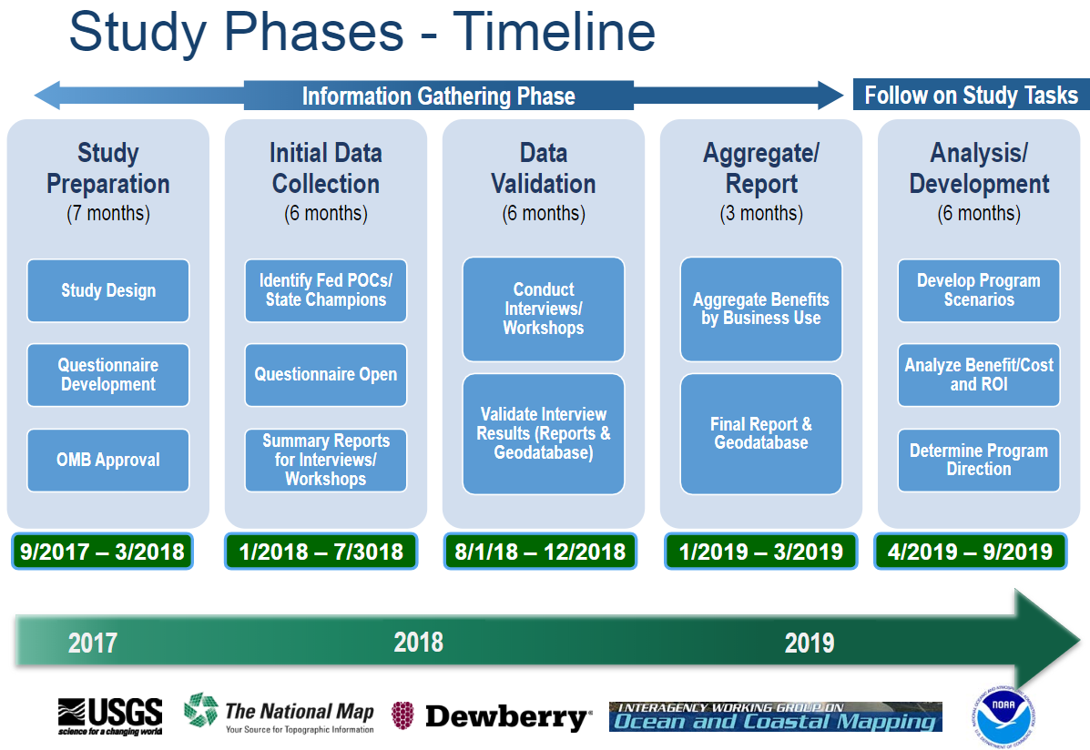
Agenda Item 9
3D Geomatics Committee update and 3D Nation
Gerry Sjerven, Dan Ross
3D Nation Study
Questionnaire – 18 invited, 14 responded
Next Steps

Slide 17
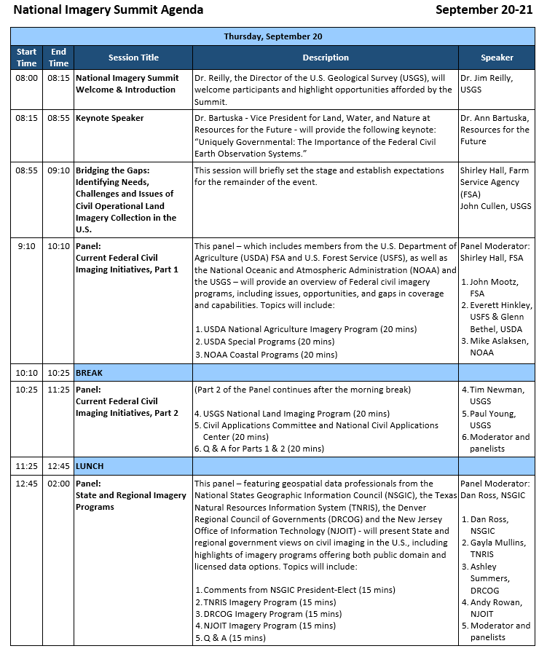
Agenda Item 10
Update on NAIP and Landsat
Dan Ross

Slide 18
Agenda Item 11
Sector report: National Guard GEOINT
David Bendickson

Slide 19
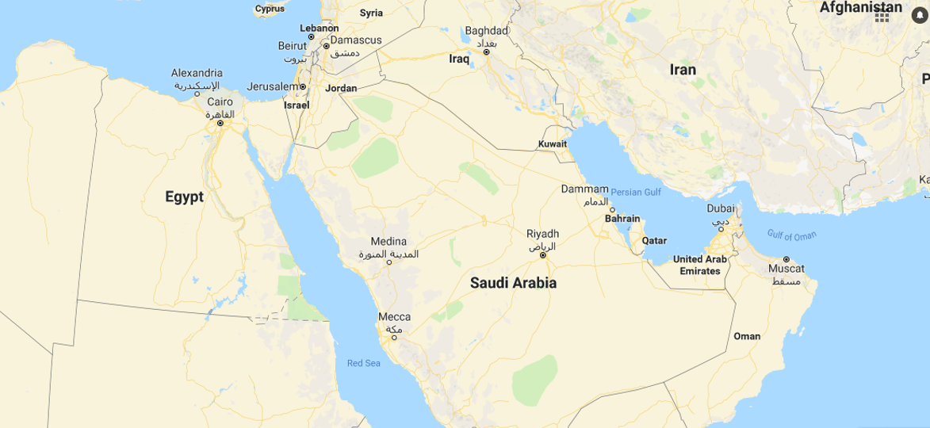

34th Infantry Division Deployment to CENTCOM
What is a Division? A large military formation consisting of 10,000-20,000 Soldiers. It is commanded by a Major General (Two star general) and historically was the default unit capable of combined arms operations. Since the War on Terror, when a division is deployed, they are a geographic command post. A Brigade Combat Team (commanded by a Colonel) is now responsible for combined arms operations.
The entire 34th Infantry Division has over 23,000 Citizen Soldiers in nine states. This is the headquarters element of the 34th Infantry Division with several hundred Soldiers deploying.
Deployment is in September and redeployment is July 2019
The GEOINT section consists of both Imagery analysts and geospatial engineers. 21 Total people will be in the GEOINT section, deployed to 4 countries: Kuwait, Jordan, Saudi Arabia, and Bahrain. There will be a mix of Minnesota National Guard, Army Reserve, and National Guard soldiers from other states. The GEOINT section will synchronize GIS and Imagery Intelligence operations across CENTCOM and will support around 9,000 Soldiers.
This is part of Operation Spartan Shield and they will conduct stability operations in CENTCOM.

Slide 20
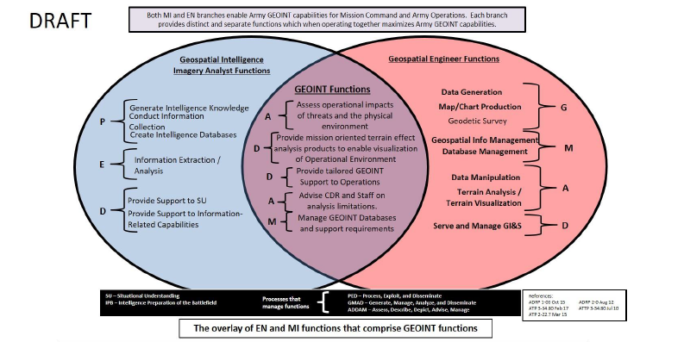
Geospatial Intelligence Imagery Analysts Functions
Overlapped With
Geospatial Engineer Functions

Slide 21
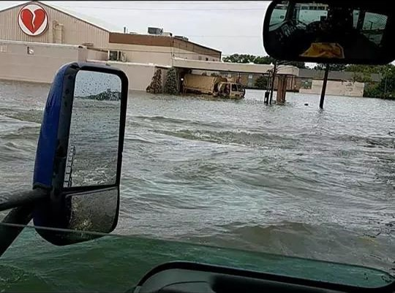
2017 Disaster impacts
Hurricanes and wildfires impacted 15% of the US population.
More disaster survivors registered for assistance than the past ten years combined.
Minnesota Army and Air National Guard assets were deployed to Texas, Florida, Puerto Rico, and the US Virgin Islands.
FEMA is substantially revising their evacuation/ shelter in place policies. FEMA will also work closer with State/Local
Tribal/Territorial (SLTT) Governments to be more prepared. FEMA is also taking efforts to reduce the complexity of assistance programs.
2018 National Preparedness Month Weekly Themes:
Week 1: (Sept 1-8) Make and Practice Your Plan
Week 2: (Sept 9-15) Learn Lifesaving Skills
Week 3: (Sept 16-22) Check Your Insurance Coverage
Week 4: (Sept 23-30) Save for an Emergency
September 15: Prepareathon

Slide 22




Old Policy
Substantial Change to UAS (drone) policy regarding National Guard Support to Domestic Operations.
Old Policy: It would require SECDEF (Secretary of Defense) approval for all UAV assets used in domestic operations.
New Policy: Governors may authorize the use of UAS issued to the state if
The systems are not allocated for a DoD mission (scheduled to deploy)
Only authorized uses are Search and Rescue or Incident Awareness and Assessment
Sensors cannot target specific US Persons without consent (implied consent for SAR)
Use in accordance with FAA policies
Personnel serve in a State Active Duty Status
States inform National Guard Bureau within 24 hours of use.
New Policy
Scan Eagle
Shadow
Raven

Slide 23
Agenda Item 11
Sector report: Surveying
Chris Mavis

Slide 24
Surveying
https://www.mngislis.org/ events/EventDetails.aspx?id=1134114

Slide 25
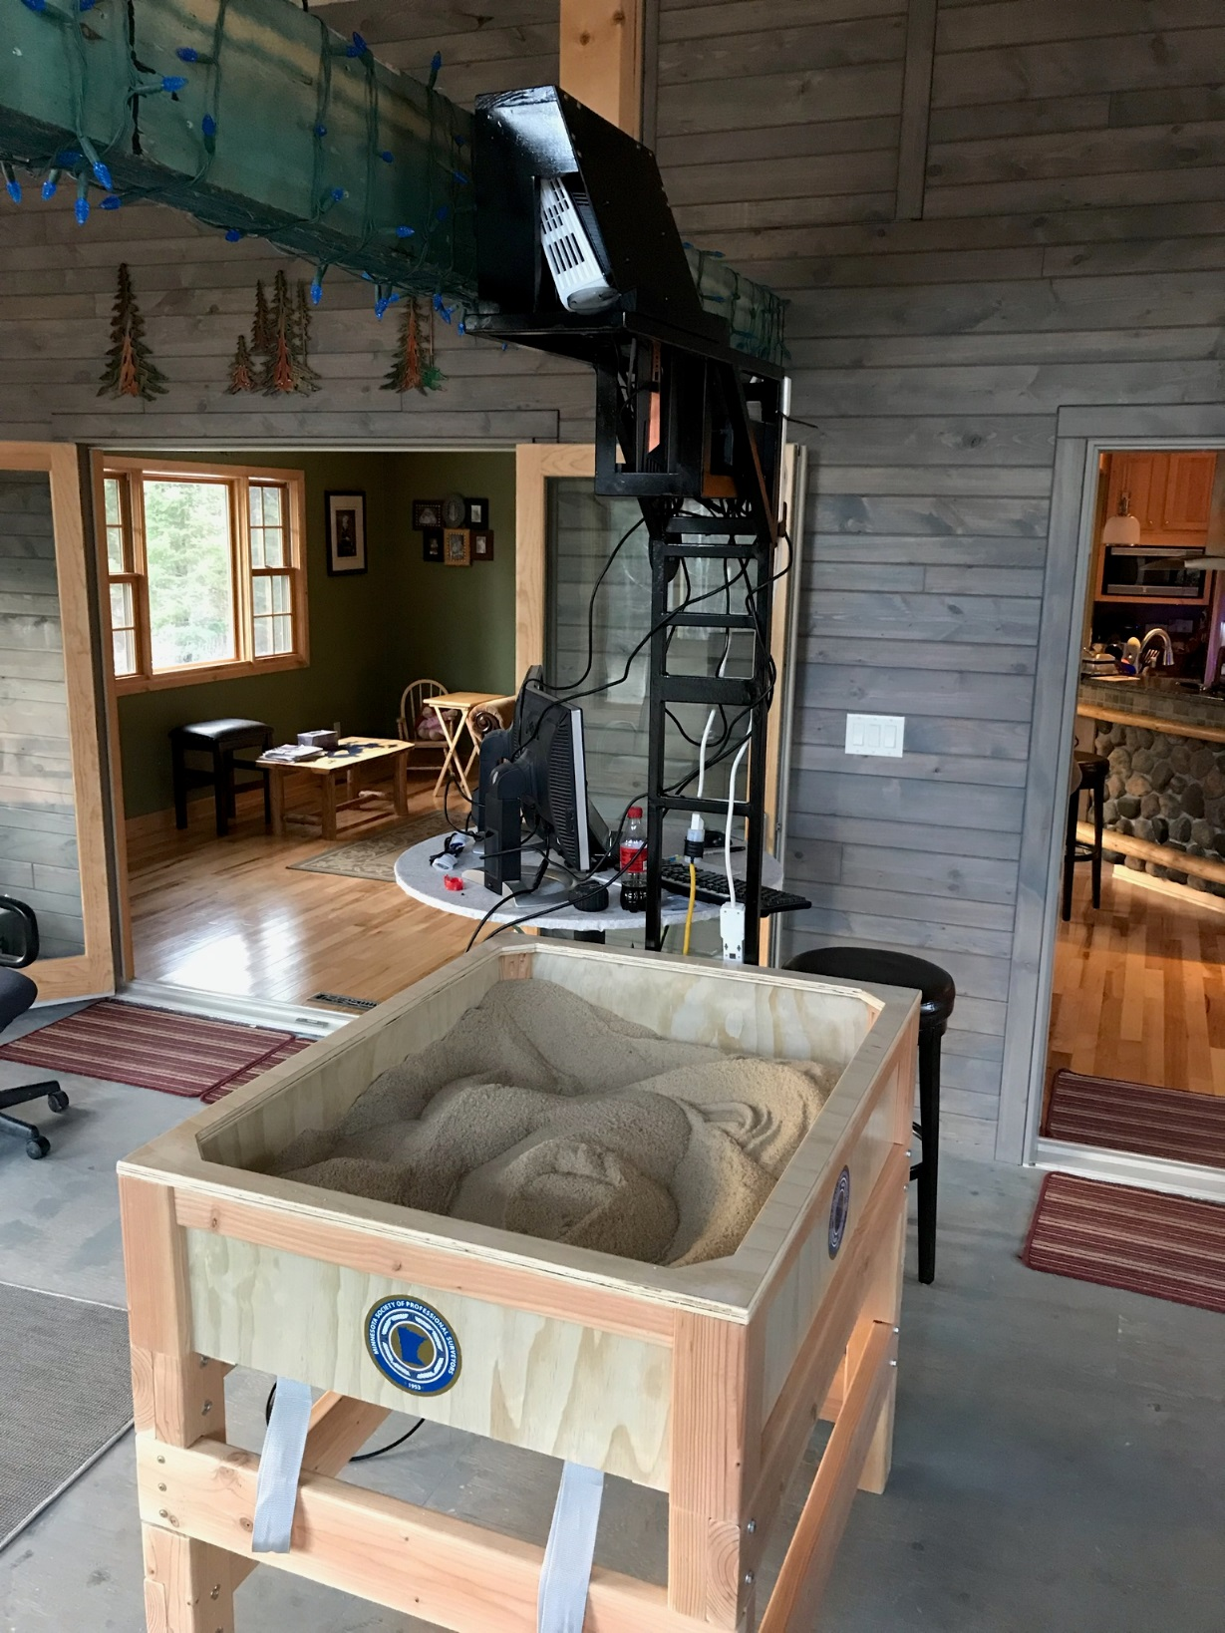
Virtual Sandbox
https://www.youtube.com/watch?v=j9JXtTj0mzE

Slide 26
Agenda Item 12
Removing priority #9 from MN GAC priorities list
Mike Dolbow

Slide 27
Agenda Item 13
Updates on MN GAC priority projects and initiatives
Mark Kotz

Slide 28
Agenda Item 13
GAC Rank | Project or Initiative Description | Status | Project Owner | Champion
1 | All Data Free and Open | Active | Len Kne | Dan Ross
2 | Image Service - Sustain | Active | Mike Dolbow | Dan Ross
3 | Address Points Data | Active |  | Dan Ross
4 | Road Centerline Data | Active |  | Dan Ross
5 | Image Service Enhancements | Active | Mike Dolbow | Dan Ross
6 | Archiving Policy/Procedure | Proposed | Ryan Mattke | many
7 | Parcel Data | Active | George Meyer
8 | Updated & Aligned Boundary Data | Proposed | Preston Dowell
9 | Image Service – Dozens of Years | Active | Mike Dolbow | Dan Ross
10 | EM Damage Assess Data Standard | Active | Brad Anderson, Cory Richter
11 | LiDAR data and related standards | Active | Gerry Sjerven
12 | Basemap Services | Active | Sonia Dickerson | Dan Ross
13 | Parks and Trails Data Standard | Active | Jim Bunning | Dan Ross

Slide 29
Agenda Item 14
Legislative updates
Dan Ross

Slide 30

Geospatial Data Act (H.R.4395, S.2128 )
Continuing to gain sponsors (Senate - 14, House – 4)
The GDA has almost cleared objections raised by the Energy & Natural Resources Committee (with the exception of a minor technical change raised by the minority, which shouldn't be a problem)
Interesting new twist: There is the potential to join the GDA with the Digital Coast Act. There would be a "firewall" between the two, which would allow for the Brooks Act/surveying language to remain in the DCA, while it would be clear that it would only apply to the DCA. This would represent a compromise to (potentially) make it a win for all the players.
Notes:
The bill establishes a clear vision, assigns responsibility, provides authority and ensures oversight of Federal activities by Congress.
Codify the existing executive orders and other guidance documents that direct work by the Federal Geographic Data Committee (FGDC) toward the NSDI.
Provide FGDC with the authority to make other agencies follow existing common sense rules
Provide Congressional oversight over geospatial activities of FGDC members and other agencies.
Require reporting that will allow Congress to track progress on the NSDI and ensure funding is spent wisely.
Provide a great deal more clout to input developed by the multi-sector membership of the National Geospatial Advisory Committee (NGAC) and require the FGDC to address NGAC’s concerns — not just dictate what NGAC should work on.
Require Federal agencies to coordinate and work in partnership with other Federal agencies, agencies of state, tribal and local governments, institutions of higher education, and the private sector to efficiently and cost-effectively collect, integrate, maintain, disseminate and preserve geospatial data.

Slide 31
Other Legislative Priorities
Digital Coast Act
Funds NOAA’s Digital Coast
DCA has passed the Senate. Senator Baldwin's office has indicated they are willing to push for a joining with GDA. Currently not moving in the House.
NG911 Act
Program (ROI of 250%)
Endorse nationwide deployment of NG911 over 10 years
Provisions related to federal funding (but no specific amounts)

Slide 32
Next Generation 9-1-1 Act
Furthers the deployment of NG9-1-1 services to enhance and upgrade nation’s 9-1-1 systems
Identical bills introduced in Nov. 2017
Hold-ups
Not bipartisan (need Republicans to sign on)
Increases responsibility of National 911 Office, but no funding level included - not sure what it would cost and cost study held up in OMB
Concerns about states raiding 911 fund
upl infrastructure
Related – The National 9-1-1 Grant Program is currently open and accepting applications. Minnesota has applied with a focus on developing geospatial data.

Slide 33
Agenda Item 15
Announcements or other business

Slide 34
Adjourn
Thank you!
Next meeting is Wednesday, December 5, 2018

