Slide 1



Minnesota Geospatial Advisory Council
December 11, 2019

Slide 2
Welcome
Introductions
Approve agenda
Approve September minutes

Slide 3
Agenda
Time | Topic
11:15 | Committee and workgroup summaries - Review and accept
11:20 | Vote on new leader positions
11:25 | GAC presentations at GIS/LIS conference – Roundtable
11:35 | Group to further flesh out MNIT Commissioner’s ideas
11:45 | Archiving Implementation Workgroup – request for approval
11:55 | Parks and trails data standard – status update
noon | Break, networking
12:30 | MN Geospatial Priorities Survey results and GAC priorities
1:10 | Retiring items from the priorities list
1:20 | GAC priority projects and initiatives updates
1:30 | Draft statewide lidar acquisition plan – What is the GAC role?
1:40 | Legislative updates and US survey foot
1:45 | Announcements

Slide 4
Agenda Item 2
Committee and workgroup summaries - Review and accept

Slide 5
Agenda Item 3
Vote on New Leader Positions

Slide 6
GAC Leadership Candidates
Leadership Team Candidates
Jeff Bloomquist
Len Kne
Chris Mavis
Ryan Stovern
Victoria Reinhardt
David Brandt
Chair and Vice Candidates
Mark Kotz – Chair
Cory Richter – Vice Chair

Slide 7
Agenda Item 4
GAC Presentations at GIS/LIS Conference – Roundtable

Slide 8
Agenda Item 5
Group to Further Flesh out MNIT Commissioner’s Ideas
Dan Ross

Slide 9
One Minnesota Plan - Building Blocks
Mission
Improve the lives of Minnesotans by working collaboratively to implement policies that achieve results.
Vision
Minnesota is the best state in the country for children to grow up in – those of all races, ethnicities, religions, economic statuses, gender identities, sexual orientations, abilities, and zip codes

Slide 10
One Minnesota Plan - Building Blocks
Minnesota does best when state agencies and community partners collaborate to achieve common goals. We will solve problems in education, healthcare, environment, energy, housing, job, transportation by focusing on these key priorities…
Priorities:
Children and Families
Equity and Inclusion
Thriving Communities
Fiscal Accountability and Measurable Results
Minnesota’s Environment

Slide 11
Commissioners’ Ask…
What can this advisory body in its work with the geospatial community do to bring together data to improve the outcomes of Minnesotans in the priority areas identified in the One Minnesota Plan?

Slide 12
Agenda Item 6
Archiving Implementation Workgroup - Approval
Ryan Mattke

Slide 13
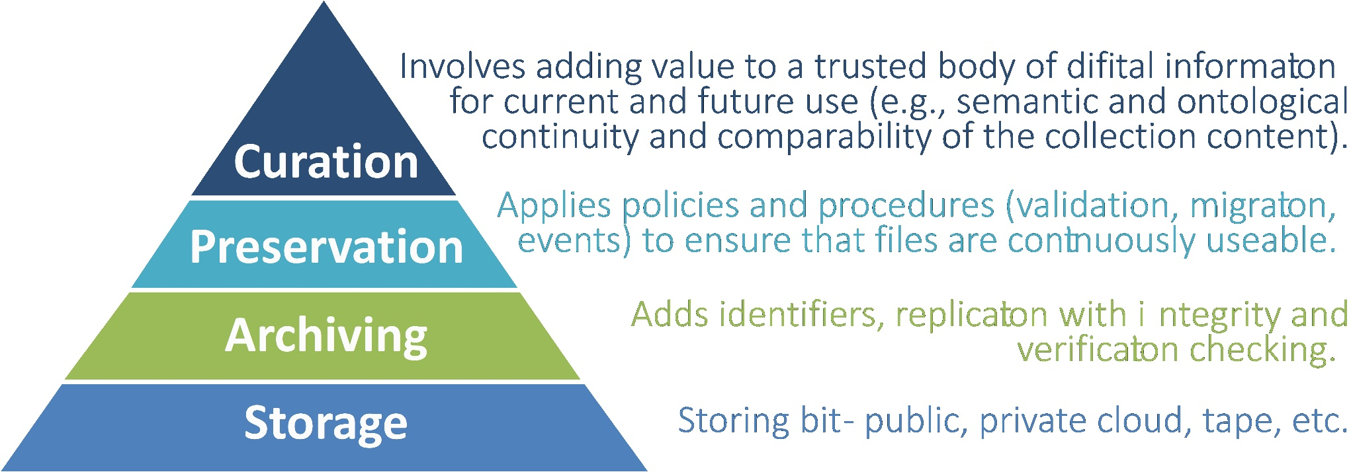
Archiving Implementation Workgroup
Mission statement:
Define and facilitate the implementation of an archive for Minnesota geospatial data by building on the work of the Archiving Workgroup

Slide 14
Archiving Implementation Workgroup
Proposed Members:
Sarah Barsness - Minnesota State Archives
David Brandt - Washington County
Jennifer Corcoran - MN DNR
Jon Hoekenga - Met Council
Melinda Kernik - UMN Libraries
Len Kne - UMN / U-Spatial
Leanne Knott - Goodhue County
Brent Lund - MNIT / MnGeo
Karen Majewicz - UMN Libraries (Vice Chair)
Andra Mathews - MN DOT
Ryan Mattke - UMN Libraries (Chair)
Nancy Rader - MNIT / MnGeo
Sandi Stroud – MNIT / MnGeo
Zeb Thomas - MNIT / MN DNR
Ben Timerson - MN DOT
Brandon Tourtelotte - Pro-West & Associates
(possible others TBD)

Slide 15
Archiving Implementation Workgroup
Work Areas (from Archiving Workgroup Summary Report):
Program: Develop a detailed program for archiving geospatial data, including governance, guidelines, procedures, and the necessary social infrastructure
Technology: Develop detailed technical infrastructure plans and workflows for archiving geospatial data
Outreach & Education: Continue to build support for the archiving effort
Funding: Research and secure funding for the archiving effort
Deliverables:
Program recommendations
Technology plans and workflows
Outreach & Education plan
Funding recommendations
Pilot Project
Report
Present at 2020 MN GIS/LIS Conference

Slide 16
Archiving Implementation Workgroup
Thoughts?
Reactions?
Questions?

Slide 17
Agenda Item 7
Parks and Trails Data Standard – Status Update
Jim Bunning & David Brandt

Slide 18

Metro Parks and Trails Standard
Kickoff meeting in November 2016
Data is updated twice per year; next update should happen early 2020
Version 1.2 of the standard is available https://www.metrogis.org/projects/park-and-trail.aspx)
Metro GIS has posted a schema validation tool on the GeoCommons https://gisdata.mn.gov/dataset/us-mn-state-metrogis-bdry-validation-parktrail
Core fields are priority for data population
The County build team members will likely meet early 2020 to discuss any potential schema changes

Slide 19

Break - Networking

Slide 20
Agenda Item 9
MN Geospatial Priorities Survey Results and GAC Priorities
Mark Kotz

Slide 21
Why Create Priorities?
To create a voice for the MN geospatial community
To direct work plans of the GAC and its committees
To recommend to MnGeo
To allow other organizations to compare priorities and align efforts
To inform outreach and policy related efforts
Having clear direction helps motivate people to participate

Slide 22
GAC Priorities Process
Create a list of proposed projects and initiatives
From GAC members and committee chairs
Announced at GIS/LIS conference
Assess the value of each – degree of business need
MN Geospatial Priorities Survey
Assess likelihood of success of each - owner, work team, champion, funding
Preliminary priority calculation
GAC discusses and adjusts

Slide 23
MN Geospatial Priorities Survey
453 survey responses
49% from state sector

Slide 24
MN Geospatial Priorities Survey
Results scoring:
Critical = 3
Very Important = 2
Nice to have = 1
Not needed or not answered = 0
Scores shown weighted and unweighted
Weighting by GAC seats representing sectors (e.g. nonprofit weight of 1 (1 seat), state government weight of 2 (2 seats)).
Results are very similar weighted and unweighted.

Slide 25
Project Short Name | Project Long Name | Score Weighted | Not Weighted
Free and Open Data | All public geospatial data in MN to be free and open to everyone. | 2.115 | 2.26
Updated & Aligned Boundary Data | Updated and aligned boundary data from authoritative sources. | 1.876 | 2.09
Hydro-DEMs | Accurate hydro-DEMs (hDEM) that serve modern flood modeling and hydro-terrain analysis tools, and the development of more accurate watercourses and watersheds. | 1.680 | 1.74
Parcel Data | Statewide publicly available parcel data. | 1.679 | 1.91
Road Centerline Data | Statewide publicly available road centerline data. | 1.671 | 1.78
LiDAR Data | New LiDAR data acquisition across Minnesota for use in developing new derived products guided by committee developed standards. | 1.671 | 1.89
Image Service Improvements | Improvements to the MnGeo Imagery Service, such as Web Mercator support, tiling, and complementary options such as “composite of latest leaf off imagery”, and downloading options. | 1.622 | 1.61
Geodata Archive Implementation | The implementation of an archive for Minnesota geospatial data. | 1.547 | 1.56
Basemap Services | Statewide and regional (e.g. Twin Cities metro) publicly available basemap services. | 1.545 | 1.60
Inventory of MN GeoData Assets | An inventory and assessment of Minnesota’s geospatial data assets. | 1.516 | 1.58
Address Point Data | Statewide publicly available address points data. | 1.412 | 1.47
EM Damage Assess Data Standard | An emergency management damage assessment data standard to provide an accepted specification to support a request for State or Federal assistance after a disaster. | 1.381 | 1.35
NG9-1-1 Geospatial Forum | A forum (committee, workgroup, etc.) for MN geospatial professionals to discuss and share best practices, standards, lessons learned, etc. for implementing and supporting the geospatial components of NG9-1-1 | 1.372 | 1.35
Underground Utilities Data Forum | A forum (committee, workgroup, etc.) to explore development of statewide data representing underground utilities. | 1.336 | 1.27
Crit Infrastructure Data Custodian | Identifying a custodian and maintenance workflow for statewide critical infrastructure data. | 1.306 | 1.42
U.S. National Grid Materials | Maps, procedures, templates and other materials to help all levels of government implement the U.S. National Grid. | 1.243 | 1.22
Culvert Data Standard | A culvert data standard. | 1.178 | 1.29
Parks and Trails Data Standard | A parks and trails data standard. | 1.165 | 1.14
Unmanned Systems Metadata Guide | A guide for describing in metadata the specifications of unmanned aircraft systems (UAS), unmanned surface water vehicles (USV), and unmanned underwater vehicles (UUV). | 1.048 | 1.04

Slide 26
Project Short Name | Weighted by Sector
Free and Open Data | 2.115
Updated & Aligned Boundary Data | 1.876
Hydro-DEMs | 1.680
Parcel Data | 1.679
Road Centerline Data | 1.671
LiDAR Data | 1.671
Image Service Improvements | 1.622
Geodata Archive Implementation | 1.547
Basemap Services | 1.545
Inventory of MN GeoData Assets | 1.516
Address Point Data | 1.412
EM Damage Assess Data Standard | 1.381
NG9-1-1 Geospatial Forum | 1.372
Underground Utilities Data Forum | 1.336
Critical Infrastructure Data Custodian | 1.306
U.S. National Grid Materials | 1.243
Culvert Data Standard | 1.178
Parks and Trails Data Standard | 1.165
Unmanned Systems Metadata Guide | 1.048

Slide 27
Prioritization
Value Score = Weighted survey result x 10
Likelihood of Success Score
Project owner = 3
Project team = 2
Champion = 2
Funding = 2
Effort: low = 3, medium = 2, high = 1

Slide 28
Time for Big Colorful Spreadsheet
Project or Initiative Name | Status | Do in '20 | GAC Rank | Priority Score | Value Score | Survey Score | Success Score | Owner Exists | Work Team Exists | Active Champ Exists | $$ Exists | Est $$ | Easy Score | Effort | Project Owner | Champ
Free and Open Data | Active |  |  | 233 | 21 | 2.115 | 11 | 3 | 2 | 2 | 2 | $0 | 2 | Med | Kari Geurts | Many
Updated & Aligned Boundary Data | Active |  |  | 188 | 19 | 1.876 | 10 | 3 | 2 | 2 | 2 | $0 | 1 | High | Preston Dowell | Ross
Hydro-DEMs | Active |  |  | 134 | 17 | 1.68 | 8 | 3 | 2 | 2 |  | some | 1 | High | Sean Vaughn | Many
Parcel Data | Active |  |  | 118 | 17 | 1.679 | 7 |  | 2 | 2 | 2 | $0 | 1 | High |  | Kotz
LiDAR Data | Active |  |  | 134 | 17 | 1.671 | 8 | 3 | 2 | 2 |  | some | 1 | High | Gerry Sjerven | Ross
Road Centerline Data | Active |  |  | 167 | 17 | 1.671 | 10 | 3 | 2 | 2 | 2 | $0 | 1 | High | Norman Anderson | Ross
Image Service Improvements | Active |  |  | 114 | 16 | 1.622 | 7 |  | 2 | 2 | 2 | $0 | 1 | High |  | Ross
Geodata Archive Implementation | Active |  |  | 170 | 15 | 1.547 | 11 | 3 | 2 | 2 | 2 | $0 | 2 | Med | Ryan Mattke | many
Basemap Services | Active |  |  | 124 | 15 | 1.545 | 8 | 3 | 2 | 2 |  | some | 1 | High | Sonia Dickerson | Ross
Inventory of MN GeoData Assets |  |  |  | 15 | 15 | 1.516 | 1 |  |  |  |  | ? | 1 | High
Address Point Data | Active |  |  | 141 | 14 | 1.412 | 10 | 3 | 2 | 2 | 2 | $0 | 1 | High | Norman Anderson | Ross
EM Damage Assess Data Standard | Active |  |  | 124 | 14 | 1.381 | 9 | 3 | 2 |  | 2 | $0 | 2 | Med | Anderson/Richter
NG9-1-1 Geospatial Forum |  |  |  | 55 | 14 | 1.372 | 4 |  |  |  | 2 | $0 | 2 | Med
Underground Utilities Data Forum |  |  |  | 53 | 13 | 1.336 | 4 |  |  |  | 2 | $0 | 2 | Med
Critical Infrastructure Data Custodian |  |  |  | 13 | 13 | 1.306 | 1 |  |  |  |  | ? | 1 | High
U.S. National Grid Materials | Active |  |  | 112 | 12 | 1.243 | 9 | 3 | 2 | 2 |  | ? | 2 | Med | Randy Knippel | Knippel
Culvert Data Standard |  |  |  | 12 | 12 | 1.178 | 1 |  |  |  |  | some | 1 | High
Parks and Trails Data Standard | Active |  |  | 116 | 12 | 1.165 | 10 | 3 | 2 | 2 | 2 | $0 | 1 | High | Jim Bunning | Ross
Unmanned Systems Metadata Guide |  |  |  | 21 | 10 | 1.048 | 2 |  |  |  |  | ? | 2 | Med

Slide 29
Agenda Item 10
Retiring Items from the Priorities List
Mark Kotz

Slide 30
Agenda Item 11
Updates on GAC priority projects and initiatives
Mark Kotz

Slide 31
Agenda Item 11
GAC Rank | Project or Initiative Description | Status | Project Owner | Champion
1 | All Data Free and Open | Active | Kari Geurts | Dan Ross
2 | Image Service - Sustain | Active |  | Dan Ross
3 | Updated and Aligned Boundary Data | Active | Preston Dowell | Dan Ross
4 | Parcel Data | Active |  | Mark Kotz
5 | Archiving Policy/Procedure | Active | Ryan Mattke | many
6 | Road Centerline Data | Active | Norm Anderson | Dan Ross
7 | New LiDAR Acquisition | Active | Gerry Sjerven | Dan Ross
8 | Address Points Data | Active | Norm Anderson | Dan Ross
9 | MN Focused Basemap Services | Active | Sonia Dickerson | Dan Ross
10 | Parks and Trails Data Standard | Active | Jim Bunning | Dan Ross
11 | EM Damage Assess Data Standard | Active | Brad Anderson, Cory Richter
12 | Accurate Hydro-DEMs | Active | Sean Vaughn

Slide 32
Agenda Item 12
Draft Statewide LiDAR Acquisition Plan – What is the GAC Role?
Gerry Sjerven, Alison Slaats

Slide 33
Agenda Item 12
Draft Statewide Lidar Acquisition Plan – What is the GAC Role?
Gerry Sjerven, Alison Slaats
Goals for today:
Update on the plan
What is GAC role
Notes:
To cover:
Update on the plan
What is GAC role

Slide 34
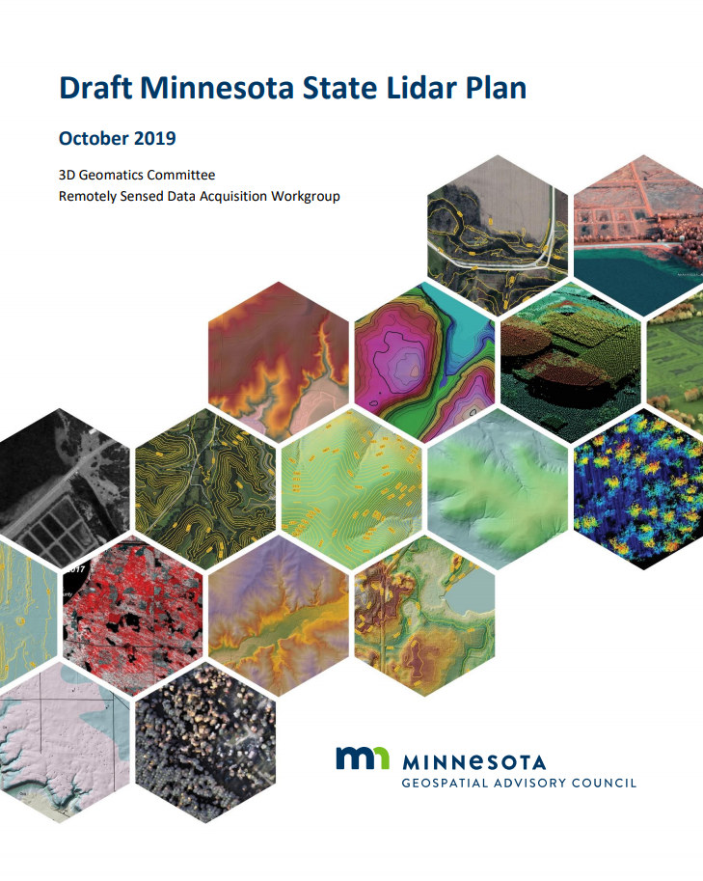
Update on work by Data Acquisition Team
Lidar Plan Update
Minnesota State Lidar Plan draft published on GAC website
Story Map published on GAC website
Funding Update
Submitted funding request to USGS through a Broad Agency Announcement (BAA) in November for the North East “Rainy Lake” region
Participated in Goodhue County BAA funding submission
Notes:
The plan is collect new and higher quality lidar for the entire state of Minnesota by 2025.
There is a national effort by USGS to create a seamless elevation dataset nationwide. The Minnesota data we collected several yeas ago the quality level required for this effort (it was QL3 and USGS 3DEP requires QL2 or better)
Minnesota led by the GAC 3D Geo Committee has created a lidar plan for acquiring new lidar data. The plan has been written and is now going through an internal review. It will be published on the GAC 3D Geo website in the next couple of weeks
This initiative needs local partners to access funding available from USGS.
Please help us
by speaking with decision makers in your organization about lidar and potential funding
By letting us know about how you can partner – define needs, provide support through sharing your needs and/or funds.
A story map is available that you can share with decision makers. Next slides show part of the story map.

Slide 35

Update on work by Data Acquisition Team
Communications Update
North East Minnesota Forested Area outreach meeting to promote BAA plan
Met Council Meeting
State Agency outreach at BWSR, DNR, MPCA
GIS/LIS conference Presentations
Notes:
The plan is collect new and higher quality lidar for the entire state of Minnesota by 2025.
There is a national effort by USGS to create a seamless elevation dataset nationwide. The Minnesota data we collected several yeas ago the quality level required for this effort (it was QL3 and USGS 3DEP requires QL2 or better)
Minnesota led by the GAC 3D Geo Committee has created a lidar plan for acquiring new lidar data. The plan has been written and is now going through an internal review. It will be published on the GAC 3D Geo website in the next couple of weeks
This initiative needs local partners to access funding available from USGS.
Please help us
by speaking with decision makers in your organization about lidar and potential funding
By letting us know about how you can partner – define needs, provide support through sharing your needs and/or funds.
A story map is available that you can share with decision makers. Next slides show part of the story map.

Slide 36
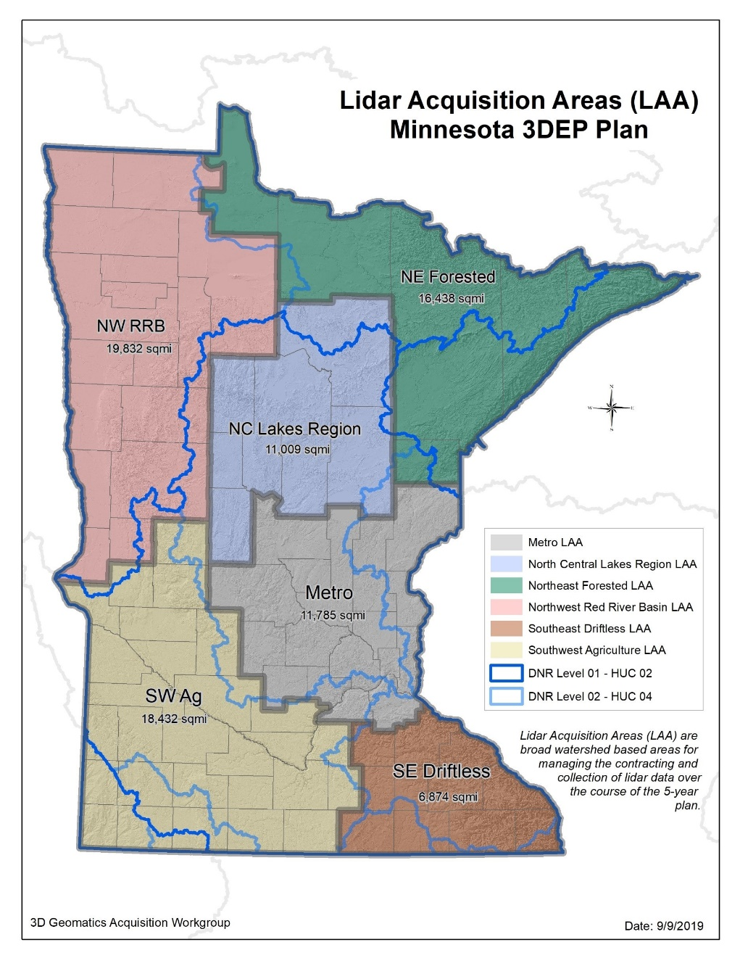
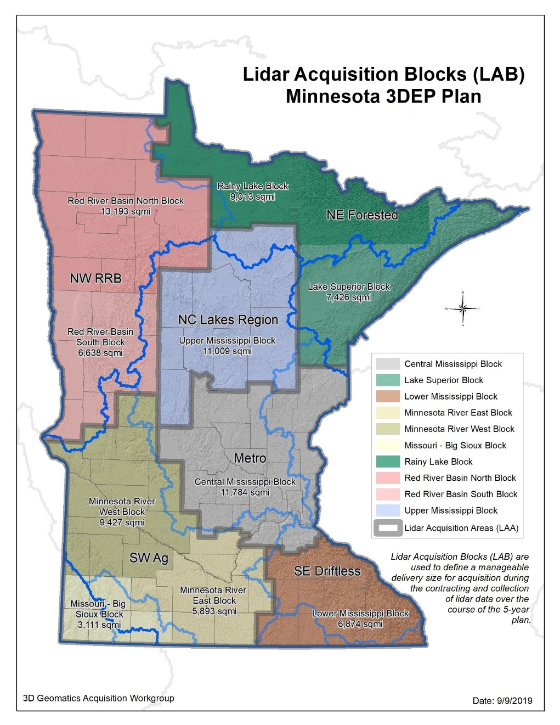
Lidar Acquisition Areas of Interest

Slide 37
Role of the GAC Members
The 3D Geo Committee would like the GAC members to:
Review the plan and provide feedback by January 15, 2020
Participate in design session to help define outreach in early January
Coordinate meetings with your GAC sector and/or geographic region
Identify local funding opportunities
Questions for GAC members:
Are these appropriate roles for you to play as a GAC representative?
Are there other tasks you could help with, or that have been missed?

Slide 38
Agenda Item 13
Legislative Updates and US Survey Foot
Dan Ross

Slide 39
Legislative Update
LiDAR budget request
Could be other sources as well or instead
National Scene
Digital Coast Act - House bill (H.R.2189) is going to be a part of a larger package of about 10 bills that the House Natural Resources Committee is assembling - H.R.729, the "Coastal and Great Lakes Communities Enhancement Act" - which appears to be the new legislative vehicle for the House bill. A House vote and/or action on the packaged bill could occur, and is expected, as early as next week.
Geospatial Data Act -

Slide 40



ENDING THE ERA OF THE U.S. SURVEY FOOT (1959 TO 2022)
Since 1893, the legal definition of the foot in the United States has been based on the meter. The definition adopted at that time was the one specified by Congress in 1866, as 1 foot = 1200/3937 meter exactly (or 1 foot = 0.304 800 6 meter approximately) - “U.S. survey foot.”
In 1959, the relationship of the foot to the meter was officially refined as 1 foot = 0.304 8 meter exactly. This change was made to support United States industry and international trade and was called the “international foot”.
U.S. survey foot will be phased out as part of the modernization of the National Spatial Reference System (NSRS) in 2022. From this point forward, the international foot will be simply called the foot.
Source: https://www.nist.gov/pml/us-surveyfoot?utm_medium=email&utm_source=GovDelivery

Slide 41
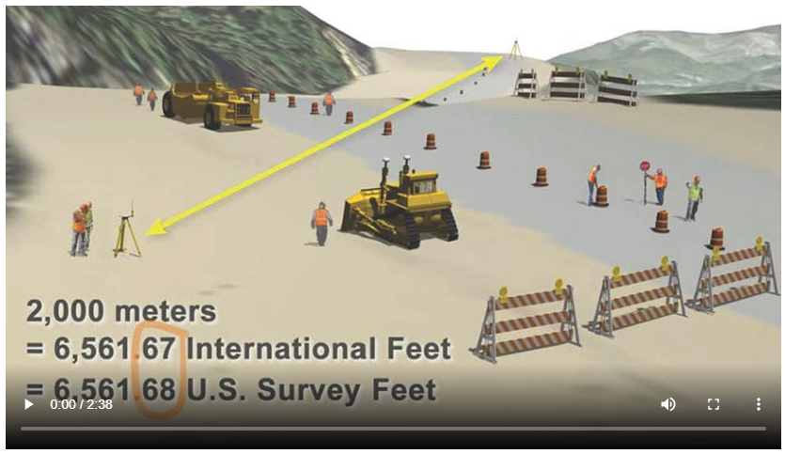
ENDING THE ERA OF THE U.S. SURVEY FOOT (1959 TO 2022)
Additional Resources
https://oceanservice.noaa.gov/geodesy/international-foot.html
https://content.govdelivery.com/accounts/USNOAANOS/bulletins/2618240
https://www.nist.gov/pml/us-surveyfoot/resources
How much is the change?

Slide 42
Agenda Item 14
Announcements or other business

Slide 43
Adjourn
Next meeting is Wednesday, March 11, 2020

