Slide 1



Minnesota Geospatial Advisory Council
May 26, 2021

Slide 2
Welcome
Introductions
Approve agenda
Approve March minutes

Slide 3
Agenda
Time | Topic
10:00 | Welcome, introductions, approve previous minutes
10:10 | Committee reports – Review and accept
10:15 | GAC appointments for next term – Process update
10:25 | GAC leadership transition plan
10:35 | GAC web presence
10:50 | NAIP update
10:55 | Break
11:00 | Low distortion projection update
11:15 | Legislative update
11:25 | GAC priority projects and initiatives updates
11:45 | Announcements
noon | Adjourn

Slide 4
Agenda Item 2
Committee Reports – Review and Accept
All

Slide 5
Agenda Item 3
GAC Appointments for Next Term – Process Update
Mark Kotz, Dan Ross

Slide 6
GAC Appointments for Next Term
Applications received for all sectors except the following, for which recruiting continues:
Federal government (1)
Greater Minnesota city
K-12
Nonprofit
Applications will be submitted to Commissioner Tomes, the State of Minnesota’s CIO
The Commissioner will make the final appointments
Dan Ross will notify all applicants

Slide 7
Agenda Item 4
GAC Leadership Transition Plan
Mark Kotz

Slide 8
Leadership Transition
Very similar to 2019
Kotz stepping down from GAC
Vice Chair Richter assumes Acting Chair for first meeting (September)
Reappointed members of Leadership Team remain for first meeting
At 2nd meeting (December), elect new Chair and Vice Chair, select members for Leadership Team

Slide 9
Agenda Item 5
GAC Web Presence
Dan Ross, Cory Richter

Slide 10
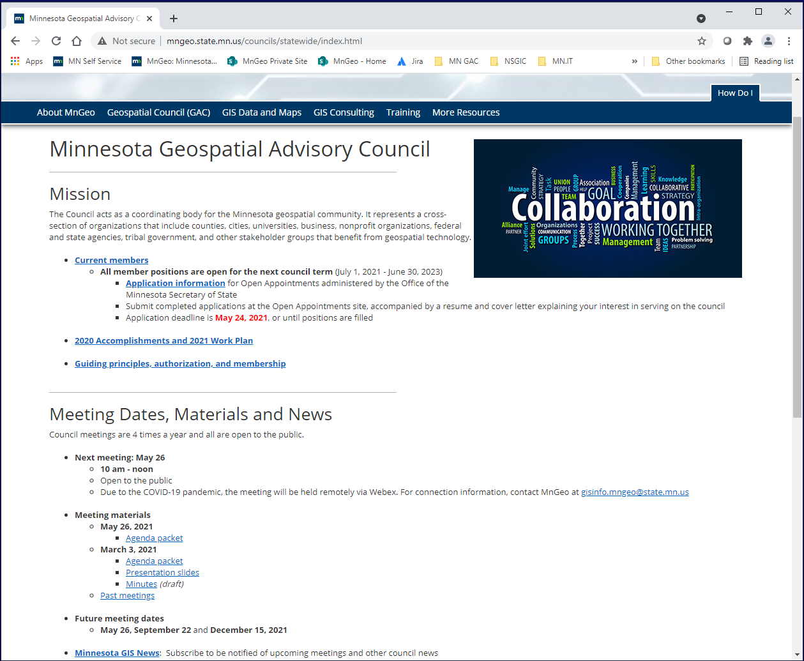
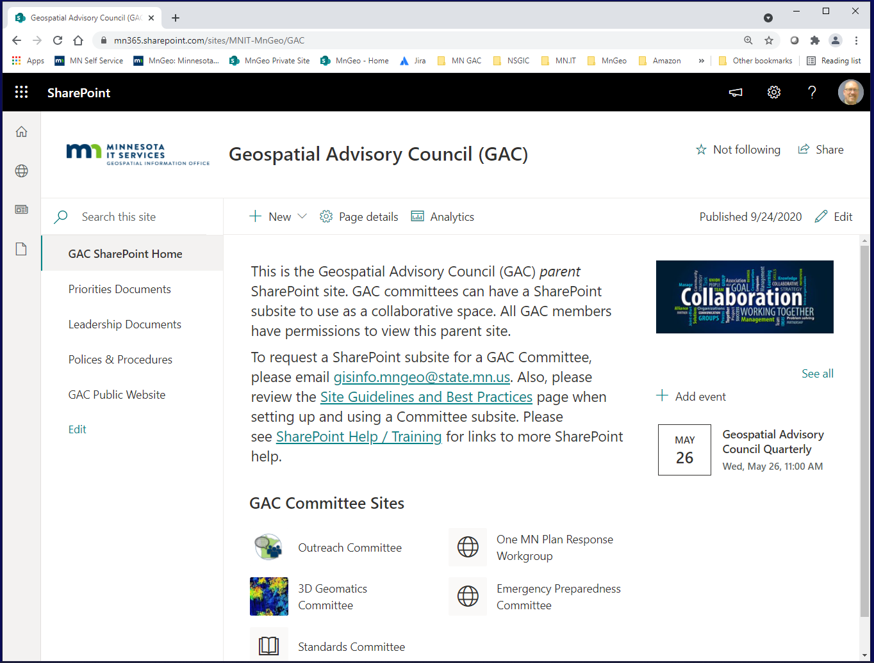
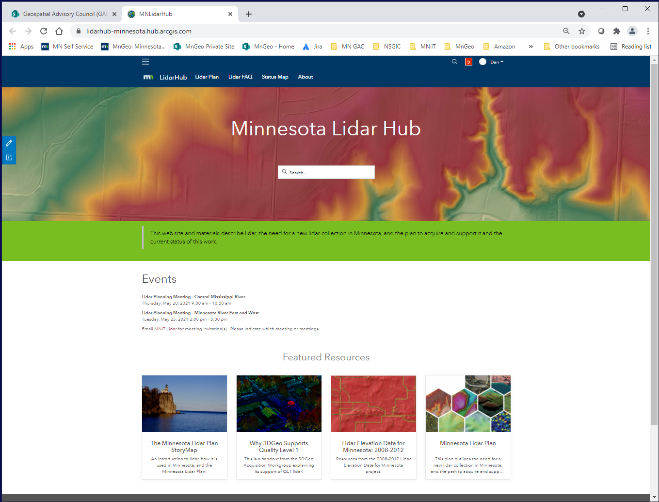
GAC Web Presence
Currently the GAC presents itself on the web in multiple ways
Web Pages – 2 public sites
MnGeo and EPC
SharePoint – collaboration and document sharing
New Esri Hub site – 3DGeo
Outreach started a Hub through MN GIS/LIS and would transfer content
Other Committees are also interested in a Hub site

Slide 11
GAC Web Presence - Proposal
Suggestion – bring the GAC web presence together under one new web presence
The single presence would allow for
One place to go for the GAC materials
Easier management of the site
Common branding
Site could include
Ability to have multiple initiatives under the site (e.g., Committees)
Content
Events
Priority survey
Maps
Charts and dashboards
Videos?
Ability for GAC and Committee to edit content

Slide 12
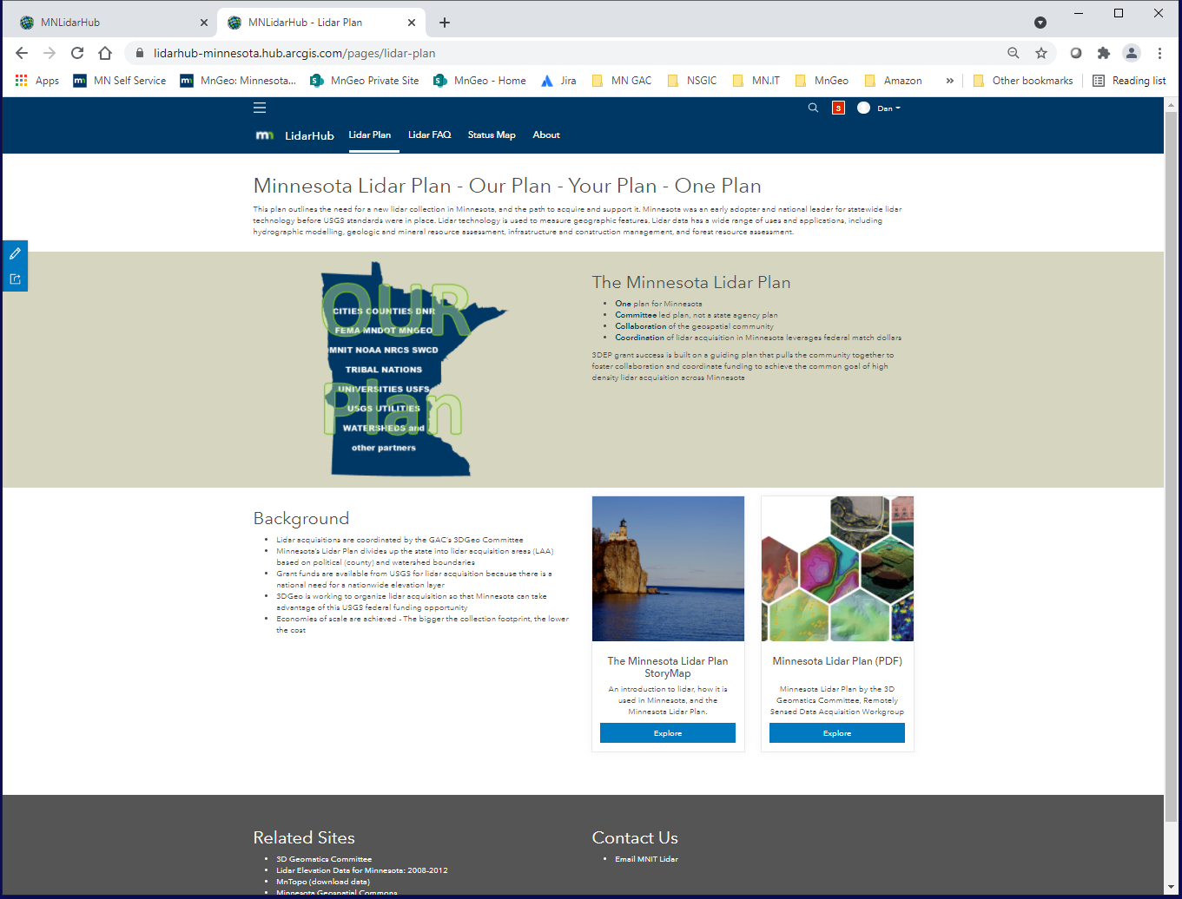
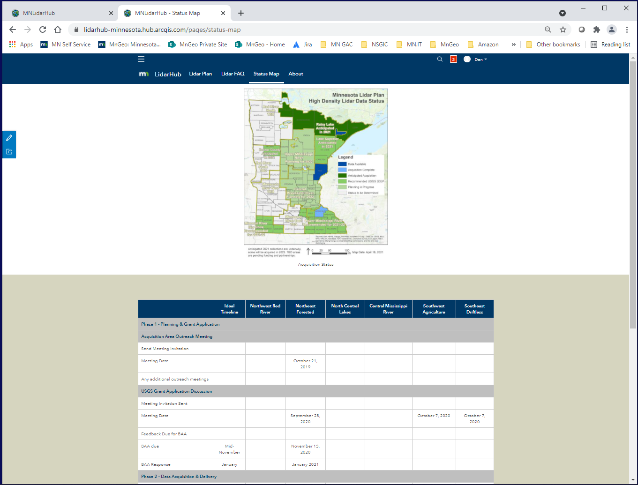
GAC Web Presence – Proposed Solution Discussion
Two sites
Esri Hub Site for public sharing
Multiple initiatives within to represent the work of GAC and committees, workgroups, outreach
Multiple content editors
SharePoint for Collaboration
MnGeo will assign a BA to work with a small group of GAC and Committee representatives to gather requirements
Slowly migrate existing sites to new site – start with 3DGeo

Slide 13
Agenda Item 6
NAIP Update
Jeff Bloomquist

Slide 14
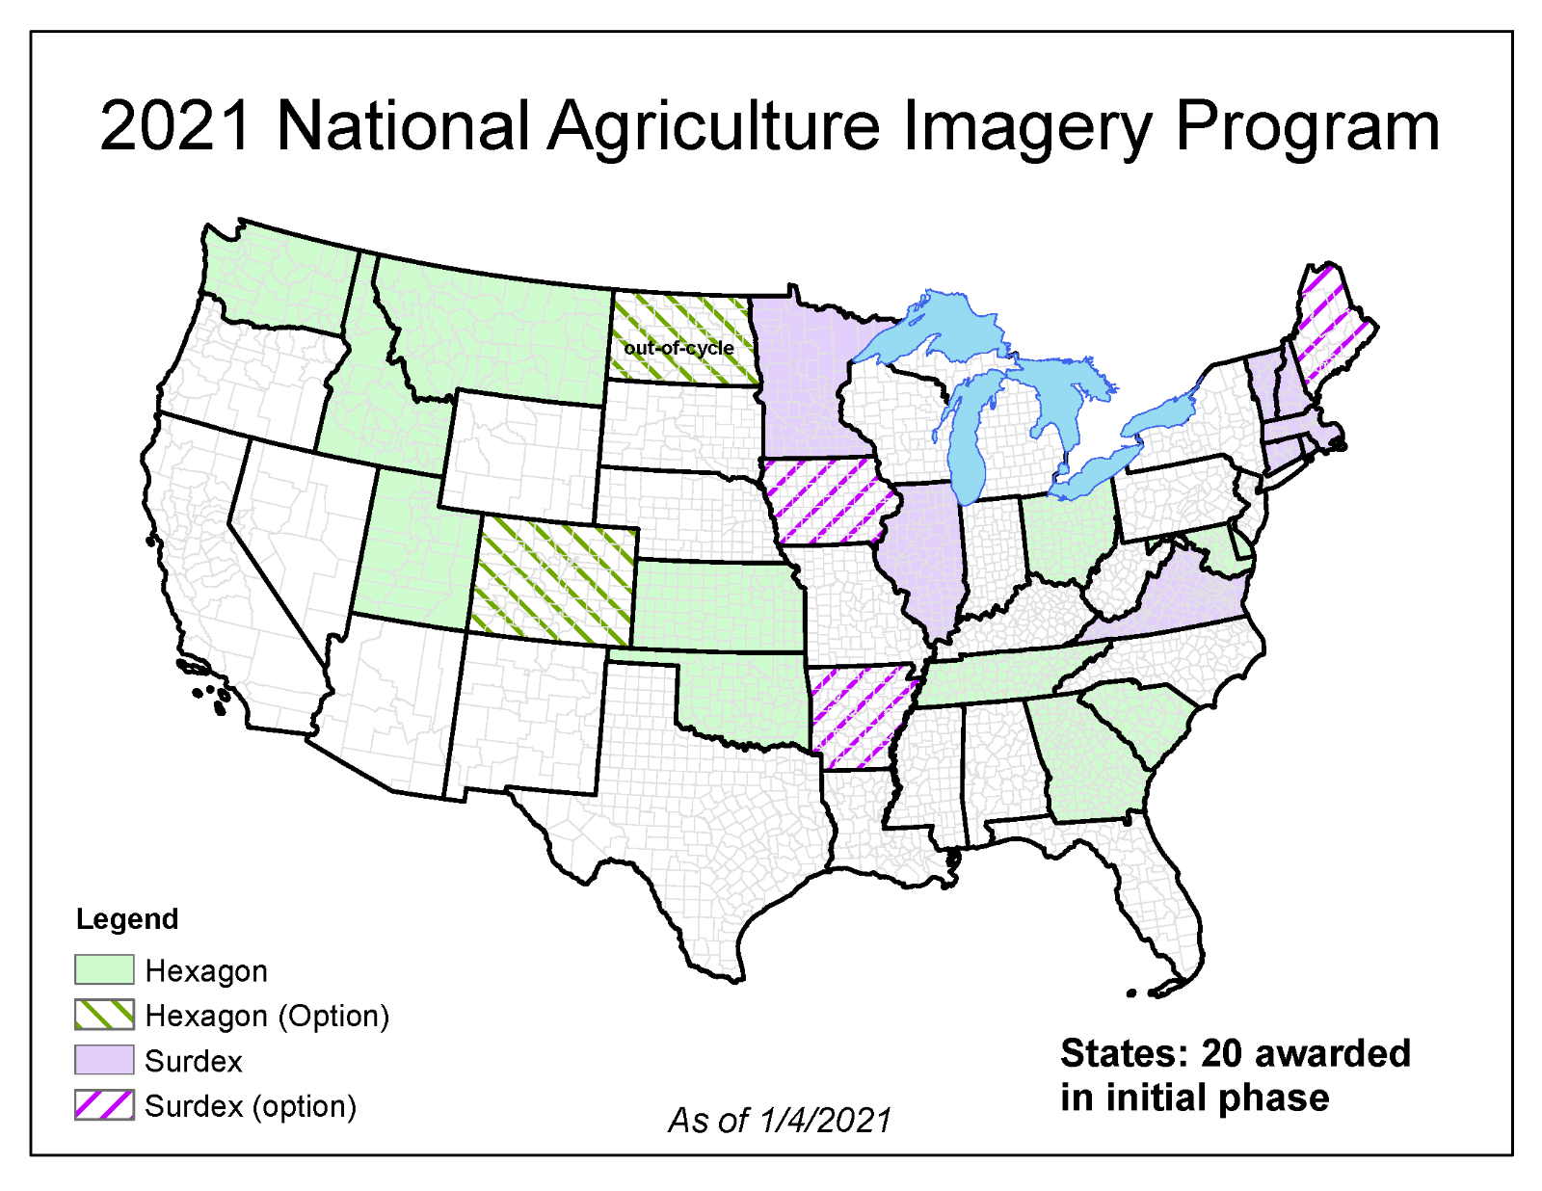
NAIP Update
https://naip-usdaonline.hub.arcgis.com/

Slide 15

Break

Slide 16
Agenda Item 8
Low Distortion Projection Update
Geoff Bitner

Slide 17
Agenda Item 9
Legislative Update
Dan Ross
Budget Requests
Survey Coordinator
Lidar Funding

Slide 18
Agenda Item 10
Updates on GAC Priority Projects and Initiatives
Cory Richter

Slide 19
Updates on GAC Priority Projects and Initiatives
Most recent success
Experiencing a barrier?
Next task

Slide 20
GAC Priorities
Project or Initiative Description | Status | Project Owner | Champion
Parcel Data | Active | Alison Slaats | Mark Kotz
Updated and Aligned Boundary Data | Active | Preston Dowell | Dan Ross
Remonumentation of Section Corners | Active | Pat Veraguth | Dan Ross
New Lidar Acquisition | Active | Gerry Sjerven | Dan Ross
Accurate Hydro-DEMs | Active | Sean Vaughn | many
Culvert Data Standard | Active | Rick Moore | Jonathan Lord
Road Centerline Data | Active | MnGeo | Dan Ross
Address Points Data | Active | MnGeo | Dan Ross
Underground Utilities Data | Active | Steve Swazee | Barb Cedarberg
Critical Infrastructure Data | Active | Stacey Stark | Steve Swazee
U.S. National Grid Materials | Active | Randy Knippel | Randy Knippel

Slide 21
GAC Priorities
Project or Initiative Description | Status | Project Owner | Champion
Image Service Improvements | Active | Alison Slaats | Dan Ross
Trails Data Standard | Active | Sandra Yassin
Archiving Implementation | Active | Ryan Mattke | many
Success Stories for Geospatial Technology | Active
Geospatial Commons Advisory Group | Inactive
NG911 Forum | Inactive
Basemap Services | Inactive
Parks Data Standard | Inactive
Optical, Lidar, Radar, Aerial and Satellite Imagery Strategy | Inactive
High-res Climate Projection Data | Inactive
Criminal Justice Info Best Practices | Inactive

Slide 22
GAC Priorities
Project or Initiative Description | Status | Project Owner | Champion
Licensed Businesses Data | Inactive
Snow Emergency Parking Restriction Data | Inactive
Geospatial Data Asset Inventory | Inactive
Property Crimes Data | Inactive
Street Parking Restrictions Data Standard | Inactive

Slide 23
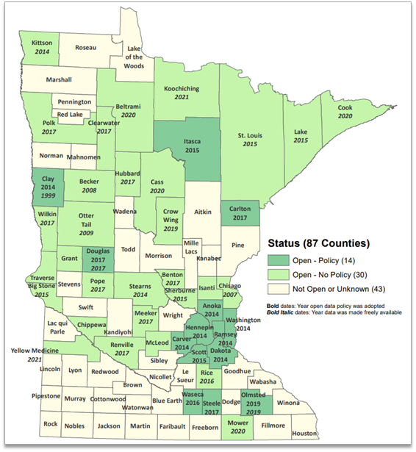

Status of Free and Open Data Public Geospatial Data
Status | Number of Counties | Total
Open - Policy | 14 | 44
Open - No Policy | 30
Not Open or Unknown | 43 | 43

Slide 24
Statewide publicly available parcel data
Most recent success:
First meeting of the Open Data Parcel subcommittee (Parcels and Land Records Committee) was held in April
If you are experiencing a barrier:
none
Next task:
Subcommittee tasks will be defined to work towards sharing parcel data publicly for open data counties
Next Open Data Parcel subcommittee meeting set for June 7

Slide 25
Updated and aligned boundary data
Most recent success:
Established a Boundary Alignment Subcommittee. Initiated pilot project for Arrowhead region.
If you are experiencing a barrier:
None
Next Task:
Write definition of Boundary Alignment. Work with Arrowhead on Pilot Project.

Slide 26
Remonumentation of all section corners
Most recent success:
Parcels and Land Records Committee established three subcommittees:
Open-Data Parcel
Boundary Alignment
Remonumentation Legislation
If you are experiencing a barrier:
Funding and Support!
Next task:
We are working on a Remonumentation Plan and a legislative proposal for Remonumentation

Slide 27
New Lidar Acquisition
Most recent success:
Successful grants for NE MN and Southern MN
If you are experiencing a barrier:
Challenges but not barriers
Next task:
Completion of Joint Funding Agreements with each funding partner and completion of Task Order for each acquisition

Slide 28
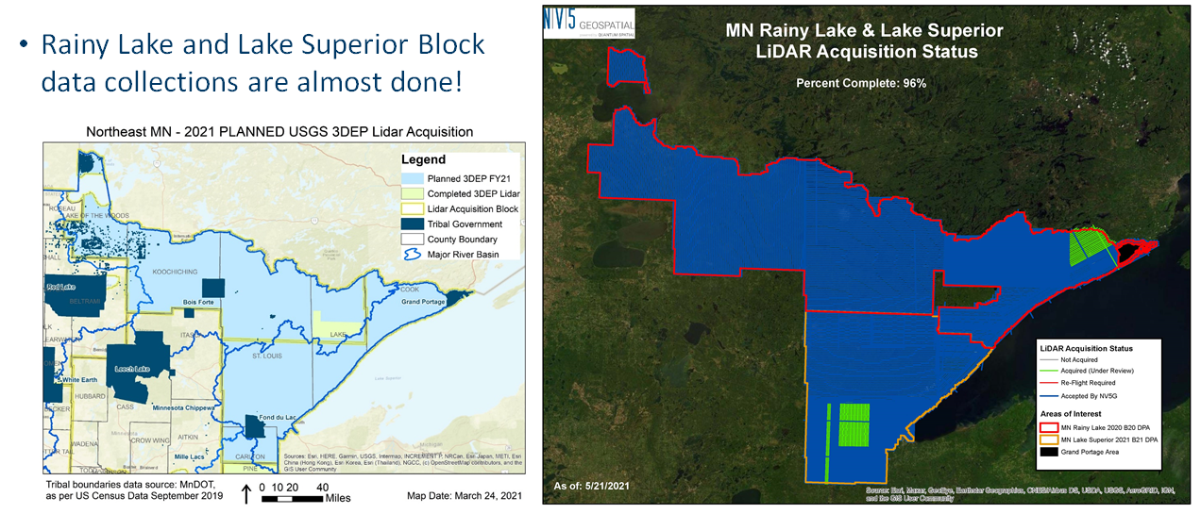
New Lidar Acquisition

Slide 29
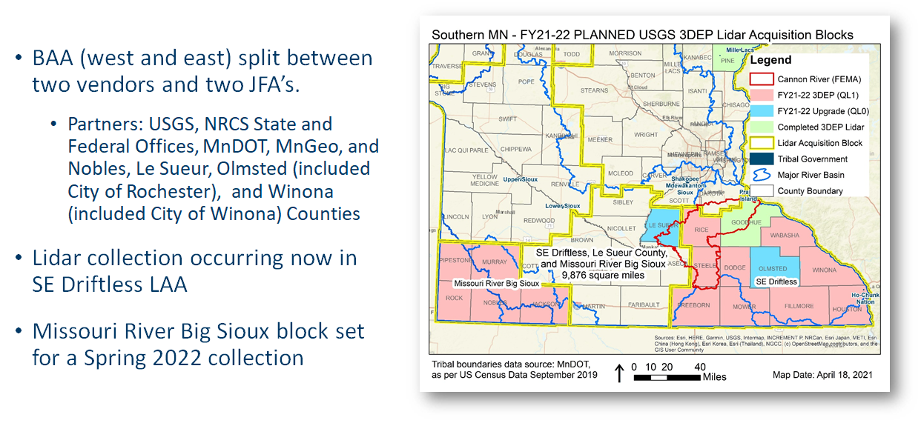
New Lidar Acquisition

Slide 30
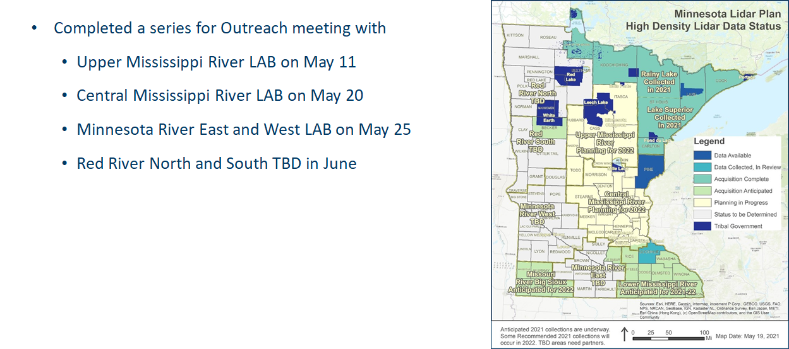
New Lidar Acquisition

Slide 31
Accurate hydro-DEMs (hDEM) that serve modern flood modeling and hydro-terrain analysis tools, and the development of more accurate watercourses and watersheds
Most recent success
If you are experiencing a barrier
Next task

Slide 32
Development of a culvert data standard for data sharing across the geospatial and infrastructure asset management communities
Most recent success
If you are experiencing a barrier
Next task

Slide 33
Road Centerline Data
Most recent success:
Internal statewide aggregation of road centerlines with address ranges to the NG911 data model
If you are experiencing a barrier:
Challenges but not barriers
Next task:
Snapping across county boundaries

Slide 34
Address Points Data
Most recent success:
Statewide aggregation of address points to the NG911 data model
If you are experiencing a barrier:
Challenges but not barriers – not currently available to provide to the public
Next task:
Statewide aggregation of updated data from authoritative sources to the GAC standard

Slide 35
A project team to develop geospatial data sharing methodologies to support the state’s underground utilities community
Most recent success
If you are experiencing a barrier
Next task

Slide 36
Establish a workflow for developing, sharing and maintaining statewide, publicly available, authoritative geospatial data for primary critical infrastructure themes
Most recent success
Established a diverse and engaged workgroup with the right experience to make meaningful progress
2 full meetings, 1 subgroup meeting
(credit all to Mike Dolbow, MDE!) Public school buildings published to MN GeoCommons
If you are experiencing a barrier
none
Next task
Narrow in on requirements to get police and fire published to the MN GeoCommons
Consolidate best available law enforcement and fire (from various verified data sources)

Slide 37
Maps, procedures, templates and other materials to help all levels of government implement the U.S. National Grid
Most recent success
If you are experiencing a barrier
Next task

Slide 38
Improvements to the MnGeo Image Service, such as Web Mercator support, tiling, and complementary options such as “composite of latest leaf off imagery”, and downloading options
Most recent success:
Update of image service with Beltrami County 2020 color and cir aerial photography
If you are experiencing a barrier:
none
Next task:
Follow up on recommendations of Image Service Sustainability Committee to add and retire some image layers.

Slide 39
A trails data standard
Most recent success
If you are experiencing a barrier
Next task

Slide 40
The implementation of an archive for Minnesota geospatial data
Next phase starting soon

Slide 41
Agenda Item 11
Announcements

Slide 42

Thank you, Mark!

Slide 43
Next Meeting
September 29*, 2021
(*date changed to the 29th after the meeting)

