Slide 1



Minnesota Geospatial Advisory Council
December 15, 2021

Slide 2
Welcome
Introductions
Approve agenda
Approve September minutes

Slide 3
Introductions
City, Twin Cities metro
  Cory Richter, City of Blaine
City, Greater Minnesota
  Shawn Strong, City of Brainerd
County, Twin Cities metro
  Victoria Reinhardt, Ramsey County
County, Greater Minnesota
  Patrick Veraguth, Douglas County
Regional government, Twin Cities metro
  Matt McGuire, Met Council
Regional government, Greater Minnesota
  vacant
State agencies
  Kari Geurts, DNR
  Ben Timerson, MnDOT
Federal government
  Jeff Bloomquist, Risk Management Agency, USDA
  Vacant
Tribal government
  Ryan Bonney, Shakopee Mdewakanton Sioux Community
Non-profit organizations
  vacant
Business
  Kendis Scharenbroich, Pro-West & Associates
  Gerry Sjerven, Minnesota Power
Higher Education
  Len Kne, U-Spatial / UMN Twin Cities
  Stacey Stark, U-Spatial / UMN Duluth
K-12 Education
  vacant
MetroGIS
  David Brandt, Washington County
MN GIS/LIS Consortium
  Leanne Knott, City of Red Wing
Surveyor
  Chris Mavis, Hennepin County
At-large
  Alex Steele, Minnehaha Creek Watershed District
  Heather Bergen-Albrecht, Hennepin County
  Britta Maddox, Anoka County
1 Chief Geospatial Information Officer (ex-officio)
  Dan Ross, MnGeo

Slide 4
Agenda
Time | Topic |  | Time | Topic
10:00 | Introductions, approve agenda and previous minutes |  | 11:00 | 2022 Priority Projects survey
10:10 | Committee reports – Review and accept |  | 11:15 | Higher Education sector report
10:15 | Confirm GAC leadership team |  | 11:25 | Legislative Update
10:20 | GIO Update |  | 11:30 | GAC priority projects and initiatives updates
10:25 | UUMPT Update |  | 11:45 | Announcements
10:30 | Open parcel data subcommittee update |  | noon
10:40 | GAC Hub
10:50 10:55 | Lidar update Break

Slide 5
Agenda Item 2
Committee Reports – Review and Accept
All

Slide 6
Agenda Item 3
Confirm GAC Leadership
Cory Richter

Slide 7
Confirm GAC Leadership
Cory Richter, Chair
David Brandt, Vice Chair
Jeff Bloomquist
Len Kne
Chris Mavis
Victoria Reinhardt
Kendis Scharenbroich
Gerry Sjerven

Slide 8
Agenda Item 4
GIO Update
Dan Ross
Thank you!
Last day
Hiring process for a new fulltime leader is moving

Slide 9
Agenda Item 5
UUMPT Update – Clean Water Council Policy Statement
Steve Swazee

Slide 10
Agenda Item 6
Open parcel data subcommittee update
Chad Martini

Slide 11
Agenda Item 6
Statewide Publicly Available Parcel Dataset
Open Parcel Data Subcommittee
Parcels and Land Records Committee

Slide 12
Open Parcel Data Subcommittee
Open Parcel Data Subcommittee created a survey that was sent out 12/3/21 asking counties if they are willing to participate in a publicly available parcel dataset. Responses needed to be collected by 12/13/21 to be included in the first release.
The plan with this survey is to create a mechanism that allows the GAC to advise MnGeo on which counties are open to being part of a statewide parcel dataset.
Once the GAC reviews the results from the survey, the Parcels and Land Records Committee is making a recommendation that the GAC inform MnGeo of the results which will allow them to start creating a statewide dataset.

Slide 13
Survey Questions
The survey asked 8 questions
  County Name
  Who/What departments are involved in order to export updates to MnGeo
  What is your process for exporting parcel data for MnGeo to consume
  Do you provide all data required in the GAC Parcel Standard
  Is there data you want to include but not sure how to include it
  Is your county an Open Data County
  If your county is an Open Data County, are you ok with the GAC Parcels and Land Records Committee advising MnGeo to publicly publish your parcel data in a public Regional or Statewide dataset? (Note that answering yes means that this will supersede any data agreements your county has previously signed with MnGeo.)
  Do you proactively share spatial data with your jurisdictional neighbors?

Slide 14
Survey Results
42 of 87 Counties responded (as of 12/15)
26 of 87 Counties said they were an Open Data County (as of 12/15)
24 of 87 Counties said Yes they want their parcels in the statewide dataset (as of 12/15)
The 2 Maybes need further discussion.
  Aitkin, Anoka, Benton, Carlton, Chisago, Clay, Cook, Crow Wing, Dakota, Hennepin, Isanti, Itasca, Koochiching, Marshall, Mower, Norman, Polk, Rice, Saint Louis, Sherburne, Stearns, Traverse, Waseca, Washington
The next survey will go out near the end of the 1st quarter in 2022 seeing if any additional counties will be joining the statewide dataset.
We understand that there will be holes in the data as not all counties are willing to participate. We feel over time those counties will join.

Slide 15
Recommendation
Parcels and Land Records Committee would like to recommend that the GAC advise MnGeo about the survey results on which counties would like to participate in a statewide publicly available parcel dataset.

Slide 16
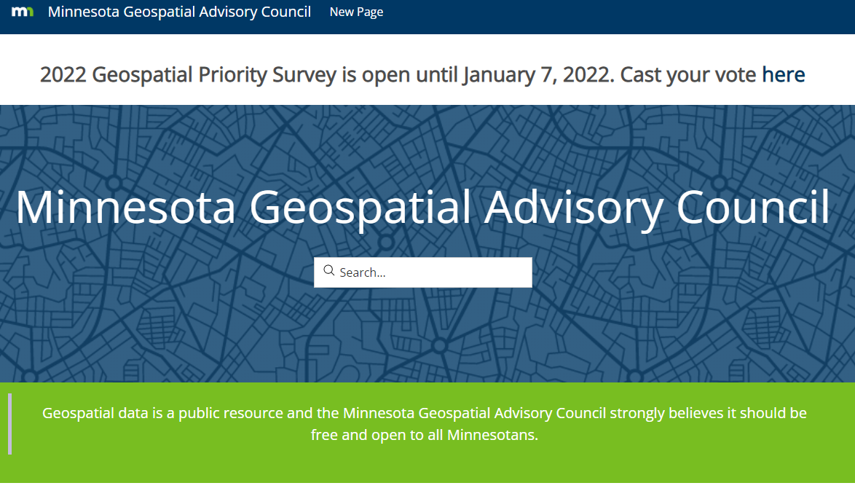
Agenda Item 7
GAC Hub
Cory Richter, Alison Slaats

Slide 17
GAC Hub
Next Steps
Workflow documentation and editor guidelines
Meet with the Hub ad-hoc team to discuss workflows and editing, revise as needed
Have committees select editors
Hold training and answer questions for editors and content approvers
Set up 'hackathons' to collaborate and work on content

Slide 18
Lidar Update – Agenda Item 8
Sean Vaughn, GIS Hydrologist | Lidar Data Steward, MNIT DNR, Co-Chair 3D Geomatics Committee, Acquisition Workgroup Champion
Gerry Sjerven, Senior GIS Analyst, Minnesota Power, Co-Chair 3D Geomatics Committee, Acquisition Workgroup Champion
Lidar Acquisition Subgroup:
Alison Slaats (MnGeo), Sean Vaughn (MNIT DNR), Gerry Sjerven (MN Power), Dan Ross (MnGeo), Jennifer Corcoran (DNR), Colin Lee (MnDOT), Matt Baltes (NRCS), Joel Nelson (U of MN), Joe Sapletal (Dakota Co), Mark Reineke (Widseth), Brandon Krumwiede (NOAA), Jeff Weiss (DNR), and Terry Zien (USACE).
Notes:
Gerry - Intro

Slide 19
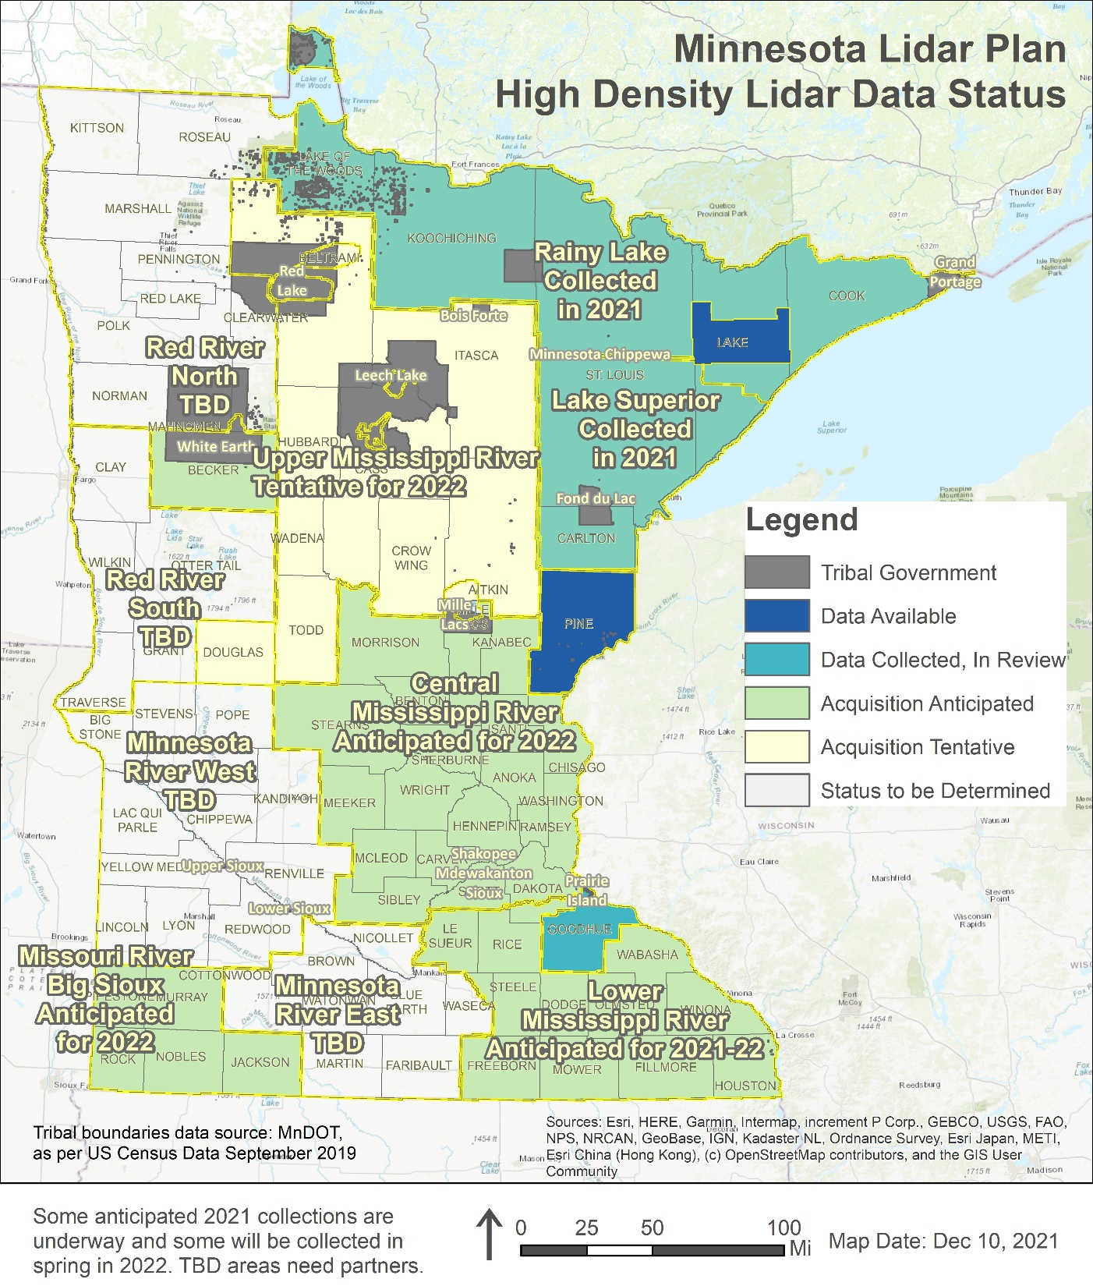
MN Lidar Status Map
Lake County area collected in 2018, data publicly available
Pine County collected in 2019, data publicly available
Goodhue County collected in 2020, data in review
Rainy Lake and Lake Superior collected in 2021, data delivery by April 2022
SE, SW funded, data partially collected in SE in 2021, remaining in 2022, data delivery expected in 2023
Central Mississippi 3DEP application accepted, collection anticipated in 2022, data delivery in 2023
Upper Mississippi 3DEP application tentative, collection proposed for 2022, data delivery in 2023
Douglas County 3DEP application accepted, collection anticipated in 2022, data delivery in 2023

Slide 20
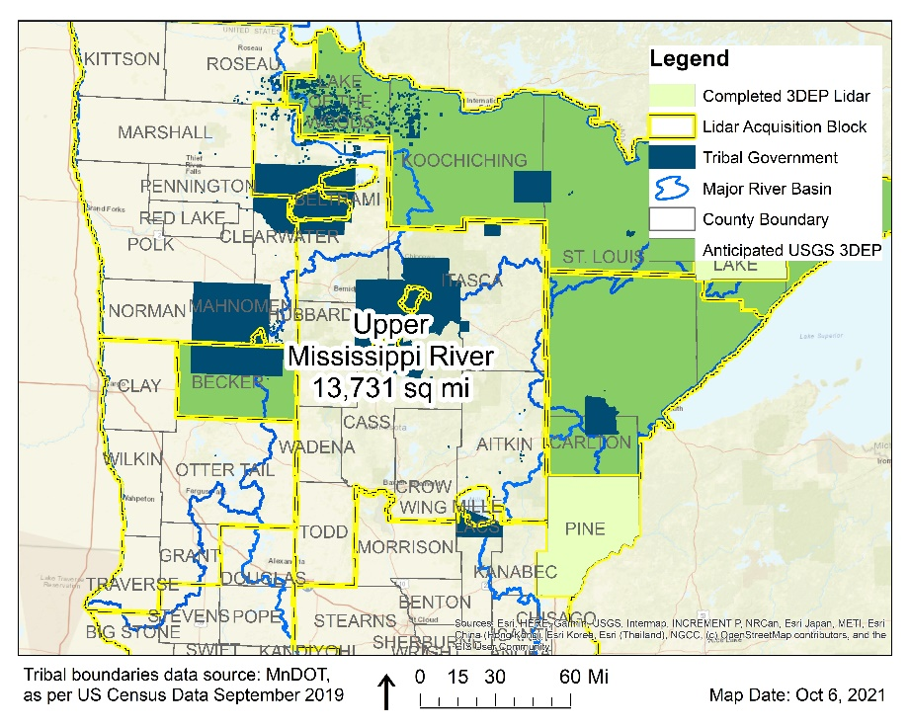
Lidar funding proposal for Upper Mississippi LAB
Total cost: $4,450,903.65
14 partners
Funds raised: $ 1,276,736 (26%)
Funds requested: $ 3,246,435 (74%)
Number | Partner | Contribution
1 | Aitkin County | $ 50,000.00
2 | Beltrami County | $ 15,000.00
3 | Beltrami SWCD | $ 1,500.00
4 | Cass County | $ 100,000.00
5 | Cass County SWCD | $ 25,000.00
6 | Crow Wing County | $ 10,000.00
7 | Hubbard County | $ 50,000.00
8 | Itasca County | $ 100,000.00
9 | MnGeo | $ 7,500.00
10 | Leech Lake Band of Ojibwe | $ 32,736.00
11 | NRCS State | $ 500,000.00
12 | MnDOT | $ 20,000.00
13 | MN DNR | $ 315,000.00
14 | USFS Chippewa NF | $ 50,000.00
 | Total | $ 1,286,736.00

Slide 21
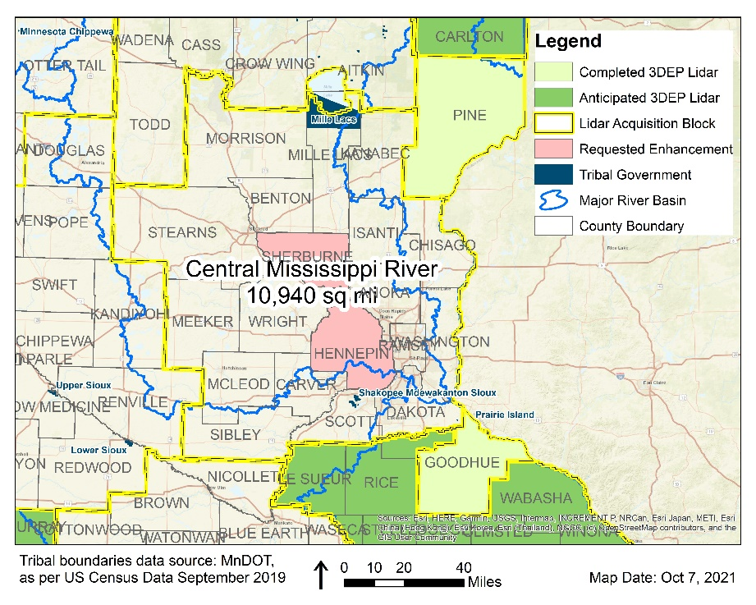
Lidar funding proposal for Central Mississippi LAB
Total cost: $3,779,549
20 partners
Funds raised: $1,580,685 (36%)
Funds requested: $2,288,337 (64%)
Number | Partner | Contribution
1 | Anoka County | $ 58,000.00
2 | Carver County | $ 60,000.00
3 | Chisago County | $ 57,816.00
4 | Dakota County | $ 58,000.00
5 | Hennepin County | $ 165,000.00
6 | Isanti County | $ 57,816.00
7 | McLeod County | $ 57,000.00
8 | Morrison County SWCD | $ 50,000.00
9 | Ramsey County | $ 57,000.00
10 | Scott County | $ 58,000.00
11 | Sherburne County | $ 136,737.00
12 | Sibley County | $ 65,000.00
13 | Washington County | $ 58,000.00
14 | Wright County | $ 57,816.00
15 | LOGIS | $ 5,000.00
16 | MetroGIS | $ 22,000.00
17 | NRCS State | $ 500,000.00
18 | MnDOT | $ 20,000.00
19 | MNDNR | $ 30,000.00
20 | MnGeo | $ 7,500.00
 | Total | $ 1,580,685.00

Slide 22
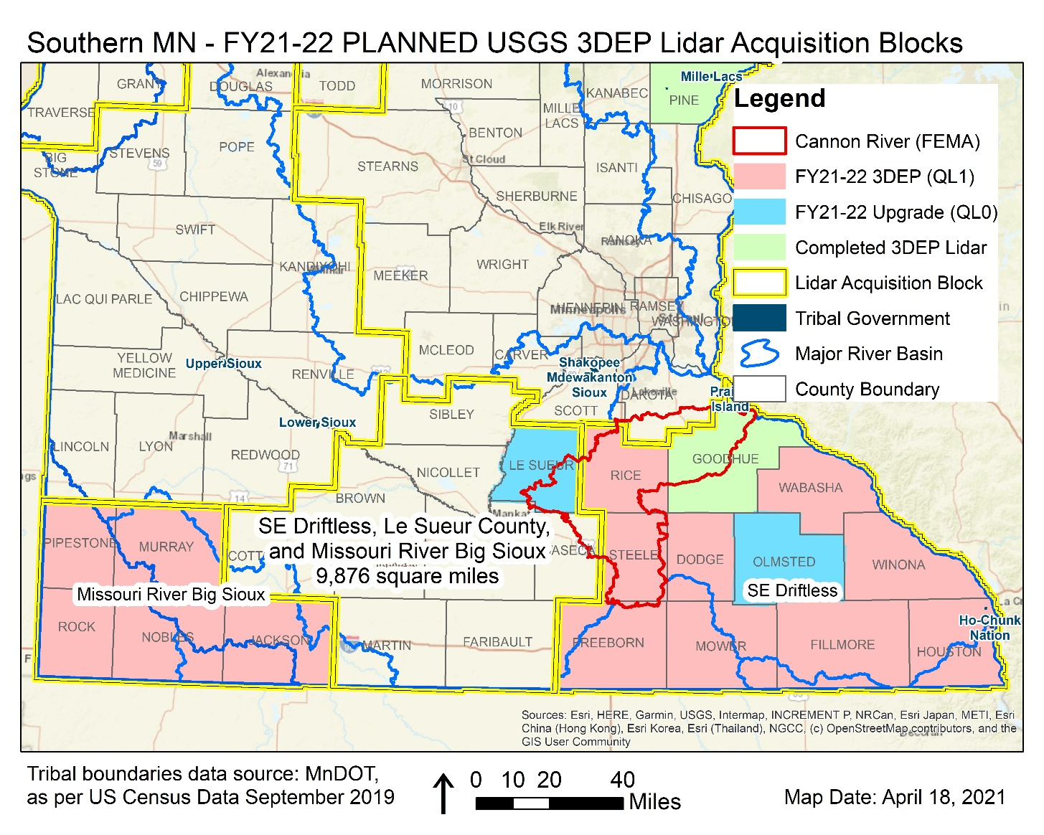
Lidar Acquisition: Southern BAA – Missouri Big Sioux & SE Driftless Blocks
Much of the SE Driftless LAA was collected, data is under vendor review.
  Pilot dataset has been sent to USGS for review
  Additional dataset will be sent for 3D Geomatics review
  Data delivery in April 2022
  Planning underway to collect remaining areas in 2022
Missouri River Big Sioux block set for a Spring 2022 collection

Slide 23
Lidar funding summary for NE & SE, SW
Project Name | Minnesota Partners | USGS | Other Federal | Total | Square Miles
Lake Superior Block | $ 515,000.00 | $ 1,271,455.72 |  | $ 1,786,455.72 | 5020
SE Region + Cannon River Extension (FEMA) | $ 1,025,193.32 | $ 1,427,487.83 | $427,738.67 | $ 2,880,419.82 | 6965
SW Region | $ 355,626.26 | $ 657,342.09 |  | $ 1,012,968.35 | 3115
Rainy Lake + Rainy Lake Extension (USGS + NRCS) | $ 1,253,560.58 | $ 2,819,057.00 | $20,000.00 | $ 4,092,617.58 | 9291
Total Contributions | $ 3,149,380.16 | $ 6,175,342.64 | $ 447,738.67 | $ 9,772,461.47 | 26734
Total Percentage Contributions | 32% | 63% | 5%

Slide 24

Break

Slide 25

Agenda Item 10
2022 Priority Projects survey
David Brandt, Cory Richter
Opens:
December 21, 2021
Closes:
January 7, 2022

Slide 26
Agenda Item 11
Higher Education Sector Report
Len Kne, Stacey Stark

Slide 27
U-Spatial
Minnesota Geospatial Advisory Council Meeting
December 15, 2021

Slide 28
About Us
Mission
To serve and drive the fast-growing need across the University for expertise, data, and tools related to Geographic Information Systems (GIS), remote sensing, and spatial computing.
Long Range Vision
To be at the nexus of the world’s first “Spatial University” and demonstrate what is possible with spatial thinking.
Organization
Office of Vice President for Research (OVPR) >> Research Computing (MSI, UMII, U-Spatial)
Our offices are on two campuses (Duluth, Minneapolis) - we serve the entire UMN system
UMN Fun Fact
Over $1 billion in research expenditures in FY21

Slide 29
About Us
Kate Carlson
Spatial Technology Consultant, Twin Cities
Shana Crosson
Spatial Technology Consultant, Twin Cities
Marylee Murphy
GIS Specialist, Duluth
Steve Graham
Research Associate, Duluth
Melinda Kernik
Spatial Data Analyst & Curator, Twin Cities
Current Research Assistants
Katie Hauer, Duluth
Cecelia Isaac, Twin Cities
Ryan Kizewski, Duluth
Andrew Smith, Duluth
Ziwei Zhang, Twin Cities
Len Kne
Director, Twin Cities
Jane Lindelof
Project Coordinator, Duluth
Stacey Stark
Associate Director, Duluth
Zachary Vavra
GIS Specialist, Duluth
Pete Wiringa
Computing Geospatial Analyst, Twin Cities
Hiring 2 developers

Slide 30
Former U-Spatial RAs
Kris Johnson (2011-14), Twin Cities
Lucas Winzenburg (2012-17), Twin Cities
Molly McDonald (2012-14), Twin Cities
Taylor Long (2013-15), Twin Cities
Yingbin (Ben) Liang (2013-15), Twin Cities
Yilun (Allen) Lin (2013-15), Twin Cities
Agata Miszczyk (2013-15), Twin Cities
Yiqun (Ian) Xie( 2013-15), Twin Cities
Corey Betchwars (2014), Twin Cities
Steve Peyton (2015-16), Twin Cities
Teran Smith (2015-16), Twin Cities
Katie Stinebaugh (2015-17), Twin Cities
Rebecca Barney (2015-18), Twin Cities
Jacob Hartle (2015-18), Twin Cities
Coleman Shepard (2015-18), Twin Cities
Brittany Krzyzanowski (2015-19), Twin Cities
Sharvari Sangle (2016), Twin Cities
Steve Schmidt (2016), Twin Cities
Dan Cahoun (2016), Duluth
Britta Hardel (2016), Duluth
Amanda Huber (2016), Duluth
Kyle Seifert (2016), Duluth
Gerrit VanderWaal (2016), Duluth
Josh Donato (2016-17), Twin Cities
Grace Johnson (2016-17), Twin Cities
Jeff Kropelnicki (2016-17), Twin Cities
Alex Nelson (2017), Duluth
Pam Potempa-Rivers (2017), Twin Cities
Jacob Arndt (2016-18), Twin Cities
Jacqueline Cassman (2017-18), Twin Cities
Arie Peterson (2017-18), Twin Cities
Ya Tao (2018), Twin Cities
Morgan Larson (2018), Duluth
Siona Roberts (2018), Duluth
Paul Jacobs (2018-19) Twin Cities
Han Bao (2018-19), Twin Cities
Jiateng Xu (2018-19), Twin Cities
Nels Anderson (2019), Duluth
Sophia Green (2019), Duluth
Sam Winters-Smith (2019), Twin Cities
John Zymslony (2019), Duluth
Micaella Penning (2010-20)
Anders Hopkins (2020)
Travis Ormsby (2019-20)
Avian Ciganko-Ford (2019-20)
Luke Henry (2019-20)
Christopher Saladin (2018-20), Twin Cities
Adam Null (2019-20), Twin Cities
Roopana Vuppalapati Chenchu (2020-21), Twin Cities
Jacob Moser (2020-21), Twin Cities
Audrey Hyke (2020-21), Twin Cities
Brian Coan (2020-2021)
Caitlyn Dibble (2021)

Slide 31

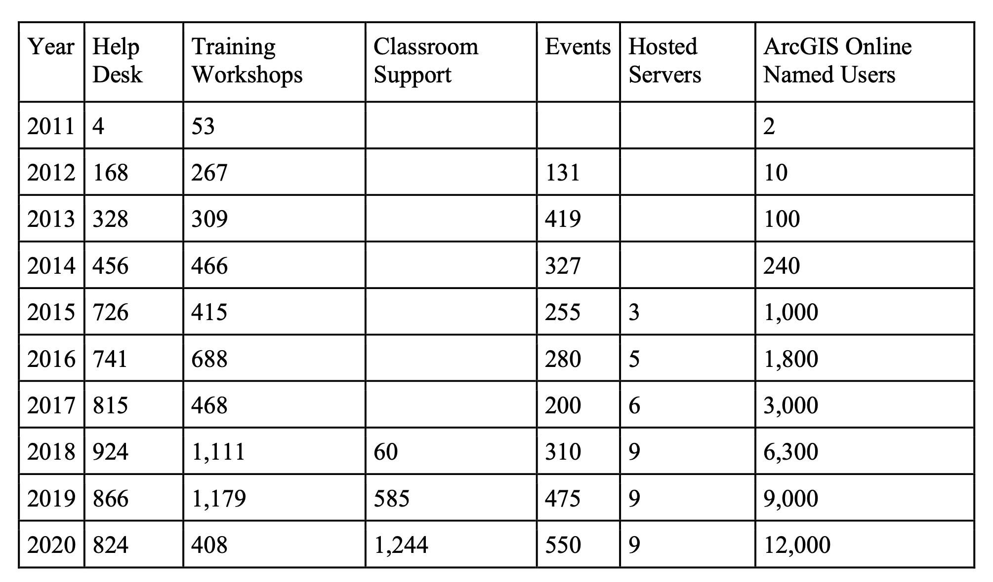


What we do
ArcGIS Online today
named users
maps, apps, layers
Notes:
Plus we have Planet Imagery...

Slide 32
Current Initiatives

Slide 33

https://thespatialuniversity.umn.edu
Notes:
https://thespatialuniversity.umn.edu

Slide 34
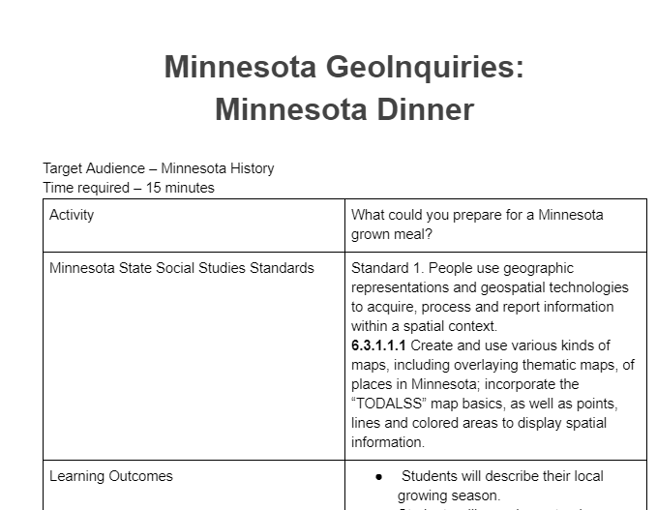
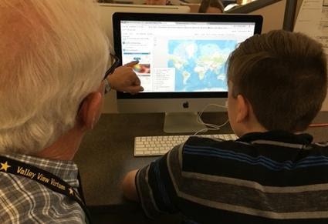
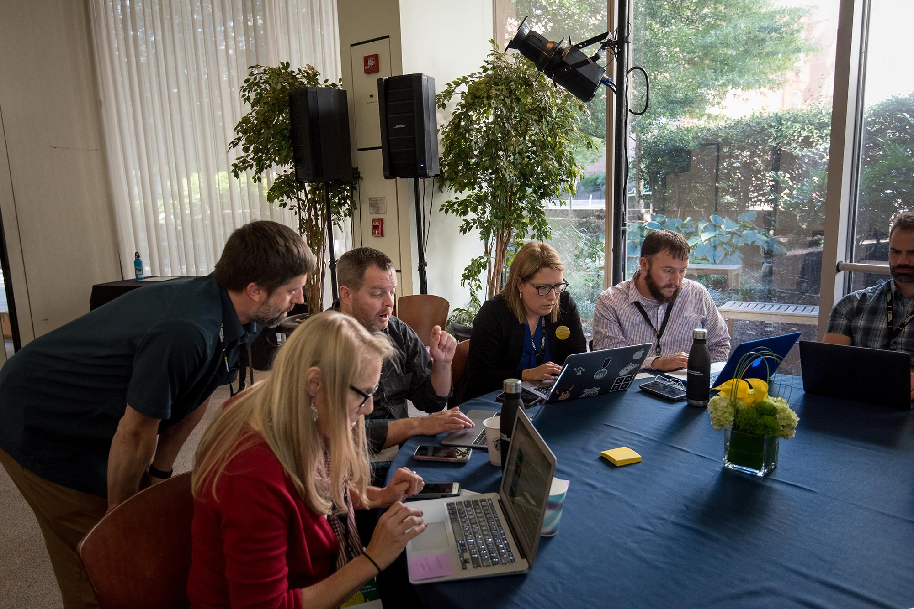

K12 Collaborative
Partnership Activities (MN GIS/LIS Consortium, MAGE, MDE)
UMN connections
Direct teacher support
Grant proposal development
mngiseducation.org
Notes:
mngiseducation.org
Activities -
Include participating in educator day, webinars, conferences
Connections -
Requests from other states WLIA
Representation to MN State
New connections with faculty - Peter Neff 160k followers, Veronica Quillen
New U-Spatial Faculty -
3 significant grant proposals, 1 submitted
GreenBook GeoInquiry
ILTF workshop
NR Atlas (MnSeaGrant)

Slide 35
Project Roundup

Slide 36
2021 Sponsored projects and external sales
> $1.2M active and funded projects
UMN: Medical School, College of Pharmacy, Carlson School,
Labovitz SBE (UMD), NRRI, CFANS
MN Agencies: MDH, DPS, MPCA, MnDOT
> $2.5M proposed projects
includes $370,000 pending in SPA/ external sales now
includes $1.6M NSF proposal PI'd by U-Spatial staff
Another 13 projects proposed / not funded
collaborations for funding LCCMR, USDA, GEMS, NIH

Slide 37
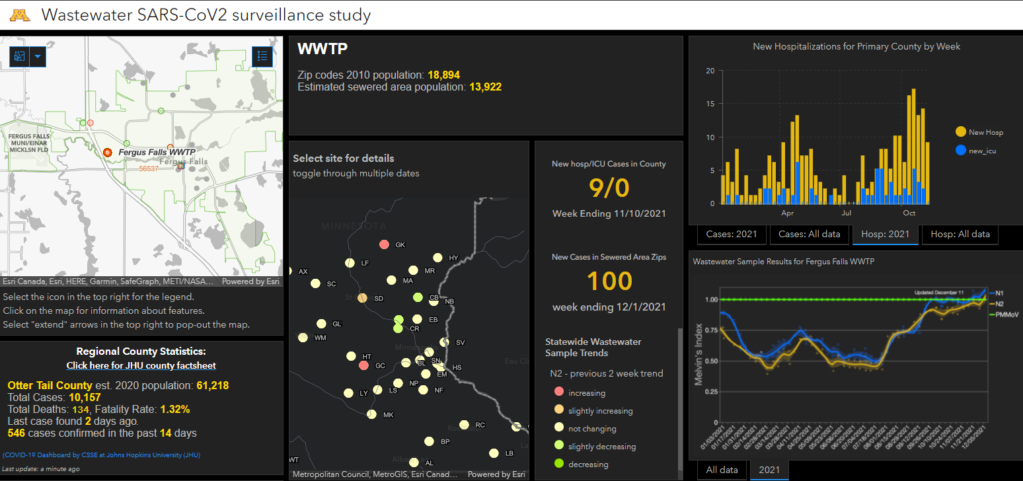
Notes:
Please let me know if you have more information: slstark@d.umn.edu
These data aren’t publicly available.

Slide 38
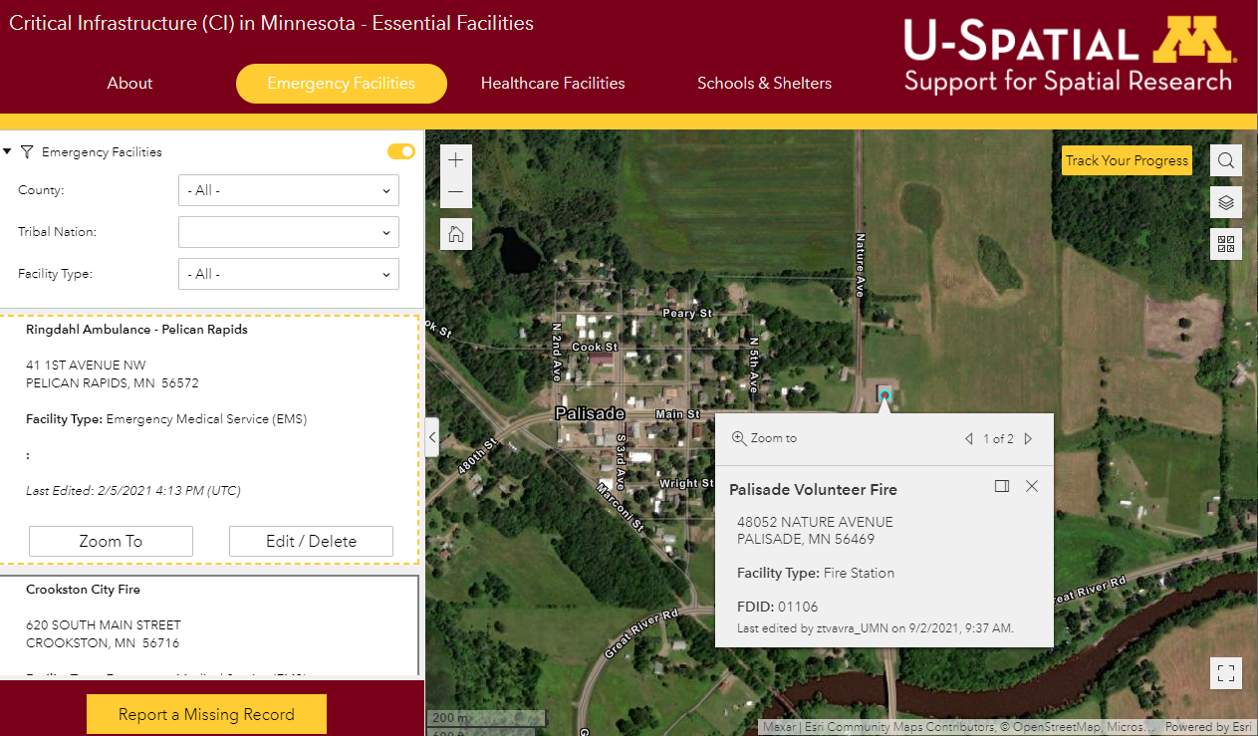
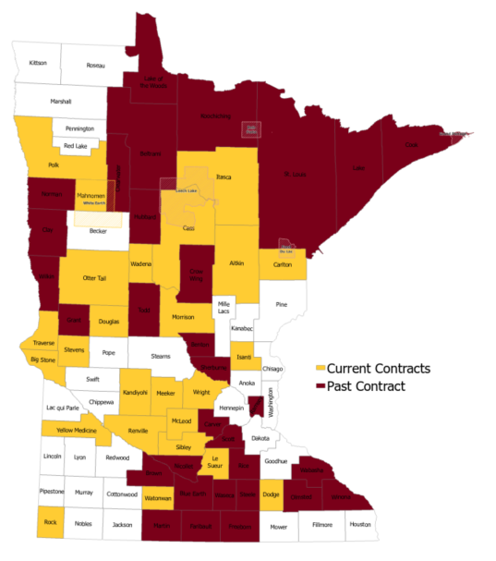
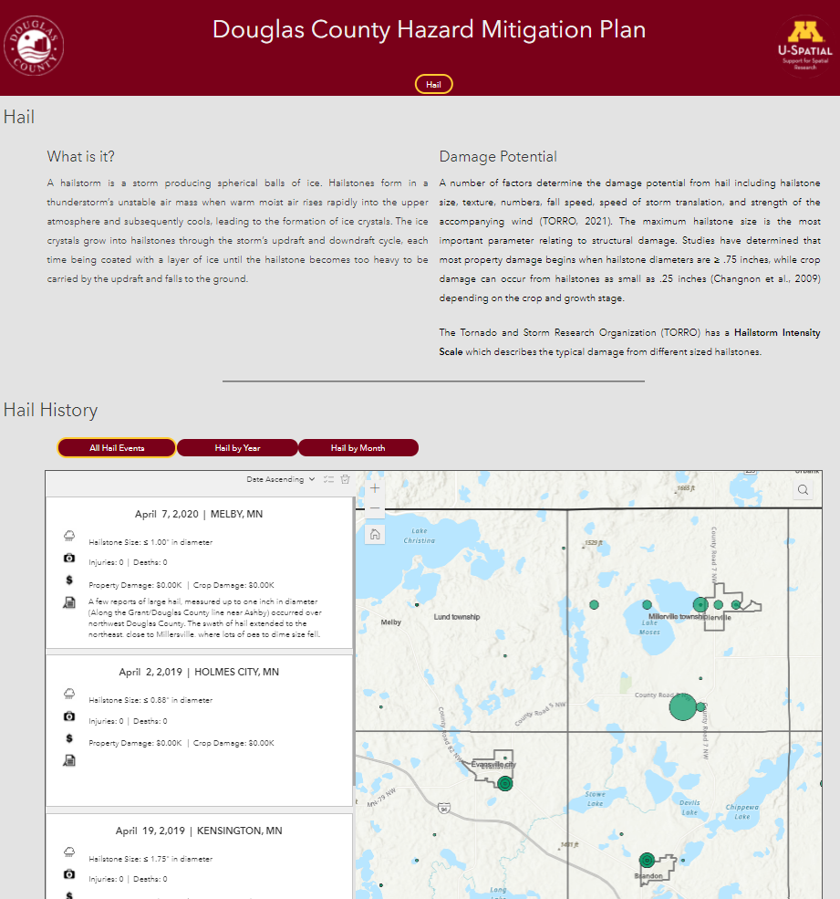
County Multi-Hazard Mitigation Plan Updates
Notes:
https://rc.umn.edu/uspatial/services/hazard-mitigation-planning

Slide 39
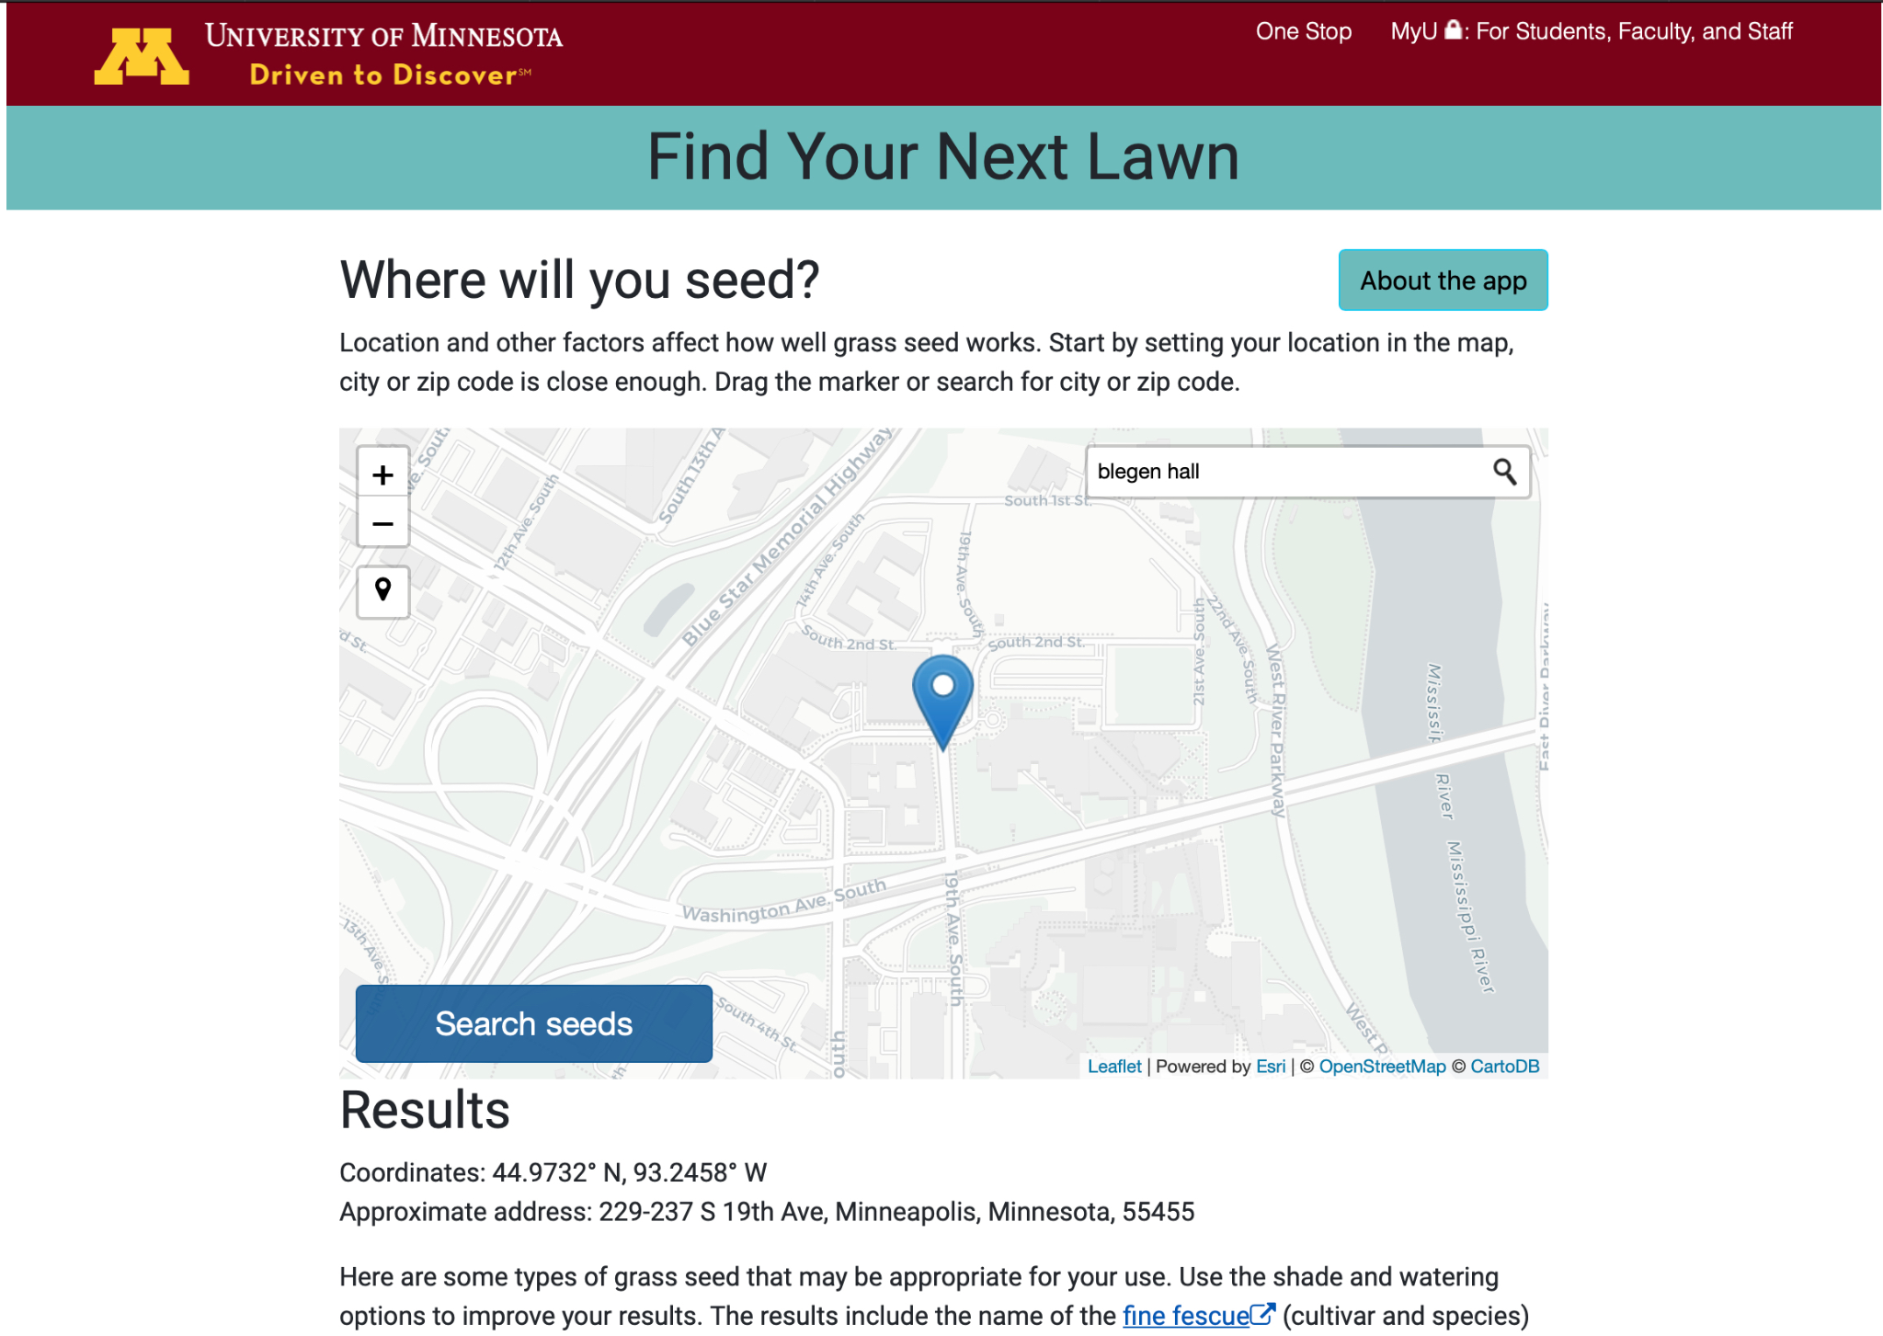
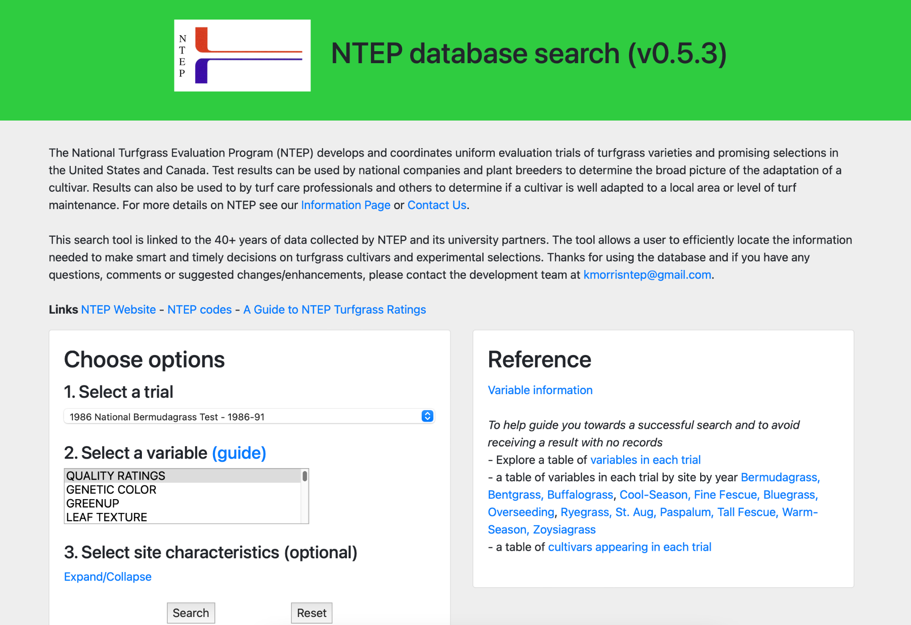
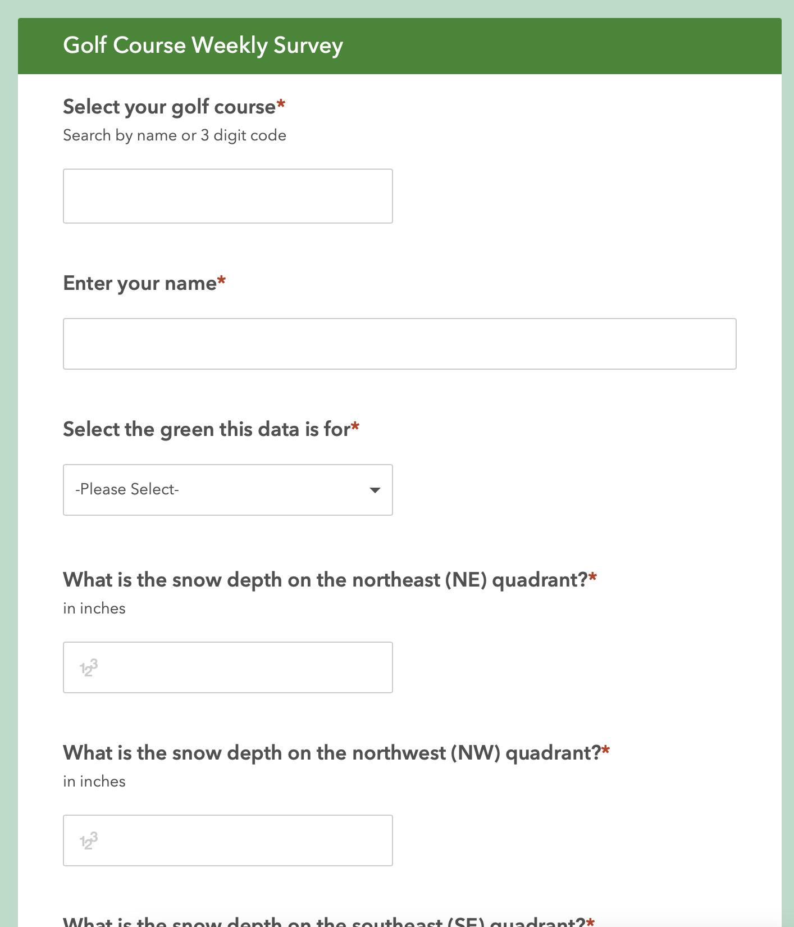
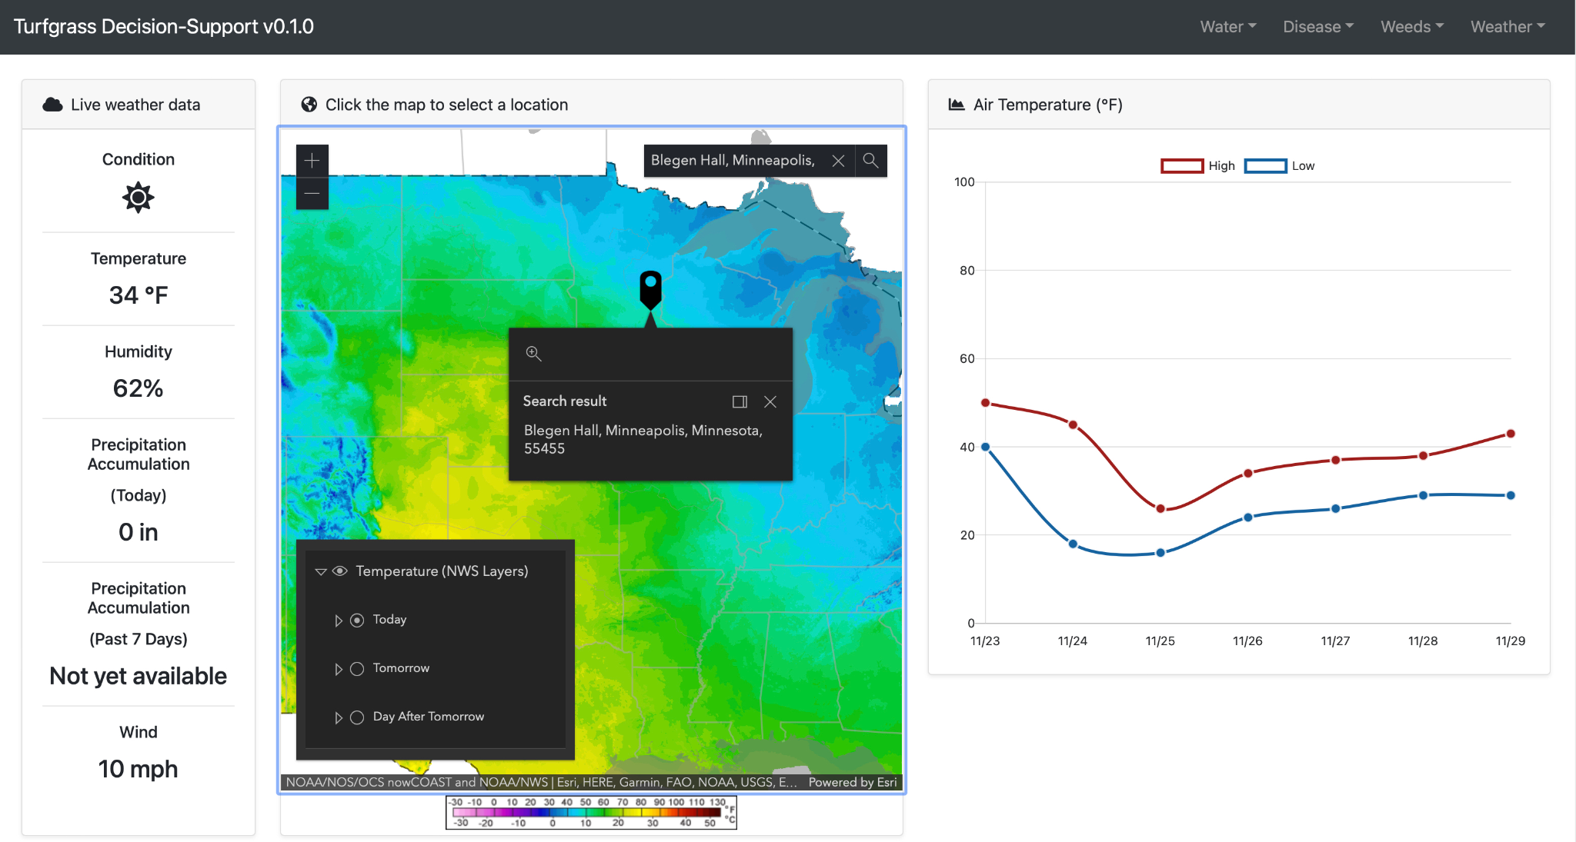
Turfgrass
Notes:
We do a lot of work with turfgrass research with generally 1 FTE of staff time working on a variety of projects, mostly web mapping applications. Examples here show a dashboard for golf course superintendents to monitor for disease conditions and an app that helps homeowners select the right grass seed for their lawn.

Slide 40
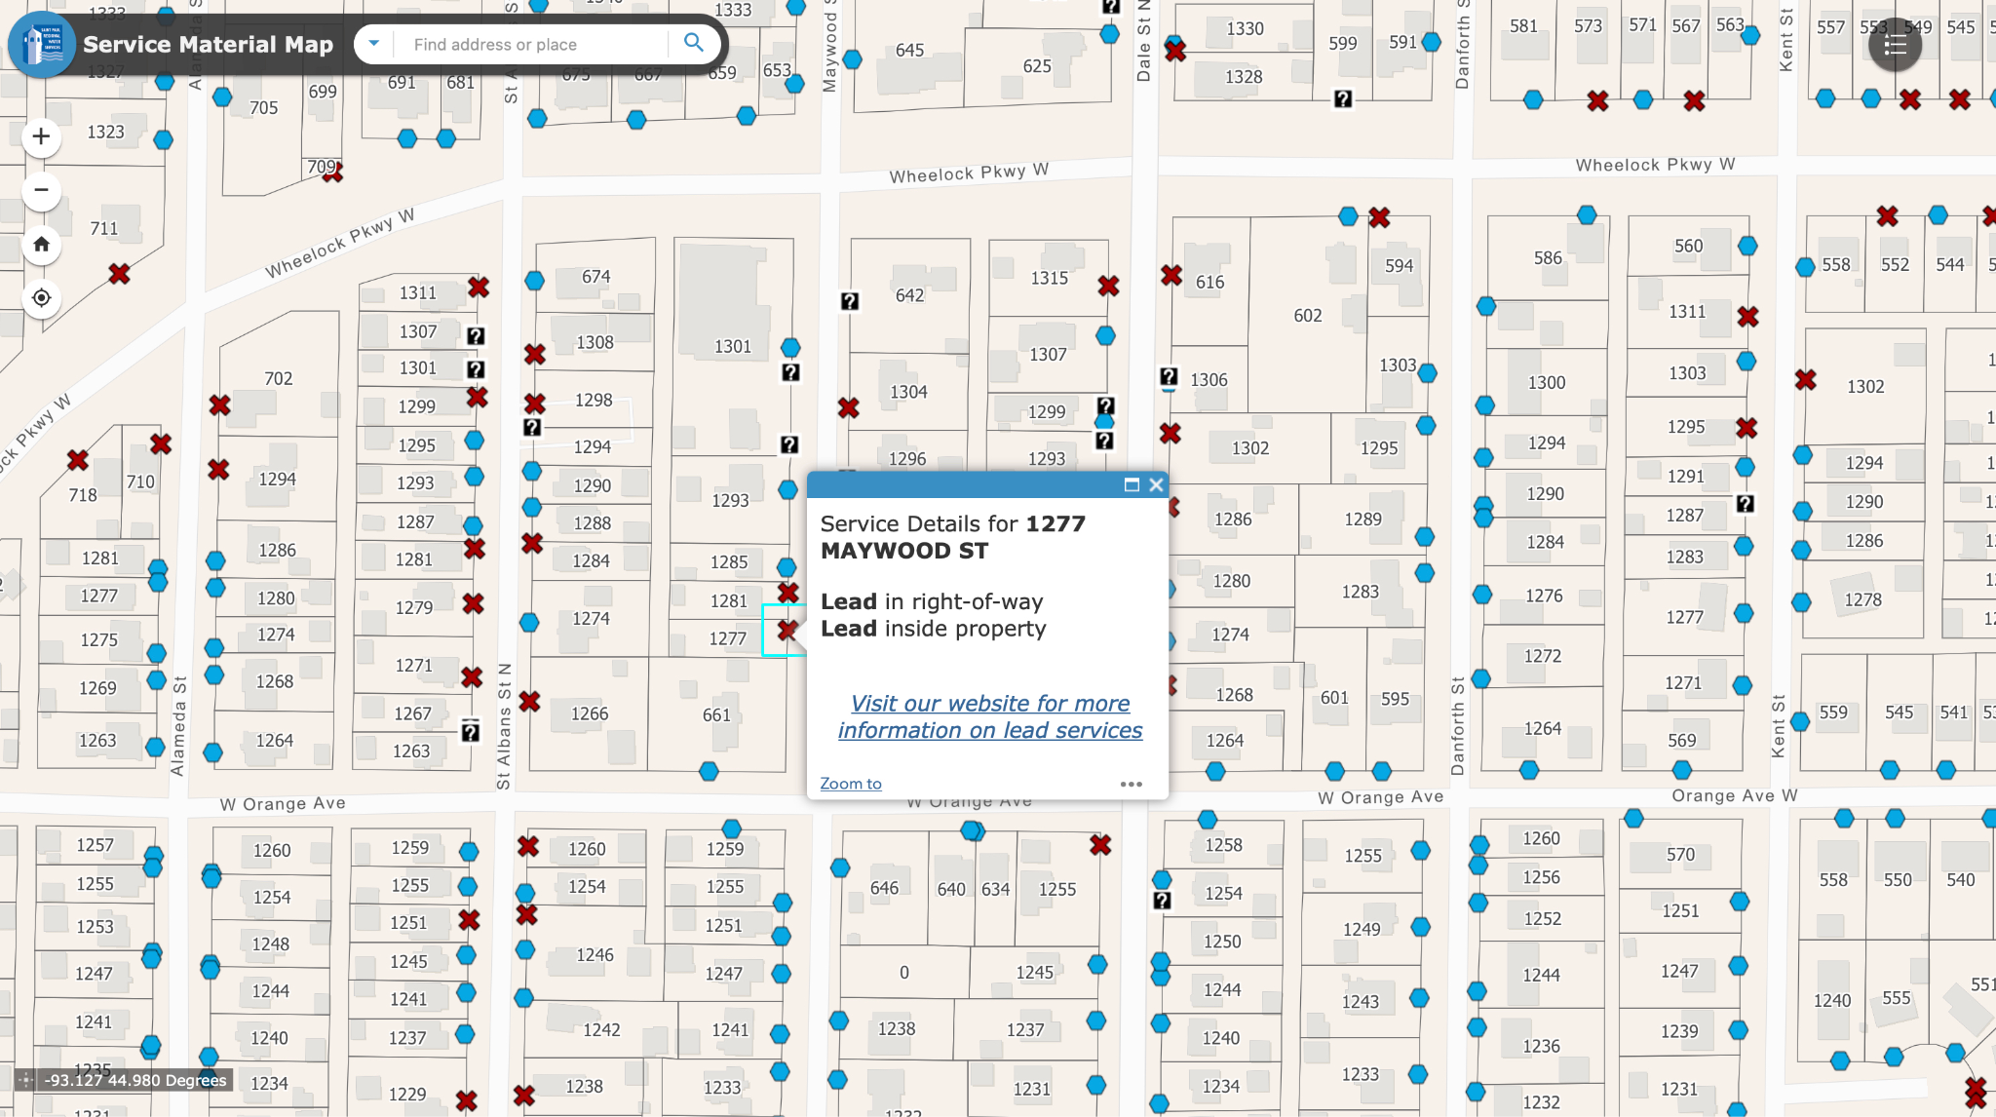
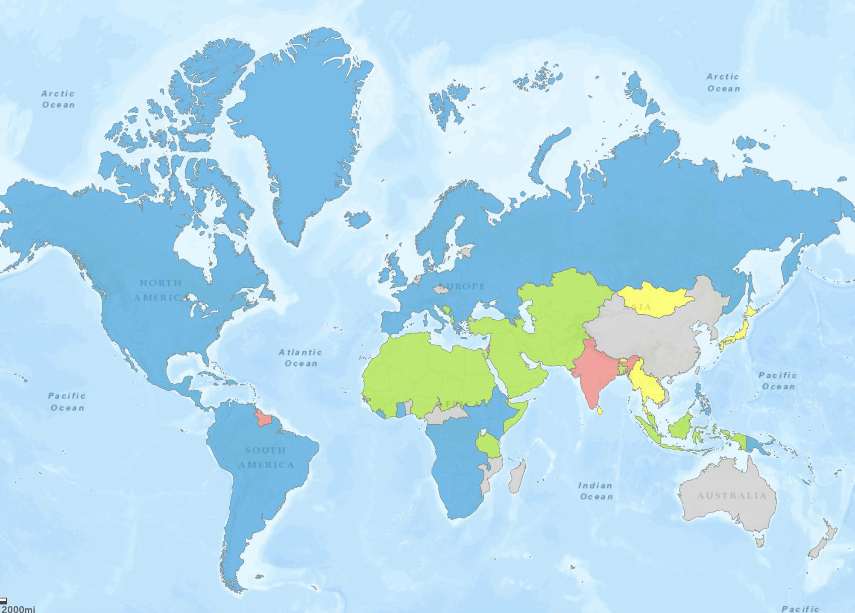
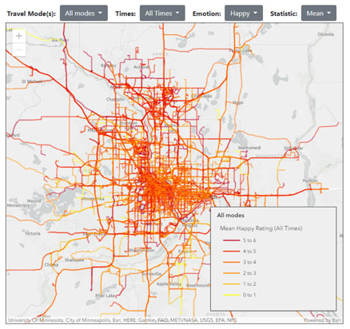
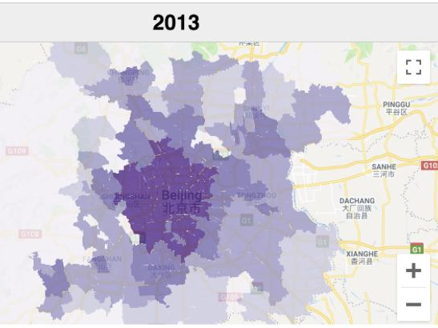
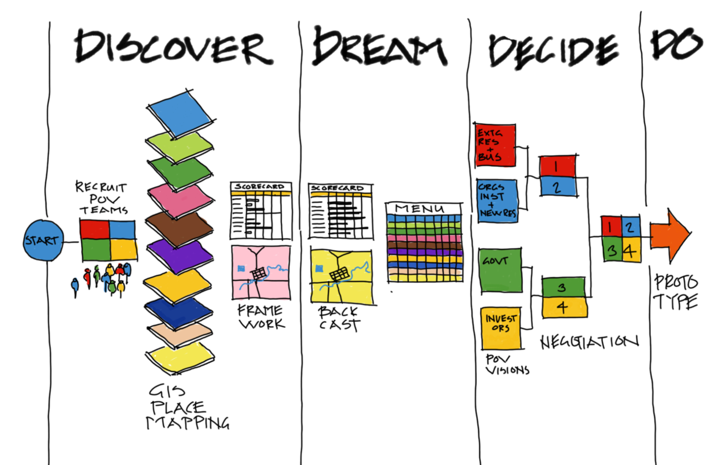


And lots of other amazing topics
MN Lead Service Lines
The Price of Empire: Political Unrest,
Distance, and Sovereign Creditworthiness in Tsarist Russia
Happy Roads - Well-Being in Transit
Beijing Job Accessibility Map
Place of Last Drink
Mapping Balzac in Historic Paris
Mapping MN North Shore Coastal Erosion Rates
MN Bike and Go! Toilet Bike Trail Map
Design for Community Regeneration, Geodesign in Warren, MN
Notes:
A map of over 1000 conflicts in the Russian empire growth over time
MN Lead Service Lines
The Price of Empire: Political Unrest,
Distance, and Sovereign Creditworthiness in Tsarist Russia - A map of over 1000 conflicts in the Russian empire growth over time
Happy Roads - well-being while traveling -When people travel, they may be happy—or not—depending on the mode they use, trip duration, and other factors. A team of U researchers has created an interactive map that illustrates differences in travelers’ happiness ratings on streets and roads in the Minneapolis–Saint Paul metro area.
Beijing Job Accessibility Map - This map describes the number of job opportunities accessible by transit from each jiedao district within 30, 45, and 60 minutes of travel time.
Place of Last Drink
Mapping Balzac in historic Paris
Mapping MN North Shore coastal erosion rates
MN Bike and Go! toilet bike trail map
Design for Community Regeneration, Geodesign in Warren, MN

Slide 41
Thanks!
lenkne@umn.edu, slstark@d.umn.edu

Slide 42
Agenda Item 12
Legislative Update
Dan Ross
Preparing for session...
Survey Coordinator
Lidar – acquisition, data storage, management, dissemination

Slide 43
Agenda Item 13
Updates on GAC Priority Projects and Initiatives
David Brandt

Slide 44
Updates on GAC Priority Projects and Initiatives
Most recent success
Experiencing a barrier?
Next task

Slide 45
GAC Priorities
Project or Initiative Description | Status | Project Owner | Champion
Parcel Data | Active | Alison Slaats | Mark Kotz
Updated and Aligned Boundary Data | Active | Preston Dowell | Dan Ross
Remonumentation of Section Corners | Active | Pat Veraguth | Dan Ross
New Lidar Acquisition | Active | Gerry Sjerven | Dan Ross
Accurate Hydro-DEMs | Active | Sean Vaughn | many
Culvert Data Standard | Active | Rick Moore | Jonathan Lord
Road Centerline Data | Active | MnGeo | Dan Ross
Address Points Data | Active | MnGeo | Dan Ross
Underground Utilities Data | Active | Steve Swazee | Barb Cederberg
Critical Infrastructure Data | Active | Stacey Stark | Steve Swazee
U.S. National Grid Materials | Active | Randy Knippel | Randy Knippel

Slide 46
GAC Priorities
Project or Initiative Description | Status | Project Owner | Champion
Image Service Improvements | Active | Alison Slaats | Dan Ross
Bikeways Data Standard | Active | Sandra Yassin
Archiving Implementation | Active | Ryan Mattke | many
Success Stories for Geospatial Technology | Active
Geospatial Commons Advisory Group | Inactive
NG911 Forum | Inactive
Basemap Services | Inactive
Parks Data Standard | Inactive
Optical, Lidar, Radar, Aerial and Satellite Imagery Strategy | Inactive
High-res Climate Projection Data | Inactive
Criminal Justice Info Best Practices | Inactive

Slide 47
GAC Priorities
Project or Initiative Description | Status | Project Owner | Champion
Licensed Businesses Data | Inactive
Snow Emergency Parking Restriction Data | Inactive
Geospatial Data Asset Inventory | Inactive
Property Crimes Data | Inactive
Street Parking Restrictions Data Standard | Inactive

Slide 48
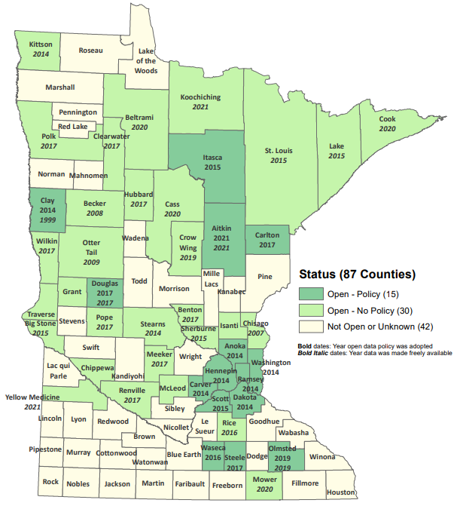
Status of Free and Open Data Public Geospatial Data
Status | Number of Counties | Total
Open - Policy | 15 | 45
Open - No Policy | 30
Not Open or Unknown | 42 | 42
Data current as of August 9, 2021
https://gisdata.mn.gov/dataset/bdry-mn-county-open-data-status

Slide 49
Statewide publicly available parcel data
Most recent success:
  PLRC's open data subcommittee sent out a survey to all counties on December 3 to ask about barriers to sharing data, and specifically ask if counties would like their data to be included in a public GAC-standard aggregated dataset
  MnGeo’s aggregation process is updated to be able to easily publish public GAC-standard aggregated dataset for counties that opt-in.
If you are experiencing a barrier:
  none
Next task:
  Publish public GAC-standard aggregated dataset for counties that opt-in in January 2022
  PLRC's open data sub-committee’s outreach team will continue reaching out from county to county to talk about benefits of sharing data and learning more about barriers and follow up on survey results.

Slide 50
Updated and aligned boundary data
Most recent success:
  PLSS Status Map transitioned to MnGeo
  Supporting Remonumentation Subcommittee which is working on Priority 14
  Supporting/documenting Arrowhead Alignment Project
If you are experiencing a barrier:
  Committee member time
Next Task:
  Update PLSS Status Map
  Continue supporting/documenting Arrowhead Alignment Project

Slide 51

Remonumentation of all section corners

Slide 52
New Lidar Acquisition
Most recent success:
If you are experiencing a barrier:
Next task:

Slide 53
Accurate hydro-DEMs (hDEM) that serve modern flood modeling and hydro-terrain analysis tools, and the development of more accurate watercourses and watersheds
Most recent success:
  No success to report related to progress
  3D Geomatics is starting to receive more questions about the new high-density lidar coming and the need for DEM Hydro-modification
    New Lidar will require DEM Hydro-modification
    Previous state investments in DEM hydro-modification and resulting datasets will support new DEM Hydro-modification
If you are experiencing a barrier:
  Funding
Next task:
  Continue to build awareness that new Lidar will require DEM hydro-modification and funding
    Identification of culverts in new lidar will facilitate DEM hydro-modification

Slide 54
Development of a culvert data standard for data sharing across the geospatial and infrastructure asset management communities
Most recent success:
  Identifying resources and interested parties to become partners/members in the committee. Researching Culvert Data practices of other states to identify best practices
If you are experiencing a barrier:
  Identifying time to coordinate meetings for the standard. Culvert Data Standard will become high priority in 2022 in tandem with DEM Hydro-modification Subgroup
Next task:
  Meeting will be set in January to bring together interested parties for the Culvert Data Standard. Meeting with MnDOT representatives forthcoming

Slide 55
Road Centerline Data
Most recent success:
  Data submission and validation routines moved to a new portal
If you are experiencing a barrier:
  All data providers need to now start using the new portal
Next task:
  Build and automate the ETL process for aggregating data to the GAC standard
  Publish to the Geospatial Commons

Slide 56
Address Points Data
Most recent success:
  Data submission and validation routines moved to a new portal
If you are experiencing a barrier:
  All data providers need to now start using the new portal
Next task:
  Build and automate the ETL process for aggregating data to the GAC standard
  Publish to the Geospatial Commons

Slide 57
A project team to develop geospatial data sharing methodologies to support the state’s underground utilities community
Most recent success:
Major – Support resolution passed by the Minnesota Clean Water Council
Minor – November 18, 2021, presentation to the APWA
2. If you are experiencing a barrier:
Not a barrier, but facing the most challenging part of the entire project – building Phase 1 (of 3) “Fusion View” software which can generate a unified view of Minnesota’s underground infrastructure
3. Next task:
    Due to the complexity of this project, there are approximately 50 tasks being worked to varying degrees at the same time

Slide 58
Priority 7: Critical Infrastructure Assessment
Most recent success:
  Published fire station dataset to GeoCommons with app for verification
If you are experiencing a barrier:
  Hoping to pique the interest of the Fire Marshal and/or other authorities of these data! Finding avenues to publicize beyond GIS community.
Next task:
  Publish “C.I. resource site” on MnGeo website
  Publish law enforcement dataset, similar to fire station dataset

Slide 59
Maps, procedures, templates and other materials to help all levels of government implement the U.S. National Grid
Most recent success:
  Developed interface to allow map publishers to contribute to an application that provides access to USNG maps series and map books published anywhere on the Internet
If you are experiencing a barrier:
  Time
Next task:
  Complete the above interface
  Migrate existing documentation from ArcMap to ArcGIS Pro

Slide 60
Improvements to the MnGeo Image Service, such as Web Mercator support, tiling, and complementary options such as “composite of latest leaf off imagery”, and downloading options
Most recent success:
  Worked on image viewer recommended by Image Service Sustainability Committee
  Added county imagery from Rice, Steele, and Carlton County to WMS
If you are experiencing a barrier:
  Time constraints to work on recommendations of committee, and did not accomplish removal of suggested retirement image layers
Next task:
  Adding county imagery from Koochiching and Le Sueur

Slide 61
Priority 9: Archiving Minnesota geospatial data
Most recent success:
  Created a test repository with sample datasets from the Commons as a proof of concept.
If you are experiencing a barrier:
  Working on getting a firm commitment from hosting entity (hopefully UMN)
Next task:
  Writing report describing pilot details
  Figuring out funding

Slide 62
Agenda Item 14
Announcements

Slide 63
Next Meetings
2022 GAC priorities special meeting
January 19, 10:00 – 11:00
Next quarterly meetings:
March 30, 10:00 – noon
May 25, 10:00 – 1:00

Slide 64
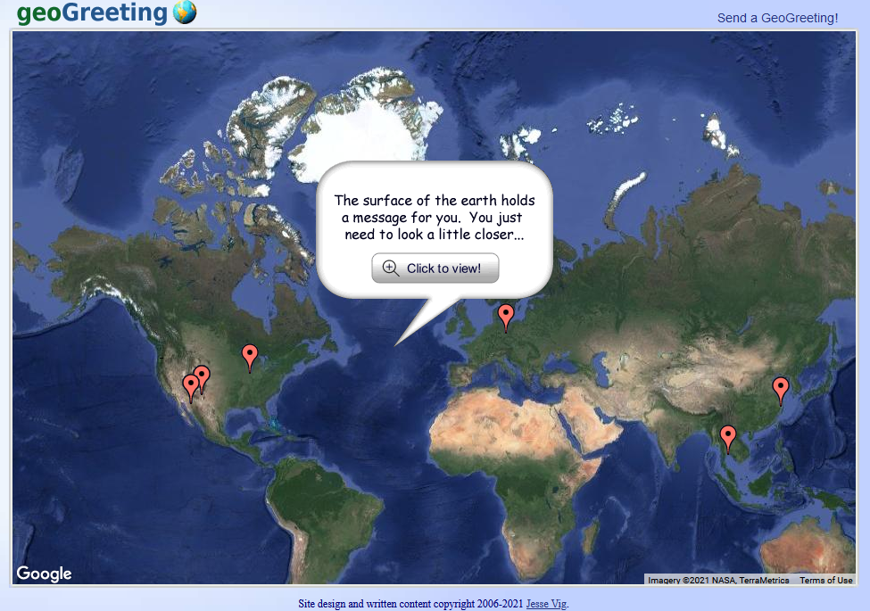
GeoGreeting

