Slide 1



Minnesota Geospatial Advisory Council
May 25, 2022

Slide 2
Welcome
Introductions
Approve agenda
Approve March minutes

Slide 3
Introductions
City, Twin Cities metro
  Cory Richter, City of Blaine
City, Greater Minnesota
  Shawn Strong, City of Brainerd
County, Twin Cities metro
  Victoria Reinhardt, Ramsey County
County, Greater Minnesota
  Patrick Veraguth, Douglas County
Regional government, Twin Cities metro
  Matt McGuire, Met Council
Regional government, Greater Minnesota
  vacant
State agencies
  Kari Geurts, DNR
  Ben Timerson, MnDOT
Federal government
  Mitch Bergeson, U.S. Geological Survey
  Jeff Bloomquist, Risk Management Agency, USDA
Tribal government
  Ryan Bonney, Shakopee Mdewakanton Sioux Community
Non-profit organizations
  Dale Watt, The Nature Conservancy
Business
  Kendis Scharenbroich, Pro-West & Associates
  Gerry Sjerven, Minnesota Power
Higher Education
  Len Kne, U-Spatial / UMN Twin Cities
  Stacey Stark, U-Spatial / UMN Duluth
K-12 Education
  vacant
MetroGIS
  David Brandt, Washington County
MN GIS/LIS Consortium
  Leanne Knott, City of Red Wing
Surveyor
  Chris Mavis, Hennepin County
At-large
  Alex Steele, Minnehaha Creek Watershed District
  Heather Bergen-Albrecht, Hennepin County
  Britta Maddox, Anoka County
1 Chief Geospatial Information Officer (ex-officio)
  Alison Slaats, MnGeo

Slide 4

Alison Slaats
Chief Geospatial Information Officer at State of Minnesota
Director of MnGeo (Minnesota Geospatial Information Office) at Minnesota IT Services

Slide 5
Agenda
Time | Topic |  | Time | Topic
11:00 | Introductions, approve agenda and previous minutes |  | 12:35 | Sector report
11:15 | Committee reports – Review and accept |  | 12:55 | Legislative update
11:25 | Archiving Imagery Workgroup |  | 1:05 | GAC priority projects and initiatives updates
11:30 | PLSS legislation update |  | 1:25 | Announcements
11:35 | Minnesota Natural Resource Atlas |  | 2:00 | Adjourn
11:50 | Break

Slide 6
Agenda Item 2
Committee Reports – Review and Accept
All

Slide 7
Agenda Item 3
Archiving Imagery Workgroup
Karen Majewicz, Melinda Kernik

Slide 8
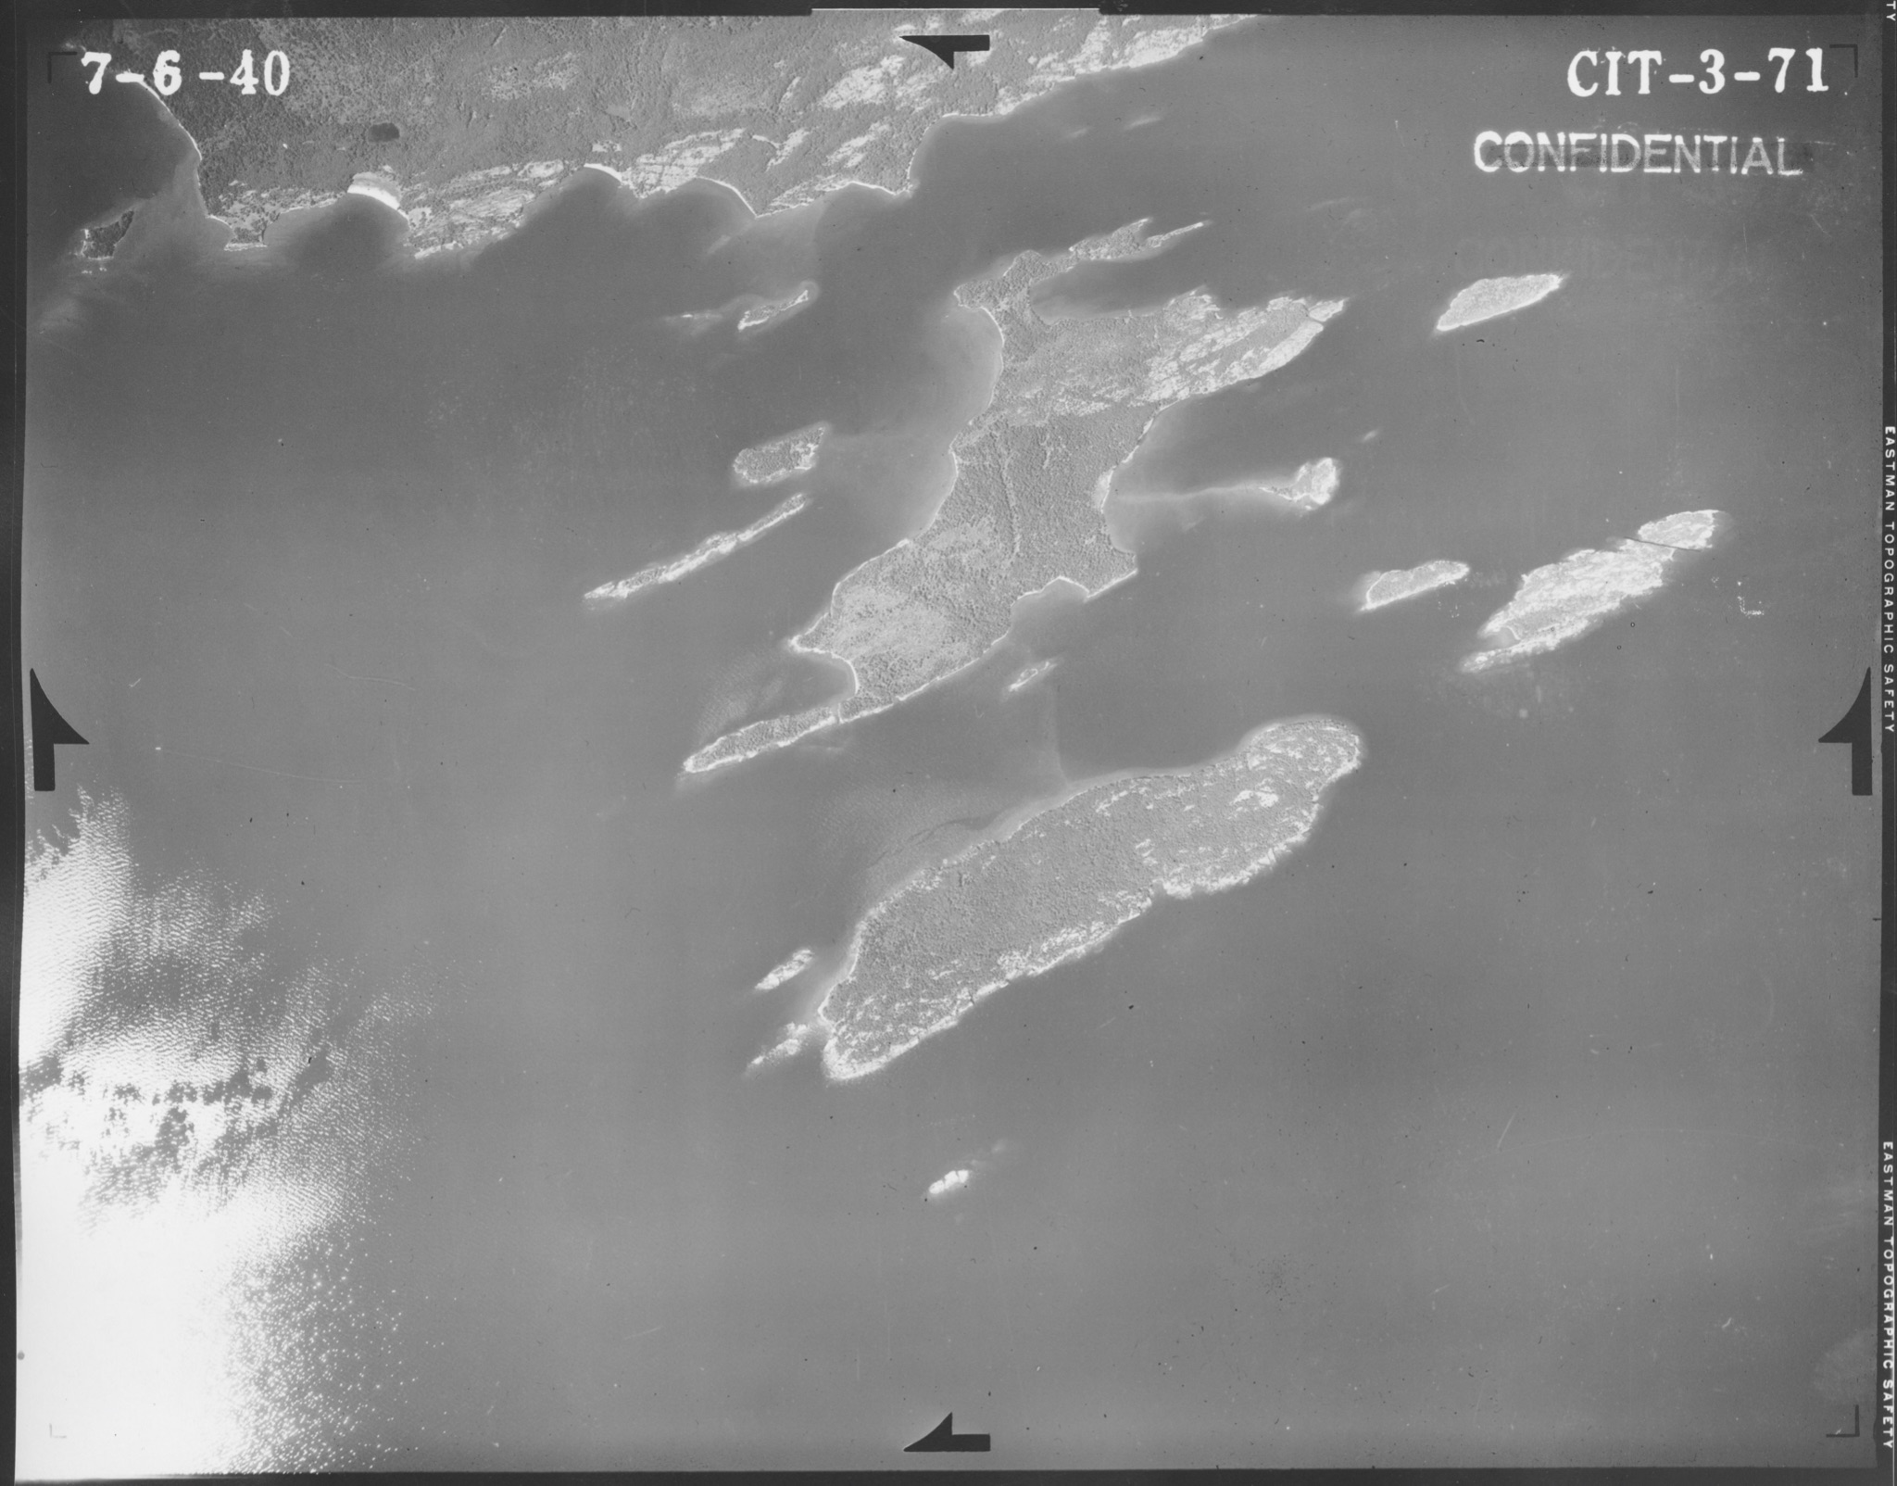
Archiving Imagery Workgroup
MnGAC Quarterly Meeting
May 25, 2022
Karen Majewicz (chair)
Melinda Kernik (vice-chair)
Aerial image from Cook County (Lake Superior) 1940

Slide 9
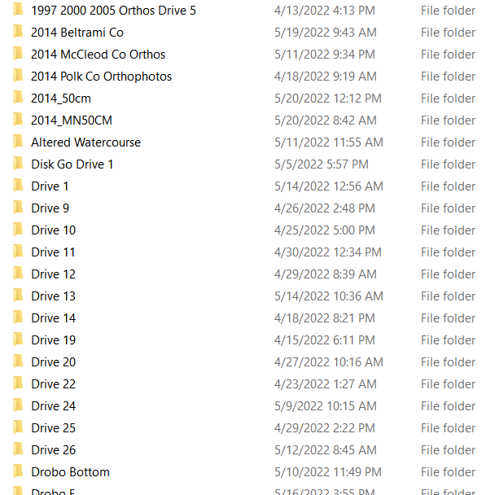

Archiving Imagery Workgroup
MOTIVATION
Imagery web services being retired
U of MN Libraries acquiring state imagery
Notes:
1) Image Service Sustainability Committee has recommended some of MNGeo’s web services be retired. What should be done with this material?
2) U of MN Libraries is currently backing-up imagery from the state. How do we make sense of these datasets and provide some kind of public record? (whether it's simply a public facing record or interactive index)

Slide 10
Archiving Imagery Workgroup
CONTEXT
Archiving Workgroup (2019)
  Charter
  Work plan
Archiving Implementation Workgroup (2020)
  Charter
  Work plan
Archiving Pilot Workgroup (2021)
  Charter
  Work plan
Archiving Imagery Workgroup (2022)
  Proposed Charter
  Proposed Work plan
Policies, priority datasets, and outreach
Workflows, technology needs assessment, and funding options
Discovery and access technology options
Research and document how to archive imagery
Notes:
We have had several Archiving Working Groups over the past few years - looking at policies, workflows, and technology options - but these groups have primarily focused on vector data.
There are some unique challenges when it comes to archiving imagery. In particular, large file sizes complicate providing access (both within the discovery platform and with transferring files)

Slide 11
Archiving Imagery Workgroup
PROPOSED CHARTER
Objectives
Research the historical and current formats of imagery data
Assess the monetary investment involved in the original creation of Minnesota imagery
Consult with the Image Service Sustainability Committee on planning workflows for image service retirements
Identify any major challenges with archiving imagery data, such as space considerations due to the size of the files
Evaluate existing practices and potential strategies for transferring, storing, transforming, documenting, and archiving imagery data
Notes:
We are proposing a work group that will evaluate existing practices and potential strategies for transferring, storing, transforming, documenting, and archiving imagery data. The group will also try estimate the monetary investment involved in the original collection of data to support the argument for its preservation.
We aim to have a report completed by December 2022.

Slide 12
Archiving Pilot Workgroup
Questions?
Karen Majewicz (chair) - majew030@umn.edu
Melinda Kernik (vice-chair) - kerni016@umn.edu

Slide 13
Agenda Item 4
PLSS legislation update
Pat Veraguth

Slide 14
Agenda Item 5
Minnesota Natural Resource Atlas
Will Bartsch

Slide 15

Minnesota Natural Resource Atlas
Will Bartsch
Innovative Research • Minnesota Value • Global Relevance
Notes:
Alternate cover slide – simple version without photo.

Slide 16

Atlas - Funding & Team
NRRI
Lucinda Johnson - Principle Investigator
Will Bartsch - Project Manager
Kris Johnson - App Developer
Norm Will - App Developer (retired)
Jane Reed - Web Developer
Kristi Nixon - Data Management
Megan Quade - Data Management
Chris Filstrup - Water Data
Beth Bernhardt - Water Data
John Du Plissis - Forestry Data
George Hudak - Geology Data
Cindy Hagley - Outreach
U of MN - CFANS
David Mulla - Agricultural Data
Jake Galzki - Agricultural Data
Mae Davenport - Cultural Resources
Sara Roth - Cultural Resources
Development Funding provided by:
Legislative-Citizen Commission on Minnesota Resources
Maintenance Funding provided by:
Department of Iron Range Resources and Rehabilitation

Slide 17
Atlas - Goal
Make spatial data more accessible.

Slide 18
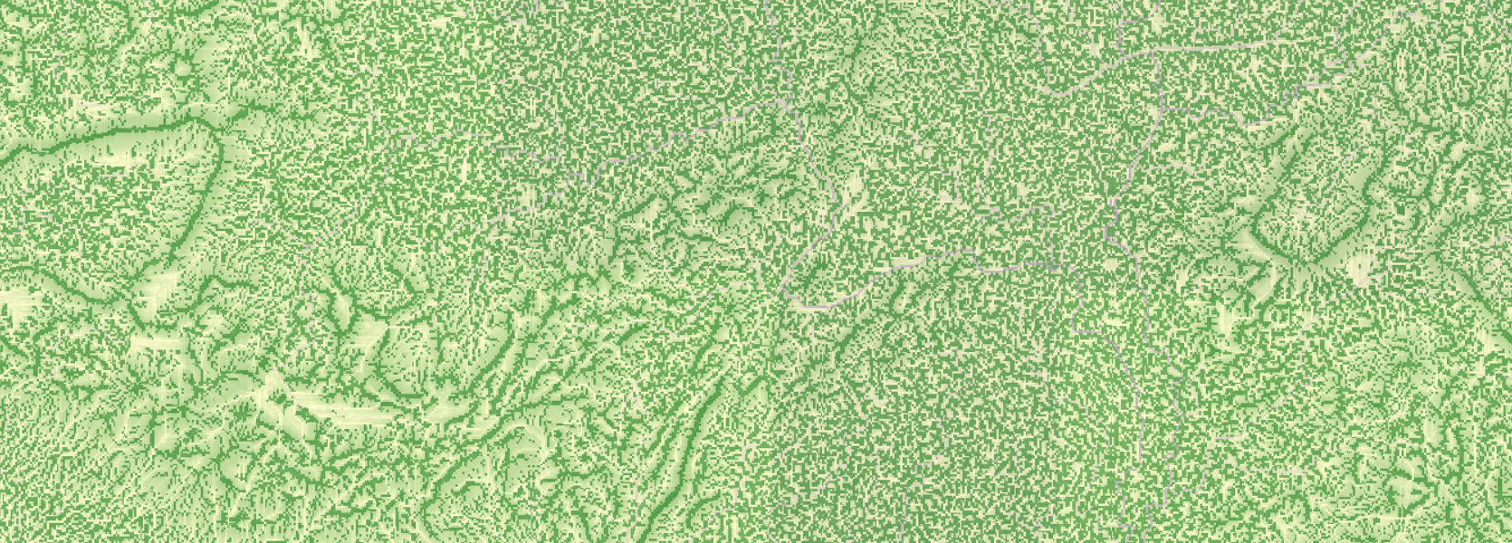
Atlas - Overview
What it is:
A freely available interactive mapping tool
A multidisciplinary spatial database
What is it not:
A replacement for a desktop GIS
A regulatory tool

Slide 19
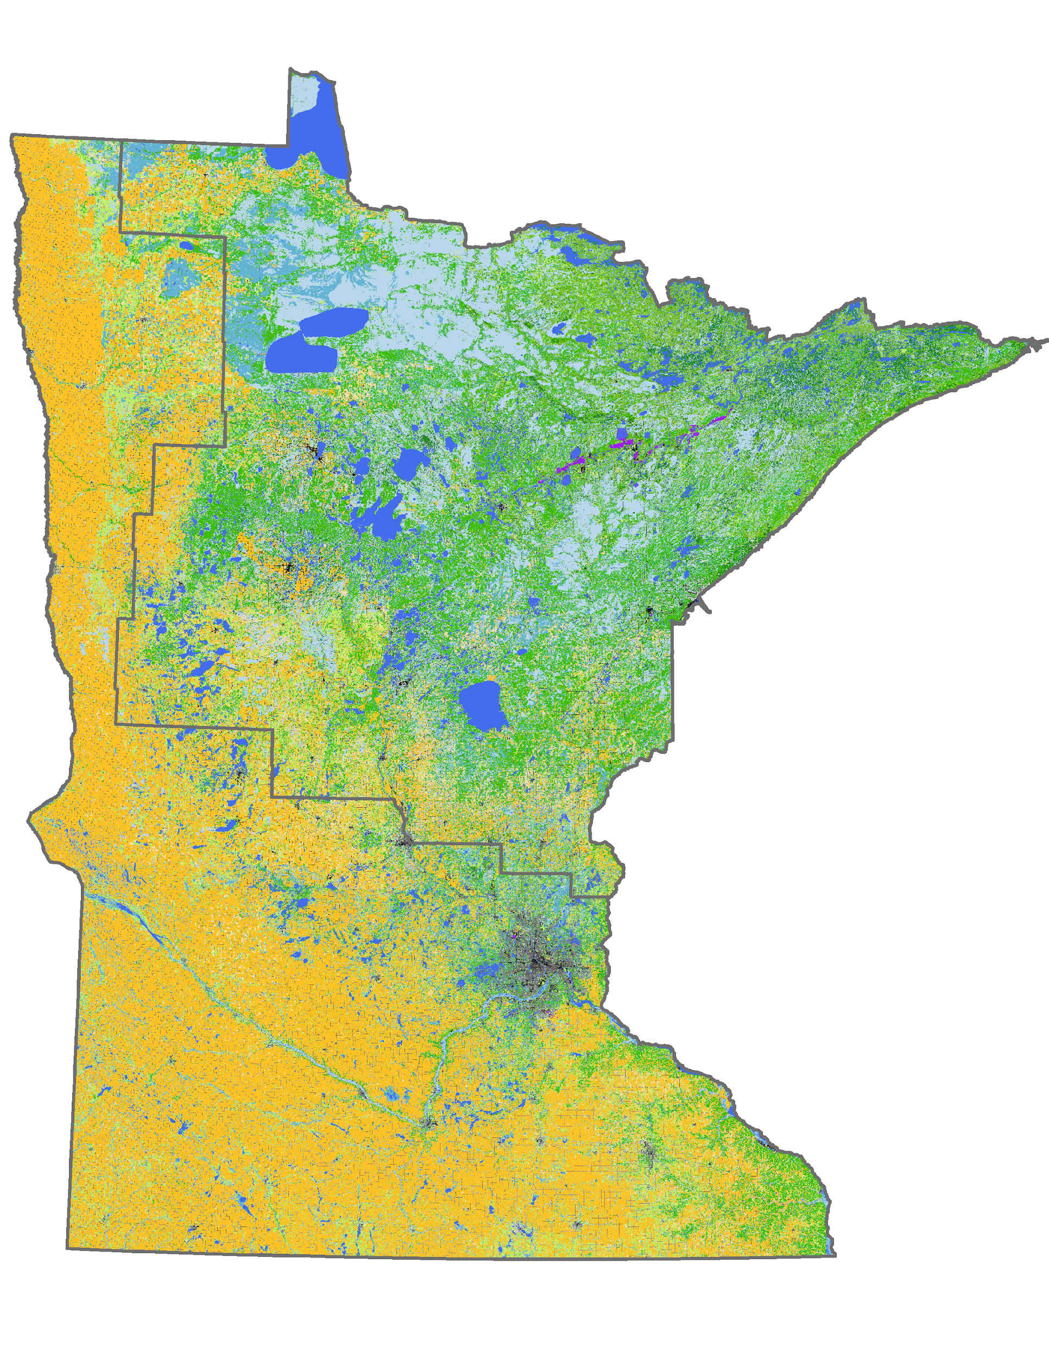
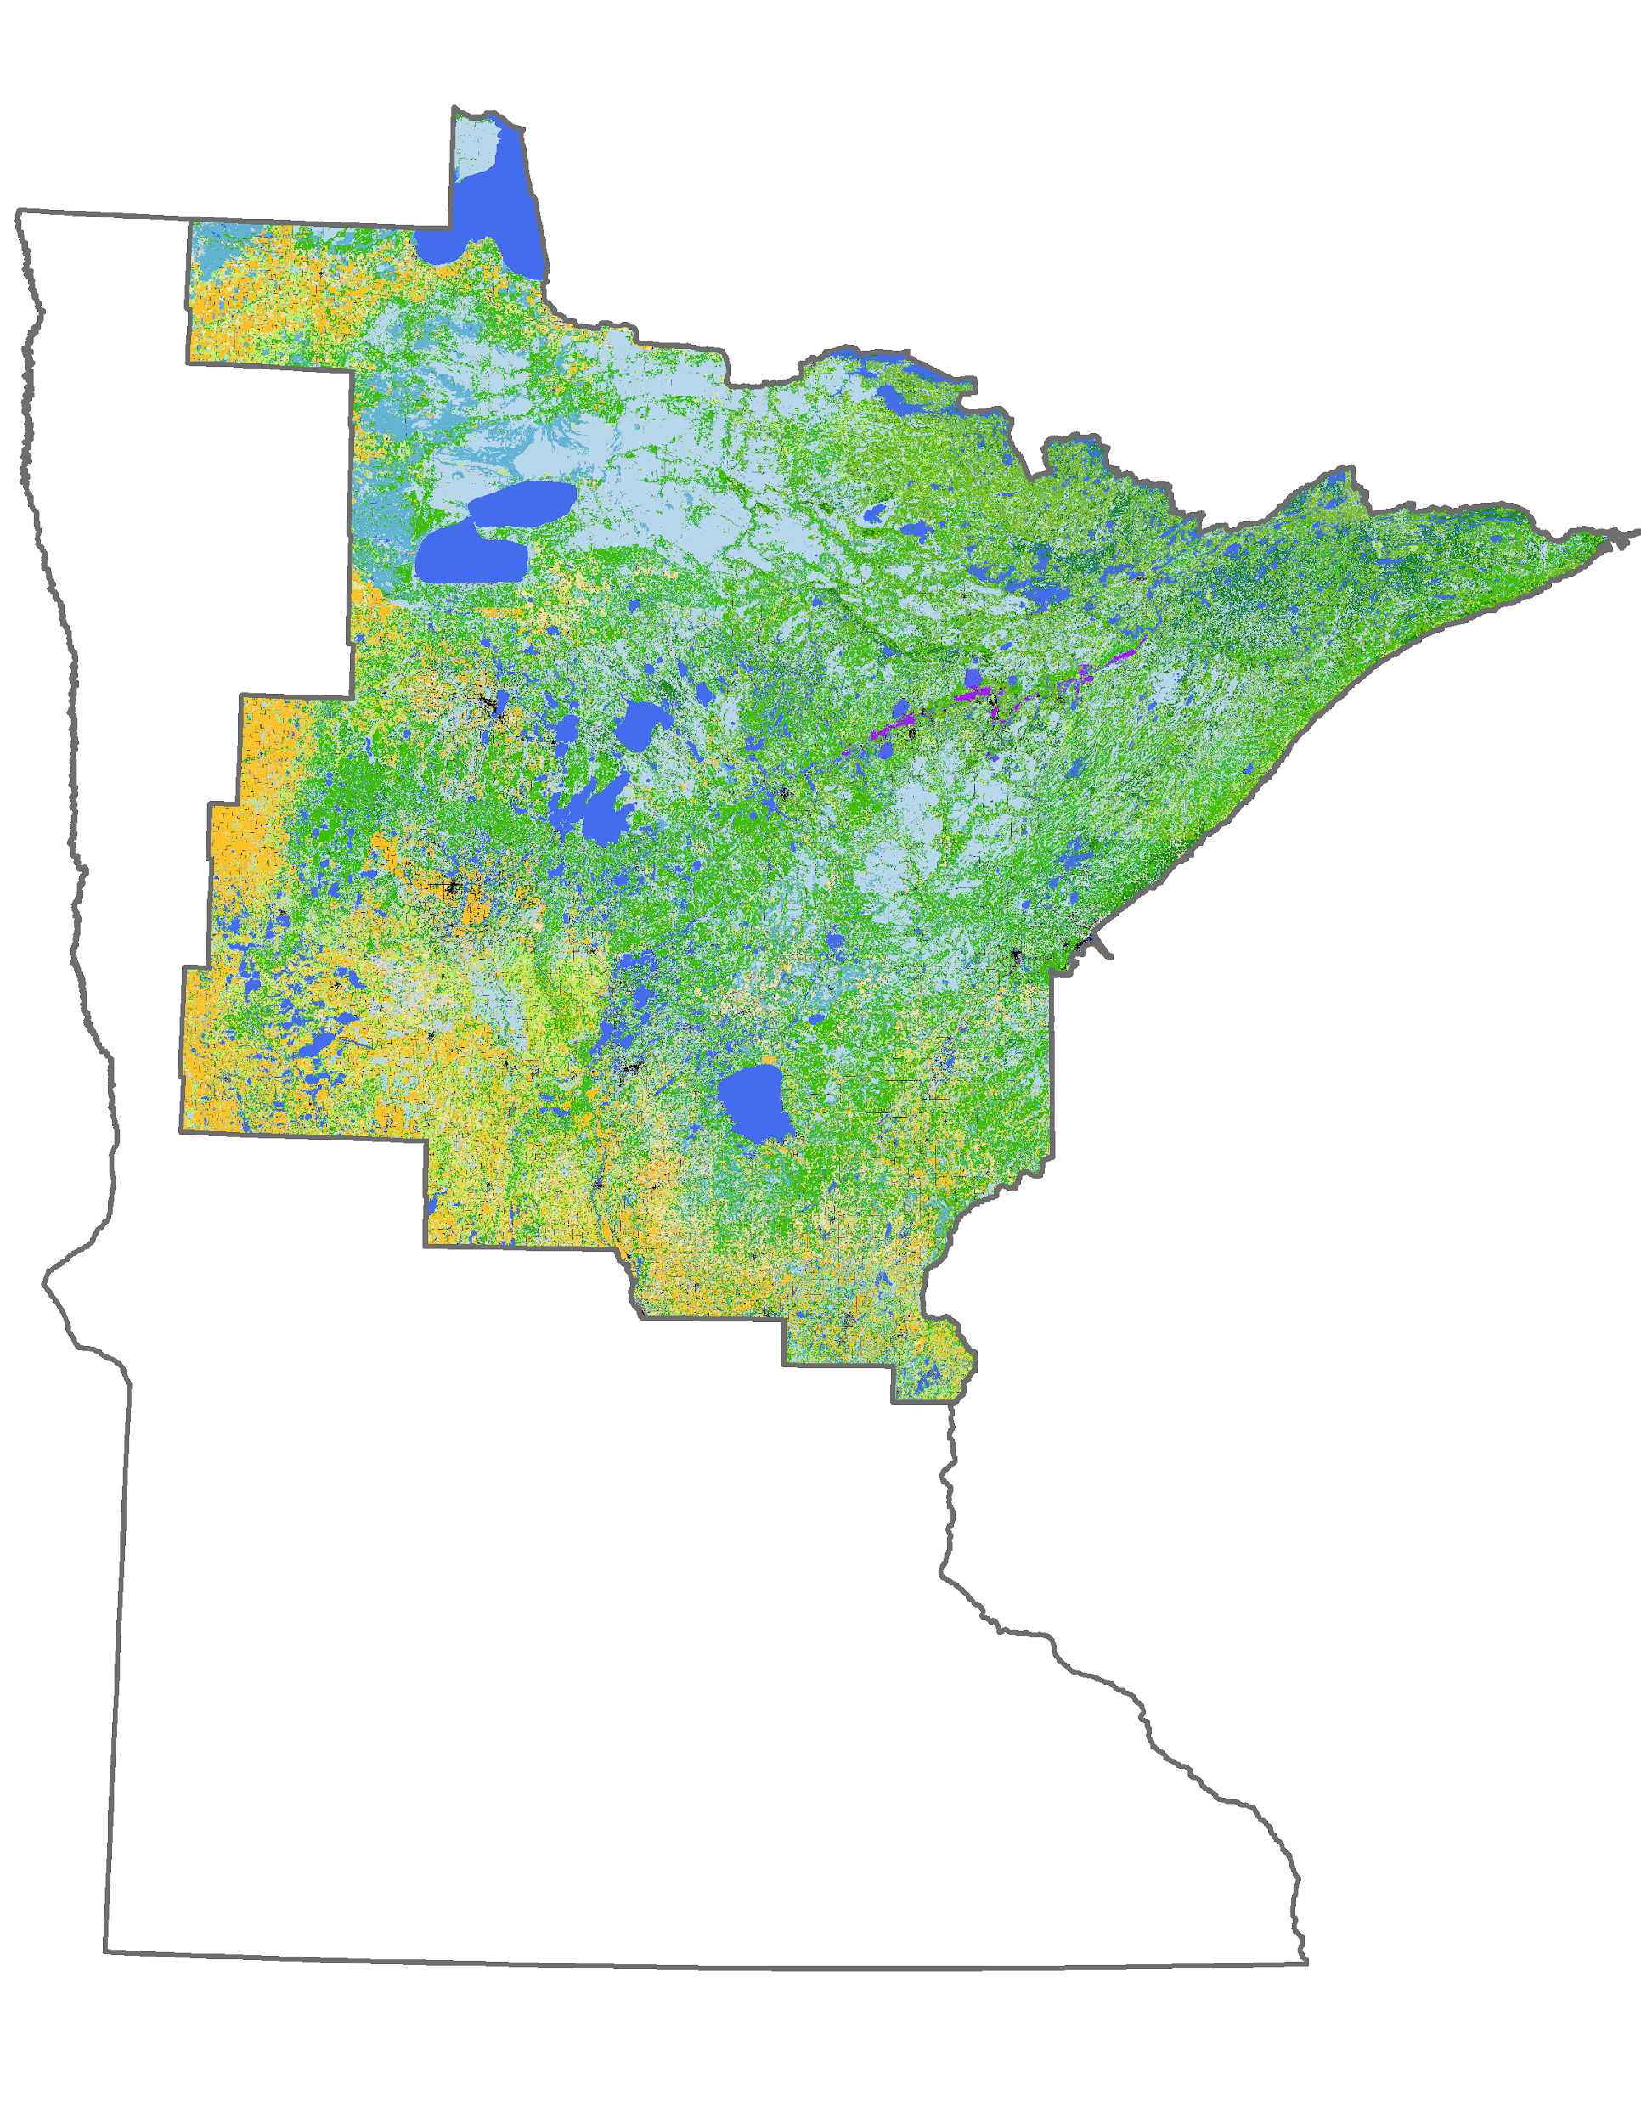
Atlas - Background
Phase 1
Phase 2

Slide 20
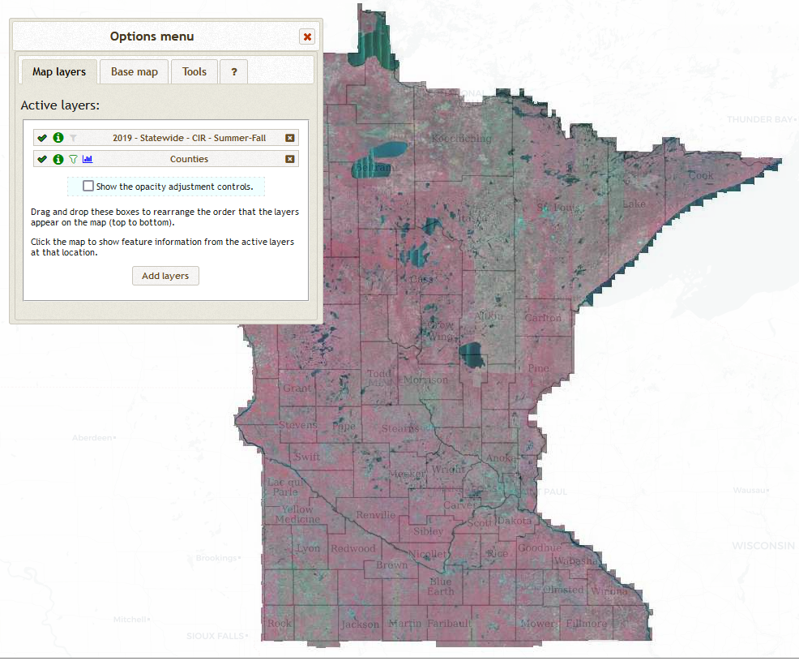
Atlas - Data
Over 500 data layers
Most data is on our server
Most data is available for download from source
Some is brought in via web services from 3rd parties
Data are regularly updated
Notes:
something about where data layers come from -- why assemble them this way. focus on geocommons

Slide 21
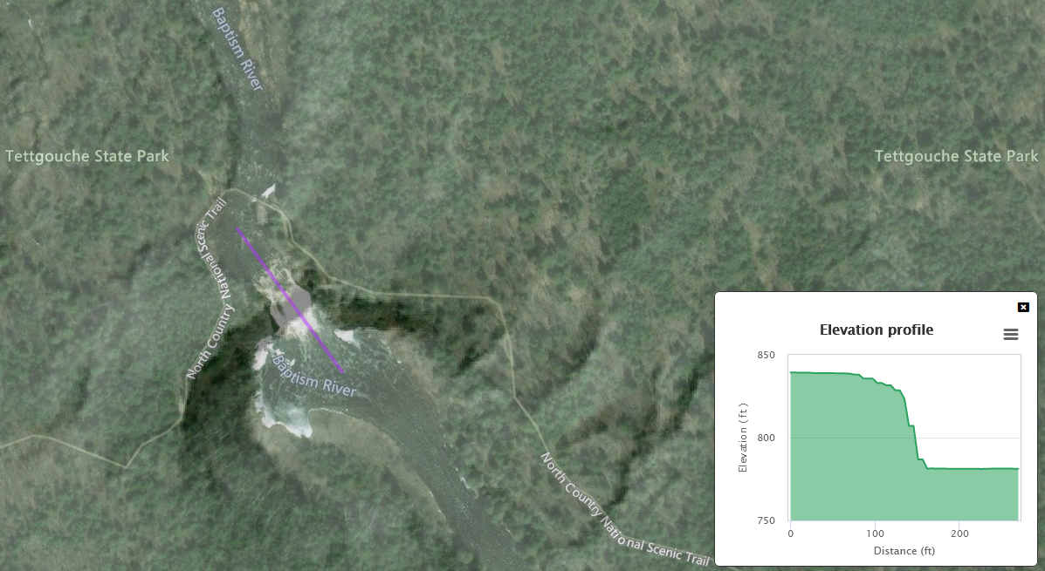
Atlas - Functionality
View multiple data layers simultaneously
Measure distance, area, elevation
Summarize data within a boundary
Create maps
Share information

Slide 22




Atlas - Open Source Approach
Client-side
Server-side
Notes:
Flexibility, speed

Slide 23
Demonstration

Slide 24

Thank You
Will Bartsch
Research Group Manager
Data Collection & Delivery
wbartsch@d.umn.edu
NRRI Duluth
(218) 788-2694
5013 Miller Trunk Hwy, Duluth, MN 55811
NRRI Coleraine
(218) 667-4201
One Gayley Avenue, Coleraine, MN 55722
nrriinfo@d.umn.edu // www.nrri.umn.edu

Slide 25

Break

Slide 26
Agenda Item 7
Sector Report
Britta Maddox

Slide 27
GAC Sector Report
LAW ENFORCEMENT/PUBLIC SAFETY

Slide 28
Some LE Uses of Geospatial Data and Technology
01
Mapping
In-car computers (MDC/MDT) utilize mapping software for routing to calls, establishing perimeters for searching, operational layers for things like hydrant locations, property owners, etc
02
Critical Incidents
Staging response plans for critical incidents including floor plans of buildings, schools, location of resources, drone flights for subject tracking
03
Crime Analysis and Statistics
Analysis of Calls for Service based on specific locations which often feeds into city planning and resource scheduling

Slide 29
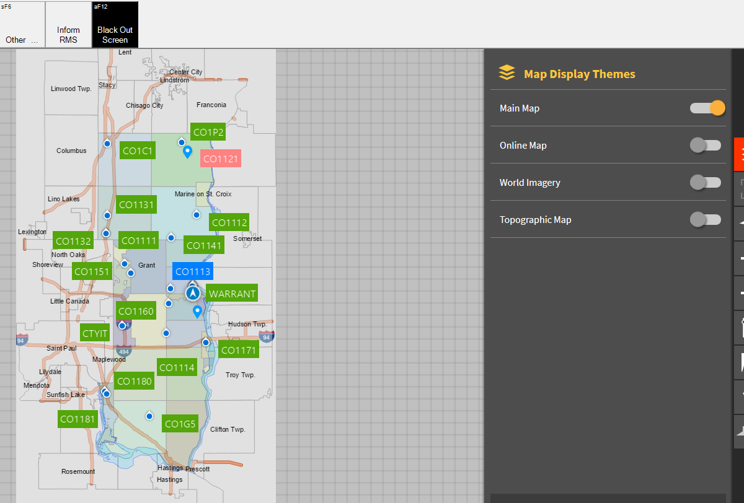
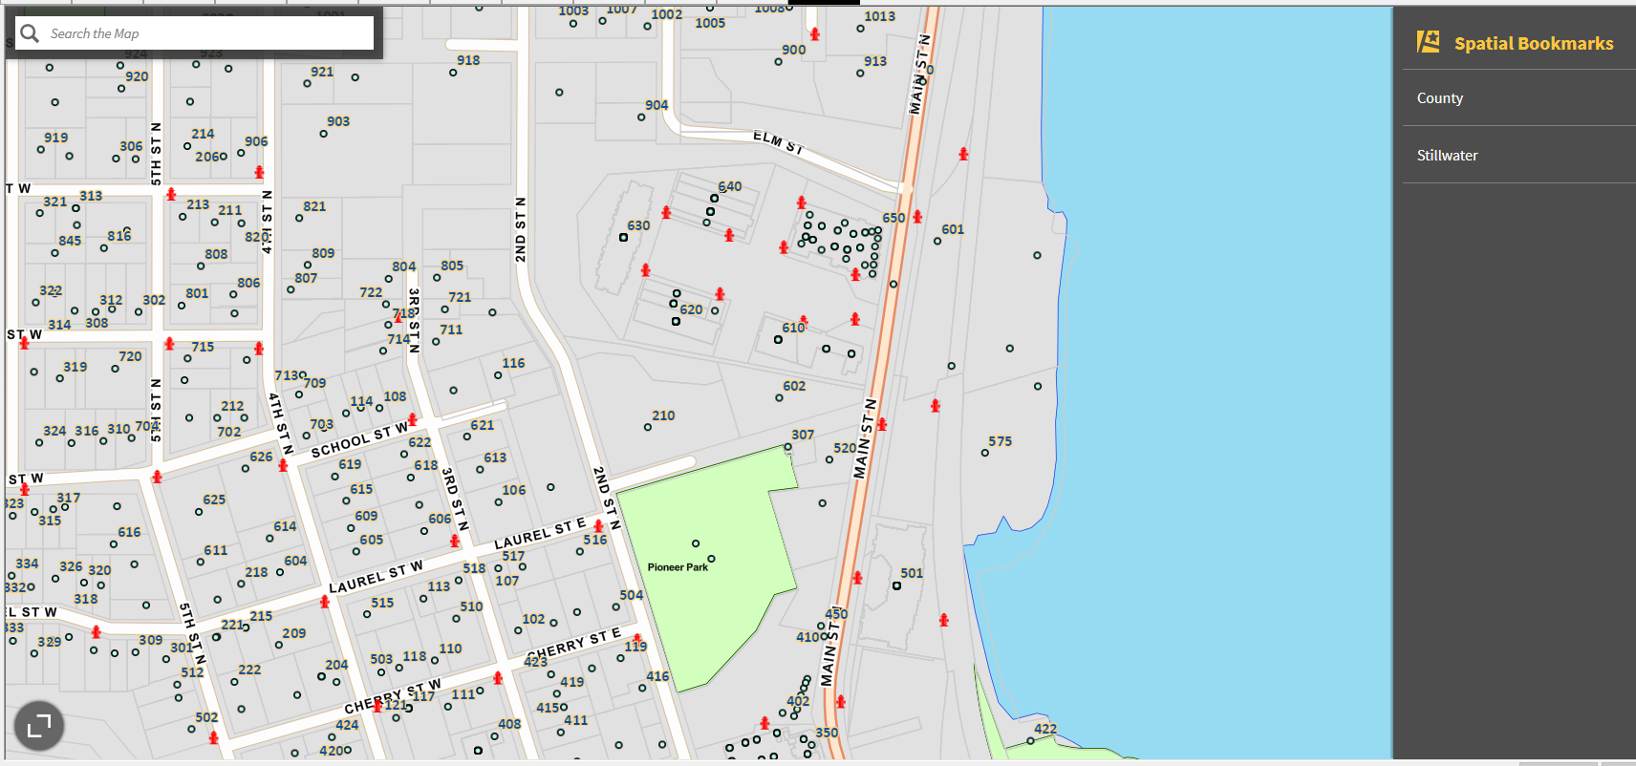
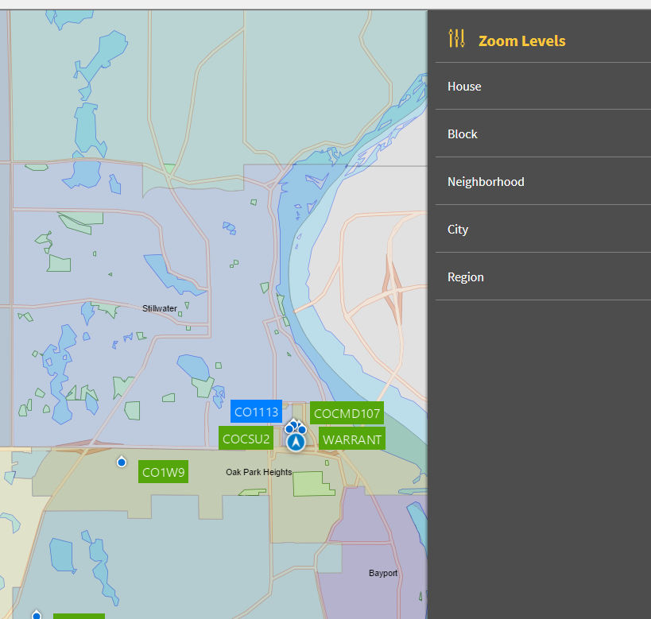
Mapping
Topographical Layers and Imagery
AVL/GPS Resource tracking
Spatial Bookmarks
Operational Layers

Slide 30




My Involvement with Spatial Data and LE
    Data Standards and Accuracy - GIS Project, Data Standards Committee, CJIS Charter Workgroup
    CrimeView Analytics (Ongoing WashCo Project) and Accurint
    Response Plans – Anoka Rhodium
    Data Sharing Efficiencies and Data Privacy

Slide 31
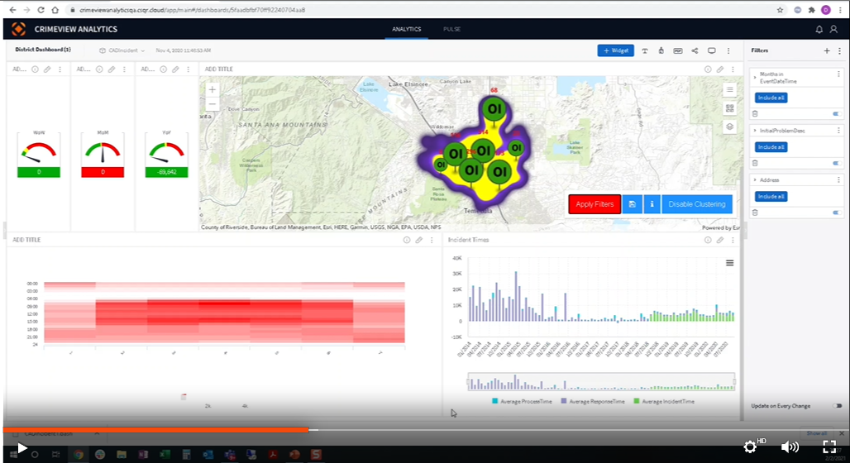



CrimeView Analytics
Statistical Reporting
Based on agency metrics for response times or any other criteria; Including public availability of crime data
Heat Mapping
Types of calls based on locations and/or increases in Calls for Service by location and date/time; Often leads to resource allocation of public safety staffing

Slide 32
CJIS Charter Workgroup
Summary of Property Crimes
Initial Meeting
Second Meeting
Begin project with GAC regarding public accessibility of property crime data within the scope of CJIS best practices
Scope of the workgroup, assign research components to SME’s within the Team
Compile all research into a document of CJIS Best Practices regarding sharing of GIS and LE data
May 20th, 2022
Summer 2022
August
2022
Fall 2022
2023
Research Period
GAC Presentation
Present document to the GAC and identify best place to store this resource for widespread accessibility/use

Slide 33
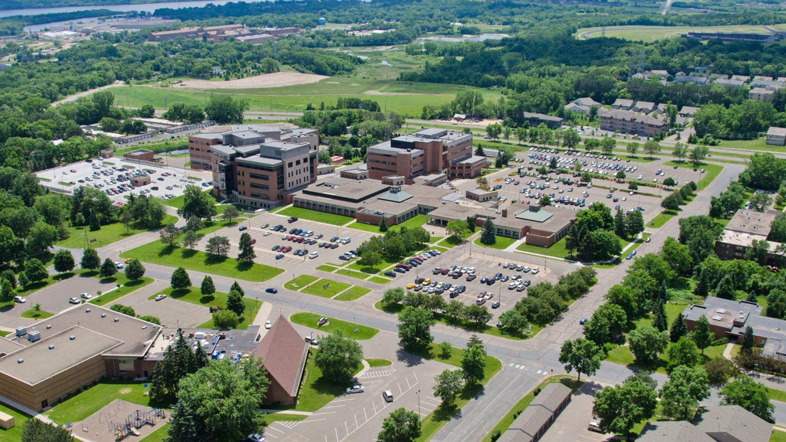
Britta Maddox, Business Analyst
Washington County Sheriff’s Office
15015 62nd St N
Stillwater, MN 55082
651.390.5435 (cell)
Britta.Maddox@co.Washington.mn.us

Slide 34
Agenda Item 8
Legislative Update
Conversations are continuing about the topics of policy, and funding of geospatial program needs
NSGIC Update
Nationwide address data

Slide 35
Agenda Item 9
Open data and outreach
Open parcels effort
Addresses and roads
Role for Outreach Committee?

Slide 36
Agenda Item 10
Updates on GAC Priority Projects and Initiatives
David Brandt

Slide 37
Updates on GAC Priority Projects and Initiatives
Most recent success
Experiencing a barrier?
Next task

Slide 38
GAC Priorities
Project or Initiative Description | Status | Project Owner | Champion
New Lidar Acquisition | Active | Gerry Sjerven | Alison Slaats
Updated and Aligned Boundary Data | Active | Preston Dowell | Alison Slaats
Parcel Data | Active | Alison Slaats | Mark Kotz
Road Centerline Data | Active | MnGeo | Alison Slaats
Image Service Improvements | Active | Jim Bunning | Alison Slaats
Critical Infrastructure Data | Active | Stacey Stark | Steve Swazee
Address Points Data | Active | MnGeo | Alison Slaats
Underground Utilities Data | Active | Steve Swazee | Barb Cederberg
U.S. National Grid Materials | Active | Randy Knippel | Randy Knippel
Archiving Implementation | Active | Ryan Mattke | many
Accurate Hydro-DEMs | Active | Sean Vaughn | many
Culvert Data Standard | Active | Rick Moore | Jonathan Lord

Slide 39
GAC Priorities
Project or Initiative Description | Status | Project Owner | Champion
Remonumentation of Section Corners | Active | Pat Veraguth | Alison Slaats
Success Stories for Geospatial Technology | Recruitment
Geospatial Commons Advisory Group | Recruitment
Criminal Justice Info Best Practices | Recruitment | Britta Maddox
NG911 Forum | Recruitment
Parks Data Standard | Inactive
Summary Crime Data | Inactive | Britta Maddox
Basemap Services | Inactive
Strategy Team for All Types of Imagery | Inactive
State Business License Data | Inactive
Snow Emergency Parking Restriction Data | Inactive
Street Parking Restrictions Data Standard | Inactive
Geospatial Data Asset Inventory | Inactive

Slide 40
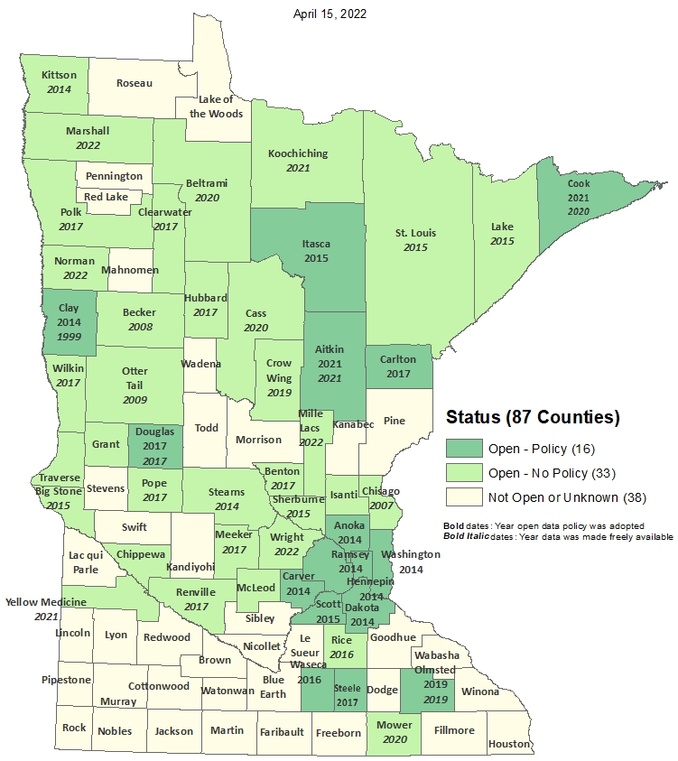
Status of Free and Open Data Public Geospatial Data
Status | Number of Counties | Total
Open - Policy | 16 | 49
Open - No Policy | 33
Not Open or Unknown | 38 | 38
Data current as of April 15, 2022
https://gisdata.mn.gov/dataset/bdry-mn-county-open-data-status

Slide 41
Updated and aligned boundary data
Most recent success:
  Committee discussed difficult parcel mapping issues along county boundaries. Hopefully this will turn into a process for proper handling and mapping of boundaries.
  PLSS Status Map transitioned to MnGeo
  Supporting Remonumentation Subcommittee which is working on Priority 14
  Supporting/documenting Arrowhead Alignment Project
If you are experiencing a barrier:
  Committee member time
Next Task:
  Update PLSS Status Map
  Review PLSS Data Standard
  Continue supporting/documenting Arrowhead Alignment Project

Slide 42
Statewide publicly available parcel data
Most recent success:
  Updated the public GAC-standard compiled dataset. Now include 33 opt-in counties
  Used the streamlined approved by GAC for including additional counties in opt-in dataset. The PLRC committee’s open data team now updates MnGeo with counties that have opted in. Since last GAC meeting, 3 more counties have opted in: Clearwater, Otter Tail and Pope
  A GovDelivery newsletter was sent to community to share success
If you are experiencing a barrier:
  none
Next task:
  PLRC's open data sub-committee’s outreach team will continue reaching out from county to county to talk about benefits of sharing data and learning more about barriers and follow up on survey results.

Slide 43
Road Centerline Data
Most recent success:
  Data submission and validation routines moved to a new portal
If you are experiencing a barrier:
  Work on validation process is still taking precedence over sharing data, but will wrap up in next couple of months
  Need to work out process similar to parcel “opt-in” process to support sharing of data. GAC involvement is requested
Next task:
  Define opt-in process with GAC
  Build and automate the ETL process for aggregating data to the GAC standard
  Publish to the Geospatial Commons

Slide 44
Address Points Data
Most recent success:
  Data submission and validation routines moved to a new portal
If you are experiencing a barrier:
  Work on validation process is still taking precedence over sharing data, but will wrap up in next couple of months
  Need to work out process similar to parcel “opt-in” process to support sharing of data. GAC involvement is requested
Next task:
  Define opt-in process with GAC
  Build and automate the ETL process for aggregating data to the GAC standard
  Publish to the Geospatial Commons

Slide 45
Improvements to the MnGeo Image Service, such as Web Mercator support, tiling, and complementary options such as “composite of latest leaf off imagery”, and downloading options
Most recent success:
  Worked on image viewer recommended by Image Service Sustainability Committee
  Added county imagery from Koochiching County to WMS
If you are experiencing a barrier:
  Time constraints to work on recommendations of committee, and did not accomplish removal of suggested retirement image layers
  Issue with Koochiching imagery borders
Next task:
  Adding county imagery Dakota
  In discussion: Le Sueur, Lyon, Lincoln, and Aitkin Counties

Slide 46
Critical Infrastructure Assessment
Most recent success:
  Published law enforcement dataset to GeoCommons with app for verification
  Published “C.I. resource site” on MnGeo website
If you are experiencing a barrier: Finding avenues to publicize beyond GIS community
Next task: Forming two subgroups:
  Data: Develop workflows for maintaining fire and law enforcement datasets. Determine costs and time, and also desired improvements to the current application (e.g., allowing counties to upload data.
  Collaborations: How can we help HIFLD get info from the states to improve their data workflow? How can national workgroups help us find other contacts to help us meet our goals? Is there cross-participation in workgroups that would be appropriate and helpful between HIFLD (other national?) workgroups and MN data workgroups (e.g., parcel data and C.I. data). What are our next steps?

Slide 47
A project team to develop geospatial data sharing methodologies to support the state’s underground utilities community
Most recent success:
Multiple – See quarterly report
2. If you are experiencing a barrier:
Working through a highly technical geospatial implementation for the first time on the planet - but making progress
3. Next task:
    Currently 5 different work groups simultaneously working over 50 spreadsheet-defined tasks spanning data, legal, security, prototype build, standards, and policy

Slide 48
Maps, procedures, templates and other materials to help all levels of government implement the U.S. National Grid
Most recent success:
  Developed interface to allow map publishers to contribute to an application that provides access to USNG maps series and map books published anywhere on the Internet
If you are experiencing a barrier:
  Time
Next task:
  Complete the above interface
  Migrate existing documentation from ArcMap to ArcGIS Pro

Slide 49
Archiving Minnesota geospatial data
Covered in agenda item 3

Slide 50
Accurate hydro-DEMs (hDEM) that serve modern flood modeling and hydro-terrain analysis tools, and the development of more accurate watercourses and watersheds
Most recent success:
  No success to report related to progress
  3D Geomatics is starting to receive more questions about the new high-density lidar coming and the need for DEM Hydro-modification
    New Lidar will require DEM Hydro-modification
    Previous state investments in DEM hydro-modification and resulting datasets will support new DEM Hydro-modification
If you are experiencing a barrier:
  Funding
Next task:
  Continue to build awareness that new Lidar will require DEM hydro-modification and funding
    Identification of culverts in new lidar will facilitate DEM hydro-modification

Slide 51
Development of a culvert data standard for data sharing across the geospatial and infrastructure asset management communities
Most recent success:
  Identifying resources and interested parties to become partners/members in the committee. Researching Culvert Data practices of other states to identify best practices.
If you are experiencing a barrier:
  Identifying time to coordinate meetings for the standard. Culvert Data Standard will become high priority in 2022 in tandem with DEM Hydro-modification Subgroup.
Next task:
  Meeting will be set to bring together interested parties for the Culvert Data Standard. Meeting with MnDOT representatives forthcoming

Slide 52
Remonumentation of all section corners
Covered in agenda item 4

Slide 53
CJIS Data GIS Best Practices
Most recent success:​
  SMEs met May 24 to begin work
If you are experiencing a barrier:​
Actively recruiting team members should anyone wish to join!
Next task:​
  Summary Crime Data - pending the completion of CJIS Data GIS Best Practices as that will be key to what we share for this.

Slide 54
New Lidar Acquisition
Most recent success:
  Created LAB Coordinators
  Statement of Work and Task Orders approved for Upper and Central Mississippi LAB, awaiting vendor selection
  Spring Flights in progress for SE and SW Minnesota
  Awaiting data for NE Minnesota this summer
If you are experiencing a barrier:
  Coordinating delivery of data and storage
Next task:
  Outreach for Minnesota River East & West LAB’s for potential 2023 collect
  Coordinate communication with the LAB partners

Slide 55
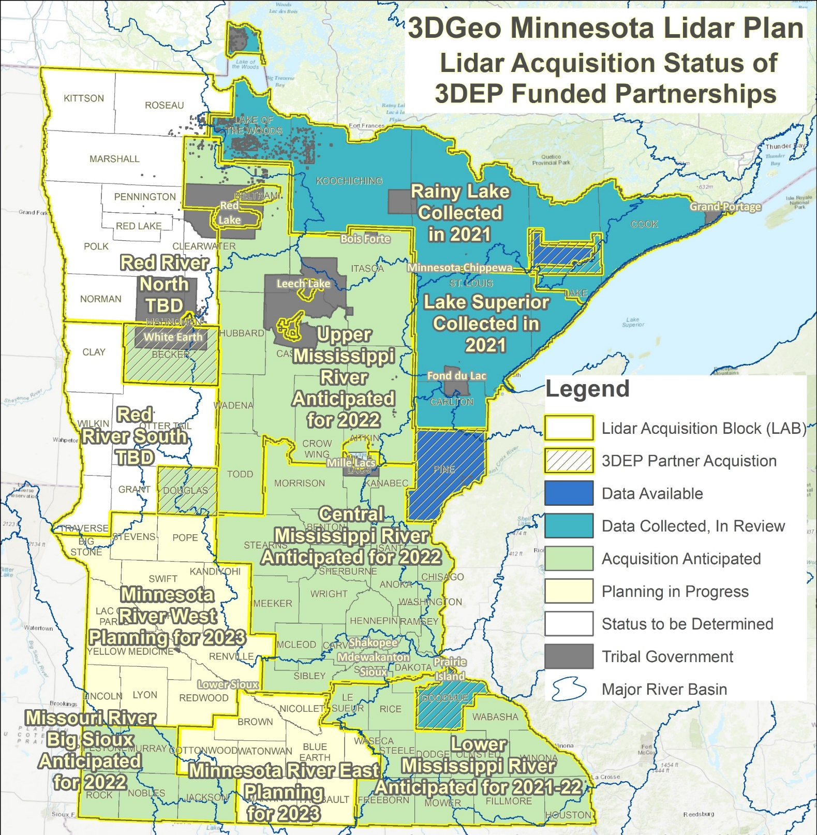
MN Lidar Status Map
Contributions to Minnesota Lidar ($ millions)
Minnesota Partners (over 40) : $ 6.05
USGS 3DEP: $11.60
Other Federal $ 0.45
Total: $18.1M
Spring 2022 Acquisition – 6 Projects
  Poor Spring Weather Conditions
      Wet – Standing water, flooding
      Partial 2021 data acquisition in SE
  As many as 13 Fixed Wing Aircraft Collecting

Slide 56
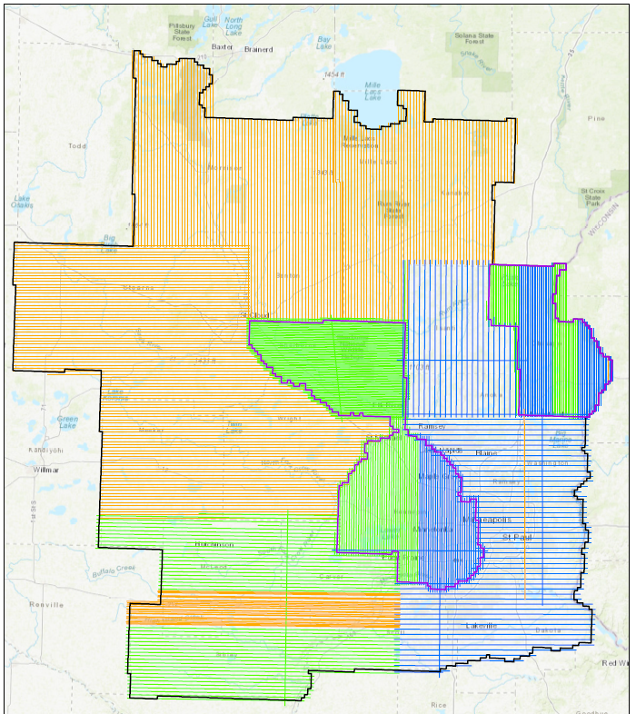
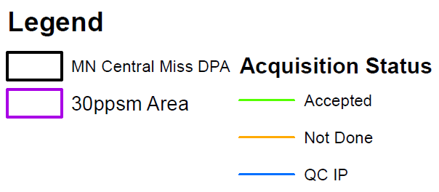
Lidar Acquisition: Central Miss LAB
Le Sueur
Olmsted

Slide 57
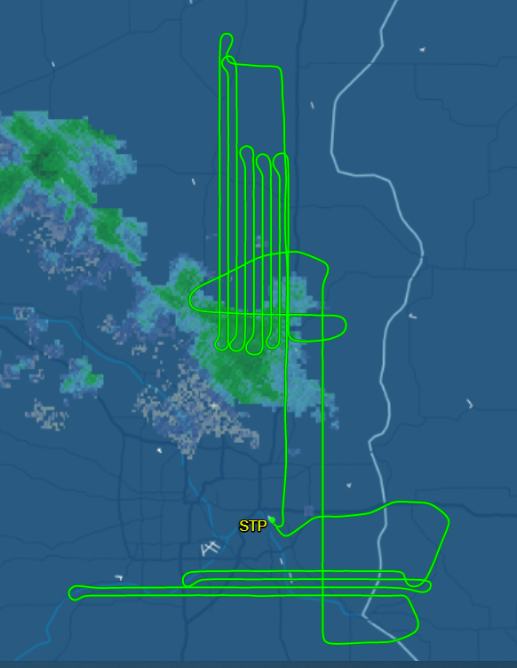
Lidar Acquisition: Central Miss LAB
Acquisition Flight Monitoring
Aircraft shift in response to conditions
  Image shows clouds moving in and the plane shifting off to a different location.
Le Sueur
Olmsted

Slide 58
Agenda Item 11
Announcements

Slide 59
Next Meeting
September 28, 2022

Slide 60
Adjourn
Thank you

