Slide 1



Minnesota Geospatial Advisory Council
December 14, 2022

Slide 2
Welcome
Introductions
Approve agenda
Approve September minutes

Slide 3
Introductions
City, Twin Cities metro
Cory Richter, Ramsey County
City, Greater Minnesota
Shawn Strong, City of Brainerd
County, Twin Cities metro
Victoria Reinhardt, Ramsey County
County, Greater Minnesota
Patrick Veraguth, Douglas County
Regional government, Twin Cities metro
Matt McGuire, Met Council
Regional government, Greater Minnesota
vacant
State agencies
Kari Geurts, DNR
Ben Timerson, MnDOT
Federal government
Mitch Bergeson, U.S. Geological Survey
Jeff Bloomquist, Risk Management Agency, USDA
Tribal government
Ryan Bonney, Shakopee Mdewakanton Sioux Community
Non-profit organizations
vacant
Business
Kendis Scharenbroich, Pro-West & Associates
Gerry Sjerven, Minnesota Power
Higher Education
Len Kne, U-Spatial / UMN Twin Cities
Stacey Stark, U-Spatial / UMN Duluth
K-12 Education
Shanna Crosson, U-Spatial / UMN Twin Cities
MetroGIS
David Brandt, Washington County
MN GIS/LIS Consortium
Leanne Knott, City of Red Wing
Surveyor
Chris Mavis, Hennepin County
At-large
Alex Steele, Minnehaha Creek Watershed District
Heather Albrecht, Hennepin County
Britta Maddox, Anoka County
1 Chief Geospatial Information Officer (ex-officio)
Alison Slaats, MnGeo

Slide 4
Agenda
Time | Topic |  | Time | Topic
10:00 | Introductions, approve agenda and previous minutes |  | 11:05 | Break
10:10 | Committee reports – Review and accept |  | 11:15 | Archiving update
10:20 | Stream ID Standard approval |  | 11:35 | GAC priority projects and initiatives update
10:25 | Criminal Justice Information Best Practices update |  | 11:55 | Announcements
10:30 | 2023 Priority Project Survey Scores |  | noon | Adjourn
10:55 | Legislative Updates

Slide 5
Agenda Item 2
Committee Reports – Review and Accept
All

Slide 6
Agenda Item 3
Stream ID Standard – Request for Approval
Curt Carlson, Mark Kotz

Slide 7
Stream ID Standard
Original GCGI Standard
“Codes for the Identification of River Reaches and Watercourses in Minnesota”
Created in 1990s
GAC Revision
Updating to GAC format
Updating language and structure to be more intuitive, increase clarity
More explicitly describe how to use/comply with standard

Slide 8
Stream ID Standard
Purpose
Common coding schemes for watercourses (the entirety of a stream) and reaches (a portion of a stream) for transferring stream data
Sources
Federal Geographic Names Information System
DNR Fisheries Stream Survey Manual

Slide 9
Stream ID Standard
Workgroup
Jamie Schulz, MNIT at DNR
Andrea Bergman, MNIT at DNR
Jennifer Crea, MNIT at PCA
Mark Kotz, Met Council
Curt Carlson, MnGeo
Standards Committee discussions and review of public review comments

Slide 10
Stream ID Standard
Public Review Process
90 days ending 7/31/22
5 comments
Most adopted to increase clarity of standard

Slide 11
Stream ID Standard
Standards Committee requests approval of draft version 1.1

Slide 12
Agenda Item 4
Criminal Justice Information Best Practices update
Britta Maddox
Final document for approval

Slide 13
Agenda Item 5
2023 Priority Project Survey Scores
David Brandt

Slide 14
Why Create Priorities?
To create a voice for the MN geospatial community
To direct work plans of the GAC and its committees
To advise MnGeo on needs of the community
To allow other organizations to compare priorities and align efforts
To inform outreach and policy related efforts
Having clear direction helps motivate people to participate

Slide 15
GAC Priorities Process
Create a list of proposed projects and initiatives
From GAC members and committee chairs
Outreach to sectors
Assess the value of each – degree of business need
MN Geospatial Priorities Survey
Assess likelihood of success of each - owner, work team, champion, funding
Preliminary priority calculation
GAC discusses and adjusts

Slide 16
MN Geospatial Priorities Survey
344 survey responses
357 last year
-13 responses

Slide 17
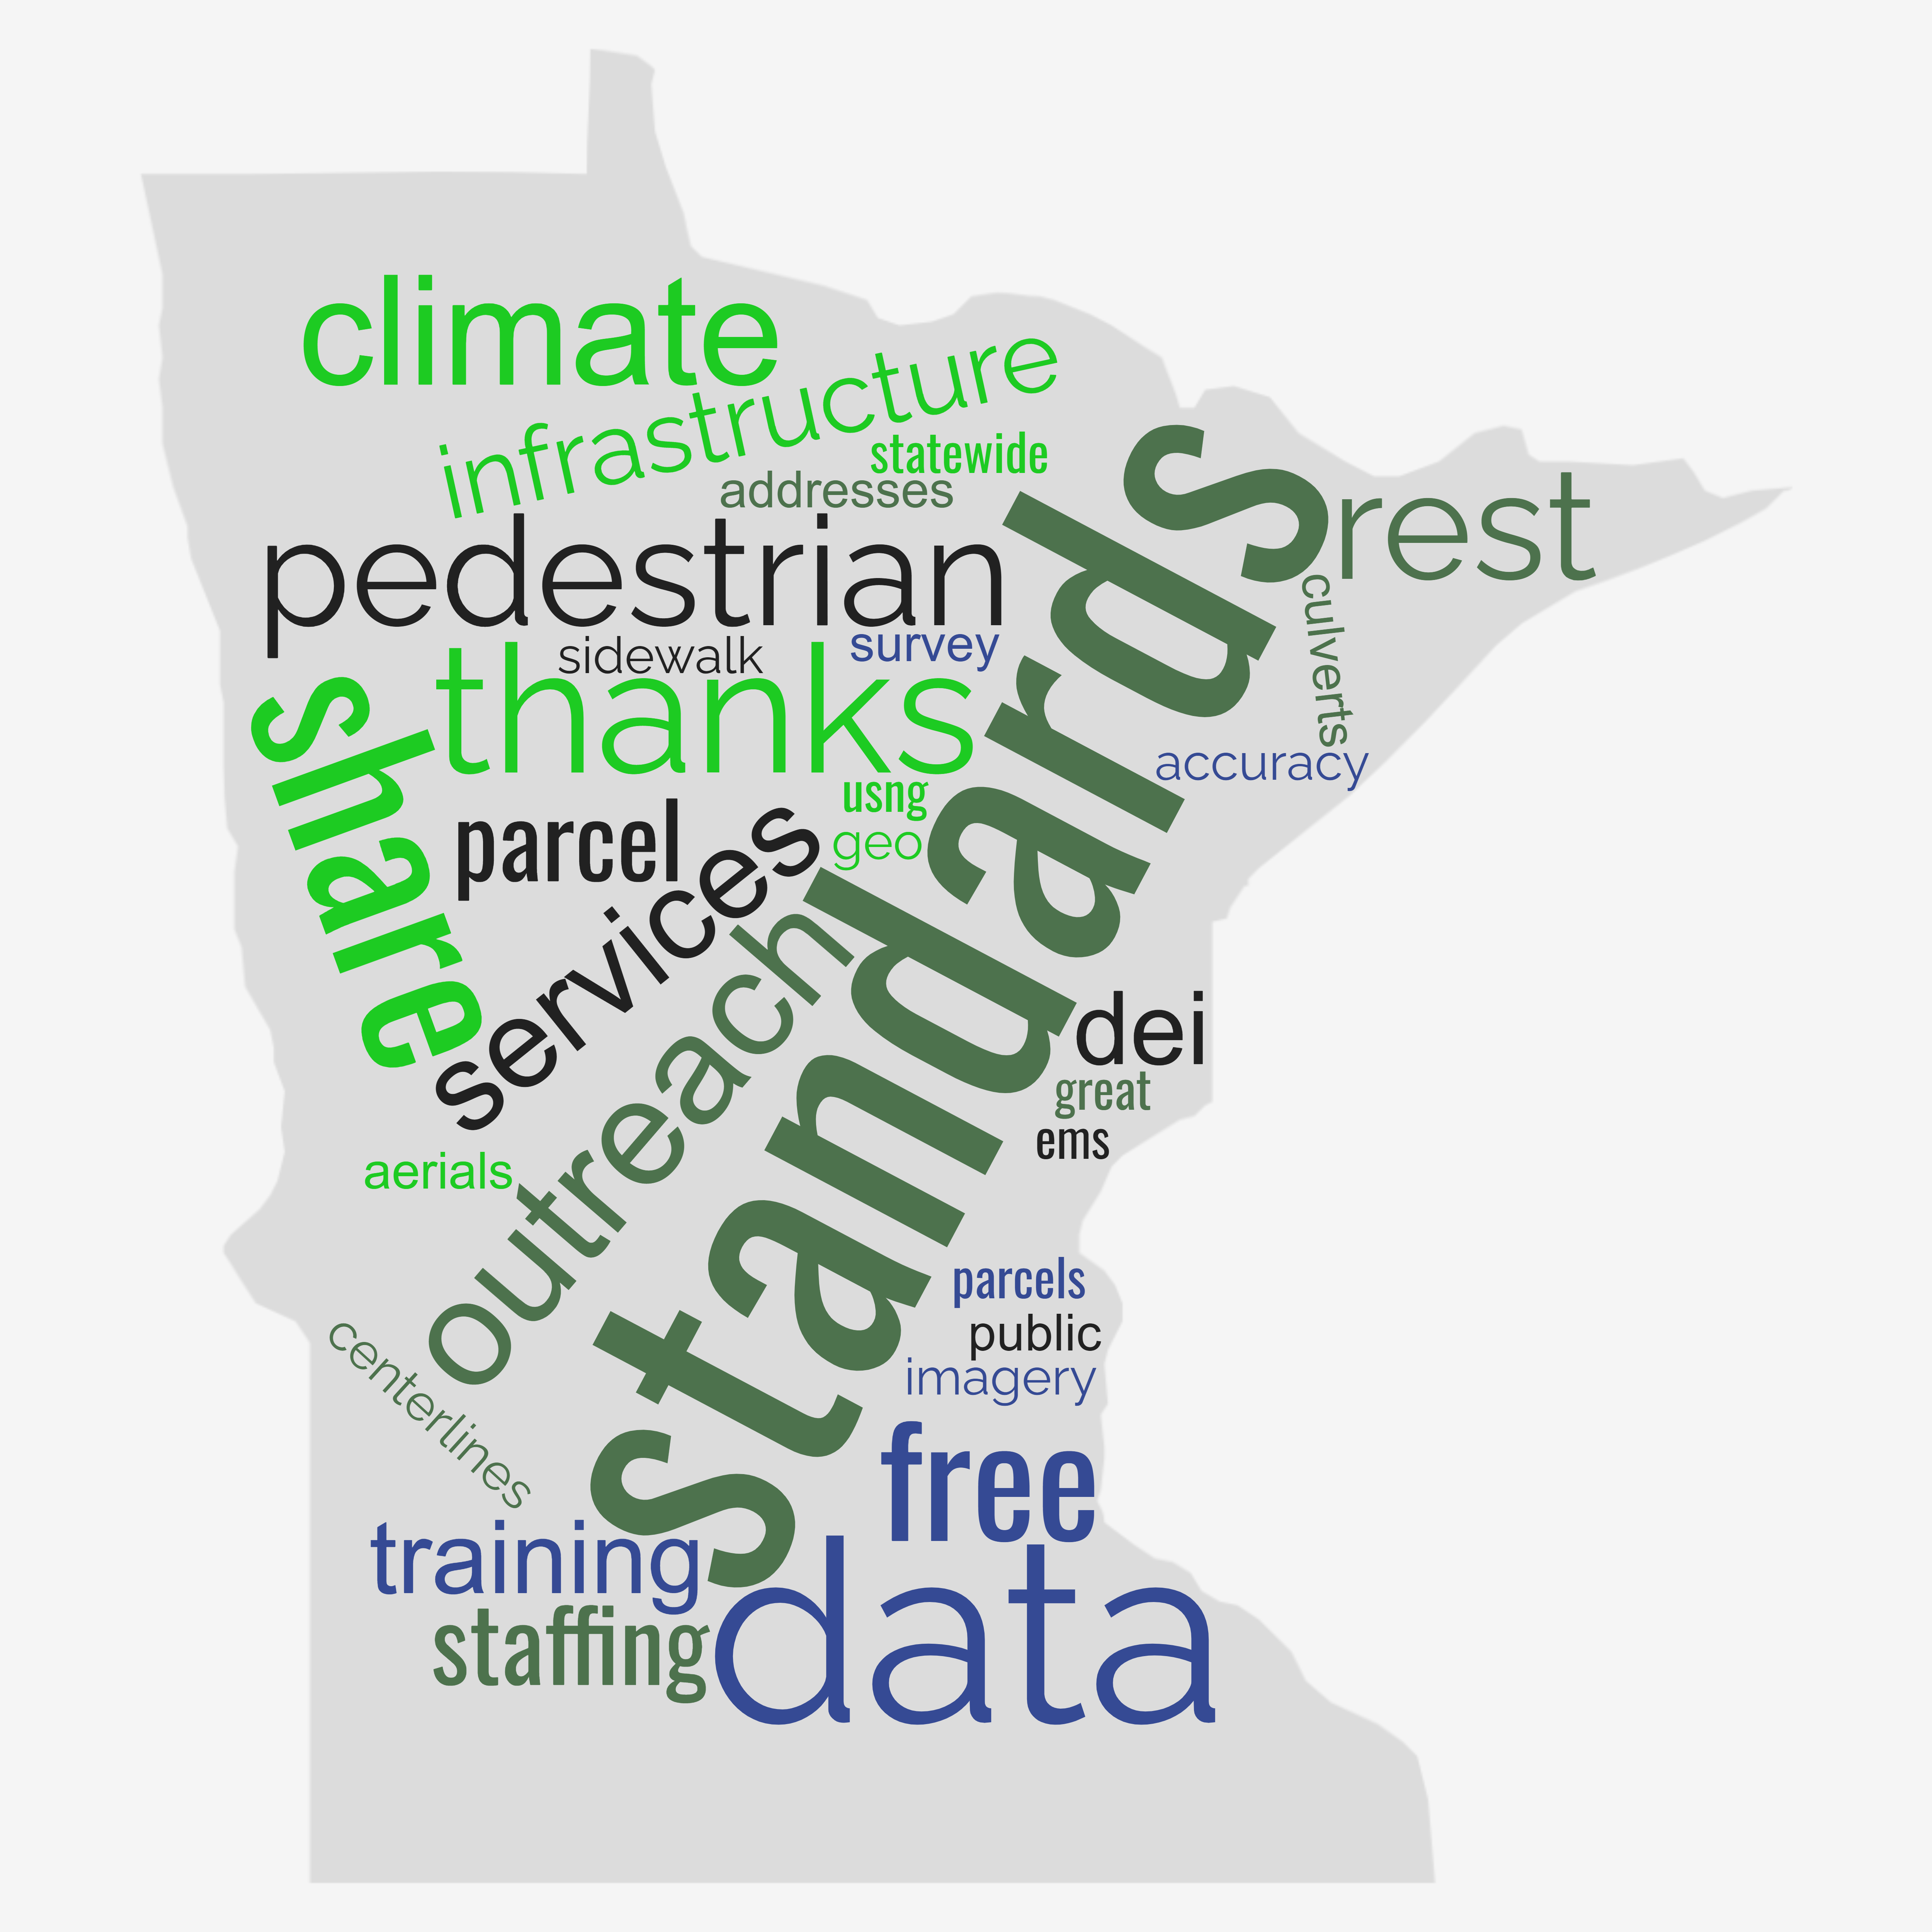
Comments and Feedback
37 comments
Importance of standards and data sharing
Aerials, centerlines, parcels and 911 related statewide data needs
Climate related data
Pedestrian network
Diversity Equity and Inclusion

Slide 18
MN Geospatial Priorities Survey
Results scoring:
Critical = 3
Very Important = 2
Nice to have = 1
Not needed or not answered = 0
Scores shown weighted and unweighted
Weighting by GAC seats representing sectors (e.g., nonprofit weight of 1 (1 seat), state government weight of 2 (2 seats))
Results are very similar weighted and unweighted

Slide 19
Project Short Name | Score Weighted by Sector | Score Not Weighted
Parcel Data | 1.999 | 2.09
State Business License Data | 1.960 | 1.93
Critical Infrastructure Data Workflow | 1.924 | 1.92
Updated & Aligned Boundary Data | 1.904 | 1.95
Publication of Open Foundational Datasets | 1.876 | 1.79
Address Points Data | 1.814 | 1.78
Remonumentation of all Section Corners | 1.775 | 1.81
CJIS Data GIS Best Practices | 1.697 | 1.74
Lidar Data | 1.662 | 1.67
Street Parking Restrictions Data Standard | 1.660 | 1.71
Culvert Data Standard | 1.584 | 1.49
Geospatial Commons Advisory Group | 1.546 | 1.60
Inventory of MN GeoData Assets | 1.428 | 1.57
Snow Emergency Parking Data Best Practices | 1.417 | 1.33
Strategy Team for All Types of Imagery | 1.403 | 1.40
Geodata Archive Implementation | 1.400 | 1.36
U.S. National Grid Materials | 1.337 | 1.40
MnGeo Image Service Improvements | 1.289 | 1.44
NG9-1-1 Geospatial Forum | 1.287 | 1.19
Parks Data Standard | 1.266 | 1.36
Road Centerline Data | 1.237 | 1.23
Summary Crime Data | 1.099 | 1.08
Underground Utilities Data Sharing Team | 1.061 | 1.16
Success Stories for Geospatial Technology | 0.874 | 0.85
Hydro-DEMs | 0.824 | 0.79
Basemap Services | 0.747 | 0.73

Slide 20
Prioritization
Value Score = Weighted survey result x 10
Likelihood of Success Score
Project owner = 3
Project team = 2
Champion = 2
Funding = 2
Effort: low = 3, medium = 2, high = 1
Big, colorful spreadsheet

Slide 21
Project or Initiative Name | Status | Do in '23 | GAC Rank | Priority Score | Value Score | Survey Score | Success Score | Owner Exists | Work Team Exists | Active Champ Exists | $$ Exists | Est $$ | Easy Score | Effort | Priority Owner | Champ
Parcel Data | Active |  |  | 200 | 20 | 1.999 | 10 | 3 | 2 | 2 | 2 | $0 | 1 | High | Alison Slaats | Ryan Stovern
Critical Infrastructure Data Workflow | Active |  |  | 192 | 19 | 1.924 | 10 | 3 | 2 | 2 | 2 | ? | 1 | High | Stacey Stark | Swazee
Updated & Aligned Boundary Data | Active |  |  | 190 | 19 | 1.904 | 10 | 3 | 2 | 2 | 2 | $0 | 1 | High | Preston Dowell | Alison Slaats
Address Points Data | Active |  |  | 181 | 18 | 1.814 | 10 | 3 | 2 | 2 | 2 | $0 | 1 | High | MnGeo | Alison Slaats
Culvert Data Standard | Active |  |  | 174 | 16 | 1.584 | 11 | 3 | 2 | 2 | 2 | $0 | 2 | High | Rick Moore | Lord
Lidar Data | Active |  |  | 166 | 17 | 1.662 | 10 | 3 | 2 | 2 | 2 |  | 1 | High | Gerry Sjerven | Alison Slaats
U.S. National Grid Materials | Active |  |  | 147 | 13 | 1.337 | 11 | 3 | 2 | 2 | 2 | ? | 2 | Med | Randy Knippel | Knippel
Remonumentation of all Section Corners | Active |  |  | 142 | 18 | 1.775 | 8 | 3 | 2 | 2 |  | some | 1 | High | Pat Veraguth | Alison Slaats
MnGeo Image Service Improvements | Active |  |  | 129 | 13 | 1.289 | 10 | 3 | 2 | 2 | 2 | $0 | 1 | High | Alison Slaats | Alison Slaats
Geodata Archive Implementation | Active |  |  | 126 | 14 | 1.4 | 9 | 3 | 2 | 2 | 1 | some | 1 | High | Ryan Mattke | many
Road Centerline Data | Active |  |  | 124 | 12 | 1.237 | 10 | 3 | 2 | 2 | 2 | $0 | 1 | High | MnGeo | Alison Slaats
Underground Utilities Data Sharing Team | Active |  |  | 117 | 11 | 1.061 | 11 | 3 | 2 | 2 | 2 | $0 | 2 | Med | Steve Swazee | Cederberg
CJIS Data GIS Best Practices | Recruitment underway |  |  | 85 | 17 | 1.697 | 5 | 3 |  |  |  | ? | 2 | Med
Geospatial Commons Advisory Group | Recruitment underway |  |  | 77 | 15 | 1.546 | 5 |  |  |  | 2 | $0 | 3 | Low
Hydro-DEMs | Active |  |  | 66 | 8 | 0.824 | 8 | 3 | 2 | 2 |  | some | 1 | High | Sean Vaughn | Many
Summary Crime Data | Inactive |  |  | 55 | 11 | 1.099 | 5 | 3 |  |  |  | ? | 2 | Med | Britta Maddox
Success Stories for Geospatial Technology | Active/Recruitment underway |  |  | 52 | 9 | 0.874 | 6 |  | 2 |  | 2 | $0 | 2 | Med
NG9-1-1 Geospatial Forum | Recruitment underway |  |  | 51 | 13 | 1.287 | 4 |  |  |  | 2 | $0 | 2 | Med
Parks Data Standard | Inactive |  |  | 51 | 13 | 1.266 | 4 |  |  |  | 2 | $0 | 2 | Med
State Business License Data | Inactive |  |  | 39 | 20 | 1.96 | 2 |  |  |  |  | ? | 2 | Med
Street Parking Restrictions Data Standard | Inactive |  |  | 33 | 17 | 1.66 | 2 |  |  |  |  | ? | 2 | Med
Snow Emergency Parking Data Practices | Inactive |  |  | 28 | 14 | 1.417 | 2 |  |  |  |  | ? | 2 | Med
Strategy Team for All Types of Imagery | Inactive |  |  | 28 | 14 | 1.403 | 2 |  |  |  |  | $0 | 2 | Med
Basemap Services | Inactive |  |  | 22 | 7 | 0.747 | 3 |  | 2 |  |  | some | 1 | High
Inventory of MN GeoData Assets | Inactive |  |  | 14 | 14 | 1.428 | 1 |  |  |  |  | ? | 1 | High
Publication of Open Foundational Datasets | Inactive |  |  | 0 | 19 | 1.876 | 0 |  |  |  |  | ?

Slide 22
Agenda Item 6
Legislative Updates
Alison Slaats and Brandon Hirsch
Overview of next legislative session
Surveyor-led team will pursue PLSS legislation
MnGeo will request increase in appropriation for surveyor position, lidar data storage and distribution support, and to support additional foundational dataset work

Slide 23
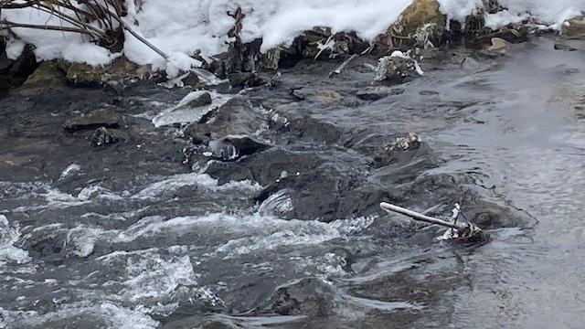
Break

Slide 24
Agenda Item 8
Archiving Update
Karen Majewicz and Melinda Kernik

Slide 25
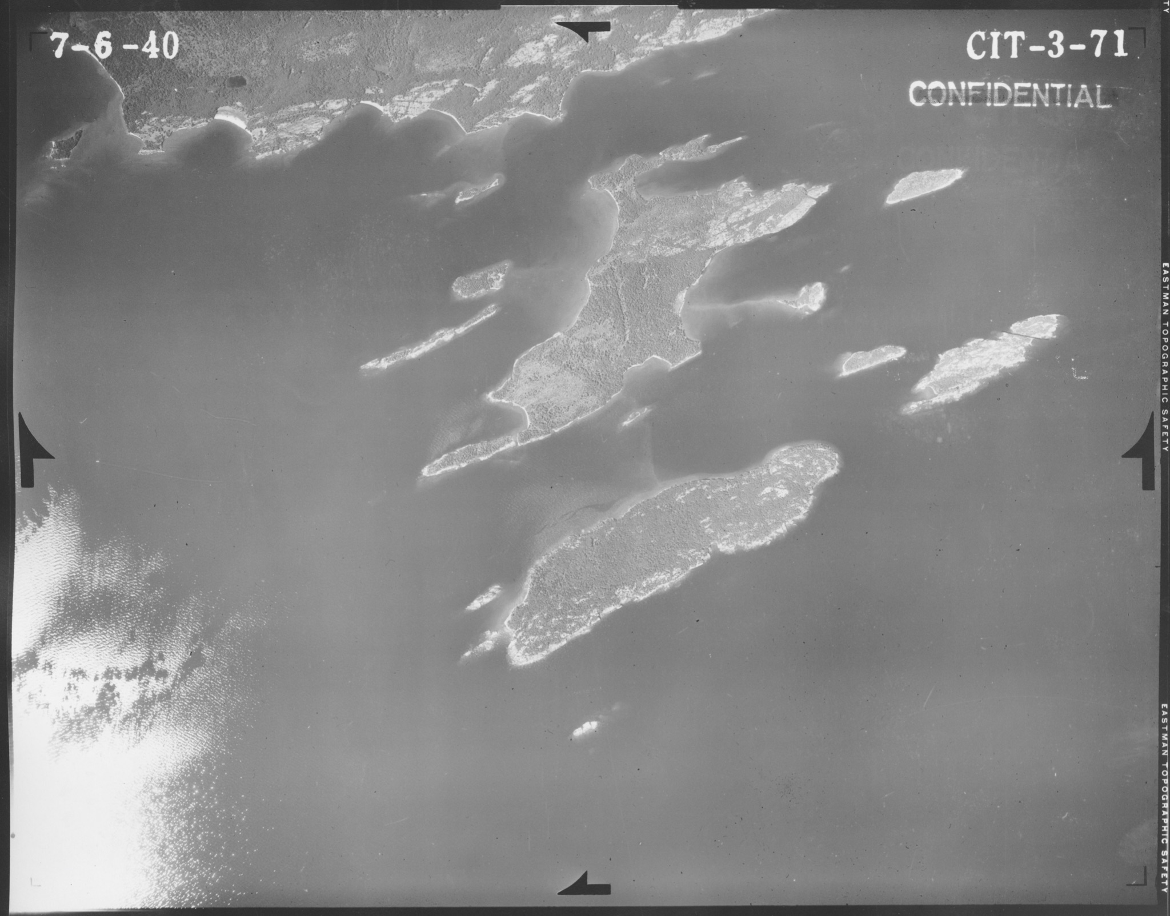
Archiving Imagery Workgroup
MnGAC Quarterly Meeting
Dec. 2022
Karen Majewicz (chair)
Melinda Kernik (vice-chair)
Aerial image from Cook County (Lake Superior) 1940

Slide 26
Archiving Imagery Workgroup
CONTEXT
Archiving Workgroup (2019)
Charter
Work plan
Archiving Implementation Workgroup (2020)
Charter
Work plan
Archiving Pilot Workgroup (2021)
Charter
Work plan
Archiving Imagery Workgroup (2022)
Proposed Charter
Proposed Work plan
Policies, priority datasets, and outreach
Workflows, technology needs assessment, and funding options
Discovery and access technology options
Research and document how to archive imagery
Notes:
We have had several Archiving Working Groups over the past few years - looking at policies, workflows, and technology options - but these groups have primarily focused on vector data.
There are some unique challenges when it comes to archiving imagery. In particular, large file sizes complicate providing access (both within the discovery platform and with transferring files)

Slide 27
Archiving Imagery Workgroup
CHARTER
Objectives
Research the historical and current formats of imagery data
Assess the monetary investment involved in the original creation of Minnesota imagery
Consult with the Image Service Sustainability Committee on planning workflows for image service retirements
Identify any major challenges with archiving imagery data, such as space considerations due to the size of the files
Evaluate existing practices and potential strategies for transferring, storing, transforming, documenting, and archiving imagery data

Slide 28
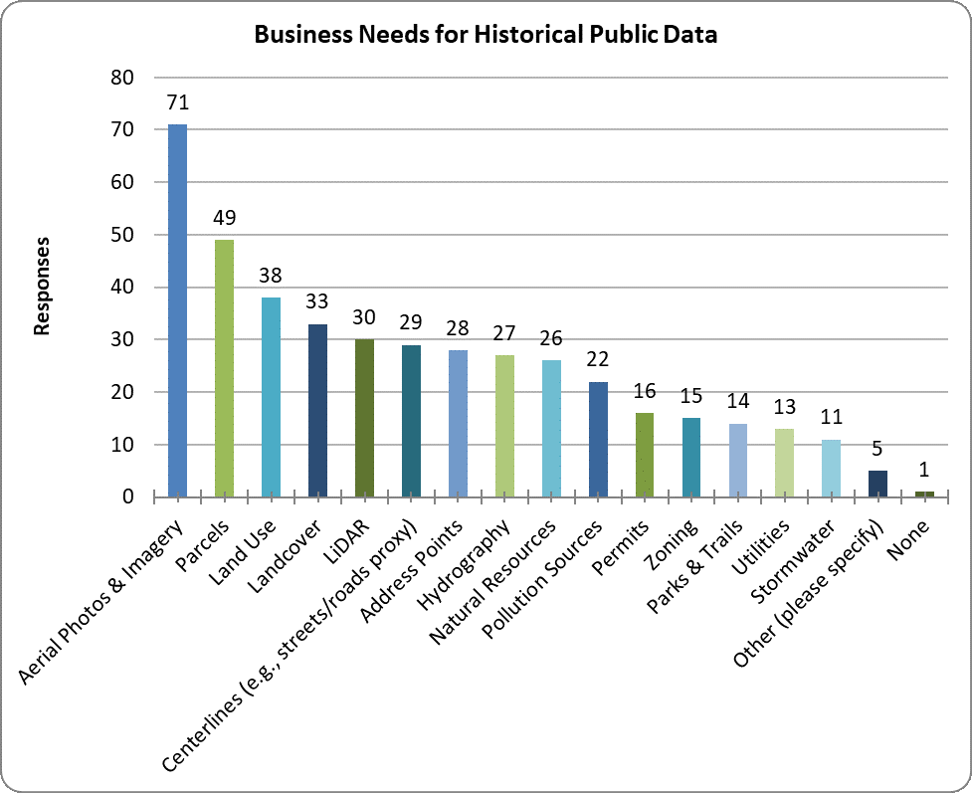
Archiving Imagery Workgroup
VALUE
Archiving Workgroup Survey 2018
The most important need for historical data is aerial photos & imagery

Slide 29
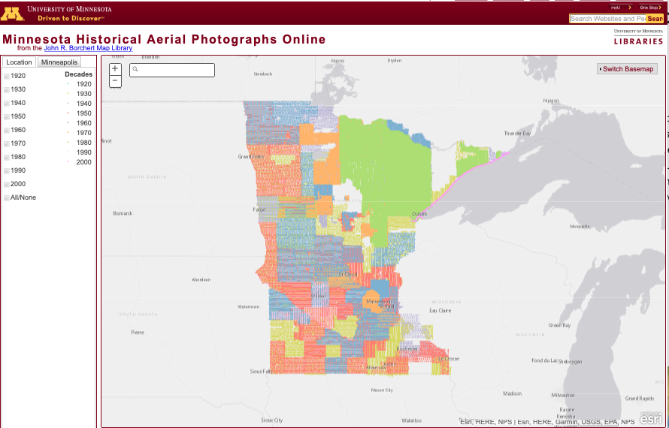
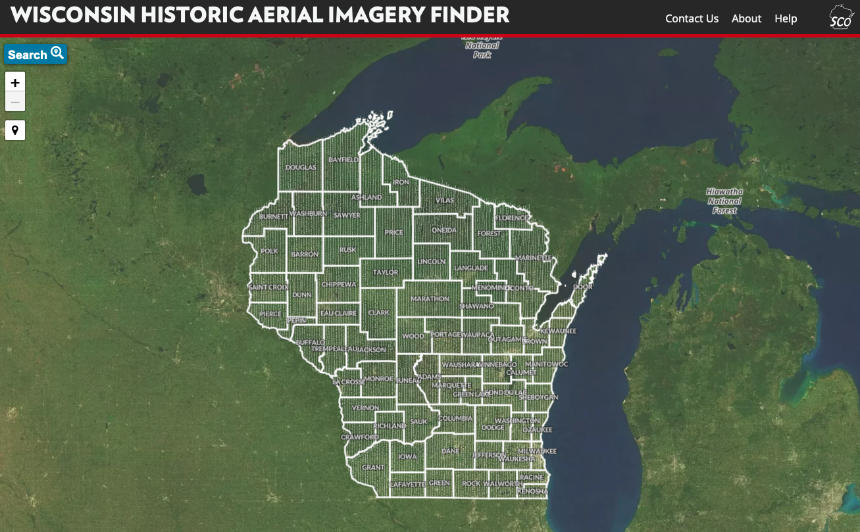
Archiving Imagery Workgroup
USE
MHAPO Statistics
Site visitors per month (average): 5,300
Site downloads per month (average):17,200
BTAA Geoportal Statistics
Most commonly visited page: Wisconsin Historic Aerial Imagery Finder (Aerial Photos 1937-41)

Slide 30
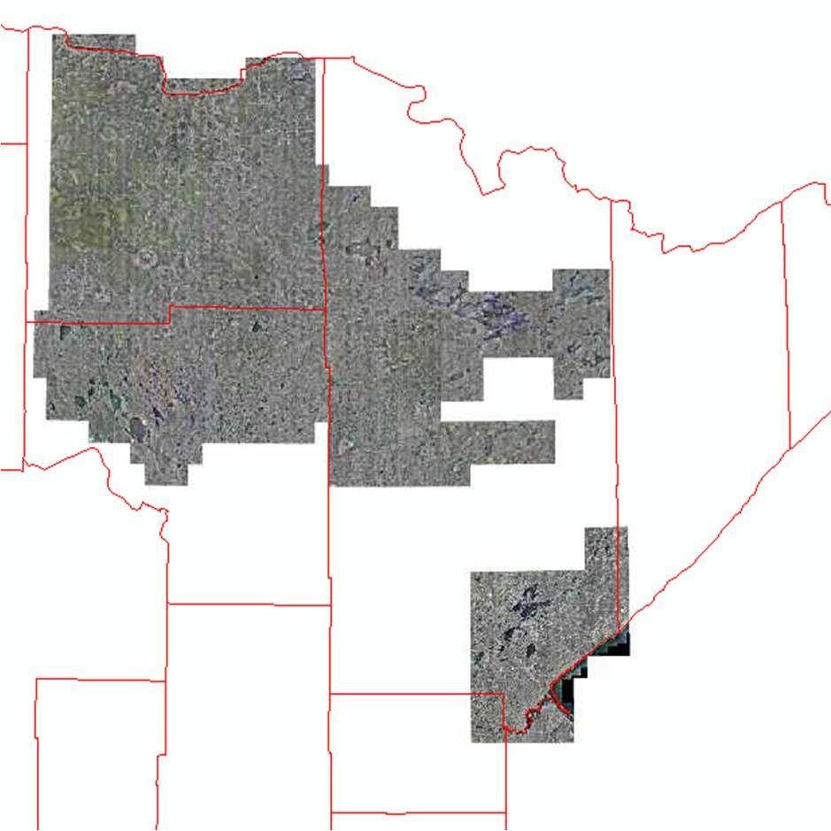
Archiving Imagery Workgroup
Eras (generalized)
Analog
1920s-1990s
Storage: Images on film stored as physical media at libraries and agencies
Access: Scanned images available for download
Digital
1990s-present
Images as digital files stored on hard drives and servers
Access: rasters downloads and images stitched together to become geospatial image services

Slide 31
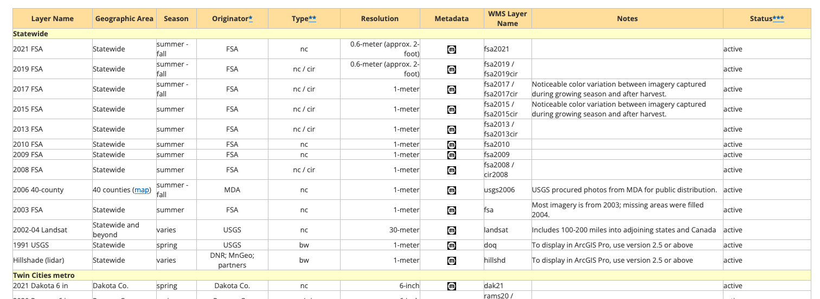
Archiving Imagery Workgroup
MnGeo Image Service

Slide 32
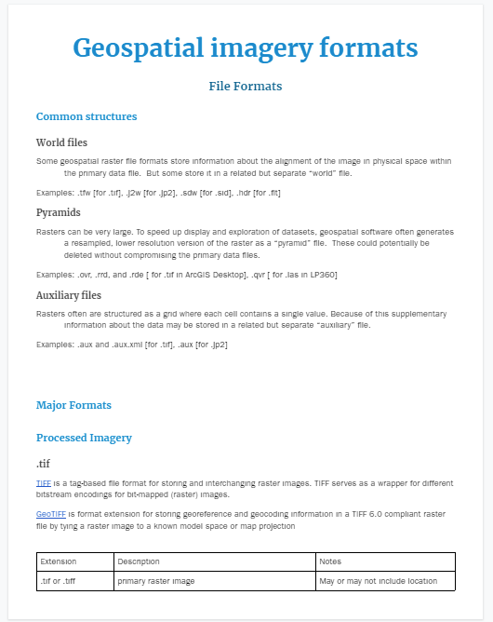
Archiving Imagery Workgroup
FILE FORMATS
Notes:
In addition to reference materials, we also examined a selection of aerial imagery inventories at the University of Minnesota John R. Borchert Library collection and from MnGeo. These activities aided us in producing an extensive (though not fully comprehensive) list of geospatial imagery file formats.

Slide 33
Archiving Imagery Workgroup
FILE FORMAT INVENTORY
File Format | Total size (before de-duplication)
.tif | 51.2 TB
.jp2 | 1.1 TB
.sid | 611.1 GB
.flt | 519.1 GB
.jpg | 142.8 GB
.adf | 101.0 GB
.bil | 48.7 GB
.img | 1.0 GB
.tiff | 865.4 MB
.ecw | 193.1 MB
Top 10 raster file formats
held by MNGeo
Notes:
We were also trying to get a general sense of what quantity of the different file formats we might expect. These are the top 10 raster file formats by size from our inventory of imagery currently held by MNGeo. Just a note: these numbers were calculated before we looked for duplicate copies. The file sizes should be seen as relative quantity, not exact numbers. The most important takeaway is that most of the imagery files are stored as TIFs - that is the recommended file format for archiving images.

Slide 34
Archiving Imagery Workgroup
FILE FORMAT INVENTORY
File Format | Total size (before de-duplication)
.tif | 51.2 TB
.jp2 | 1.1 TB
.sid | 611.1 GB
.flt | 519.1 GB
.jpg | 142.8 GB
.adf | 101.0 GB
.bil | 48.7 GB
.img | 1.0 GB
.tiff | 865.4 MB
.ecw | 193.1 MB
Top 10 raster file formats
held by MNGeo
 | Proprietary
 | Legacy
Notes:
But there are a variety of other file formats commonly being used, including some that are either proprietary or a legacy format.

Slide 35
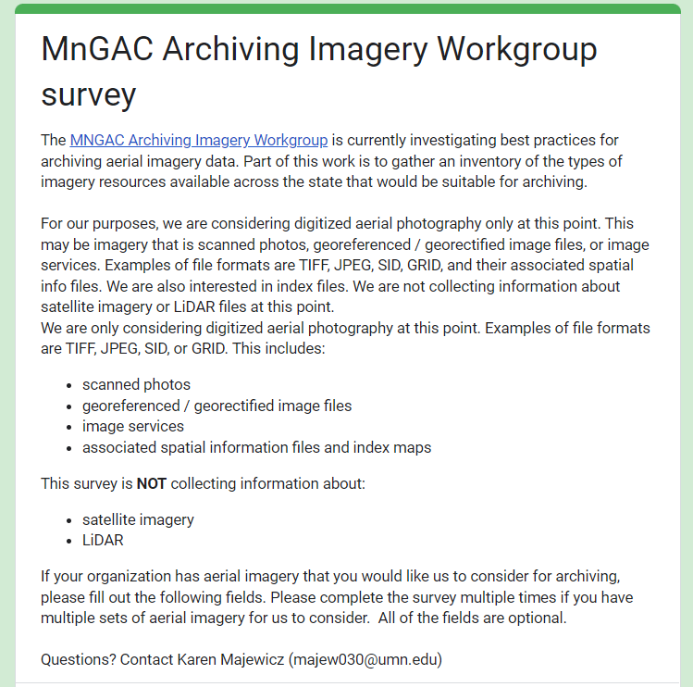
Archiving Imagery Workgroup
COMMUNITY SURVEYS
Notes:
To reach a wider audience, we created an online survey to gather information about what types imagery exist across the state that would be suitable for archiving. Responses were collected from November 2-28, 2022. We received 12 responses from a variety of organizations including those representing county, city, university, private company, and tribal nation.
Responses were collected from November 2-28, 2022. Twelve responses were received in this short time period.

Slide 36
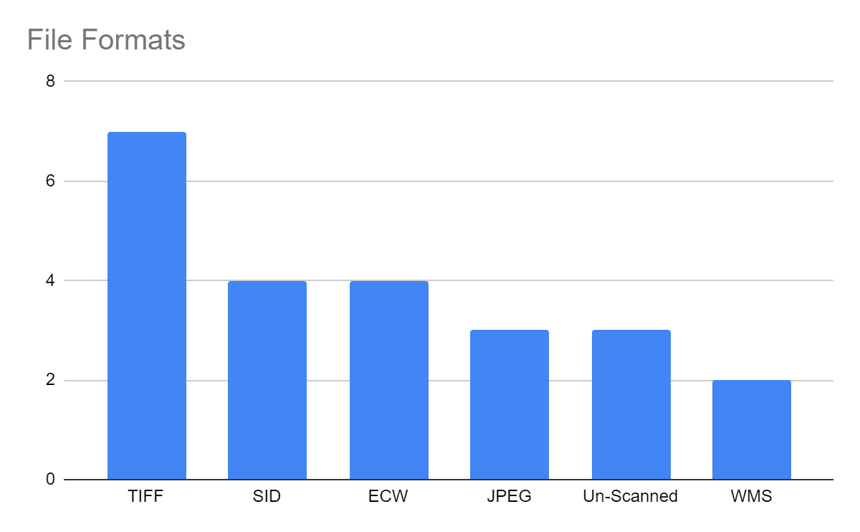
Archiving Imagery Workgroup
COMMUNITY SURVEYS
Notes:
To summarize just a few of our findings, TIFF was again the most prevalent file format.

Slide 37
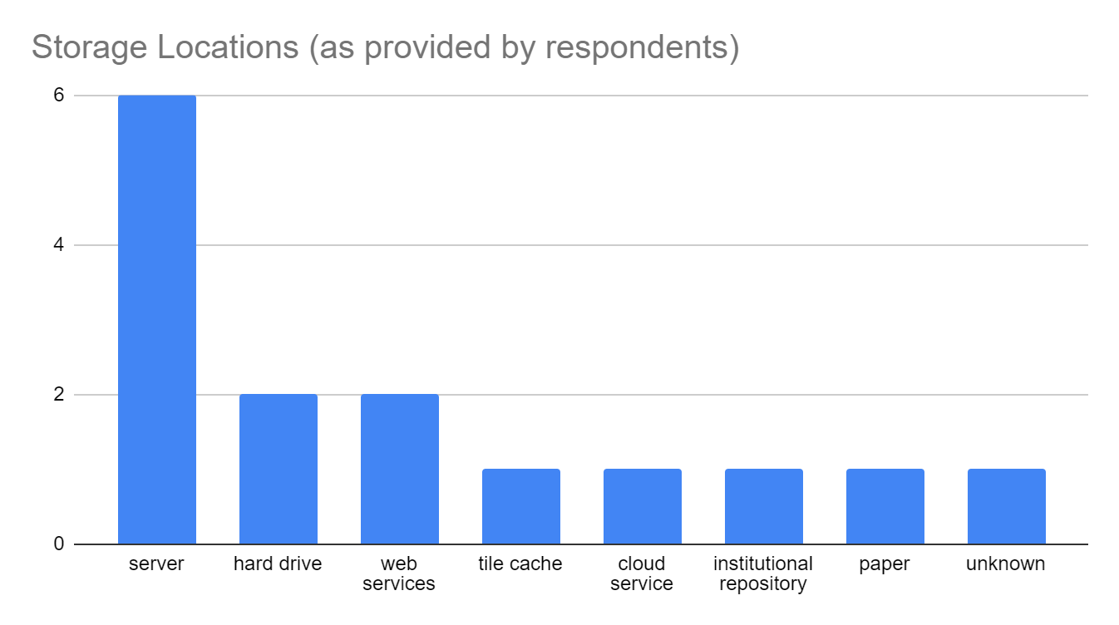
Archiving Imagery Workgroup
COMMUNITY SURVEYS
Notes:
Most of the data is being stored on servers, but with a wide variety of other storage methods.

Slide 38
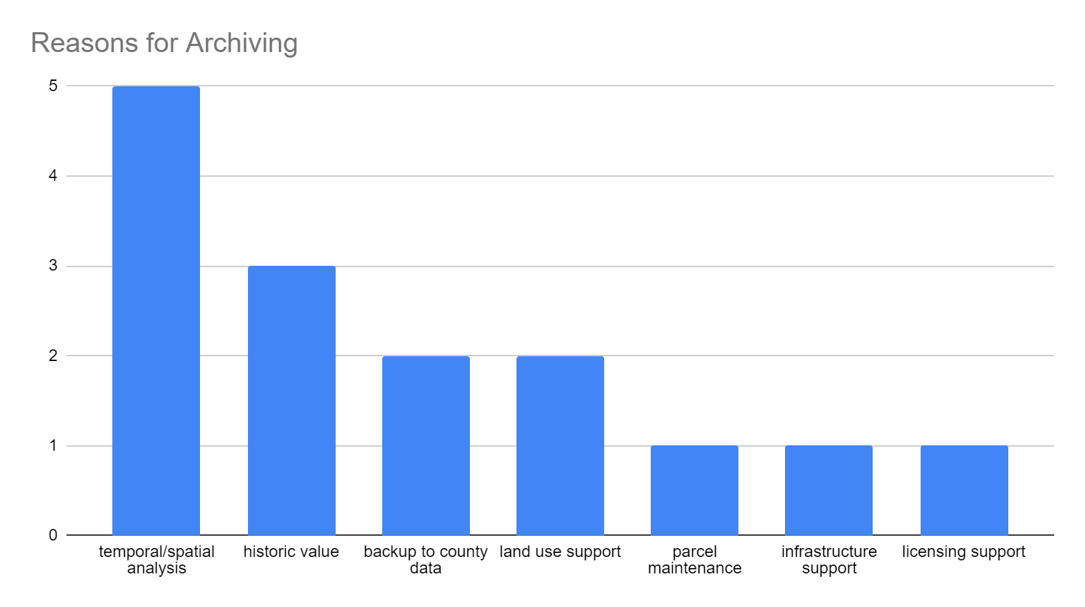
Archiving Imagery Workgroup
COMMUNITY SURVEYS
Notes:
The most common reason given wanting to arching the imagery was its value for temporal or spatial analysis.

Slide 39
Archiving Imagery Workgroup
SUMMARY
Historical aerial imagery is highly valued and used by the community
Various agencies are spending hundred of thousands of dollars per year collecting new imagery
Digital image files are stored inconsistently and are at risk of loss
Digital image files take up considerable server space
Digital image files are often unknowingly stored on duplicate drives across the state
Imagery is being stored in a variety of file formats including formats that are proprietary or legacy
There is no clear workflow for retroactively archiving images from geospatial image services
Providing access to archived files may look different than the way existing services provide access to imagery as the focus is on long term availability and preservation rather than immediate use
Final report

Slide 40
Archiving Imagery Workgroup
Questions?
Karen Majewicz (chair) - majew030@umn.edu
Melinda Kernik (vice-chair) - kerni016@umn.edu

Slide 41
Agenda Item 9
Updates on GAC Priority Projects and Initiatives
David Brandt

Slide 42
Updates on GAC Priority Projects and Initiatives
Most recent success
Experiencing a barrier?
Next task

Slide 43
GAC Priorities
Project or Initiative Description | Status | Project Owner | Champion
New Lidar Acquisition | Active | Gerry Sjerven | Alison Slaats
Updated and Aligned Boundary Data | Active | Preston Dowell | Alison Slaats
Parcel Data | Active | Alison Slaats | Mark Kotz
Road Centerline Data | Active | MnGeo | Alison Slaats
Image Service Improvements | Active | Jim Bunning | Alison Slaats
Critical Infrastructure Data | Active | Stacey Stark | Steve Swazee
Address Points Data | Active | MnGeo | Alison Slaats
Underground Utilities Data | Active | Steve Swazee | Barb Cederberg
U.S. National Grid Materials | Active | Randy Knippel | Randy Knippel
Archiving Implementation | Active | Ryan Mattke | many
Accurate Hydro-DEMs | Active | Sean Vaughn | many
Culvert Data Standard | Active | Rick Moore | Jonathan Lord

Slide 44
GAC Priorities
Project or Initiative Description | Status | Project Owner | Champion
Remonumentation of Section Corners | Active | Pat Veraguth | Alison Slaats
Success Stories for Geospatial Technology | Recruitment
Geospatial Commons Advisory Group | Recruitment
Criminal Justice Info Best Practices | Active | Britta Maddox
NG911 Forum | Recruitment
Parks Data Standard | Inactive
Summary Crime Data | Inactive | Britta Maddox
Basemap Services | Inactive
Strategy Team for All Types of Imagery | Inactive
State Business License Data | Inactive
Snow Emergency Parking Restriction Data | Inactive
Street Parking Restrictions Data Standard | Inactive
Geospatial Data Asset Inventory | Inactive

Slide 45
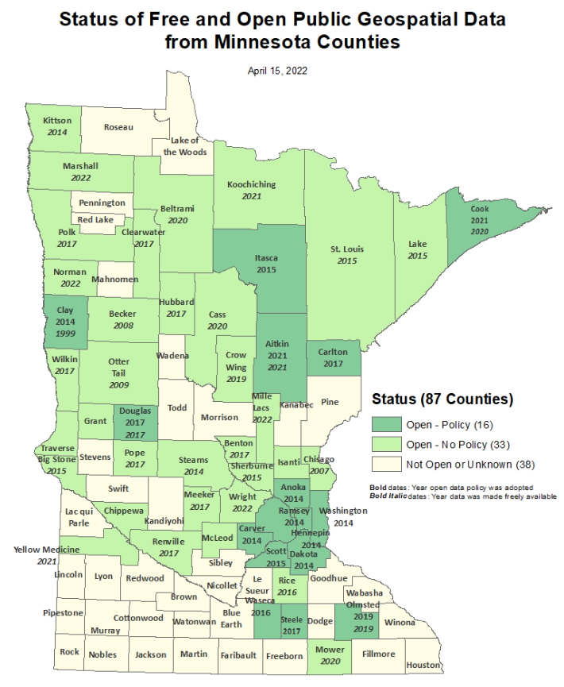
Status of Free and Open Data Public Geospatial Data
Status | Number of Counties | Total
Open - Policy | 16 | 49
Open - No Policy | 33
Not Open or Unknown | 38 | 38
Data current as of April 15, 2022 (no change since then)
https://gisdata.mn.gov/dataset/bdry-mn-county-open-data-status

Slide 46
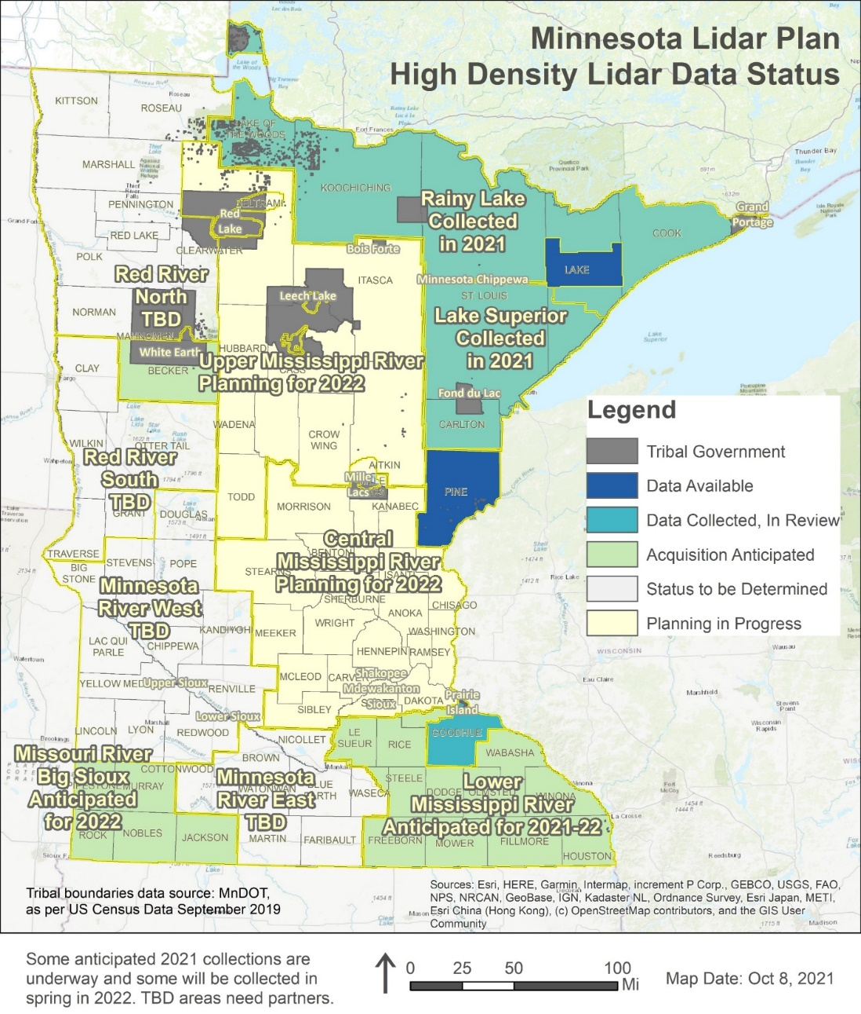
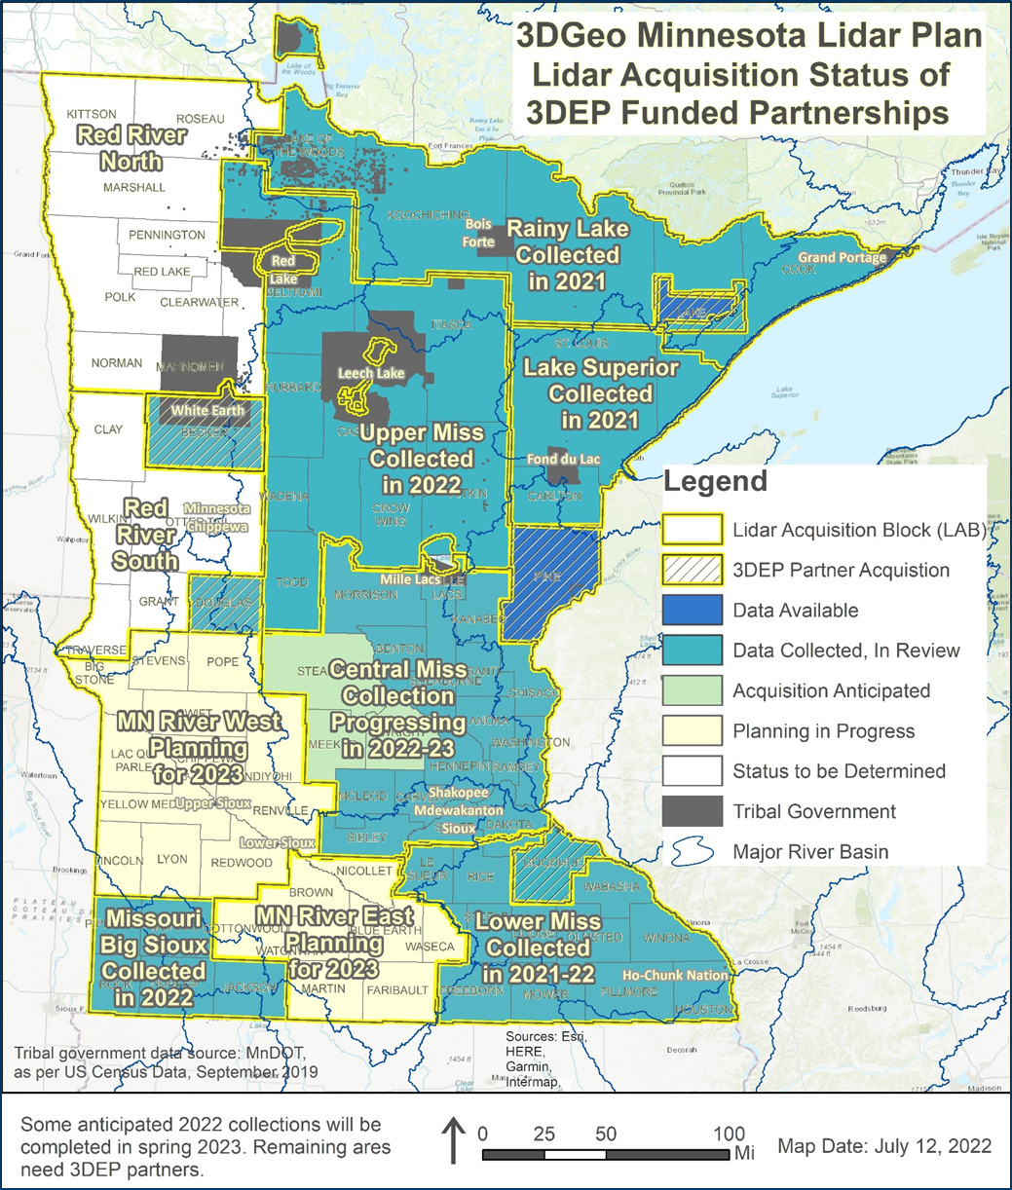
MN Lidar Status Map 2021 - 2022

Slide 47
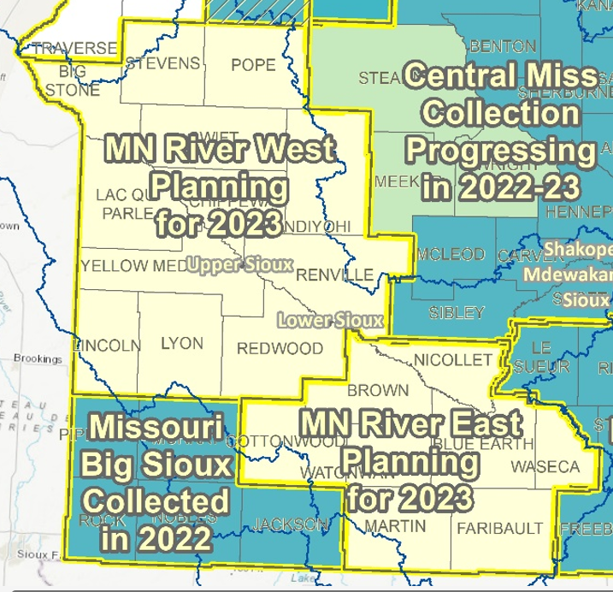
3DGeo Outreach: PLANNING for 2023 → Minnesota River – East & West LAB
December 2: USGS 3DEP announced they accepted our grant proposal for acquisition and processing of lidar data for MN River East and West.
MN River East LAB
12 state and local partners $636,000 for a $1.03M matching 3DEP grant fund request
MN River West LAB
8 state and local partners $856,000, for a $2.09M matching request for 3DEP grant funds
Notes:
TOTAL Est Funds Needed: $1,633,125
Estimated using $325 per square mile for QL1
8 Counties - 5025 square miles
$61,242 per county goal

Slide 48
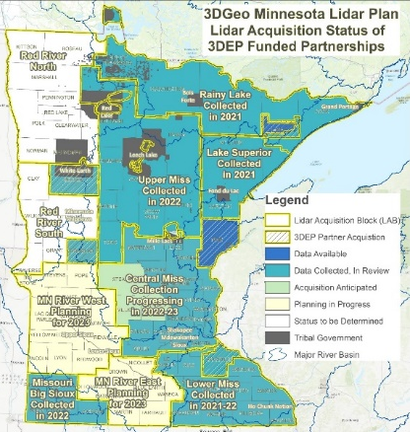




3D Geomatics: Funding, Agreements, and Acquisition
Contributions to Minnesota Lidar ($millions)
Minnesota Partners: $ 7.54
USGS 3DEP: $14.18
Other Federal $ 0.45
Total: ~$21.68M
Minnesota Funding Partners
68 Funding Partners
65,359 Square Miles of New Lidar
$118* Cost/mi² For MN Partners
MN IT Services is the Fiscal Agent
MnGeo is establishing funding agreements with all local funding partners
MnGeo establishes individual funding agreements with USGS 3DEP for each of the 3DGeo lidar acquisition blocks
* Estimated cost per square mile paid by 48 unique Minnesota funding partners working collaboratively for consistent lidar data acquisition. $118 Value: 1.) is not specific to a 3DGeo Lidar Acquisition Block, 2.) is based on total Minnesota partner contributions of $6,053,761.44 (03/28/2022), 3.) does not include federal contributions.
Notes:
Additional classes available for the point cloud: 3 - Low vegetation; 4 - Medium Vegetation (use for single vegetation class); 5 - High Vegetation; 6 - Buildings, other man-made structures; n - Additional classes or features as agreed upon in advance.

Slide 49
Updated and aligned boundary data
Most recent success:
If you are experiencing a barrier:
Next Task:

Slide 50
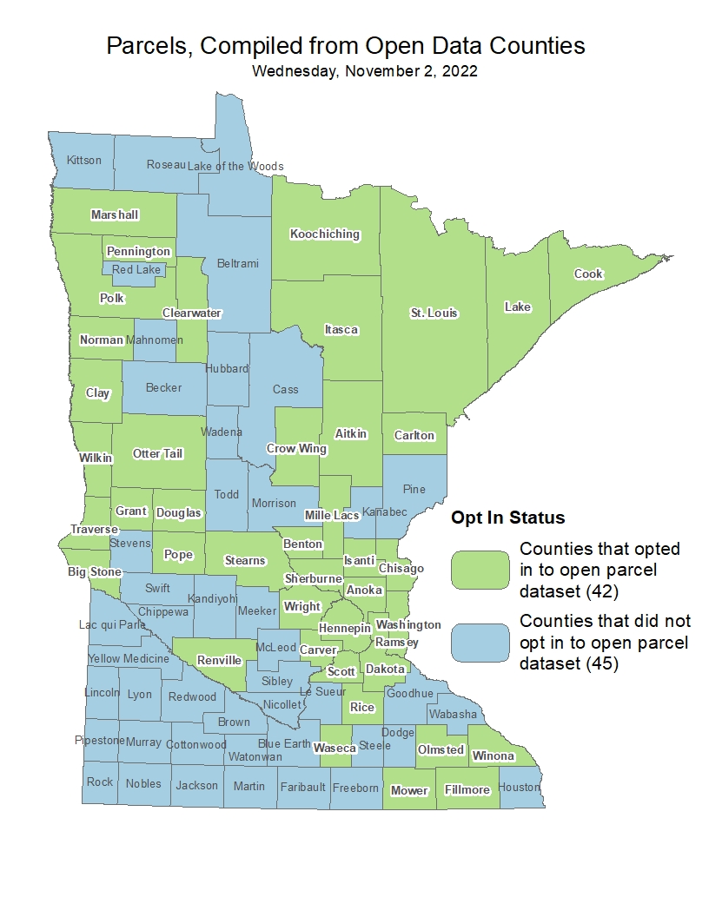
Statewide publicly available parcel data
Most recent success:
Published update (11/2/22) of opt-in public GAC-standard compiled dataset including 42 counties
Addition of open parcels from four more counties: Big Stone, Mille Lacs, Pennington and Renville
If you are experiencing a barrier:
Next task:
PLRC's open data sub-committee’s outreach team will continue reaching out from county to county to talk about benefits of sharing data and learning more about barriers and follow up on survey results.
https://gisdata.mn.gov/dataset/plan-parcels-open

Slide 51
Road Centerline Data & Address Points Data
Most recent success:
More counties are submitting their data through the NG9-1-1 data ECN 1Spatial Portal. Progress can be seen on the NG9-1-1 hub on the status page
If you are experiencing a barrier:
Final 1Spatial validation steps need to be completed so that MnGeo can pull data in streamlined process.
Need to define “opt-in” process to ask counties if they’d like to be included in public dataset (MnGeo, GAC Outreach Committee, input from MCGISA)
Next task:
Complete 1Spatial validation process & steps (ECN, 1Spatial, MnGeo)
Create process to move data from 1Spatial to public dataset (MnGeo)
Outreach to counties to ask if they’d like to “opt-in” included in public dataset (MnGeo, GAC Outreach Committee, input from MCGISA)

Slide 52
Improvements to the MnGeo Image Service, such as Web Mercator support, tiling, and complementary options such as “composite of latest leaf off imagery”, and downloading options
Most recent success:
Added Lyon County imagery to WMS
If you are experiencing a barrier:
Time constraints to work on recommendations of committee; did not accomplish removal of suggested retirement image layers
Next tasks:
Currently working on Le Sueur County
NAIP 2021 GeoTIFF imagery currently being downloaded
Review Lyon County imagery shift
Build out new development/staging image server
In discussion: Lincoln and Aitkin counties

Slide 53
Critical Infrastructure Assessment
Most recent successes:
working on updating correctional facilities dataset in MNGeoCommons.
new priority initiative proposal: To publish foundational data nationally through open data and commercial sources. Foundational datasets are defined as parcels, addresses, road centerlines, and critical infrastructure. This is a great idea to move this aspect of the C.I. workgroup to another new workgroup. We've talked about this a lot and it has become a whole separate project.
If you are experiencing a barrier:
Few meetings and little time for forward movement 4th quarter.
Next task:
Refresh our goals for 2023. Invite new members.

Slide 54
A project team to develop geospatial data sharing methodologies to support the state’s underground utilities community
Most recent successes:
Dedicated support website is created (www.fuzionview.org) and outreach to the Minnesota utility community has begun
Presentation at MN GIS/LIS October 13-14.
Gopher State One Call COO Barbara Cederberg now working closely with the Common Ground Alliance GIS Working Group. The Minnesota project is seen as leading the nation and is receiving community wide support.
2. If you are experiencing a barrier:
3. Next tasks:
Review promotional flyer
Gopher State One Call is preparing to contract for development of open source product to leverage concepts and approaches used during development of prototype.

Slide 55
Maps, procedures, templates and other materials to help all levels of government implement the U.S. National Grid
Most recent success:
Two presentations at MN GIS/LIS Conference, October 13-14 (full session and lightning session)
If you are experiencing a barrier:
Next tasks:
Next quarterly meeting of the USNG Implementation Working Group is Jan. 18; next meeting of the group’s Board of Directors is Jan. 17
Anticipate release of a new USNG mapbook publishing application on USNG Center by the end of the year

Slide 56
Archiving Minnesota geospatial data
Already covered during the meeting

Slide 57
Accurate hydro-DEMs (hDEM) that serve modern flood modeling and hydro-terrain analysis tools, and the development of more accurate watercourses and watersheds
Most recent success:
No success to report related to progress
3D Geomatics is starting to receive more questions about the new high-density lidar coming and the need for DEM hydro-modification
New lidar will require DEM hydro-modification
Previous state investments in DEM hydro-modification and resulting datasets will support new DEM hydro-modification
If you are experiencing a barrier:
Funding
Next task:
Continue to build awareness that new lidar will require DEM hydro-modification and funding
Identification of culverts in new lidar will facilitate DEM hydro-modification

Slide 58
Development of Culvert Data Standard
Most recent success:
Kickoff meeting December 12 with 16 members present. Developed infrastructure for the group, reviewed other culvert standard projects and identified roadmap forward.
Researching culvert data practices of other states to identify best practices.
If you are experiencing a barrier:
Culvert Data Standard has become high priority in Fall 2022. Culvert Standard will move forward with every-other-month meetings and collaborative workspace for action items.
3. Next tasks:
Recruit additional members and map out the process in creating the standard.
Identify culvert datasets within the state; develop comprehensive attribute list

Slide 59
Hydrogeomorphology Workgroup…
Key Meetings
Sept – Lidar Update, Guest Presentation: Met Council Priority Waters Project presentation
Oct – Lidar Update, 3D Geo DEM Hydro-modification Subgroup – “Standards, Breachlines and Pilot Projects”
Nov – no meeting
Dec – Lidar Update, Guest Presentation: USGS 3DHP Update
Workplan Progress
Developed roadmap for NXG-Hydro Development – Communication and Outreach
Engaged with national hydrography programs – 3DHP, 3DNTM
Foundational Data Stewards
GAC Stream ID Standard presented for approval
Working with DNR Data Governance Administrator on standards
Partnering with LCCMR funded Lake Inventory Update to inform and guide

Slide 60
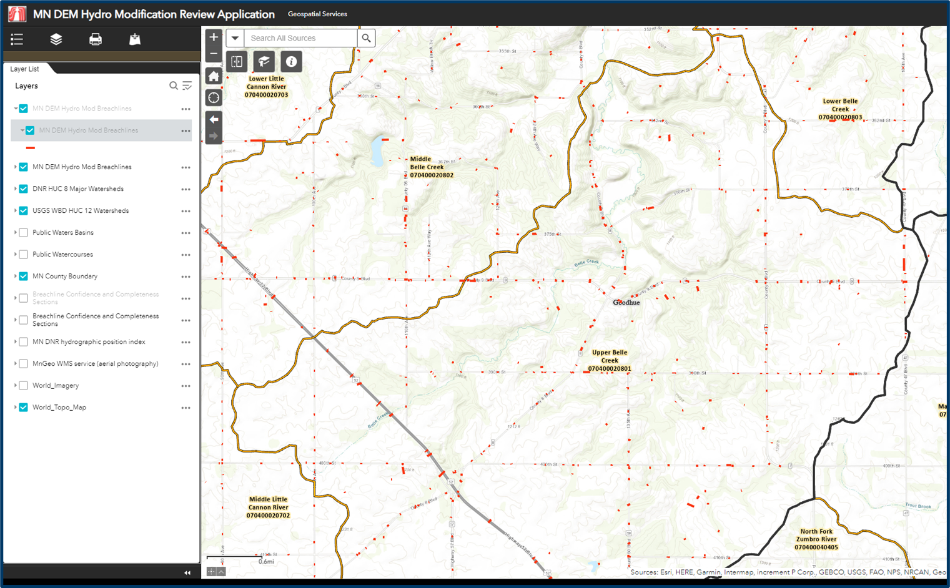
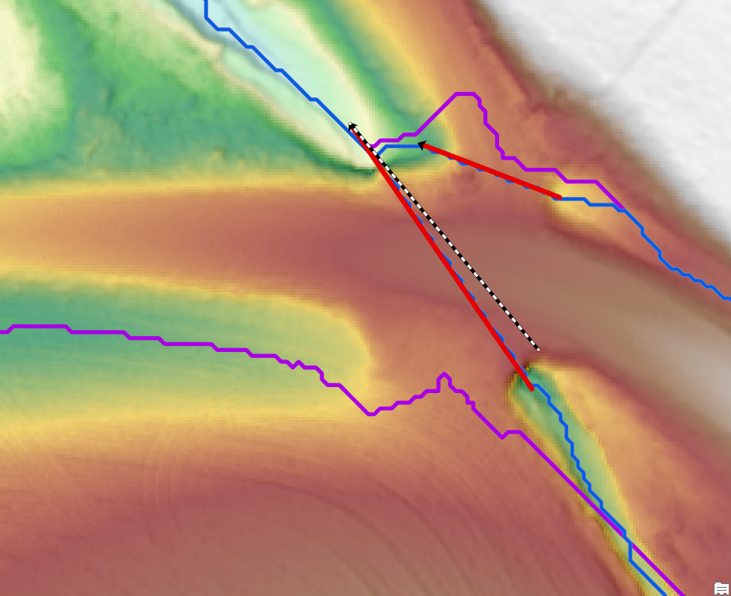
DEM Hydro-modification Subgroup…
Goodhue County High Resolution DEM
Pilot Project to inform future efforts of using existing breachlines with high resolution DEMS.
Breachline Dataset
Update dataset with most recent datasets being completed
Explore database structure for breachlines
DEM Hydro-modification Review Web Application
Detail locations and completeness of datasets
Define Project boundaries and locations needing data
Collaboration and cooperation amongst members
Ongoing discussions of standards and best practics

Slide 61
Remonumentation of all section corners
Most recent success:
If you are experiencing a barrier:
Next Task:

Slide 62
CJIS Data GIS Best Practices
Already covered during the meeting

Slide 63
Agenda Item 10
Announcements

Slide 64
Next Meeting
Wednesday, March 15
10:00 - noon
Will be remote only (not hybrid)

Slide 65
Adjourn
Thank you

