Slide 1



Minnesota Geospatial Advisory Council
March 15, 2023

Slide 2
Welcome
Introductions
Approve agenda
Approve December minutes

Slide 3
Introductions
City, Twin Cities metro
  Cory Richter, Ramsey County
City, Greater Minnesota
  Shawn Strong, City of Brainerd
County, Twin Cities metro
  Victoria Reinhardt, Ramsey County
County, Greater Minnesota
  Patrick Veraguth, Douglas County
Regional government, Twin Cities metro
  Matt McGuire, Met Council
Regional government, Greater Minnesota
  vacant
State agencies
  Kari Geurts, DNR
  Ben Timerson, MnDOT
Federal government
  Mitch Bergeson, U.S. Geological Survey
  Jeff Bloomquist, Risk Management Agency, USDA
Tribal government
  Ryan Bonney, Shakopee Mdewakanton Sioux Community
Non-profit organizations
  vacant
Business
  Kendis Scharenbroich, Pro-West & Associates
  Gerry Sjerven, Minnesota Power
Higher Education
  Len Kne, U-Spatial / UMN Twin Cities
  Stacey Stark, U-Spatial / UMN Duluth
K-12 Education
  Shanna Crosson, U-Spatial / UMN Twin Cities
MetroGIS
  David Brandt, Washington County
MN GIS/LIS Consortium
  Leanne Knott, City of Red Wing
Surveyor
  Chris Mavis, Hennepin County
At-large
  Alex Steele, Minnehaha Creek Watershed District
  Heather Albrecht, Hennepin County
  Britta Maddox, Anoka County
1 Chief Geospatial Information Officer (ex-officio)
  Alison Slaats, MnGeo

Slide 4
Agenda
Time | Topic |  | Time | Topic
10:00 | Introductions, approve agenda and previous minutes |  | 11:00 | Legislative Updates
10:15 | Committee reports and review of new quarterly reporting |  | 11:10 | Break
10:30 | Outreach Committee update |  | 11:20 | GAC priority projects and initiatives update
10:35 | Success Stories for Geospatial Technologies Workgroup |  | 11:40 | Applications for Next GAC Term
10:40 | Culvert Data Standard Workgroup |  | 11:45 | Announcements
10:50 | Lidar data acquisition |  | noon | Adjourn

Slide 5
Agenda Item 2
Committee Reports – Review and Accept
All
Review of new quarterly reporting
Cory Richter

Slide 6
3D Geomatics
Data Acquisition
Most recent success:
  Data acquisition will begin in the Minnesota River East and West blocks. Data for some portions of the state are now available on the National Map.
Next Task:
  Preparing to release the ground conditions reporting tool for the Minnesota river.
  See https://arcg.is/1KDOyP

Slide 7
Awards
Most recent success:
  Big thanks to Andra Mathews for migrating the Awards Committee website to the new Hub Site.
Next Task:
  Getting ready to promote the next round of award nominations due June 1, 2023

Slide 8
Parcels and Land Records
Remonumentation
Most recent success:
  MSPS hired a lobbyist for this legislation.
  Legislation has been submitted in the House and Senate. We have six authors in the house and three in the Senate.
  Had our first hearing in the House State Government Committee, March 3.
  We were submitted for inclusion in the House Financial Omnibus Bill
Request for assistance:
  We may need help setting up a commission to run this program if legislation goes through. It will depend on the level of funding. Reach out to your legislators and help support this.
Next Task:
  Next hearing in the Senate State Government Committee, March 18th.

Slide 9
Agenda Item 3
Outreach Committee update
Cory Richter, Heather Albrecht

Slide 10
Agenda Item 3
Opt-in model for publishing foundational datasets to the Commons
Request
  To authorize the Outreach Committee and associated workgroups for opt-in foundational datasets to work directly with MnGeo to publish said datasets to the Minnesota Geospatial Commons; updated lists of opt-in datasets to be reported at quarterly GAC meetings.

Slide 11
Agenda Item 4
Success Stories for Geospatial Technologies Workgroup
Len Kne

Slide 12
Agenda Item 5
Culvert Data Standard Workgroup
Rick Moore

Slide 13
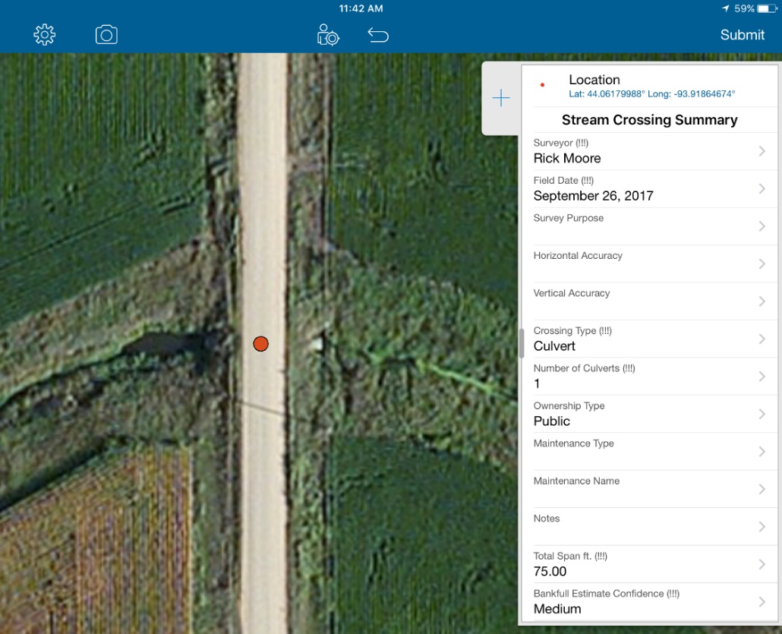
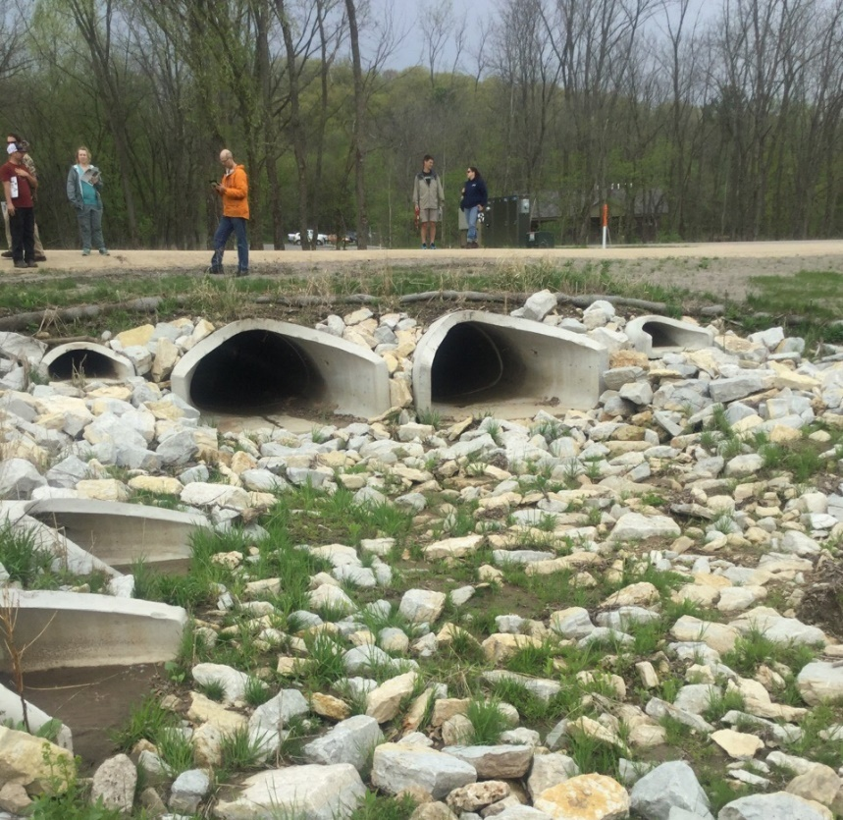
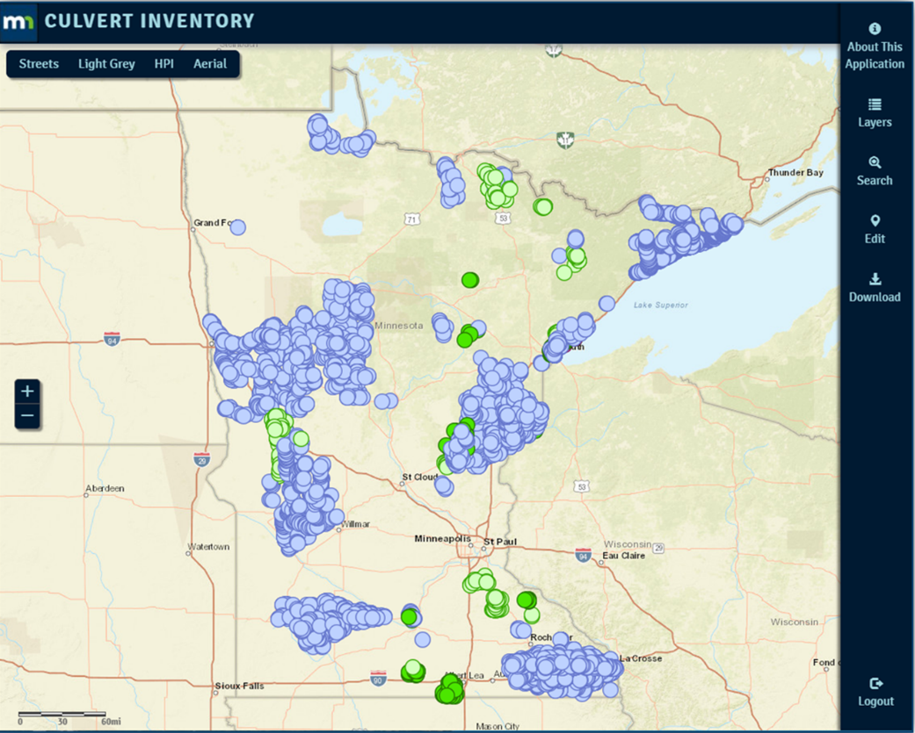


MN Geospatial Advisory Council Priority:
Culvert Data Standard
Wednesday, March 15, | Update Meeting
Rick Moore | Sean Vaughn

Slide 14
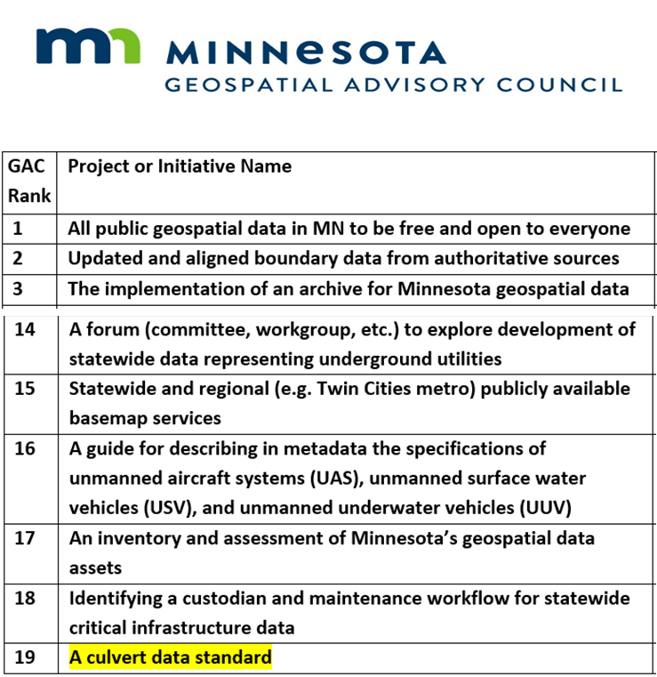
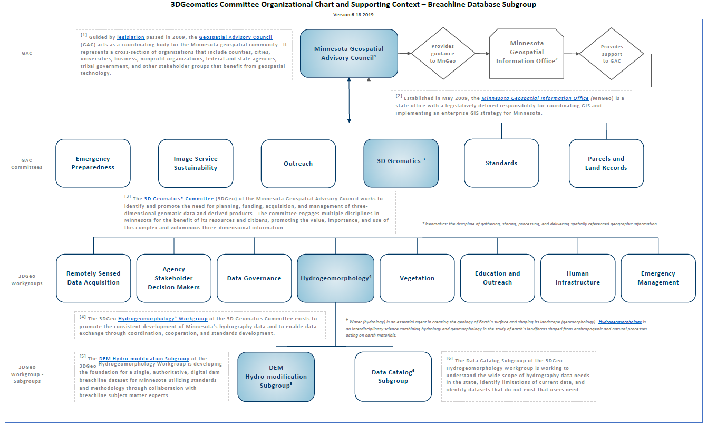
3D Geomatics Organizational Chart

Slide 15
GAC Priority: Culvert Data Standard
Development of a culvert data standard for data sharing across the geospatial and infrastructure asset management communities and to support development of a future statewide culvert inventory
The purpose of this standard is to provide a single, commonly accepted set of attribute specifications (field name, type, field width and order) for transferring and aggregating culvert data in Minnesota for a wide variety of applications.

Slide 16
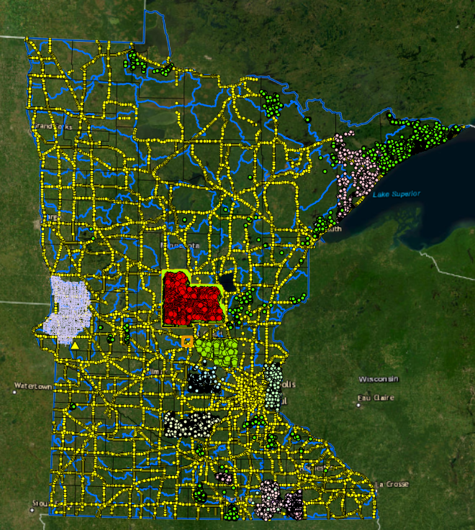
GAC Priority: Culvert Data Standard
To support development of a future statewide culvert inventory and to integrate data from multiple data sources across the state.
Culvert Standard will provide a single, commonly accepted set of attribute specifications (field name, type, field width and order)
Allow for transferring and aggregating culvert data in Minnesota.
Entities that have not collected culvert data will have a resource to help implement their culvert inventory.

Slide 17
Where do we begin?
Common Language…

Slide 18

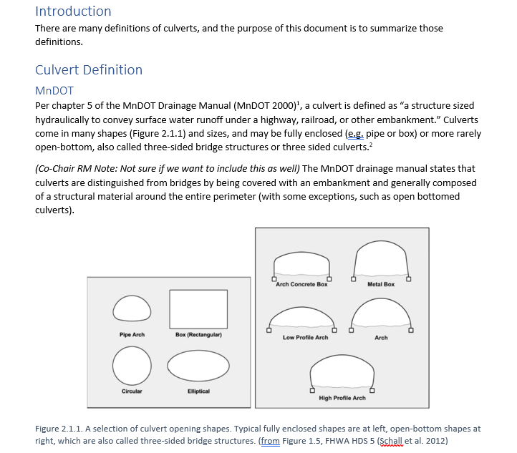

Definitions - What is a Culvert?

Slide 19
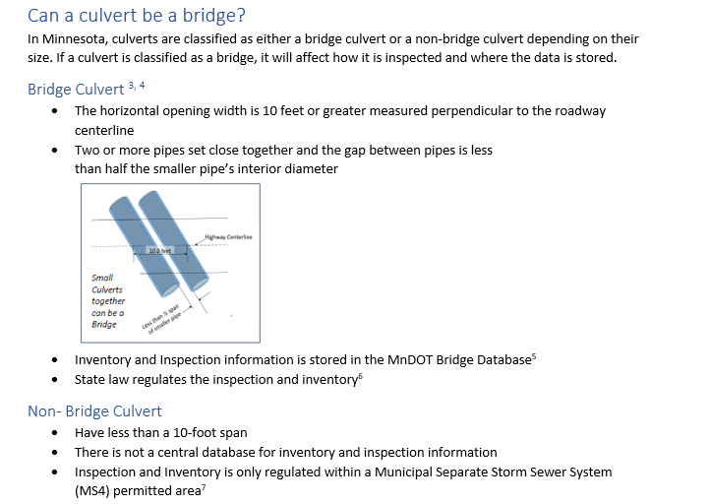
Definitions - What is a Culvert?

Slide 20
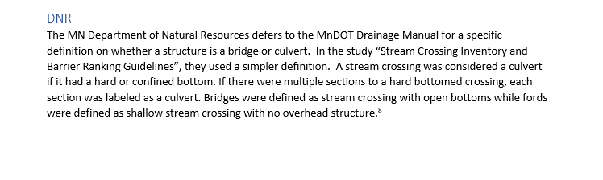
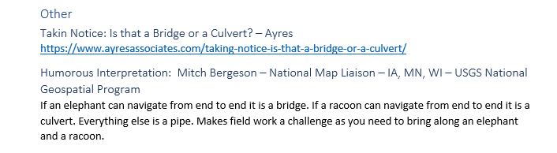
Definitions - What is a Culvert?

Slide 21
Culvert Data Standard Survey
Next…

Slide 22
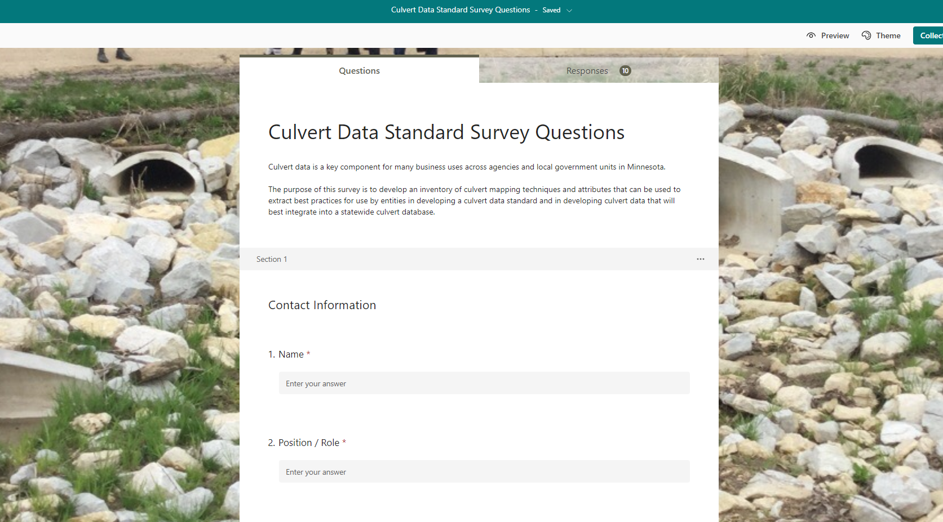
Culvert Inventory Survey
Culvert Data Standard Subgroup Survey
Based on survey questions from recent NSGIC survey and members

Slide 23
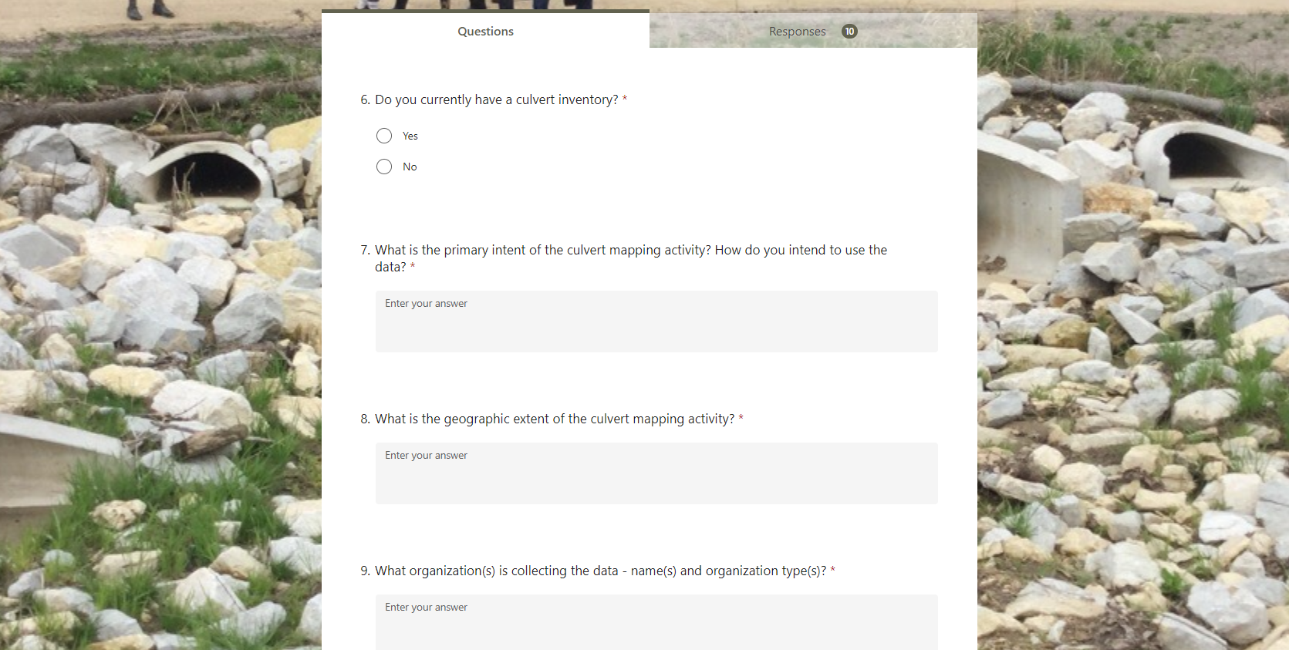
Culvert Inventory Survey
Culvert Data Standard Subgroup Survey

Slide 24
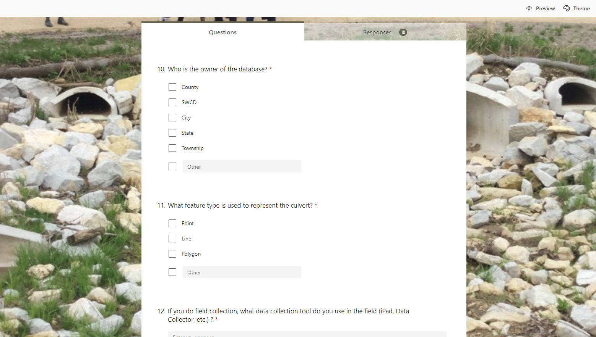
Culvert Inventory Survey
Culvert Data Standard Subgroup Survey

Slide 25
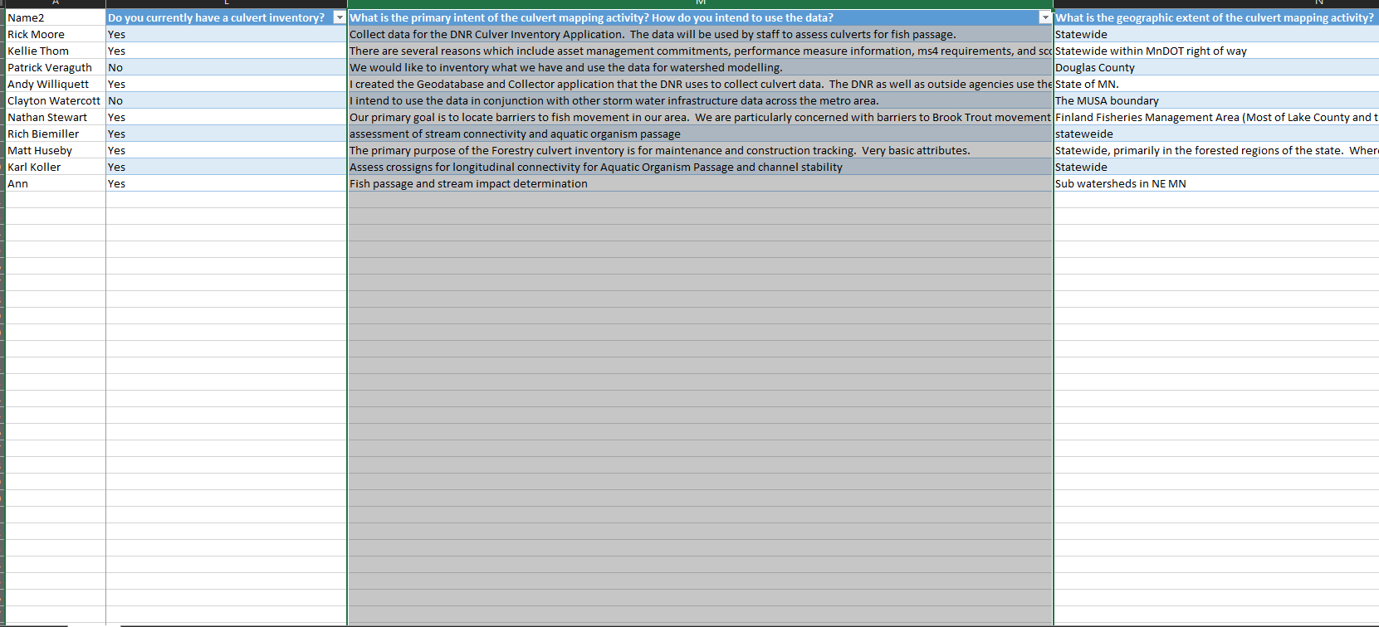
Culvert Inventory Survey
Culvert Data Standard Subgroup Survey

Slide 26
Culvert Data Standard Survey
Determining common attributes…

Slide 27
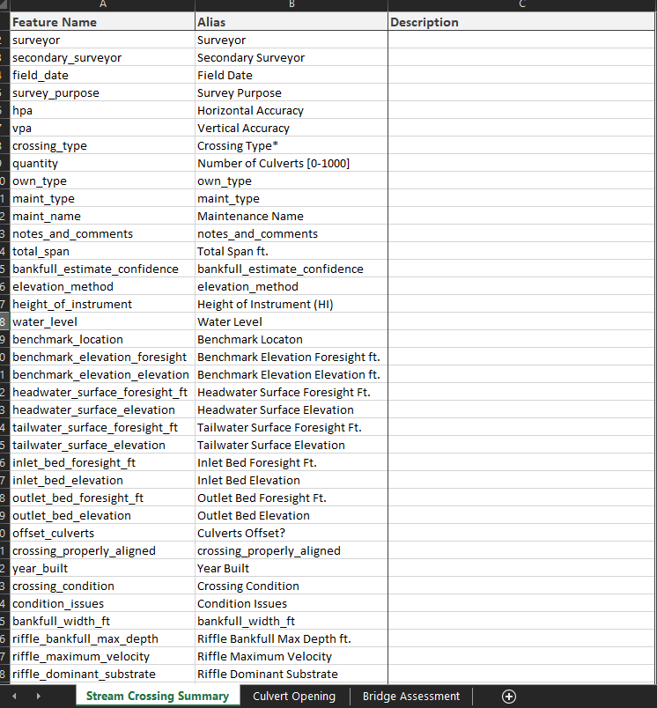
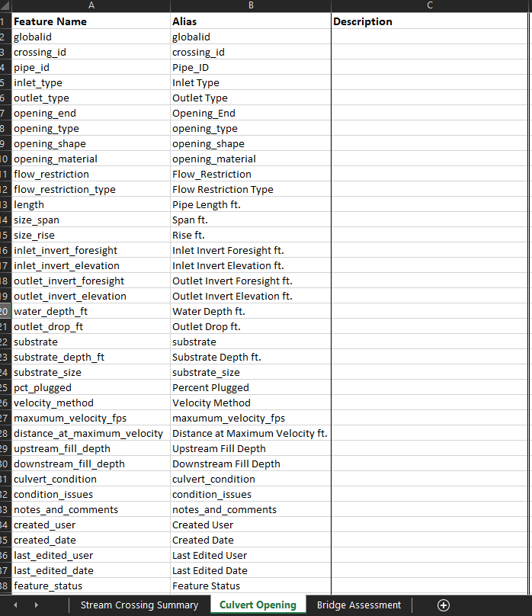
MN DNR Culvert Inventory Application
Notes:
Attributes
Domains

Slide 28
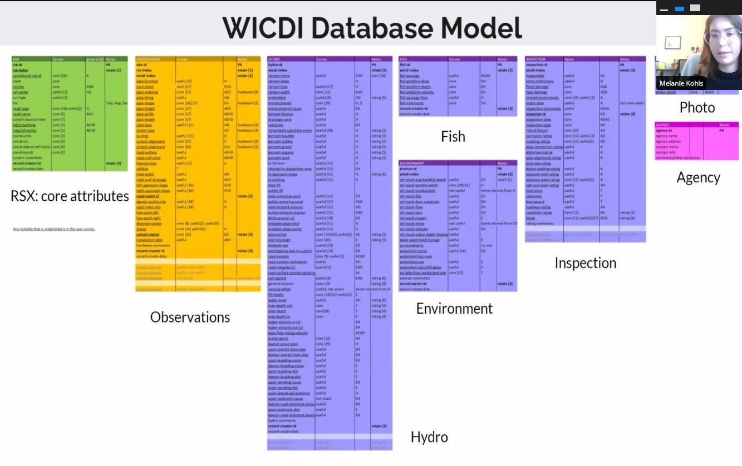
Potential Database Example
Wisconsin Coastal-Management Data Infrastructure

Slide 29
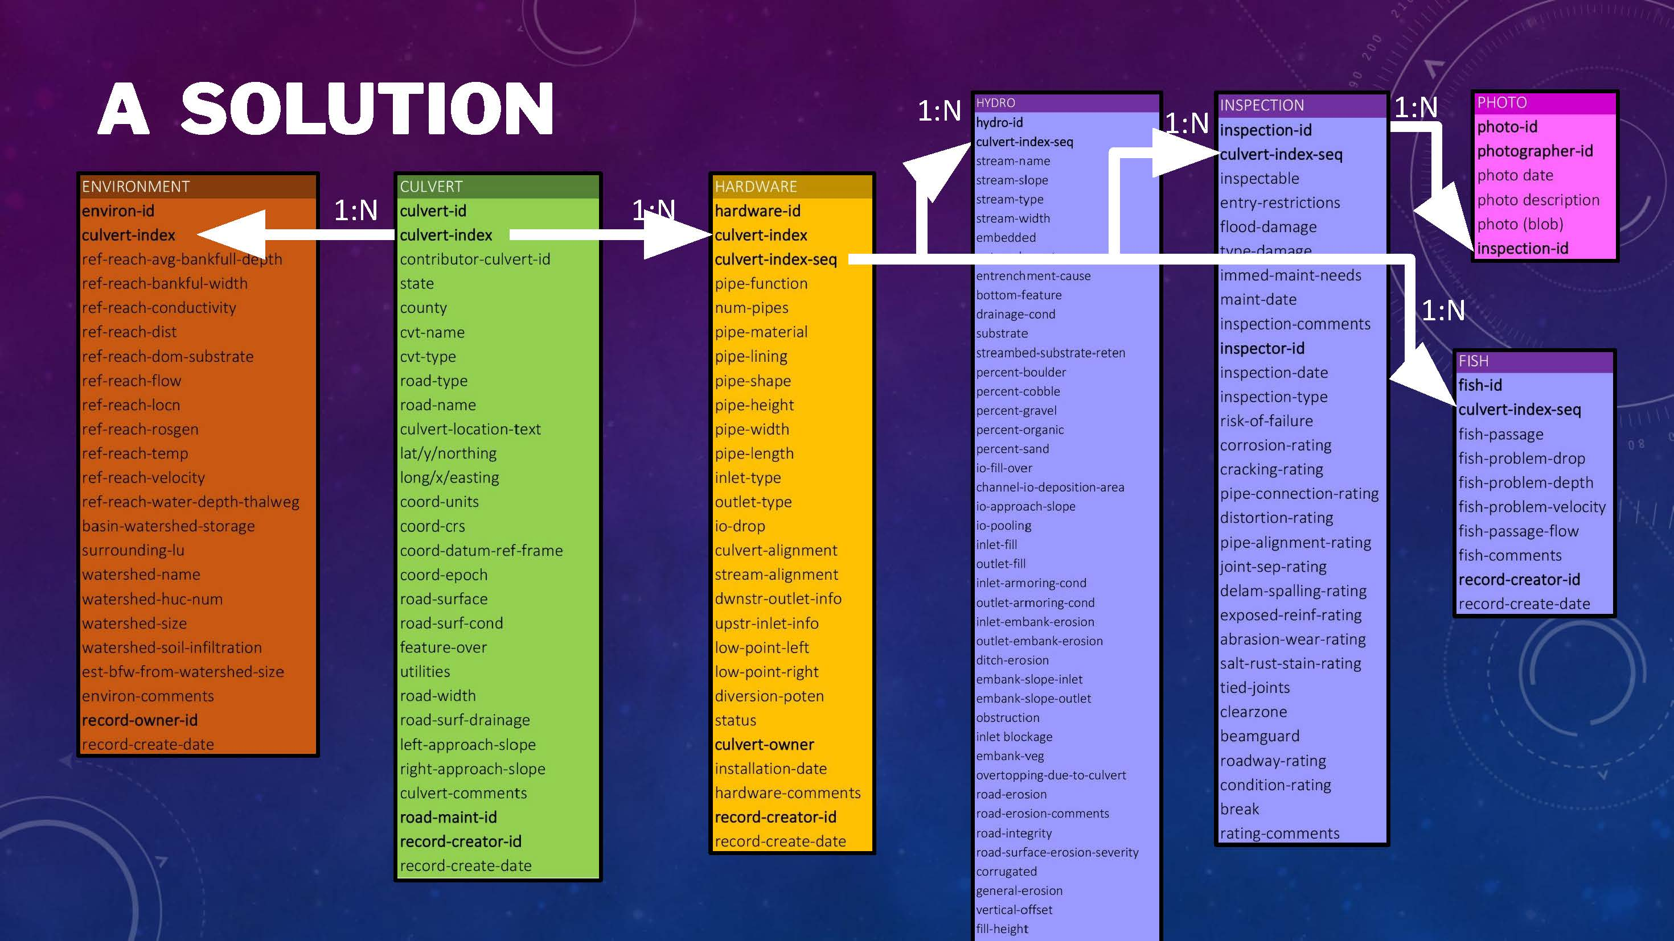
Potential Database Example
Wisconsin Coastal-Management Data Infrastructure

Slide 30
MN GAC Culvert Data Standard
Next Steps / Actions
  Data Submission Process (We are here!)
  Create Preliminary Universal Attribute List
  Sort Attributes into Categories
  Proposed Schema

Slide 31
Thank You!
Rick Moore | Sean Vaughn
sean.vaughn@state.mn.us rick.moore@state.mn.us
763-284-7223 507-389-8810

Slide 32
Agenda Item 6
Lidar data acquisition update
Sean Vaughn, Gerry Sjerven

Slide 33
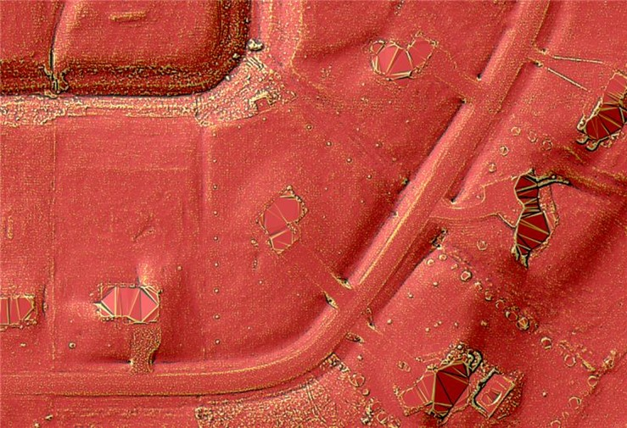
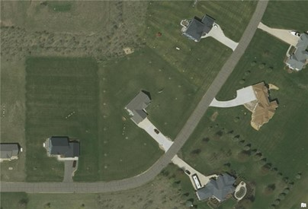
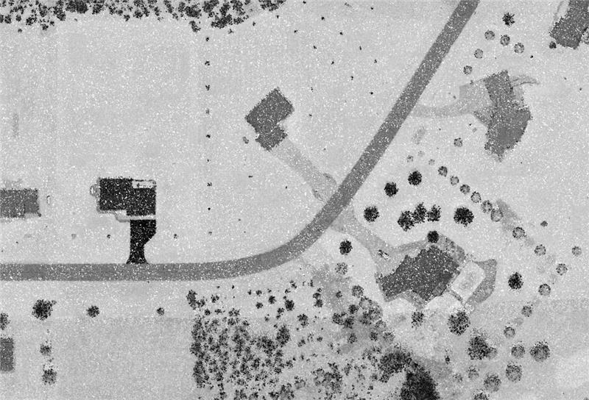

3D Geomatics Acquisition Update:
3DGeo GAC Update
Wednesday | March 15, 2023 | 10:00 – 12:00
Sean Vaughn (MNIT DNR)
Gerry Sjerven (MN Power)

Slide 34
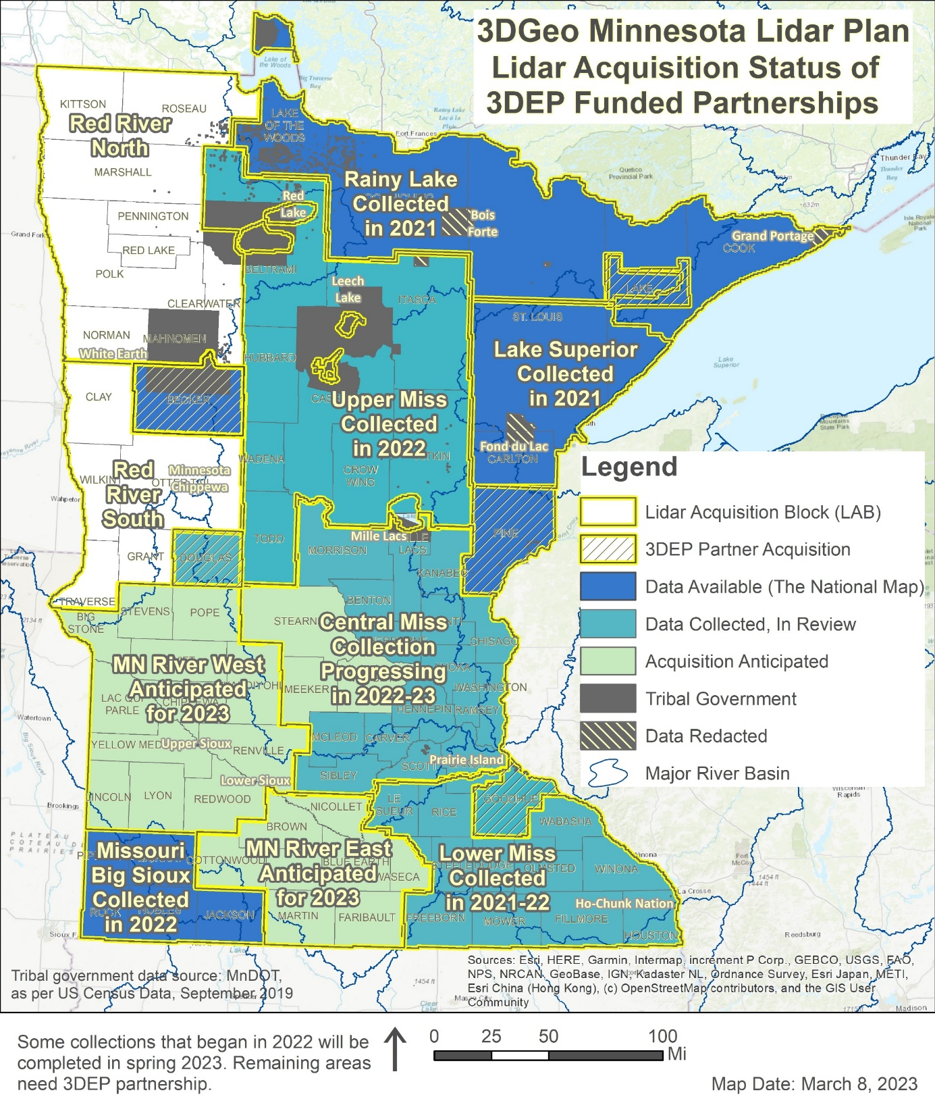
3DGeo Lidar Acquisition → Update
All areas in teal and royal blue have been collected
Central Mississippi LAB was not completed due to weather and green-up.
Missouri Big Sioux LAB vendor reporting preliminary accuracy assessment or non-vegetated areas to be 3.1 cm for entire LAB
MN River East and West was 3DGeo priority for 2022 planning, coordination, and establishment of funding partners.
Notes:
*Special note: the Red River Watershed Management Board (RRWMB) and partners, collected lidar in fall 2021. RRWMB is considering sharing their complete lidar point cloud data with the USGS for 3DEP compliance certification. Therefore, the RRWMB data currently do not meet 3DEP standards and are therefore not considered part of the MN Lidar Plan at this time. If RRWMB data is shared with the USGS, certified as 3DEP compliant, and made publicly available as a result, 3DGeo will welcome RRWMB data as a temporal lidar dataset within the statewide MN Lidar Plan.
The 3D Geomatics Data Acquisition Team will be submitting a USGS 3DEP BAA for the entire 3DGeo MN River West Lidar Acquisition Block (LAB) as outlined in the Minnesota Lidar Plan to ensure there are no gaps between the RRWMB and 3DGeo lidar acquisition initiatives.

Slide 35
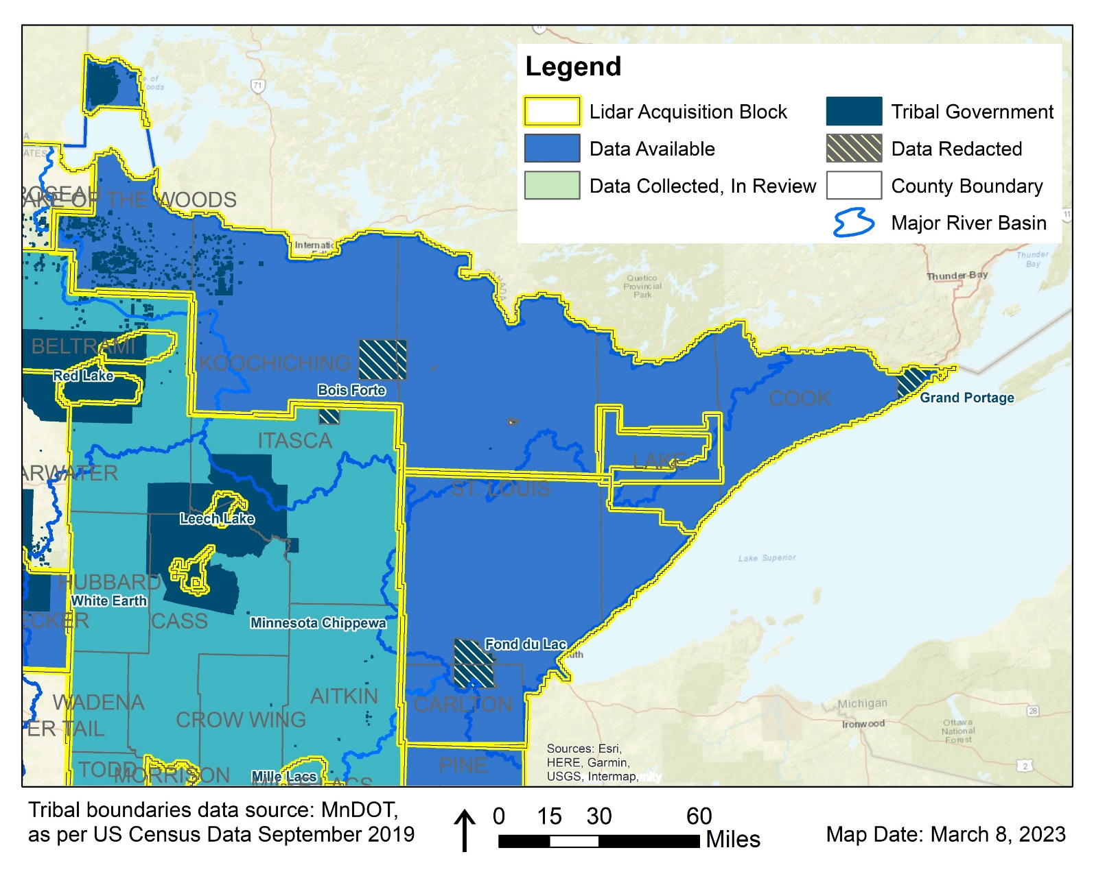
3DGeo Outreach: COLLECTED in 2021
Northeast – Rainy Lake & Lake Superior Blocks
17 state/local partners raised $1.7M
Leveraged a $3.8M match from 3DEP!
3DEP deliverables are available on The National Map!
Notes:
17 state/local partners raised $1,768,561 total
Leveraged a $3,803,513 match from 3DEP!

Slide 36
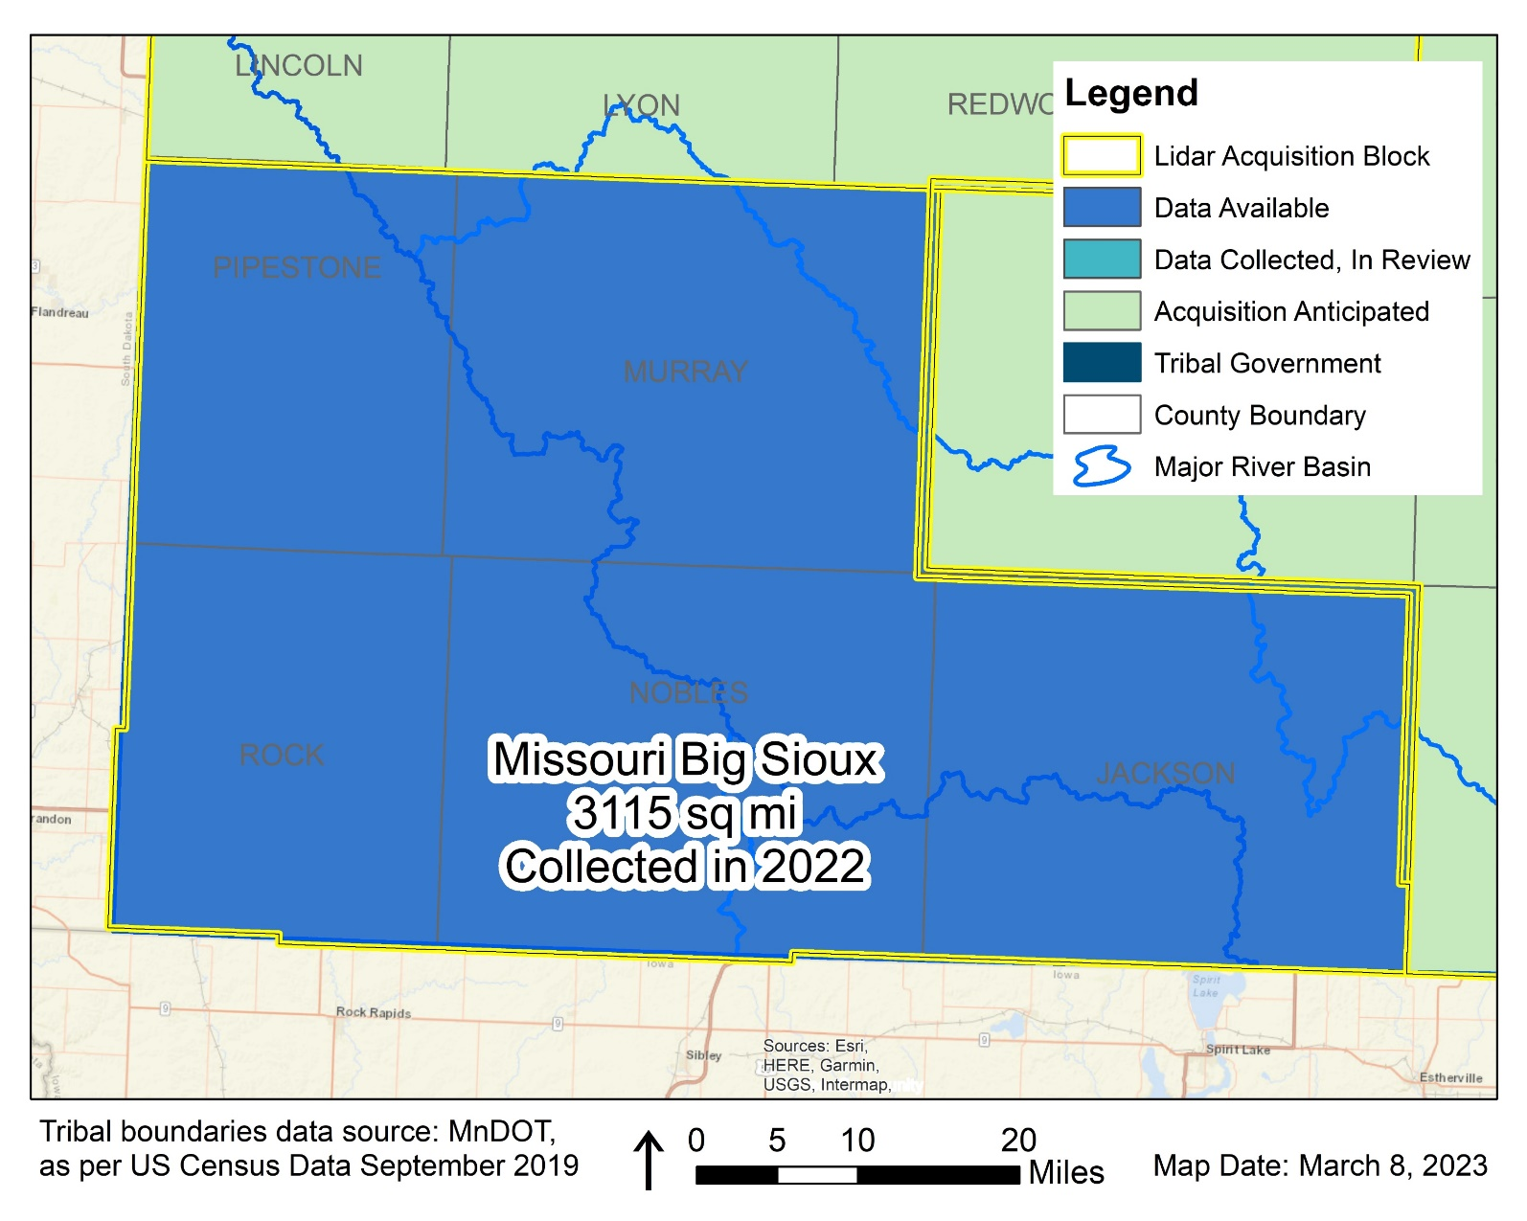
3DGeo Outreach: COLLECTED in 2022
Southwest – Missouri River Big Sioux Block
8 state/local partners raised $355K total
Leveraged a $657K match from 3DEP!
3DEP deliverables are available on The National Map!
Notes:
8 state/local partners raised $355,626 total leveraging a $657,342 match from 3DEP!

Slide 37
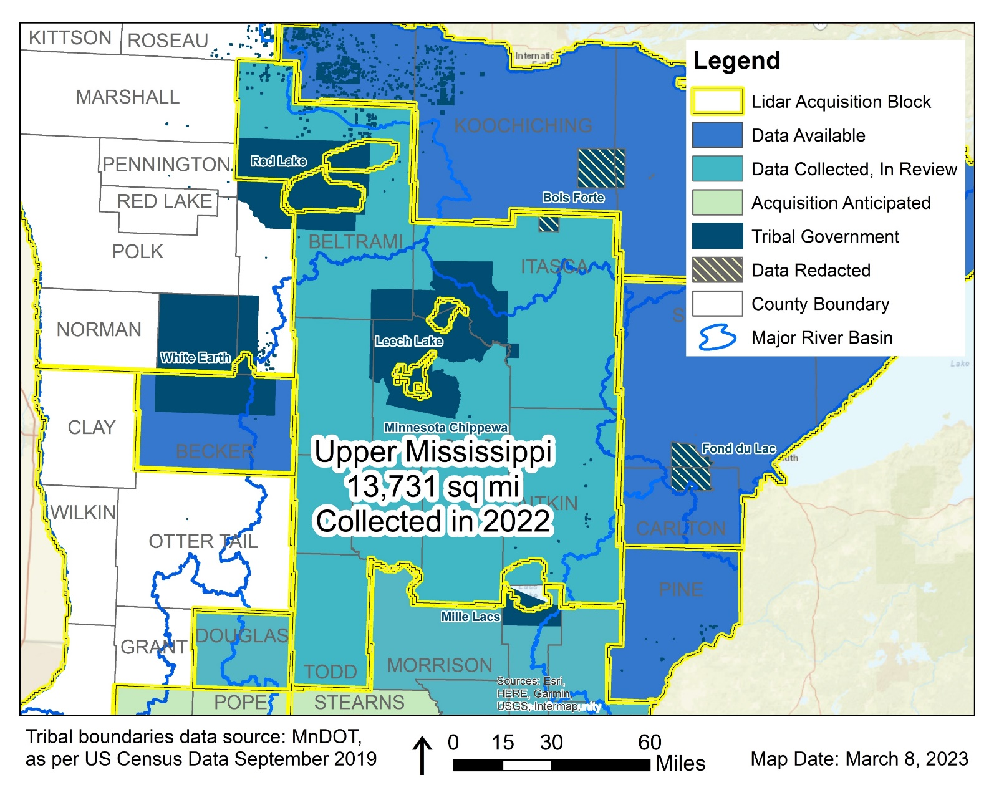
3DGeo Outreach: COLLECTED in 2022
Upper Mississippi River Block
15 state/local partners raised $1.2M total
Leveraged a $3.M match from 3DEP!
Data is currently under review by the USGS
Notes:
15 state/local partners raised $1,236,736 total, leveraging a $3,214,168 match from 3DEP!

Slide 38
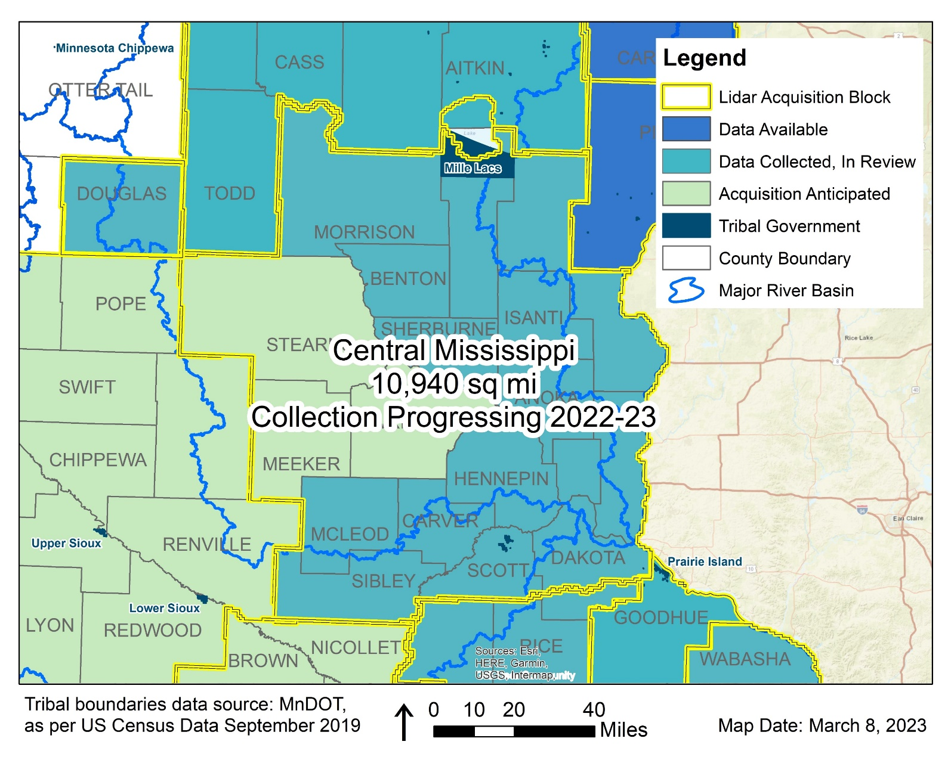
3DGeo Outreach: COLLECTED/ANTICIPATED in 2022 and 2023
Central Mississippi River Block
20 state/local partners raised $1.7M total
Leveraged $2.2M match from 3DEP!
Three counties will be acquired spring 2023
Portions are currently under review at the USGS

Slide 39
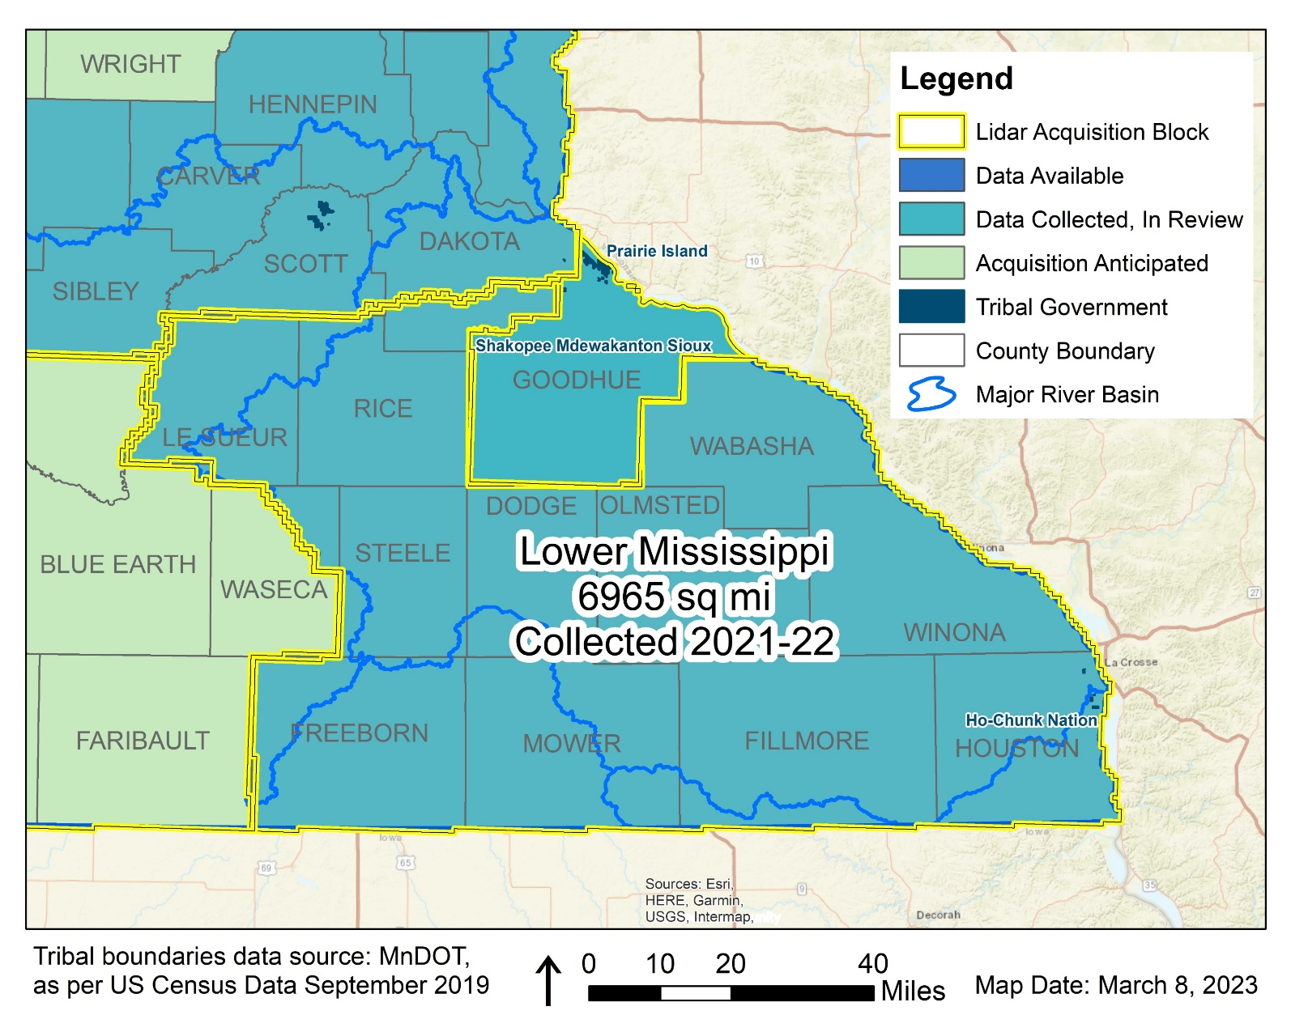
3DGeo Outreach: COLLECTED in 2021 & 2022
Southeast – Driftless Block
6 state/local partners raised $1.1M total
Leveraged $1.4M match from 3DEP!
Portions are currently under review at the USGS
Portions of the LAB 3DEP deliverables are becoming available on National Map

Slide 40
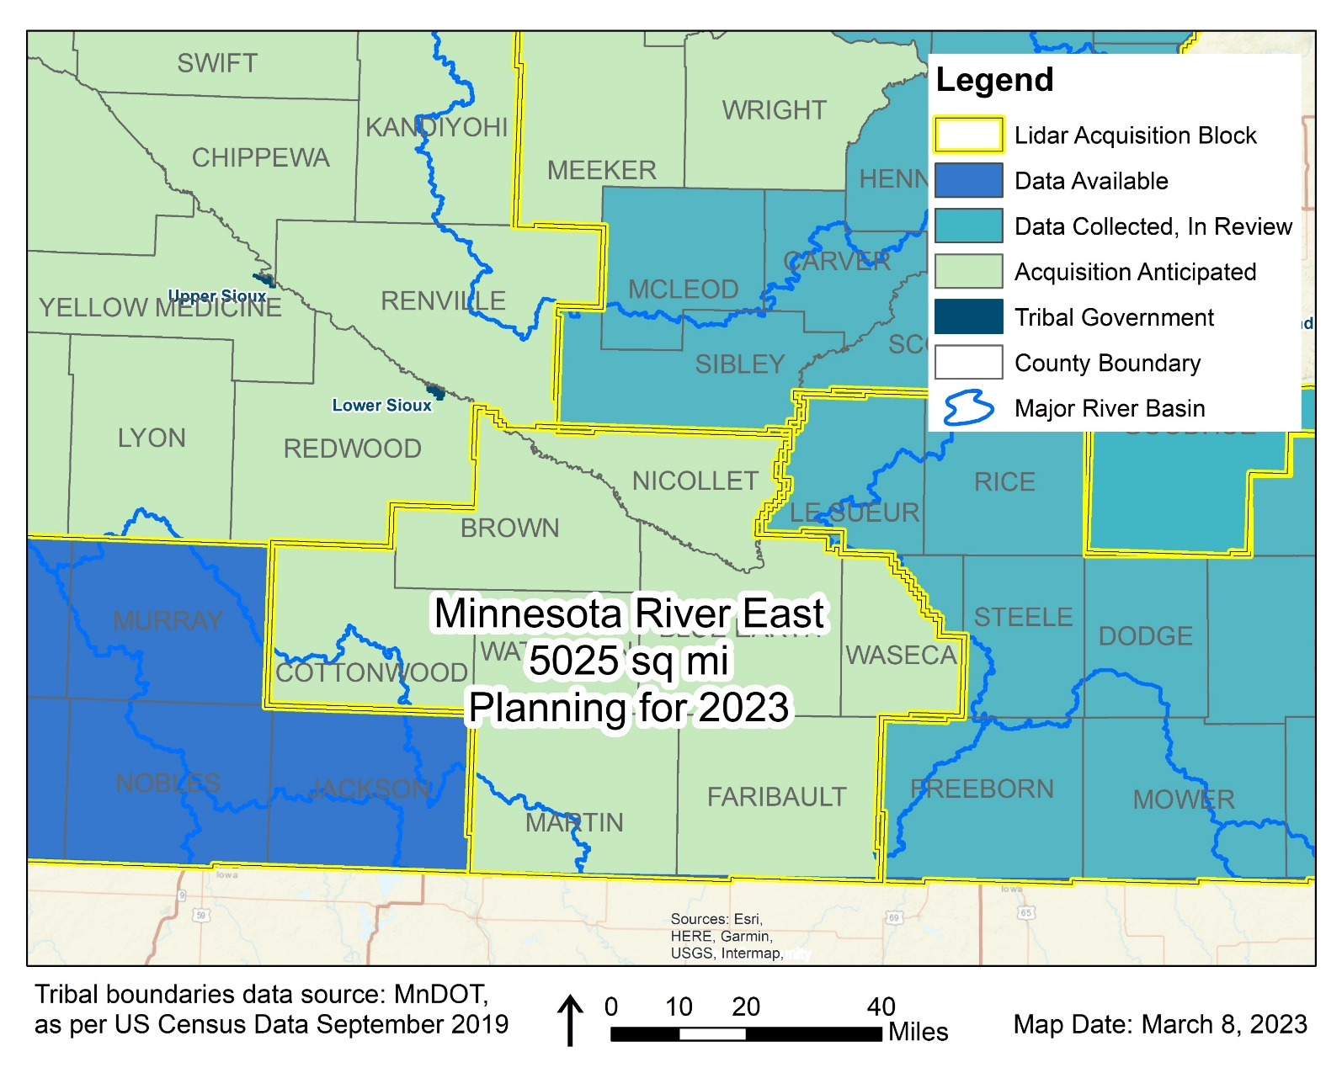
3DGeo Outreach: ANTICIPATED for 2023
Minnesota River - East Block
13 state/local partners raised $636K total
Leveraged $1.03M match from 3DEP!
Data acquisition will begin spring 2023 – snow free, leaf-off conditions
Notes:
TOTAL Est Funds Needed: $1,633,125
Estimated using $325 per square mile for QL1
8 Counties - 5025 square miles
$61,242 per county goal

Slide 41
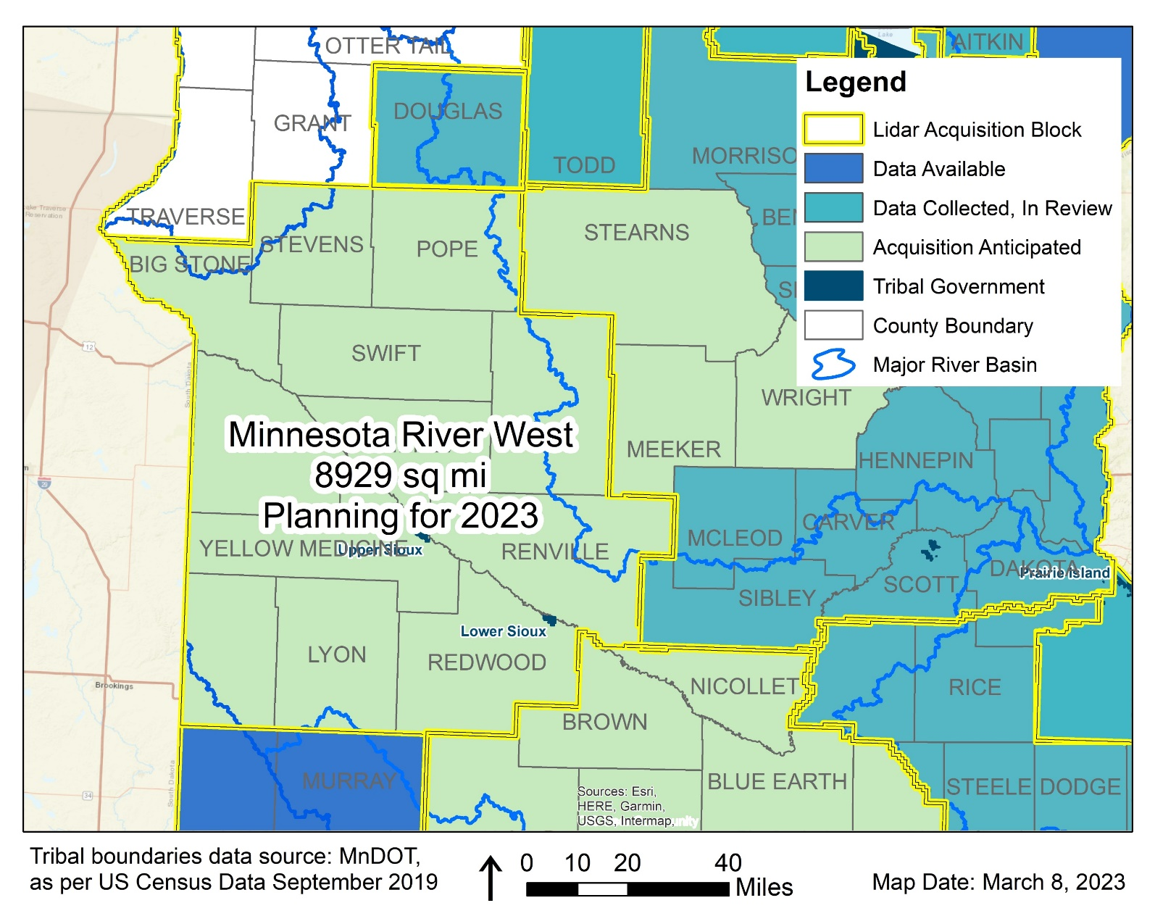
3DGeo Outreach: ANTICIPATED for 2023
Minnesota River - West Block
8 state/local partners raised $856K total
Leveraged $2.09M match from 3DEP!
Data acquisition will begin spring 2023 – snow free, leaf-off conditions
Notes:
TOTAL Est Funds Needed: $2,901,925
Estimated using $325 per square mile for QL1
12 Counties – 8929 square miles
$72,548 per county goal
*Special note: the Red River Watershed Management Board (RRWMB) and partners, collected lidar in fall 2021. RRWMB is considering sharing their complete lidar point cloud data with the USGS for 3DEP compliance certification. Therefore, the RRWMB data currently do not meet 3DEP standards and are therefore not considered part of the MN Lidar Plan at this time. If RRWMB data is shared with the USGS, certified as 3DEP compliant, and made publicly available as a result, 3DGeo will welcome RRWMB data as a temporal lidar dataset within the statewide MN Lidar Plan.
The 3D Geomatics Data Acquisition Team will be submitting a USGS 3DEP BAA for the entire 3DGeo MN River West Lidar Acquisition Block (LAB) as outlined in the Minnesota Lidar Plan to ensure there are no gaps between the RRWMB and 3DGeo lidar acquisition initiatives.

Slide 42
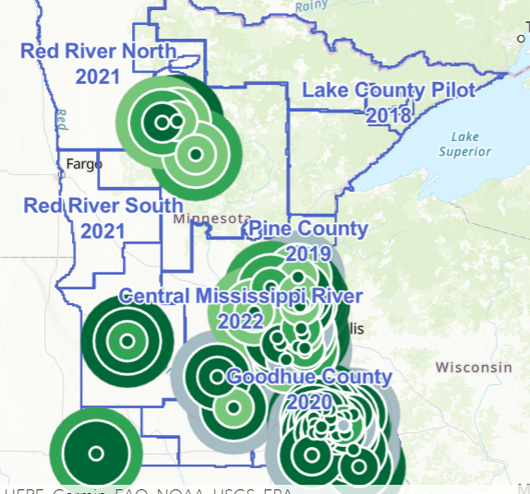

3DGeo - CONDITIONS REPORTING TOOL
3DGeo created a crowdsourcing tool that uses ArcGIS Survey123 to track conditions of ice, vegetation, and the ground in support of timing and coordinating lidar data procurement throughout 3DGeo lidar acquisition blocks (LAB).
App
  Conditions entry
  Install the app on a mobile device by clicking on this link https://arcg.is/1KDOyP or scanning the QR Code:
Dashboard
  Information collected is shared in a dashboard that allows cooperators to monitor changing conditions.
  https://smarturl.it/3DGeoLidarDashboard
Notes:
https://arcg.is/1KDOyP
https://smarturl.it/3DGeoLidarDashboard

Slide 43




3D Geomatics: Funding, Agreements, and Acquisition
Contributions to Minnesota Lidar ($millions)
Minnesota Partners: $ 7.55
USGS 3DEP: $14.72
Other Federal $ 0.45
Total: ~$22.71M
Minnesota Funding Partners
59 Funding Partners
65,359 Square Miles of New Lidar
$115* Cost/mi² For MN Partners
* Estimated cost per square mile paid by 59 unique Minnesota funding partners working collaboratively for consistent lidar data acquisition. $115 Value: 1.) is not specific to a 3DGeo Lidar Acquisition Block, 2.) is based on total Minnesota partner contributions of $7,545,761.44 (03/08/2023), 3.) does not include federal contributions.

Slide 44
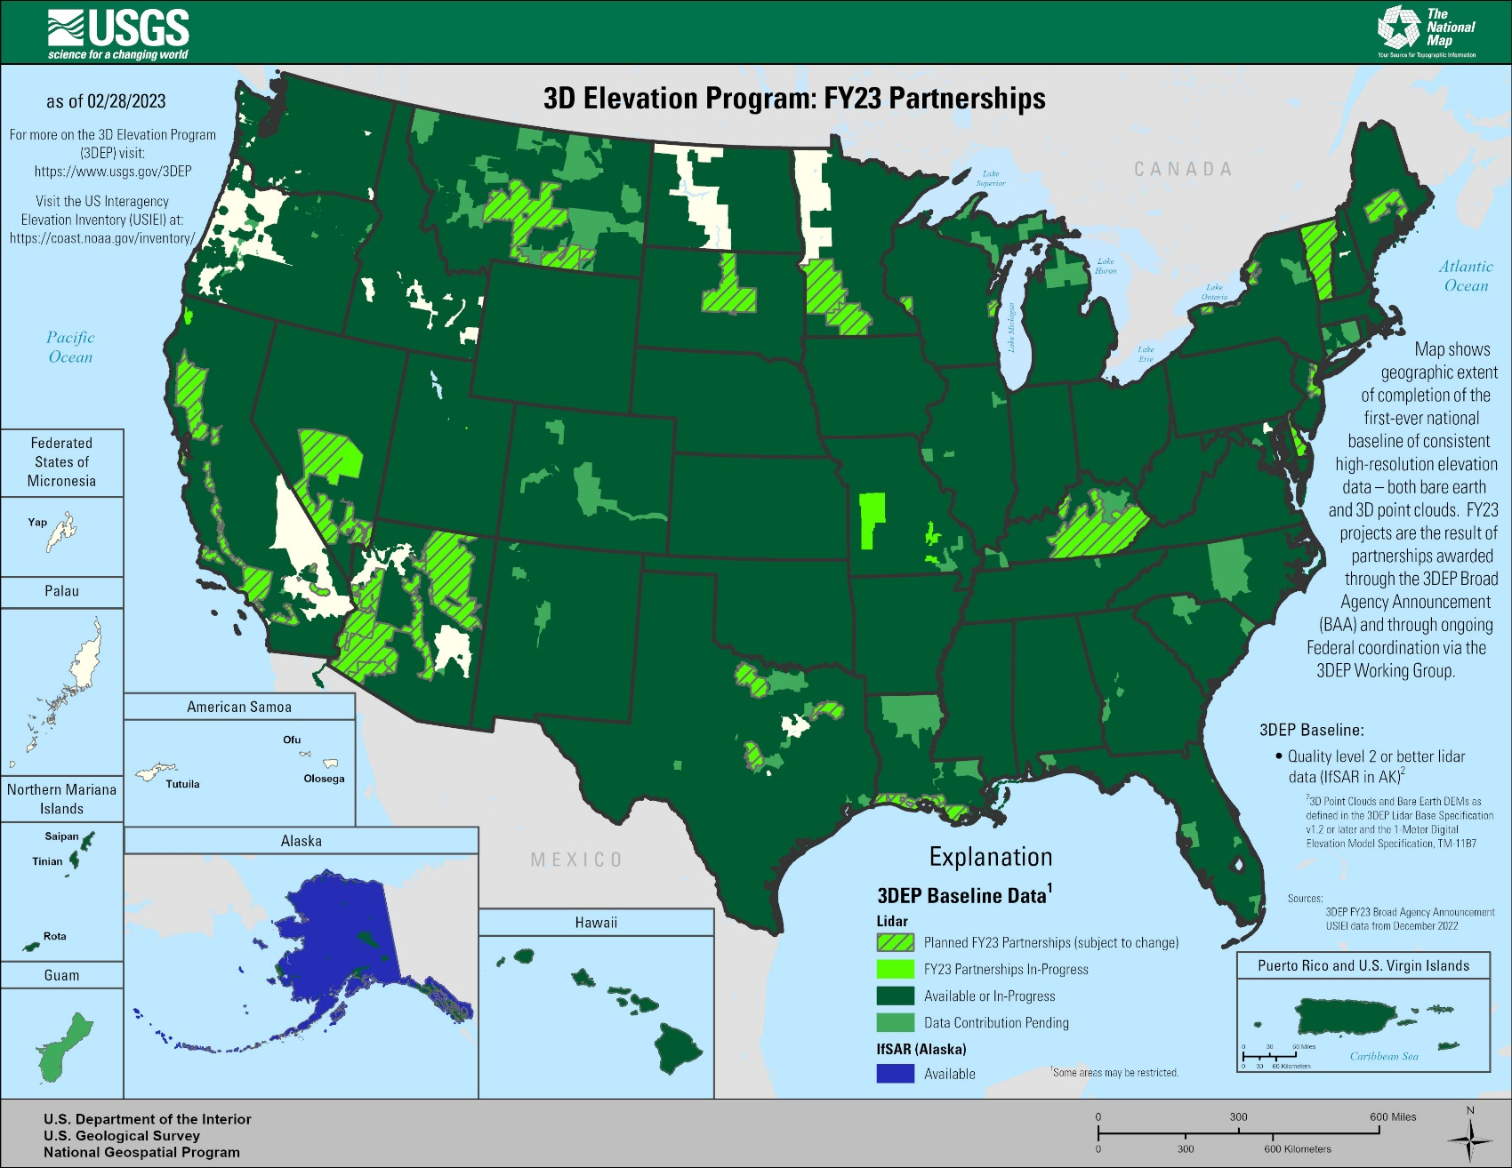
USGS 3D Elevation Program (3DEP)
3D Elevation Program (3DEP)
Systematically guiding the collection of 3D elevation data in the form lidar data for the United States, and the U.S. territories

Slide 45
USGS 3D Elevation Program (3DEP)
3DEP is an Established Federal Program
Foundational | Consistent | Transparent | Trusted
  Established } Program launched in 2011
  Lidar for U.S. } Guiding systematic lidar acquisition across the United States
  Standardized } USGS Lidar Base Specification 2022 rev.A
  Quality Control } Nationally recognized data assessment and certification process
  Transferable Data } Supports implementation into state and federal programs
  Coordination } Mitigates duplication of lidar acquisitions
  Partnerships } Partner-based procurement, government agency supported
Notes:
We checked this morning and the BAA has not been released yet

Slide 46
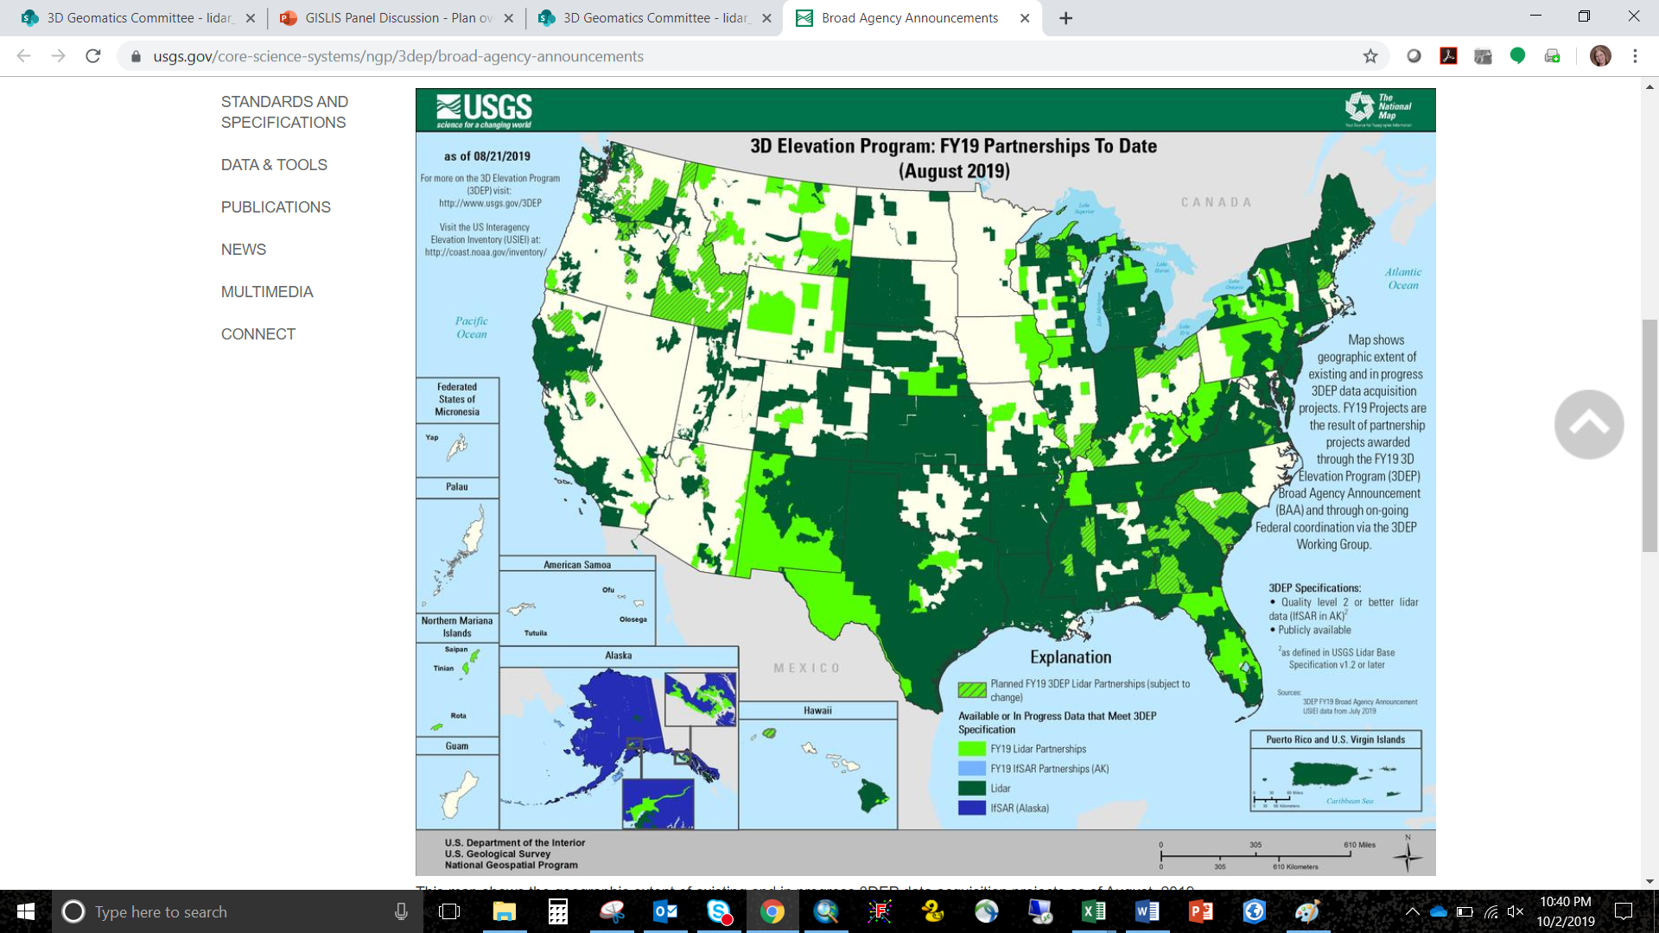
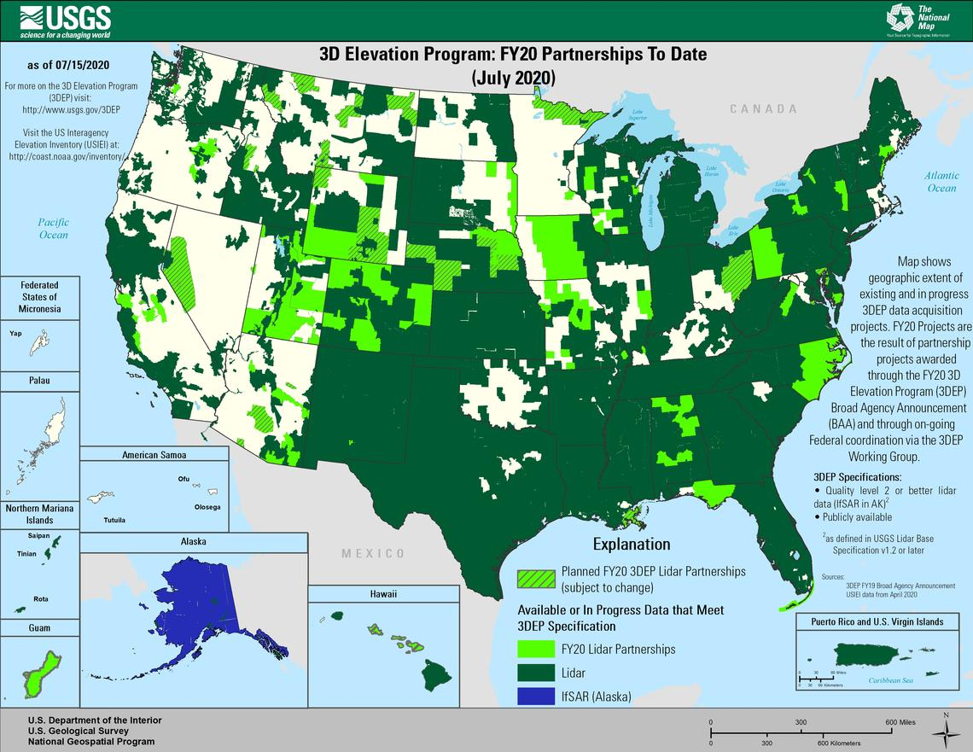
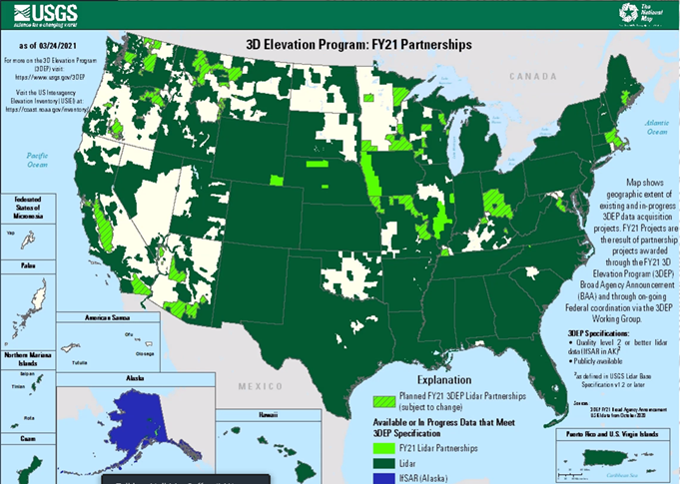
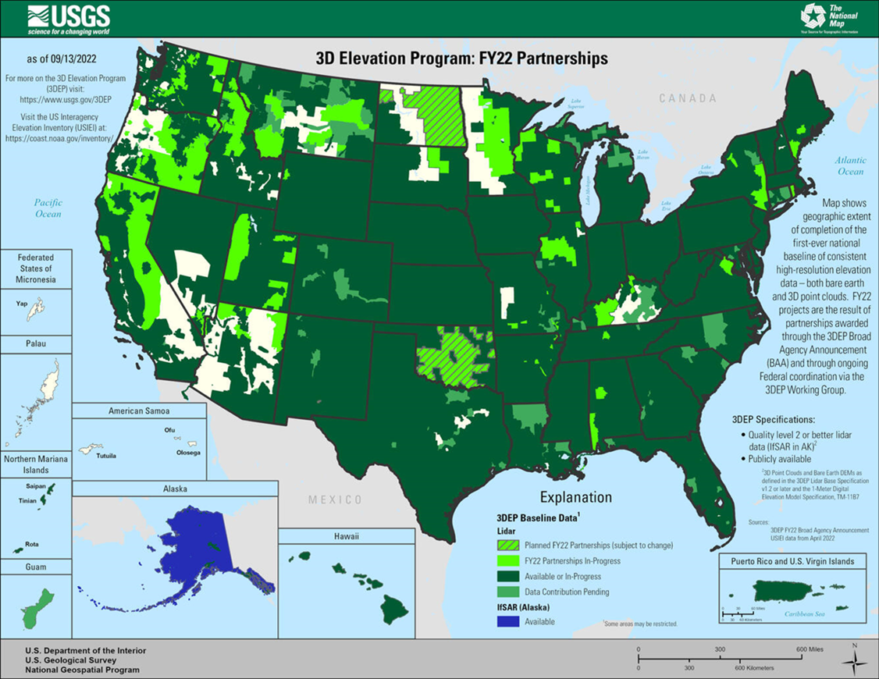

USGS 3D Elevation Program (3DEP)
2019
Maps show geographic extent of completion of the first-ever national baseline of consistent high-resolution elevation data –both bare earth and 3D point clouds – identified by the U.S. Interagency Elevation Inventory (USIEI) that meet 3DEP base level specification. -USGS https://www.usgs.gov/media/images/fy22-status-3dep-quality-data
2020
2021
2022
2023

Slide 47
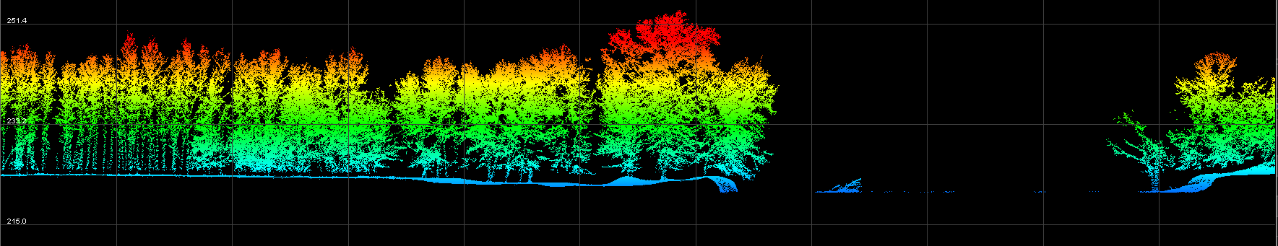
Minnesota Lidar → Ownership
Minnesota’s Authoritative Lidar Data:
Current lidar collations (2021 – 2025) are defined as Minnesota's second-generation high density lidar data
USGS Prime Vendors:
  The data was collected under contract by federally identified prime vendors managed by the U.S. Geological Survey (USGS).
Contracts were administered in partnership with other federal agencies, Minnesota 3D Geomatics Committee, Minnesota state agencies, and many local-Minnesota funding partners.

Slide 48
State Agency Lidar Derived Products → DEM – LAB
Interim Lidar Acquisition Block Data
Individual LAB data will be managed and served as interim data until the state is completed and authoritative statewide datasets are published.
  DEMs, Hillshade rasters and Contours will be created and made publicly available for each lidar acquisition block (LAB), within 3-months after final delivery of the last vender acquisition block is received by 3DGeo from the USGS (14 LABs in total)
Final Statewide Data
After the Final Data is received from the USGS that completes the 3DGeo managed lidar acquisition footprint for Minnesota under the 3DEP program, the lidar data will be compiled into mosaicked datasets within 6-months and published for public consumption.
      After the statewide data is published, the individual LAB project datasets will be removed from publication

Slide 49
State Agency Lidar Derived Products → DEMs – Statewide
Final Statewide Data
After the Final Data is received from the USGS that completes the 3DGeo managed lidar acquisition footprint for Minnesota under the 3DEP program, the lidar data will be compiled into mosaicked datasets within
6 months and published for public consumption.
Mosaicked
    Mosaicked for entire state
    County
    Major/HUC 8 Watershed
DEM Resolution | QL1 Contour Interval | QL0 Contour Interval
0.5-meter (provided as a 3DEP deliverable) | 1-foot | 0.5-foot
1-meter | 2-foot
3-meter

Slide 50
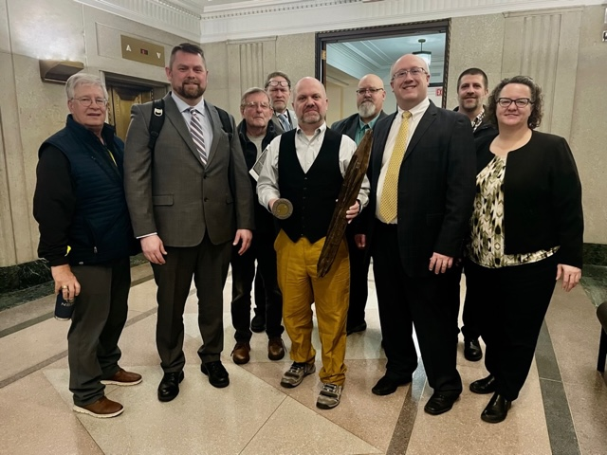
Agenda Item 7
Legislative Updates
Alison Slaats and Brandon Hirsch
Governor's budget
  MnGeo has requested an increase in appropriation for lidar data storage and distribution support, and to support additional foundational dataset work
PLSS Remonumentation
Surveyor-led team is pursuing PLSS legislation
Left to right: Peter Jenkins, DOT; Preston Dowell,
St. Louis Co.; Rod Squires, UofM; Geoffrey Maas, Ramsey Co.; Rep. Mike Freiberg, chief author of the legislation; Patrick Veraguth, Douglas Co.; Phil Raines, MSPS; Dan Baar, Ramsey Co.; Julie Groetsch, DOT

Slide 51

Break

Slide 52
Agenda Item 9
Updates on GAC Priority Projects and Initiatives
David Brandt

Slide 53
Updates on GAC Priority Projects and Initiatives
Most recent success
Experiencing a barrier?
Next task

Slide 54
GAC Priorities
Project or Initiative Description | Status | Project Owner | Champion
Parcel Data | Active | Ryan Stovern | Alison Slaats
Critical Infrastructure Data Workflow | Active | Stacey Stark | Steve Swazee
Updated and Aligned Boundary Data | Active | Preston Dowell | Alison Slaats
Address Points Data | Active | MnGeo | Alison Slaats
Road Centerline Data | Active | MnGeo | Alison Slaats
Culvert Data Standard | Active | Rick Moore | Andrea Bergman?
Publication of Open Foundational Data | Active | David Brandt, Randy Knippel | Alison Slaats
Lidar Data | Active | Gerry Sjerven | Alison Slaats
U.S. National Grid Materials | Active | Randy Knippel | Randy Knippel
Remonumentation of All Section Corners | Active | Pat Veraguth | Alison Slaats
MnGeo Image Service Improvements | Active | Alison Slaats | Alison Slaats
Geodata Archive Implementation | Active | Ryan Mattke | many

Slide 55
GAC Priorities
Project or Initiative Description | Status | Project Owner | Champion
Underground Utilities Data Sharing Team | Active | Steve Swazee | Barb Cederberg
Success Stories for Geospatial Technology | Active | Outreach Committee? | Len Kne
Geospatial Commons Advisory Group | Recruitment | Ben Timerson
Hydro-DEMs | Active | Sean Vaughn | many
Summary Crime Data | Active | Britta Maddox
NG9-1-1 Geospatial Forum | Recruitment
Parks Data Standard | Inactive | Standards Committee?
State Business License Data | Inactive
Street Parking Restrictions Data Standard | Inactive | Standards Committee?
Snow Emergency Parking Data Practices | Inactive
Strategy Team for All Types of Imagery | Inactive | Imagery Team?
Basemap Services | Inactive
Inventory of MN GeoData Assets | Inactive

Slide 56
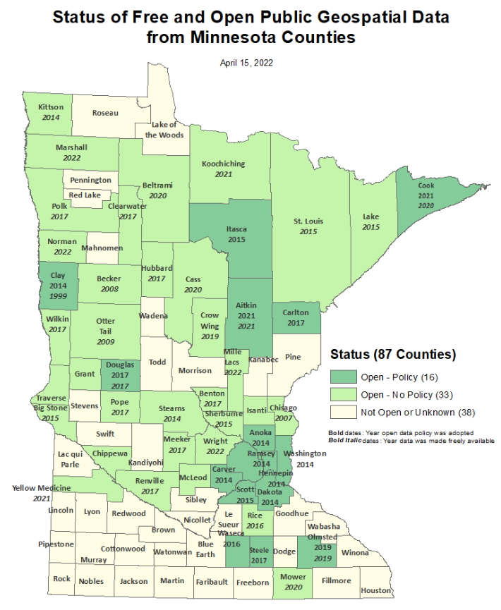
Status of Free and Open Data Public Geospatial Data
Status | Number of Counties | Total
Open - Policy | 16 | 49
Open - No Policy | 33
Not Open or Unknown | 38 | 38
Data current as of April 15, 2022 (no change since then)
https://gisdata.mn.gov/dataset/bdry-mn-county-open-data-status

Slide 57
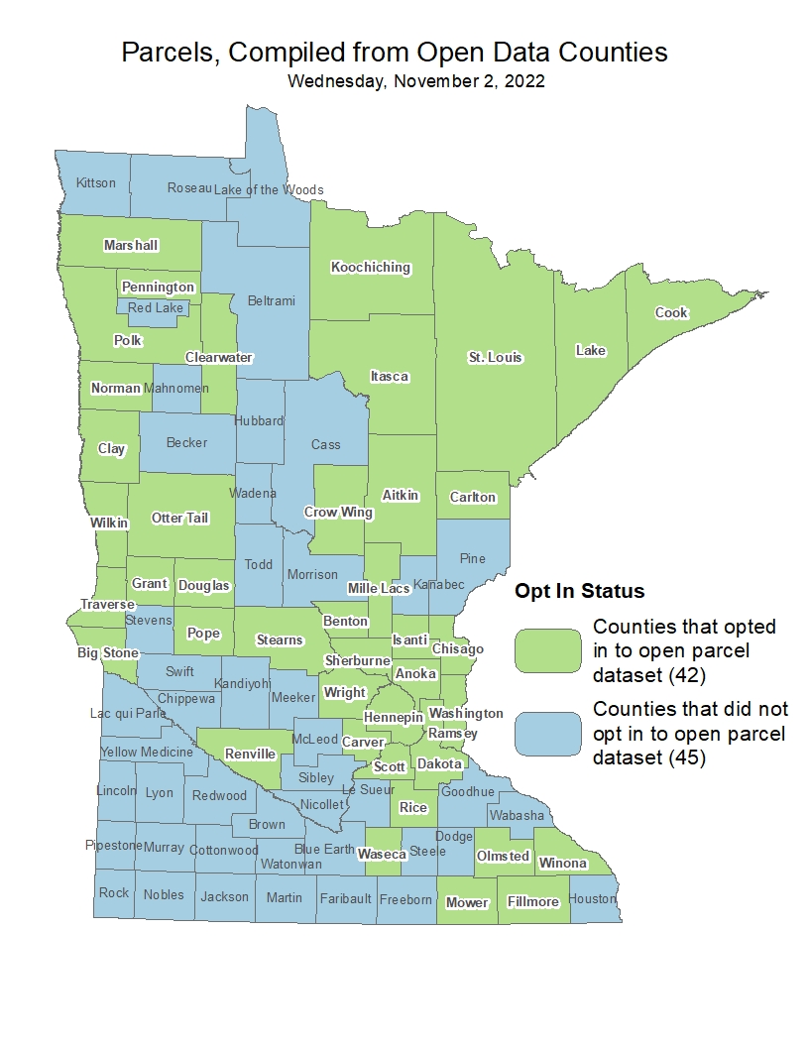
Statewide Publicly Available Parcel Data
Most recent success:
  Published update (2/1/2023) of opt-in public GAC-standard compiled dataset including 42 counties
If you are experiencing a barrier:
  PLRC's open data sub-committee’s outreach team will continue reaching out from county to county to talk about benefits of sharing data and learning more about barriers and follow up on survey results.
Next task:
  PLRC's open data sub-committee’s outreach team will continue reaching out from county to county to talk about benefits of sharing data and learning more about barriers and follow up on survey results.
  https://gisdata.mn.gov/dataset/plan-parcels-open

Slide 58
Critical Infrastructure Data Workflow
Most recent successes:
  working on updating correctional facilities dataset in MNGeoCommons.
  new priority initiative proposal: To publish foundational data nationally through open data and commercial sources. Foundational datasets are defined as parcels, addresses, road centerlines, and critical infrastructure. This is a great idea to move this aspect of the C.I. workgroup to another new workgroup. We've talked about this a lot and it has become a whole separate project.
If you are experiencing a barrier:
  Few meetings and little time for forward movement 4th quarter.
Next task:
  Refresh our goals for 2023. Invite new members.

Slide 59
Updated and Aligned Boundary Data
Most recent success:
If you are experiencing a barrier:
Next Task:

Slide 60
Road Centerline Data & Address Points Data
Most recent success:
  More counties are submitting their data through the NG9-1-1 data ECN 1Spatial Portal. Progress can be seen on the NG9-1-1 hub on the status page
If you are experiencing a barrier:
  Final 1Spatial validation steps need to be completed so that MnGeo can pull data in streamlined process.
  Request for GAC to approve "opt-in" process using the same method as used to opt-in to statewide parcel dataset
Next task:
  PLRC Open Data subcommittee will work with Outreach team to ask counties if they’d like to "opt-in" to be included in public dataset
  ETLs are in progress to pull data from 1Spatial NG911 validation to statewide dataset

Slide 61
Culvert Data Standard
Most recent success:
  The Culvert Data Standard workgroup officially formed in December 2022. We have identified co-chairs (Kellie Thom - MNDOT) and Mike Becker (Morrison SWCD) along with Rick Moore (MNIT@DNR). The group has met twice and we have developed a definitions document that details a definition for culverts that meets the needs of all members. We will be expanding this to include other definitions that pertain to the standard. We have also developed a survey that will be distributed to counties, SWCD’s, watershed districts, etc. to determine the status of culvert mapping in their local unit of government. We have pre-tested it with our members and will work with the GAC to disseminate. We are growing in membership as entities learn of our mission and want to be included in the effort.

Slide 62
Culvert Data Standard (cont.)
2. If you are experiencing a barrier:
  There are really no barriers other than determining the process through the GAC on how to share a survey.
  Assistance with disseminating the survey to a larger audience.
3. Next tasks:
  The next activity will be sharing the survey with counties, SWCD's, cities, etc. and waiting for responses. Once those responses and the inclusion of their attributes are shared with the subgroup, we will start comparing the attributes for commonality and eventually determining which attributes should make it into the standard. The next meeting is slated for early May.

Slide 63
Publication of Open Foundational Datasets
Most recent success:
If you are experiencing a barrier:
Next Task:

Slide 64
Lidar Data Acquisition
Most recent success:
  Working on a new subgroup. Data Governance to help work on lidar-derived products.
If you are experiencing a barrier:
Next Task
  Continue to reach out to stakeholders to create lidar derived products through:
    Coordinated Development
    Best Practices
    Exploration of New Techniques
    Emerging Technologies

Slide 65
U.S. National Grid Materials
Most recent success:
  Most recent quarterly meeting of the USNG Implementation Working Group was Jan. 18
  Most recent meeting of the group’s Board of Directors was Jan. 17
If you are experiencing a barrier:
Next tasks:
  Anticipate release of a new USNG mapbook publishing application on USNG Center by the end of the year

Slide 66
Remonumentation of All Section Corners
Covered earlier in the meeting – see agenda item 2

Slide 67
MnGeo Image Service Improvements
Most recent success:
  Added Le Sueur County imagery
  Added storage to production server so that additional imagery may be added
  NAIP2021 GeoTIFF imagery downloaded, shared NAIP imagery with U of M
  Received Hennepin County imagery via SFTP upload, received Douglas County imagery
  Complete build out of new development/staging image server
  In discussion: Lincoln and Aitkin counties
2. If you are experiencing a barrier:
  Time constraint is the biggest issue
3. Next Tasks:
  Publish Polk County imagery
  Process Hennepin County imagery, Process Douglas County imagery

Slide 68
Geodata Archive Implementation
Most recent success:
  Archiving Imagery Workgroup report submitted in December 2022.
If you are experiencing a barrier:
Next Task:
  Working on next steps for how to move forward with an archiving plan.

Slide 69
Underground Utilities Data Sharing Team
Most recent successes:
  Dedicated support website is created (www.fuzionview.org) and outreach to the Minnesota utility community has begun
  Presentation at MN GIS/LIS October 13-14.
  Gopher State One Call COO Barbara Cederberg now working closely with the Common Ground Alliance GIS Working Group. The Minnesota project is seen as leading the nation and is receiving community wide support.
2. If you are experiencing a barrier:
3. Next tasks:
  Review promotional flyer
  Gopher State One Call is preparing to contract for development of open source product to leverage concepts and approaches used during development of prototype.

Slide 70
Success Stories for Geospatial Technology
Already covered during the meeting

Slide 71
Accurate hydro-DEMs (hDEM)
Most recent success:
  The 3D Geomatics DEM Hydro-modification Subgroup continues to meet to develop standards, methodology and protocols related to DEM hydro-modification. We continue to collect breachline datasets from members and entities that do hydro-modification and absorb it into our breachline dataset. With the advent of new lidar, we are testing the use of legacy breachlines with the new lidar DEM's and make recommendations for methodologies into the future.
If you are experiencing a barrier:
  No foreseen barriers. Just need time to compile the comments for the documentation.
Next task:
  Continue to meet as a group and complete documentation on the standards, methodology, and protocols as well as completing the final documentation on the pilot project.

Slide 72
Summary Crime Data
Most recent success:
If you are experiencing a barrier:
Next Task:
  Meet to review and understand scope

Slide 73
Agenda Item 10
Applications for next GAC term
Nancy Rader

Slide 74
Next GAC Term
All member terms end June 30, 2023
The next two-year term will run July 1, 2023 – June 30, 2025
Applications are submitted through the Open Appointments process administered by the Minnesota Office of the Secretary of State
Current GAC members who wish to continue will need to re-apply
Publicity about applying for the next term will go out soon, including details about the application deadline and process

Slide 75
Agenda Item 11
Announcements

Slide 76
Next Meeting
Wednesday, May 24
11:00 – 2:00
Hybrid meeting: Options to attend remotely or in-person
Location TBD

Slide 77
Adjourn
Thank you

