Slide 1



Minnesota Geospatial Advisory Council
September 13, 2023

Slide 2
Welcome
Introductions
Approve agenda
Approve May minutes

Slide 3
Introductions
City, Twin Cities metro
Dennis Tumberg, City of Chanhassen
City, Greater Minnesota
Vacant
County, Twin Cities metro
Victoria Reinhardt, Ramsey County
County, Greater Minnesota
Christy Christensen, McLeod County
Regional government, Twin Cities metro
Tanya Mayer, Met Council
Regional government, Greater Minnesota
Jill Amundson, West Central Initiative
State agencies
Kari Geurts, DNR
Ben Timerson, MnDOT
Federal government
Jeff Bloomquist, Risk Management Agency, USDA
Mitch Bergeson, US Geological Survey
Tribal government
Ryan Bonney, Shakopee Mdewakanton Sioux Community
Non-profit organizations
Jessica Fendos, LOGIS
Business
Kendis Scharenbroich, Pro-West & Associates
Gerry Sjerven, Minnesota Power
Higher Education
Len Kne, U-Spatial / UMN Twin Cities
Stacey Stark, U-Spatial / UMN Duluth
MetroGIS
David Brandt, Washington County
MN GIS/LIS Consortium
Leanne Knott, City of Red Wing
Surveyor
Pat Veraguth, Douglas County
At-large
Cory Richter, Ramsey County
Heather Albrecht, Hennepin County
Britta Maddox, Anoka County
Chief Geospatial Information Officer (ex-officio)
Alison Slaats, MnGeo

Slide 4
Agenda
Time | Topic | Time | Topic
11:00 | Introductions, approve agenda and previous minutes | 12:05 | Break & networking
11:10 | Review and Accept Committee Summaries (All) PLSS Preservation Committee Charter Revision | 12:35 | State of Minnesota Hazard Mitigation Plan (Stark)
11:20 | Welcoming returning and new GAC appointees (Richter/Slaats) | 1:00 | Legislative & NSGIC Updates (MnGeo)
11:25 | The GAC & MnGeo Relationship (MnGeo) | 1:10 | Priority Projects Annual Survey: Timeline & Goals (Richter/Brandt)
11:35 | GAC Member Roles & Expectations (Richter) | 1:30 | Updates on MN GAC Priority Projects and Initiatives (Brandt)
11:40 | Committee Recruitment (Richter) | 1:45 | Announcements or Other Business
11:50 | Leadership Team (Richter) Roles & Expectations Selection | 2:00 | Adjourn

Slide 5
Agenda Item 2
2. Committee Reports – Review and Accept
All

Slide 6
PLSS Preservation Committee Charter Revision
Pat Veraguth

Slide 7
PLSS Preservation Committee Revised Charter
September 13, 2023
Patrick D. Veraguth

Slide 10
Agenda Item 3
Welcoming returning and new GAC appointees
Cory Richter/Alison Slaats

Slide 11
Returning and New Appointees
GAC Mission
The Council acts as a coordinating body for the Minnesota geospatial community. It represents a cross-section of organizations that include counties, cities, universities, business, nonprofit organizations, federal and state agencies, tribal government, surveyors and other stakeholder groups that benefit from geospatial technology.

Slide 12
Returning and New Appointees
Guiding Principles
Promote effective investments in geospatial information
Promote geospatial information as a shared public resource
Support the establishment and use of geospatial standards and best practices
Champion collaboration among geospatial practitioners and related stakeholders
Educate and inform policymakers about the value and use of geospatial technology
Provide a forum for ideas and issues to be shared and acted upon by the geospatial community
Encourage all council sectors to contribute to the state geospatial infrastructure
Encourage all council members to communicate outcomes with relevant stakeholders
Encourage geospatial education at all levels
Advocate for free and open geospatial data

Slide 13
Returning and New Appointees
Examples of Coordination
Advising, supporting and making recommendations to MnGeo
Creating, endorsing and advocating for standards
Defining policy requirements and driving policy decisions
Representing the geospatial community
Advocating for project priorities

Slide 14
Returning and New Appointees
To do items:
Review and return the Oath of Office
Review and submit profile updates
Verify you have access to SharePoint
Add important dates to your calendar
Join a committee, workgroup or project team!

Slide 15
Agenda Item 4
The GAC & MnGeo Relationship
Alison Slaats

Slide 16

About MnGeo
By statute* MnGeo provides coordination, guidance, and leadership for the state’s use of geographic information systems (GIS)
MnGeo is the Minnesota Geospatial Information Office and is an office within Minnesota IT Services (MNIT)
Being part of MNIT, MnGeo also provides IT geospatial services to state agencies through a service bureau model
MnGeo’s work is guided by the Geospatial Advisory Council (GAC) that is representative of the Minnesota geospatial community
* https://www.revisor.mn.gov/statutes/cite/16E.30

Slide 17
Geospatial Advisory Council
Subd. 8.Geospatial Advisory Council created.
(a) The chief information officer must utilize a governance structure that includes an advisory council to provide recommendations for improving the operations and management of geospatial technology within state government and also on issues of importance to users of geospatial technology throughout the state.
(b) The Geospatial Advisory Council must advise the Minnesota Geospatial Information Office regarding the improvement of services statewide through the coordinated, affordable, reliable, and effective use of geospatial technology. The chief information officer must appoint the members of the council. The members must represent a cross-section of organizations including counties, cities, universities, business, nonprofit organizations, federal agencies, tribal governments, and state agencies. In addition, the chief geospatial information officer must be a nonvoting member.
(c) Members of the Geospatial Advisory Council must be recommended by a process that ensures that each member is designated to represent a clearly identified agency or interested party category. Members of the Geospatial Advisory Council must be selected in compliance with the state's open appointment process. Members shall serve a term of two years.
(d) The Minnesota Geospatial Information Office must provide administrative support for the Geospatial Advisory Council.

Slide 18



MnGeo work and funding
Guided by
Funding
Approach
Work guided by the Geospatial Advisory Council (GAC)
Program work funded by General Fund & PLSS Preservation Funds
MnGeo Programs & Projects
MnGeo Strategic Plan
Work from MNIT and state agencies
Service Bureau work funded by state agencies

Slide 19

MnGeo’s Strategic Plan Priorities
Geospatial Commons
Improve Statewide Services (Parcel, Geocoder, Imagery)
Support PLSS Remonumentation through grant program
Work with regional groups
Improve communication in the GIS community (GovDelivery, State Collaborative)
Produce or Improve products that benefit the greater community
Form an Enterprise Technology Strategy

Slide 20

Improve statewide geospatial data foundations
Geospatial Commons – collaborative site for users and publishers of geospatial resources
Support the aggregation and sharing of foundational datasets and services such as parcels, streets, address points, elevation and lidar data
Support County remonumentation efforts through PLSS grant program

Slide 21
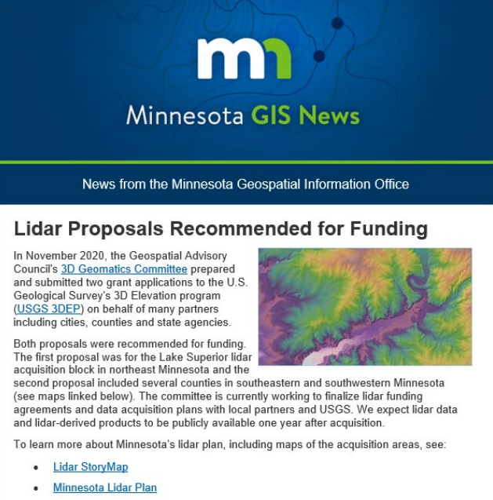
Lead the Geospatial Community in Coordination and Communications
Support the Geospatial Advisory Council (GAC) that guides MnGeo, including meeting support, providing SharePoint and Esri Hub collaboration sites
Regional Coordination – participate in GIS user groups
Collaboration and information sharing through Minnesota GIS News, Geospatial Updates, Agency Geospatial Collaborative
Support activities of the GAC

Slide 22

Provide Outstanding Technical Support in Geospatial Technologies
MnGeo also offers project based Professional Services
Services include
Business analysis and requirements gathering
Database design
Application and data development
Application and data hosting
Projects with 20+ agencies
Look for ways to support GAC priorities, such as data sharing (Next Generation 9-1-1 project)

Slide 23
GAC and MnGeo
MnGeo provides administrative support to the GAC
Provides a SharePoint site for the GAC leadership team, committees and workgroups, for internal collaboration
Provides support for GAC web pages
Provides Esri Hub sites and support for committees and workgroups for public facing content
Provides support for GAC priority survey creation and delivery
Co-chairs, attends, participates in and contributes to many committees and workgroups. (This works best if a GAC member or geospatial community member is the workgroup or committee chair).
Facilitates NSGIC membership for GAC members
Organizes and hosts GAC Quarterly meetings, provides refreshments, takes minutes, etc.

Slide 24
GAC and MnGeo
The work you do as part of the GAC, and its committees and workgroups, helps shape and direct the work we do at MnGeo
Examples of work done by MnGeo’s work advised by the GAC
Quarterly aggregation of parcel data, including conversion to GAC parcel standard, and publication of opt-in parcel dataset on Commons
Support of Geospatial Commons (1000+ resources and 45 publishers)
Financial and organizational support for USGS 3DEP lidar funding partnerships
Building of MnTOPO 2 application to support storage and delivery of new lidar data and derivatives
Building a StoryMap to explain the benefits of parcel sharing, with content from the Parcel and Land Records Committee
Ongoing support the WMS image service that shares county, state agency, federal and other imagery in a fast and freely available service
Participation in meetings to advocate for GAC goals and principles, such as data sharing
Thank you GAC for guiding MnGeo so we can better serve the Minnesota Geospatial Community

Slide 25
Agenda Item 5
GAC Member Roles & Expectations
Cory Richter

Slide 26
GAC Member Roles & Expectations
Support the Council's mission
Prepare for and be active in the quarterly Council meetings
Be an ambassador representing your sector stakeholders and other stakeholders with whom you are connected (e.g., professional groups)
Speak for stakeholders at Council meetings
Carry Council news and proposals back to stakeholders
Collect stakeholder views on complex issues, either from individuals or existing umbrella organizations
Actively Participate in at least one workgroup, committee, or project team
Be a positive voice for the work of the GAC
Annually participate in the priority project survey through contributing ideas and disseminating the survey to stakeholders

Slide 27
Agenda Item 6
Committee Recruitment
Cory Richter

Slide 28
Committee Recruitment
3D Geomatics
Awards
Emergency Preparedness
Image Service Sustainability
Outreach
Parcels and Land Records (formerly Digital Cadastral Data)
PLSS Preservation
Standards

Slide 29
Agenda Item 7
Leadership Team
Cory Richter
Roles & Expectations
Selection

Slide 30
Leadership Team: Roles and Expectations
Participate in leadership team meetings by advocating for the GAC members & sectors
Help develop content and vote on agendas
Attend the quarterly leadership planning meetings
Participate in other leadership team discussions and meetings as needed
Participate in at least one committee, workgroup, or project team
Attend the quarterly GAC meetings
Be a positive voice for the work of the GAC
Annually contribute to the workplan and accomplishments of the GAC

Slide 31
Leadership Team: Nominations
Multiple Roles
Chair (1)
Vice Chair (1)
Secretary (1)
Advisor (1)
Board (Up to 3)
Lead meetings
Finalize agendas with the leadership team
Communicate with MnGeo, the GAC and the leadership team
Provide guidance to inquiries from committees or the public via MnGeo
Provide overall vision and leadership for the GAC, and meet with MnGeo GIO as needed to collaborate on GAC priorities
Write letters of support or directives
Lead in absence of the Chair
Advocate for priority projects by communicating with the GAC and sectors about priorities
Engage with committees to see that they are getting requested support from the GAC or MnGeo
Lead discussions about priority projects
Curate and manage the annual priority survey, including presentation to GAC
Lead in absence of the Chair and Vice Chair
Disseminate draft agendas to the GAC and MnGeo
Quarterly emails to the GAC and leadership team advising of timelines and due dates
Oversee content collection for project & committee updates, annual reports, workplans, and quarterly meeting packets
Work with MnGeo on GovDelivery GAC related announcements
Curate content for quarterly GAC meetings and bring ideas forward to the leadership team for agenda setting
Assist leadership team and GAC as requested

Slide 32

Break & Networking

Slide 33

MN State Hazard Mitigation Plan Update 2024
MN Geospatial Advisory Council
September 13, 2023

Slide 34

Overview of Plan Update
The MN State Hazard Mitigation Plan (HMP) update is a state & federal requirement. The plan must be updated every 5 years.
The purpose of this plan is to identify the state's major hazards, assess the vulnerability to those hazards, and take steps to reduce vulnerability using the technical and program resources of Minnesota agencies.
Hazard Mitigation is any action taken to reduce or eliminate long term risk to people and property from natural disasters.
https://dps.mn.gov/divisions/hsem/hazard-mitigation/

Slide 35
Plan Content and Requirements:
Planning process: Describe how the state coordinated with other agencies and stakeholders. [44 CFR §201.4(b) and (c)(1)]
2.2 Agency Partners
Geospatial Advisory Council (and subcommittees), MnGeo
MnDNR
Also – meeting and outreach documentation
Discuss the evaluation of the state’s hazard management policies, programs, capabilities, and funding sources to mitigate the hazards identified in the risk assessment. [44 CFR §201.4(c)(3)(ii)
5.6 State Programs, Policies and Funding
MDH Climate and Health Program
MN DNR State Climatology Office
Firewise in Minnesota
5.7 State Capability Assessment
Mn GeoCommons
MetCouncil Tools: Regional Climate Vulnerability Assessment, Localized Flood Map Screening Tool, and Extreme Heat Map Tool.
GAC – Emergency Preparedness Committee
Partners
Programs
Tools
(2019 examples in blue)

Slide 36
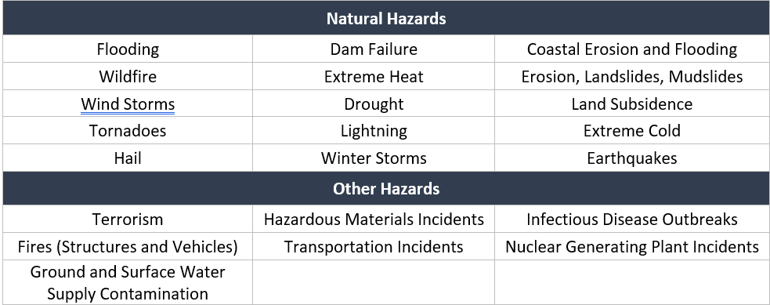
Include an overview of the type and location of all natural hazards that can affect the state, as well as the probability of future hazard events, using maps where appropriate? [44 CFR §201.4(c)(2)(i)]
4.4 Identifying Hazards
Table of data resources, maps
Describe vulnerability in terms of the jurisdictions most threatened by the identified hazards, and most vulnerable to damage and loss associated with hazard events. State owned or operated critical facilities located in the identified hazard areas must be addressed [44 CFR §201.4(c)(3)(ii)
4.6 Risk Exposure of State Assets and 4.6.2 Statewide Critical Facilities and Infrastructure
Table of CI resources, interactive maps
Plan Content and Requirements:
Data
(2019 examples in blue)

Slide 37
Hazard | State Mitigation & Climate Adaptation Actions | Funding and Resources
All-Hazards | 1a Fund development of high-resolution dynamically downscaled climate projections (that replicate atmospheric conditions) with a web portal that makes output available for use by planners, architects, designers, and engineers for building and infrastructure design including energy and stormwater modeling. | Legislature, state agencies, other partners
 | 1a Extend funding for and access to data portals that include climate projection data as well as state asset and population vulnerability data in order for planners to easily access these data and maps. A relevant pilot tool is here: https://maps.umn.edu/climatehealthtool/ | MDH, other state agencies, other partners
 | Engagement with MN Geospatial Advisory Council to support 2019 (and forward) priorities. Priorities that will benefit future Jurisdictional HMPs include: statewide address points data, street centerline data, and parcel data (all publicly available and including a data standard) and an emergency management damage assessment data standard for rapid, post event damage assessment GPS field collection (see: http://www.mngeo.state.mn.us/councils/statewide/index.html) | MN Geospatial Advisory Council, MnGeo, state agencies, other partners
 | Engagement with MN Geospatial Data community to develop a sustainable workflow to acquire and maintain essential state facility data in the Minnesota Geospatial Commons | MN Geospatial Advisory Council, MnGeo, state agencies, other partners
 | Engagement with MN Geospatial Data community to develop a sustainable workflow to acquire and maintain MN critical facility data, including Minnesota State Owned Buildings. | MN Geospatial Advisory Council, MnGeo, state agencies, other partners
 | Improve state owned and operated facility database | MnGeo-GAC, Admin, HMGP & PDM planning
Mitigation Actions –
strategy type: data
Prioritize mitigation actions to reduce vulnerabilities identified in the risk assessment? [44 CFR §§201.4(c)(3)(iii) and (iv)]
5.4 Mitigation, Climate Adaptation and Resilience Actions

Slide 38
Mitigation Actions –
strategy type: data
Hazard | State Mitigation & Climate Adaptation Actions | Funding and Resources
Flood | Complete FIRM data for all of MN counties: Current Status: 8 unmapped (neither paper or digital), 9 paper with no digital data. MN DNR in the process of getting GIS delineations for the remaining 70 counties. The MN DNR plan is to obtain funding from FEMA to digitize the 9 paper counties and then 8 unmapped counties. The 8 unmapped are mostly lake development and the Shoreland rules already require minimum elevations for development. | FEMA, DNR .../watermgmt_section/floodplain/access-flood-maps.html
Wildfire | Map and Assess Vulnerability to Wildfire | DNR Firewise, USFS, HMGP-Planning, PDM-Planning
Coastal Erosion and Flooding | Map and Assess Vulnerability to Erosion | HMGP, PDM, MN DNR, BWSR, USDA, NRCS, FSA, SWCDs, Silver Jackets
 | Inventory data and research related to Northshore Coastal Erosion. | HMGP, PDM, MN DNR, BWSR, USDA-NRCS-FSA, SWCDs, Silver Jackets
 | Develop data-based tools to aid local SWCDs and Cities develop common guidelines for landowners Lake Superior's North Shore | HMGP, PDM, MN DNR, BWSR, USDA-NRCS-FSA, SWCDs, Silver Jackets
Landslides | Map and Assess Vulnerability to Landslides. Ongoing multi-agency workgroups at universities to map and inventory landslide information. MNDNR has limited information on bluffs and landslides on website. | HMGP, PDM, MN DNR, USDA, NRCS, FSA, SWCDs, Silver Jackets
Prioritize mitigation actions to reduce vulnerabilities identified in the risk assessment? [44 CFR §§201.4(c)(3)(iii) and (iv)]
5.4 Mitigation, Climate Adaptation and Resilience Actions

Slide 39
How else can the geospatial community support hazard mitigation and climate resilience planning?
Message me to be a reviewer of the geospatial data sections (or any part!)
Share “success stories” of how geospatial data has contributed to HM and CR planning
Share datasets that support natural hazard research and mitigation
Contribute to resiliency planning efforts in your local jurisdictions – review local plans, share mitigation ideas

Slide 40

Contact Information
Stacey Stark, MS, GISP
slstark@d.umn.edu

Slide 41
Agenda Item 9
State of Minnesota Hazard Mitigation Plan
Stacey Stark

Slide 42
Agenda Item 10
MnGeo Updates
Alison Slaats
Surveyor Position
Progress on advised work
NSGIC membership for GAC members

Slide 43
MnGeo Surveyor Coordinator position
The Minnesota legislature funded a public land survey system (PLSS) remonumentation program in the 2023 legislature. This pilot grant program will provide grants to Minnesota Counties to remonument the PLSS.
$9.7 M is provided for use over 4 years (starting July 1, 2023). 6% is for administrative support.
MnGeo will hire a Survey Coordinator to set up and manage the program
Position posting closed on August 28
Interviews during weeks of September 11 and 18
Hope to have a the MnGeo Survey Coordinator onboard in October

Slide 44
Progress on advised work
Continued work to support committee and workgroup initiatives
Continued addition of counties to opt-in parcel dataset as needed based on advisement letters from GAC
Preparation of road centerlines and address points resources based on opt-in advisement letters from GAC

Slide 45
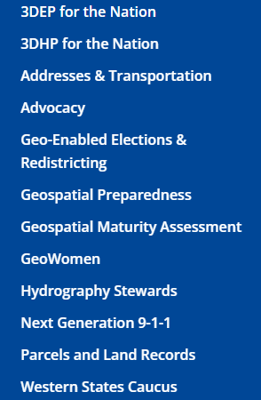
GAC Administrative support: National States Geographic Information Council (NSGIC)
About NSGIC
The National States Geographic Information Council (NSGIC) exists to advance effective state-led geospatial coordination for the nation.
NSGIC provides a national forum to share policies and practices for geospatial activities and provide a forum for national policy leadership
NSGIC has many committees and workgroups working on similar issues
NSGIC is working on bringing state geospatial councils together – stay tuned
https://nsgic.org/
As a GAC member, you have a membership in NSGIC
If you are new to NSGIC, we will have you signed up
There are a limited number of membership for GAC committee members
Let MnGeo know if a membership would benefit your committee work

Slide 46
Agenda Item 11
Legislative & NSGIC Updates
Alison Slaats

Slide 47
Legislative Updates
Funding for PLSS preservation and remonumentation
$9.7 M for FY24/25 biennium, can be spent through FY27
6% for administrative costs
MnGeo funding increase
The omnibus state government and elections finance bill (House File 1830) included an increase of $350,000/year in additional funding to expand the capacity of MnGeo.
Plan to use funds to focus on lidar data distribution and GAC data priorities

Slide 48
NSGIC updates
Geospatial Maturity Assessment
The NSGIC Geospatial Maturity Assessment (GMA) provides a summary of geospatial initiatives, capabilities, and issues within and across state governments
This information is intended to assist state governments with setting goals, identifying peer states for collaboration, identifying areas requiring attention, and connecting with opportunities and resources
The assessment is performed every two years.
MnGeo filled out the 2021 survey in May of this year

Slide 49
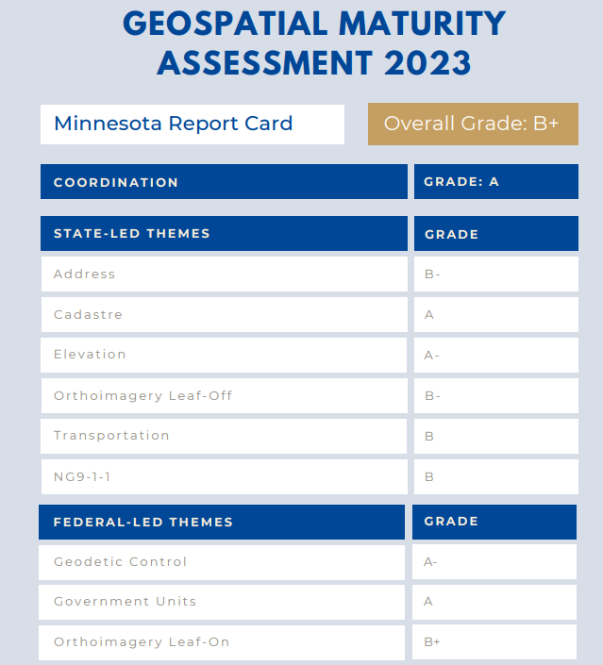
2023 draft NSGIC Geospatial Maturity Assessment
Overall grade of B+
This is lower than our 2021 score of A-
This change is primarily due to the grade changes in the Address and Transportation sections.
We no longer have current statewide address points and road centerline (with address range) datasets

Slide 50
NSGIC Geospatial Maturity Assessment (GMA)
Section | 2021 Grade | 2023 Grade
Coordination | A | A
State-Led Themes
Address | A | B-
Cadastre (parcels) | B | A
Elevation | A- | A-
Orthoimagery Leaf-off | C- | B-
Transportation | A | B
NG9-1-1 | Not graded | B
Federal-Led Themes
Geodetic Control | A- | A-
Government Units | A | A
Hydrography | A+ | Not graded
Orthoimagery Leaf-on | A | B+
Overall Grade | A- | B+
Comparison between 2021 and 2023
Parcels grade improved, reflects PLRC open data committee work
Transportation and Address grade went down, due to change in data collection, validation process. With new opt-in work being done for these datasets by Outreach Committee, this can improve

Slide 51
NSGIC updates
NSGIC Annual conference September 25-29
Many ongoing groups
Example: 3DHP – to assist states with the USGS implementation of 3D National Hydrography Program which will remap the nation’s hydrography based on 3D Elevation Program (3DEP) lidar. (This will new hydrography will update NHD - National Hydrography Dataset). As with 3DEP, funding for partnership project will be available.
Memberships for GAC members will be set up

Slide 52
Agenda Item 12
Priority Projects Annual Survey: Timeline & Goals
Cory Richter/David Brandt

Slide 53
Priority Projects Annual Survey
September
Review current priority projects list
October – MN GIS/LIS Annual Conference
Survey GIS stakeholders for project ideas
Late October
Have GAC review proposed survey via email vote
Early November
Distribute Priorities Survey to stakeholders
Late November
Score survey results
December Quarterly GAC meeting
Review Priority Project Survey results and set 2024 project lists

Slide 54
Priority Projects Annual Survey
Options
Present as one unified list
Group projects into categories
Expanding Status
Active, Inactive, Recruiting, Maintenance

Slide 55
Agenda item 13
Updates on GAC Priority Projects and Initiatives
David Brandt

Slide 56
Updates on GAC Priority Projects and Initiatives
Most recent success
Experiencing a barrier?
Next task
Request for Assistance

Slide 57
GAC Priorities
Project or Initiative Description | Status | Project Owner | Champion
Parcel Data | Active | Ryan Stovern | Alison Slaats
Critical Infrastructure Data Workflow | Active | Stacey Stark | Steve Swazee
Updated and Aligned Boundary Data | Active | Preston Dowell | Alison Slaats
Address Points Data | Active | MnGeo | Alison Slaats
Road Centerline Data | Active | MnGeo | Alison Slaats
Culvert Data Standard | Active | Rick Moore | Andrea Bergman
Publication of Open Foundational Data | Active | David Brandt, Randy Knippel | Alison Slaats
Lidar Data | Active | Gerry Sjerven | Alison Slaats
U.S. National Grid Materials | Active | Randy Knippel | Randy Knippel
Remonumentation of All Section Corners | Active | Pat Veraguth | Alison Slaats
MnGeo Image Service Improvements | Active | Alison Slaats | Alison Slaats
Geodata Archive Implementation | Active | Ryan Mattke | many

Slide 58
GAC Priorities
Project or Initiative Description | Status | Project Owner | Champion
Underground Utilities Data Sharing Team | Active | Steve Swazee | Barb Cederberg
Success Stories for Geospatial Technology | Active | Outreach Committee | Len Kne
Geospatial Commons Advisory Group | Recruitment | Ben Timerson
Hydro-DEMs | Active | Sean Vaughn | many
Summary Crime Data | Active | Britta Maddox
NG9-1-1 Geospatial Forum | Recruitment
Parks Data Standard | Inactive | Standards Committee?
State Business License Data | Inactive
Street Parking Restrictions Data Standard | Inactive | Standards Committee?
Snow Emergency Parking Data Practices | Inactive
Strategy Team for All Types of Imagery | Inactive | Imagery Team?
Basemap Services | Inactive
Inventory of MN GeoData Assets | Inactive

Slide 59
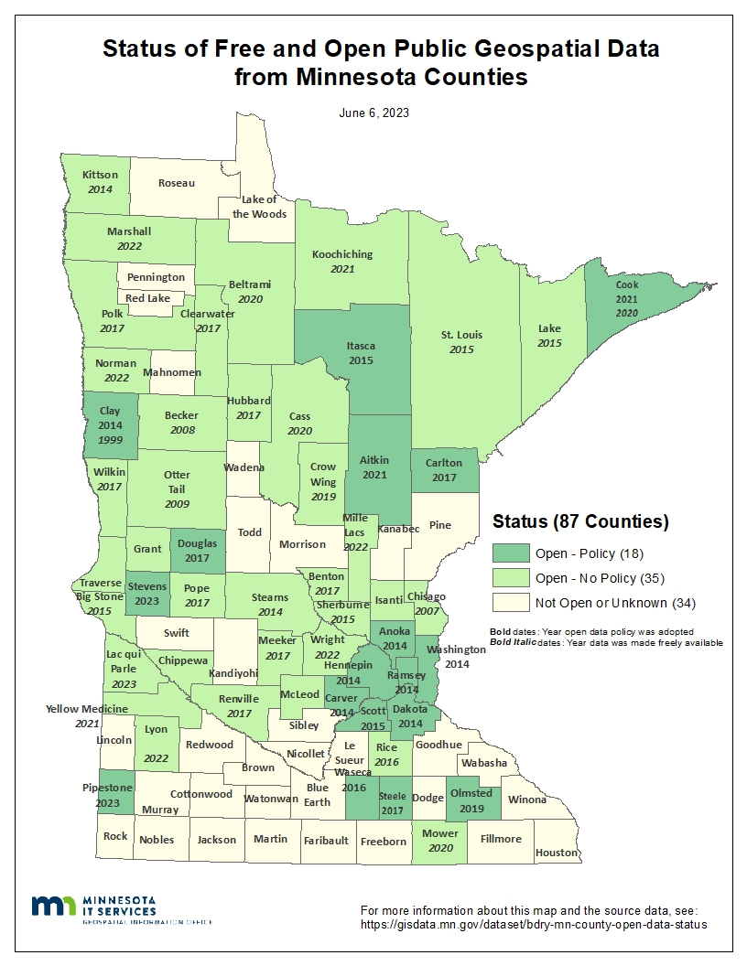
Status of Free and Open Data Public Geospatial Data
Status | Number of Counties | Total
Open - Policy | 18 | 53
Open - No Policy | 35
Not Open or Unknown | 34 | 34
Additions since last update: Lac qui Parle, Lyon, & Pipestone
Data current as of June 6, 2023 (Stevens County is the newest addition)
https://gisdata.mn.gov/dataset/bdry-mn-county-open-data-status

Slide 60
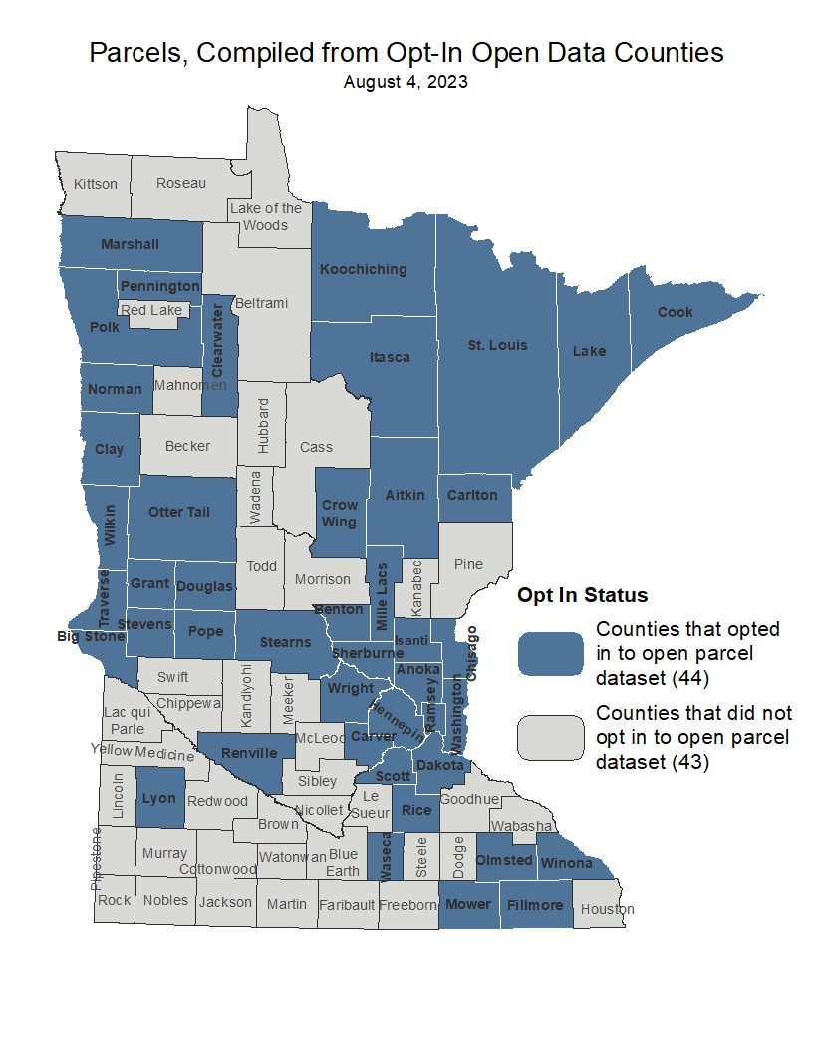
Statewide Publicly Available Parcel Data
Most recent success:
Published most recent quarterly update August 4, 2023
Published an ArcGIS Online webmap and feature layers: data & metadata
Next task:
Update Opt-In data to include McLeod & Morrison
Create a secure ArcGIS Online statewide feature layer for internal use
https://gisdata.mn.gov/dataset/plan-parcels-open

Slide 61
Critical Infrastructure Data Workflow
Most recent success:
If you are experiencing a barrier:
Next Task:

Slide 62
Updated and Aligned Boundary Data
Most recent success:
If you are experiencing a barrier:
Next Task:

Slide 63
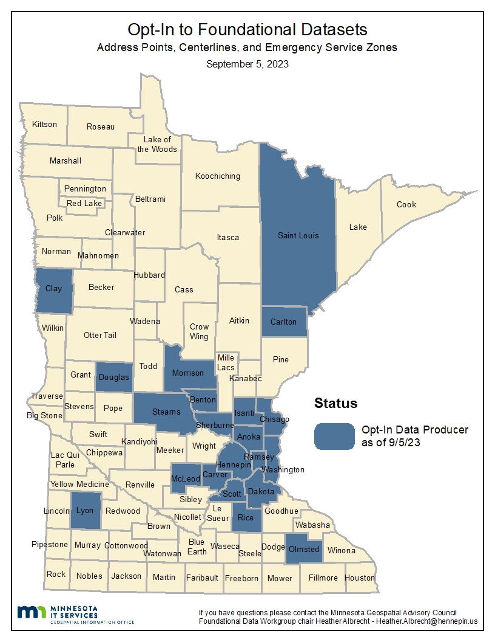
Road Centerline & Address Point Data
Most recent success:
Opt-In: Anoka, Benton, Carver, Chisago, Clay, Dakota, Douglas, Hennepin, Isanti, Lyon, McLeod, Morrison, Olmsted, Ramsey, Rice, Scott, Sherburne, St. Louis, Stearns, and Washington
Next Task:
Continue to support the Foundational Data Workgroup efforts to secure county Opt-In agreements
Update the metadata for the resources
Finalize data package/process for publication
Create separate slides for road centerline and address point data

Slide 64
Culvert Data Standard
Most recent success:
If you are experiencing a barrier:
Next Task:

Slide 65
Publication of Open Foundational Datasets
Most recent success:
If you are experiencing a barrier:
Next Task:

Slide 66
Lidar Data Acquisition
Most recent success:
If you are experiencing a barrier:
Next Task:

Slide 67
U.S. National Grid Materials
Most recent success:
If you are experiencing a barrier:
Next Task:

Slide 68
Remonumentation of All Section Corners
Most recent success:
If you are experiencing a barrier:
Next Task:

Slide 69
MnGeo Image Service Improvements
Most recent success:
Added 4 new layers - 2023 Rice (color 6 in.), 2022 Hennepin (color 6 in.), 2022 Douglas (color 2 in.) and 2021 cir FSA
If you are experiencing a barrier:
Time is the #1 barrier
Next Task:
Lake County Imagery, complete build out of dev/staging server in Azure

Slide 70
Geodata Archive Implementation
Most recent success:
The Big Ten Geospatial Information Network is working on a report outlining what it would look like to build a Geodata Archive for the Big Ten. Much of the work of the Archiving Workgroup will be utilized for this exploration.
3. Next Task:
Determining costs and software options for different ways of implementing an archive. We are hopeful that we will get the green light to proceed later in the fall.
4. Request for Assistance
Not so much assistance as (future) input -- how can we leverage this to archive Minnesota data? Would a Big Ten Geodata Archive serve the need for a Minnesota Geodata Archive?

Slide 71
Underground Utilities Data Sharing Team
Most recent success:
Completed series of eight utility operator interviews which are being used to shape software development. Commenced onboarding of first utility operator, and an engineering design firm. Developing project guidelines at request of the Common Ground Alliance. Last large group meeting was June 22, next is September 21. Leadership team meeting monthly, development team meeting weekly
If you are experiencing a barrier:
Next Task:
Complete software hookup between first utility operator and engineering design firm

Slide 72
Success Stories for Geospatial Technology
Most recent success:
Been having regular meeting through the summer. MnGeO has created a hub site to gather stories.
Next Task:
Start testing and populating the new hub site. Will share link to publicly available Hub site before end of 2023.

Slide 73
Accurate hydro-DEMs (hDEM)
Most recent success:
If you are experiencing a barrier:
Next Task:

Slide 74
Summary Crime Data
Most recent success:
Presented about the topic to the GIS Bytes Lunch and Learn.
If you are experiencing a barrier:
Data privacy, retrieving appropriate data sets
Next Task:
Delve further into the data provided on the state's website and talk to the BCA regarding what data is available for mapping use.

Slide 75

Agenda Item 14
Announcements or other Business
Congratulations to Ryan Mattke on his appointment to National Geospatial Advisory Committee (NGAC) in the U.S. Department of the Interior.
The NGAC helps manage federal geospatial programs and develop a national spatial data infrastructure.

Slide 76
Next Meeting
December 13, 2023

Slide 77
Adjourn
Thank you

