Slide 1
Statewide Geospatial Advisory council
May 29, 2013

Slide 2
AGENDA
Call to order and introductions 5 Min
Approval of November 28, 2012 Meeting Minutes 5 Min
2013 Legislative session 20 Min
Open Appointments 5 Min
Governor’s Commendations 5 Min
Esri Master Purchase Agreement 10 Min
MnGeo Priority Activities and Initiatives 10 Min
MnGeo Parcel Project and Revenue’s PRISM Project 20 Min
Break 15 Min
Updates: Members describe their sector activities 35 Min
Hot topic – PCA’s Surface Water Environmental Data Application 15 Min
Review of past 2 years of the Council 20 Min
Update: State Geospatial Governance going forward 10 Min
Future Council Meeting Dates - August 28, November 20, 2013
Adjourn

Slide 3
November 28, 2012 Meeting Minutes

Slide 4

Legislative Session
MnGeo Legislation – HF1390
Discretionary powers
State Government Geospatial Advisory Council eliminated
No sunset of Statewide Geospatial Advisory Council
Defines Electronic Geospatial
Government Sharing of Electronic Geospatial Data

Slide 5
Legislation
Agreed to on the House floor
Subd. 11. Government sharing of electronic geospatial data. (a) The definitions in section 13.02 apply to this subdivision.
(b) Electronic geospatial government data must be shared at no cost with government entities, the notification center established under section 216D.03, and federal and tribal government agencies. Data received under this subdivision may be reproduced or shared with other government entities or agencies. A release of data under this subdivision must include metadata or other documentation that identifies the original authoritative data source. Government entities providing data under this subdivision are not required to provide data in an alternate format specified by the requestor. A government entity is not required to provide the same data to the same requestor more than four times per year, unless required by law or court order. Government entities and agencies sharing and receiving electronic geospatial data under this subdivision are immune from civil liability arising out of the use of the shared electronic geospatial data. This subdivision does not authorize the release of data that are not public data.
Proposed amendment for the Senate floor
Subd. 11. Government sharing of electronic geospatial data. (a) The definitions in section 13.02 apply to this subdivision.
(b) Electronic geospatial government data must be shared at no cost with government entities, the notification center established under section 216D.03, and federal and tribal government agencies. Data received under this subdivision may be reproduced or shared with other government entities or agencies. A release of data under this subdivision must include metadata or other documentation that identifies the original authoritative data source and specifies any redistribution restrictions. Nongovernmental requestors shall be directed to the original authoritative source for data received pursuant to this subdivision. Government entities providing data under this subdivision are not required to provide data in an alternate format specified by the requestor. A government entity is not required to provide the same data to the same requestor more than four times per year, unless required by law or court order. Government entities and agencies sharing and receiving electronic geospatial data under this subdivision are immune from civil liability arising out of the any use of the shared electronic geospatial data by government entities and non-government entities, including specifically the public. This subdivision does not authorize the release of data that are not public data or any data purchased from a vendor that is classified as trade secret or copyrighted as part of a written licensed agreement.

Slide 6
Legislative Session
Other Geospatial Legislation?
Discussion:
How do we collaborate?
Future direction: A data sharing workgroup?

Slide 7
Open Appointments
Current terms end June 30, 2013
Next term runs through June 30, 2015
Application deadline June 28, 2013
Apply through Secretary of State’s Office

Slide 8
Governor’s Commendations
The award honors organizations that have gone the extra mile to deliver products and services, improve government responsiveness, promote public access to information, and demonstrate the benefits of collaboration that encourage, by example, others to do the same.
Nominations due July 31
Form a committee to review nominations

Slide 9

Esri Master Purchase Agreement
What is it?
Master Purchase Agreement –
Products not covered by ELA
Regional and local, government – discounts for software and Professional and Technical Services
Not included: Managed Services
Who wants/needs it?

Slide 10
Western States Contracting Alliance (WSCA)
National Association of State Procurement Officials
50 states’ buying power
Use by state signing a Participation Agreement
Managed Services
Application hosting
Esri-licensed hosting solutions
Data storage and database hosting
Consulting services
Support

Slide 11
Western States Contracting Alliance (WSCA)
Cloud processing not currently available for Minnesota
Security concerns
Vendors using Amazon Cloud Services
Amazon recently met Federal Security Standard
State’s next steps

Slide 12
MnGeo Priority Projects
Addresses
Aerial Imagery
Altered Waters
Geospatial Commons
LiDAR/Elevation
Hydrography
Parcels
Street Centerlines

Slide 13
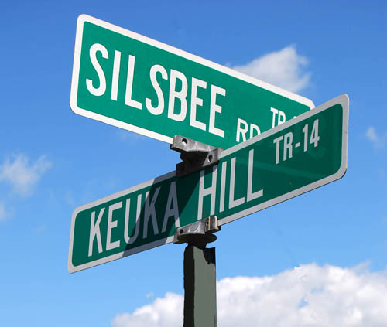
Addresses Future Project

Slide 14
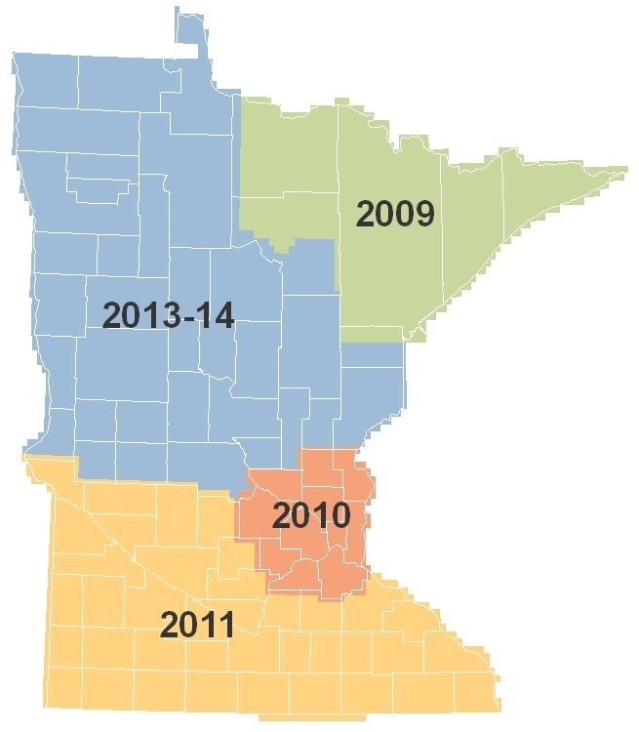
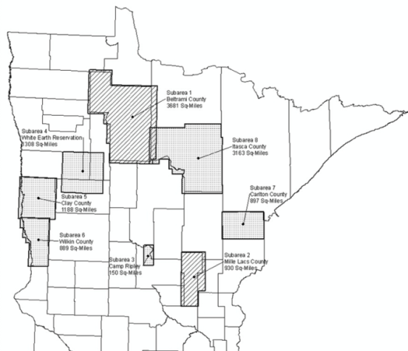
Spring Aerial Imagery Program (SAIP)
Leaf-off, 4-band imagery
Despite adverse weather, much of 2013-14 area was flown at 50 cm resolution
Nine partners cost-shared for 30 cm (1-foot) resolution
This year’s imagery anticipated to be available Fall 2013
Remaining areas to be flown Spring 2014
Notes:
Statewide Aerial Imagery Program (SAIP)
Five Phases Planned
We’re beginning the 4th now:
Technical Proposals have been evaluated
A top-scoring vendor has been identified
Final negotiations are currently underway with that vendor
Plan is to have a contract fully executed later this month
There are 8 partners involved in this next phase:
Beltrami County
Carlton County
Camp Ripley
Clay County
Itasca County
Mille Lacs County
White Earth Nation
Wilkin County
About $1.2 in Legacy funds have been committed thus far
About a $51K spend for project administration
GF primarily for outreach in developing and managing partnerships
For every $100 of state money investing in this program, $67 are added by non-State partners

Slide 15
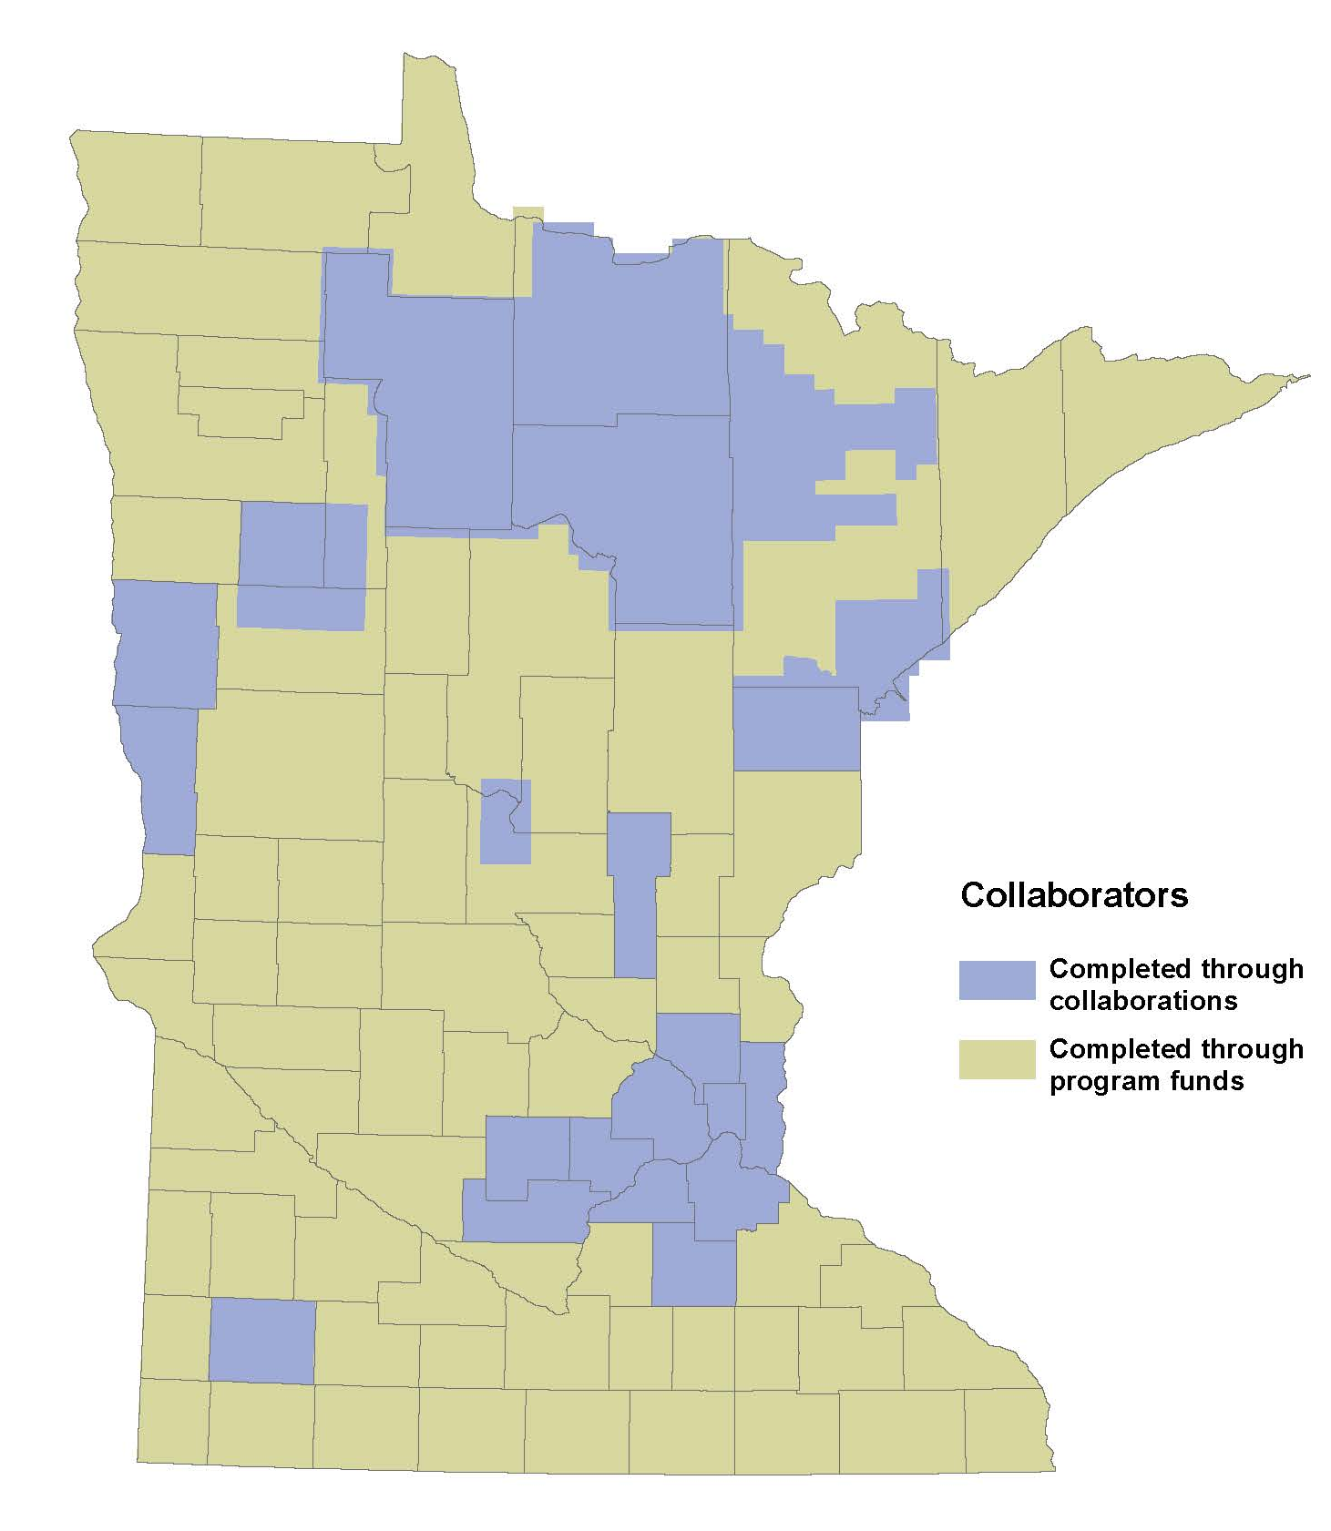
SAIP Investments
21 partnerships:
Federal (2)
State (1)
Counties (13)
Native American Lands (2)
Regional (2)
National Guard (1)
Program Funds: $1,300,000
Partner buy-ups: $650,000

Slide 16

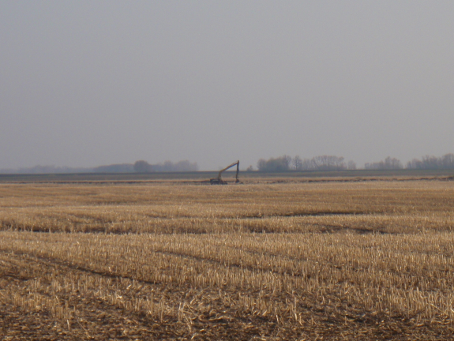
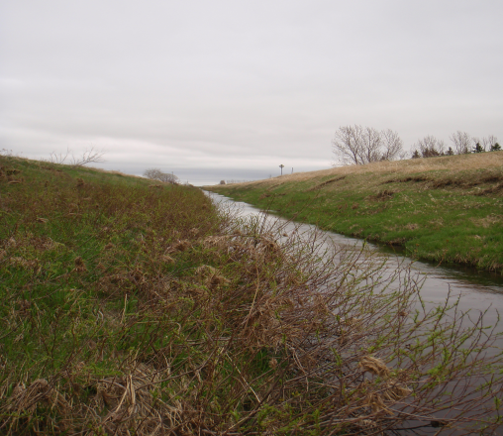
Altered Watercourses
An altered watercourse is a stream/river or portion of a stream/river that has been modified in such a way to alter its natural course
Channel alterations include:
Channelized streams, ditches and impoundments
Channel alterations do not include:
Beaver dams, dredging, rip-rap, removed snags and wetlands

Slide 17
MN Geospatial Commons
A single place we all go to find and share geospatial resources
Where are we?
Hired project manager
Aligning with infra-structure and data
Defining scope
CKAN selected for portal
Evaluate
Share
Administer
Find

Slide 18
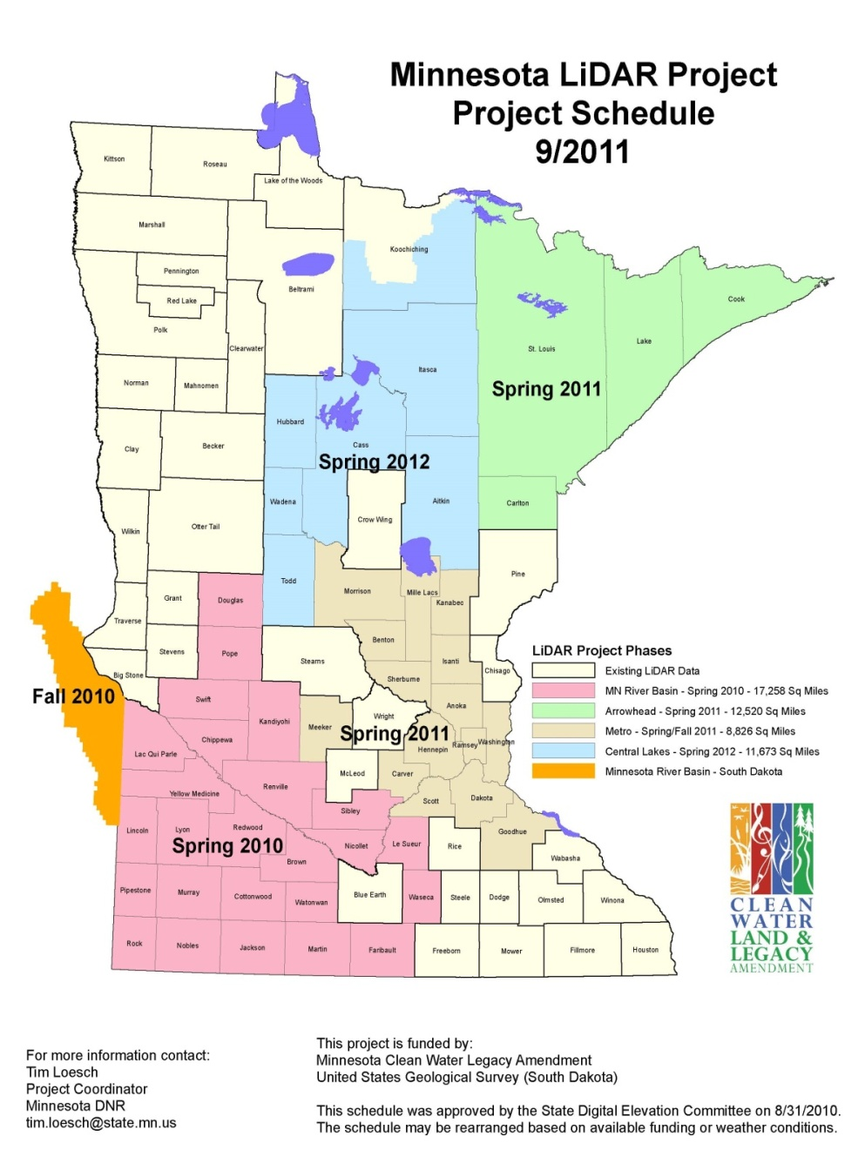
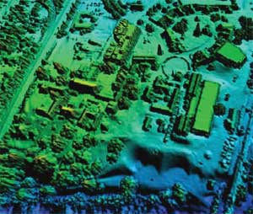
LiDAR Elevation
Partnership with MN DNR to:
Provide FTP site
Improve data download
Develop browser viewer

Slide 19
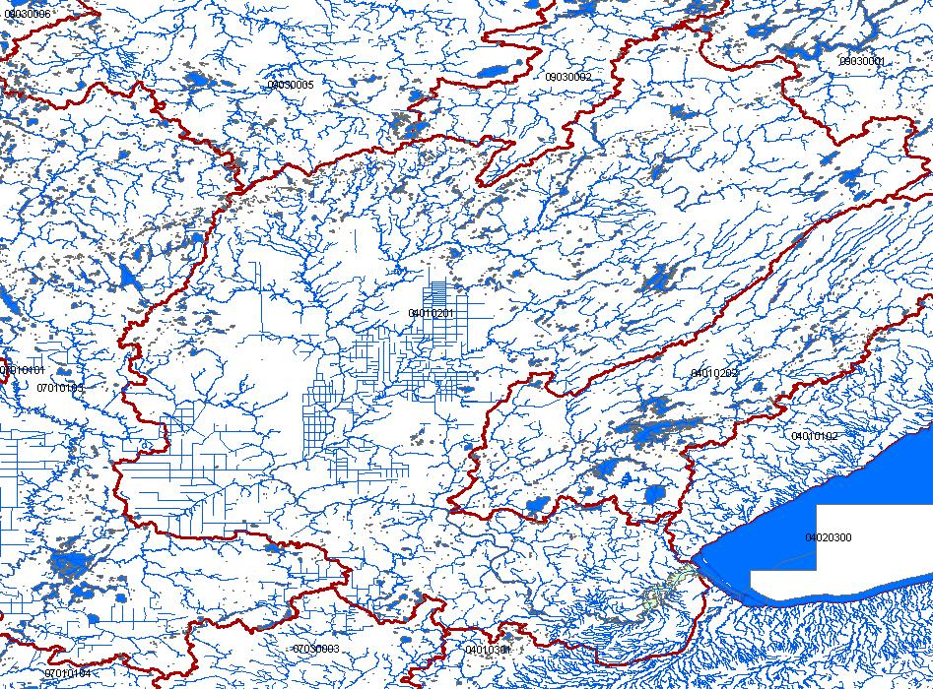
Hydrography
Hydrographic features for making maps
A national stream addressing system
A modeling network for navigating upstream/downstream
A maintenance infrastructure
Additional tools to enhance use of data
Notes:
Graphic – St. Louis River Basin is the central basin – emptying into Lake Superior. Hydro features include lakes, rivers for mapping (1-d, 2-d), rivers for networking (1-d); A system of Watershed Boundaries (WBD) is also included. Those are the red lines on this graphic.
Flow volume and velocity within catchments

Slide 20
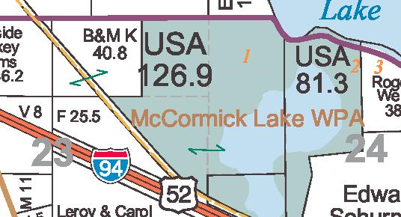
Statewide Parcel Integration Project
Legislation
License Agreement
Exchange Guideline
Regional Collaborations
MN Dept. of Revenue Project

Slide 21
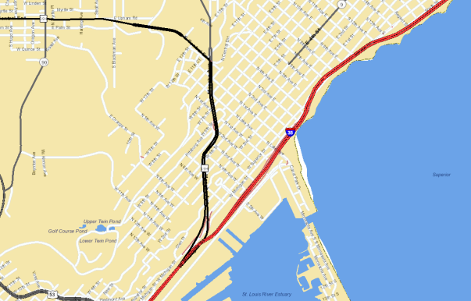
Street Centerlines
Multi government/agency
MnDOT, MnGeo, Met Council
Single authoritative centerline
Common tools
Roads and highways at MnDOT
Pilot and partners
Stearns, Benton, Carver, Ramsey, Mahnomen
White Earth Nation
NextGen 911

Slide 22
Update: Committee/Workgroup Guide
Guide
Charter template
Additional templates to come
Committees and workgroups need to generate charters

Slide 23
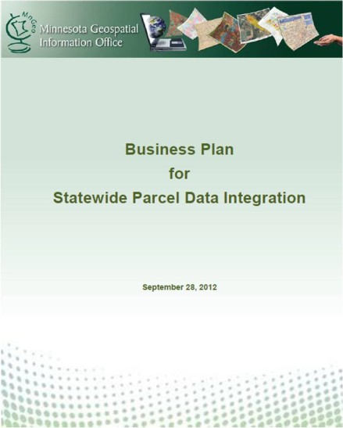
MnGeo Parcel Project
Working from the Business Plan
Legislation
Data Exchange Guideline
License Agreement
Pilot Efforts – Regional Collaborations
New – PRISM Project

Slide 24
MnGeo Parcel Project
Legislation
Worked with Association of MN Counties to address county concerns
Able to get several updates included
Initial version passed this session
More work is still needed

Slide 25
MnGeo Parcel Project
Data Exchange Guideline
Based on MetroGIS standard
Out for community review & comment
Identified several changes so far

Slide 26
MnGeo Parcel Project
License Agreement
One agreement for all State Government
Single agency execute for State
Authority and liability concerns
Work with County Attorney Association
Improved State and partner efficiency

Slide 27
MnGeo Parcel Project
Pilot Project(s)
Regional collaborations
MetroGIS
Arrowhead
Others
Data aggregation at MnGeo

Slide 28
Minnesota Department of Revenue PRISM Overview
Heather Bestler

Slide 29

Project Scope
To electronically collect data at a more detailed level.
UTA level sub-parcel level
Consolidation of the county data submissions into one standard format.
Currently 9 formats
Reporting/data extracts available to Revenue, counties and other stakeholders.
Improved data portal, messaging

Slide 30
Project Scope
Phase 1 – The technical model will be developed and the first file (valuation) will be submitted by all counties.
Phase 2 – More files will be submitted by all counties, including tax data. A more advanced portal will be developed and hopefully counties will be able to pull information and reports from the warehouse.
Phase 3 – Determination of what additional CAMA data is needed.

Slide 31
What happens next?
The stakeholder review concludes July, 2013.
Finalized document review - Fall 2013.
Internal Development and Testing July 2013- Mid 2014.
Documentation, schema and data model will be finalized and specifications for testing will be available Mid 2014.
First submission 9/1/2015.

Slide 32

BREAK

Slide 33
Outstate Non-Metro Sharing & Collaboration
GIS Folks Strive for Matching Schema, but differences do occur
Non-Matching Schema – Extensive Field Mapping
City GIS Database
City SQL Database
Information
County GIS Database
County Tax Database
City and County Data
Cadastral
Easements
Valuations
Floodplain
Zoning
Utilities
Permitting
Census Redist
Special Assessment
Cadastral
Easements
Valuations
Floodplain
Zoning
Permitting
Census Redist
Special Assessment
City and County Data
Workflow Management
End Users
Applications
Websites
End Users
Applications
Websites
Notes:
Brad Anderson

Slide 34
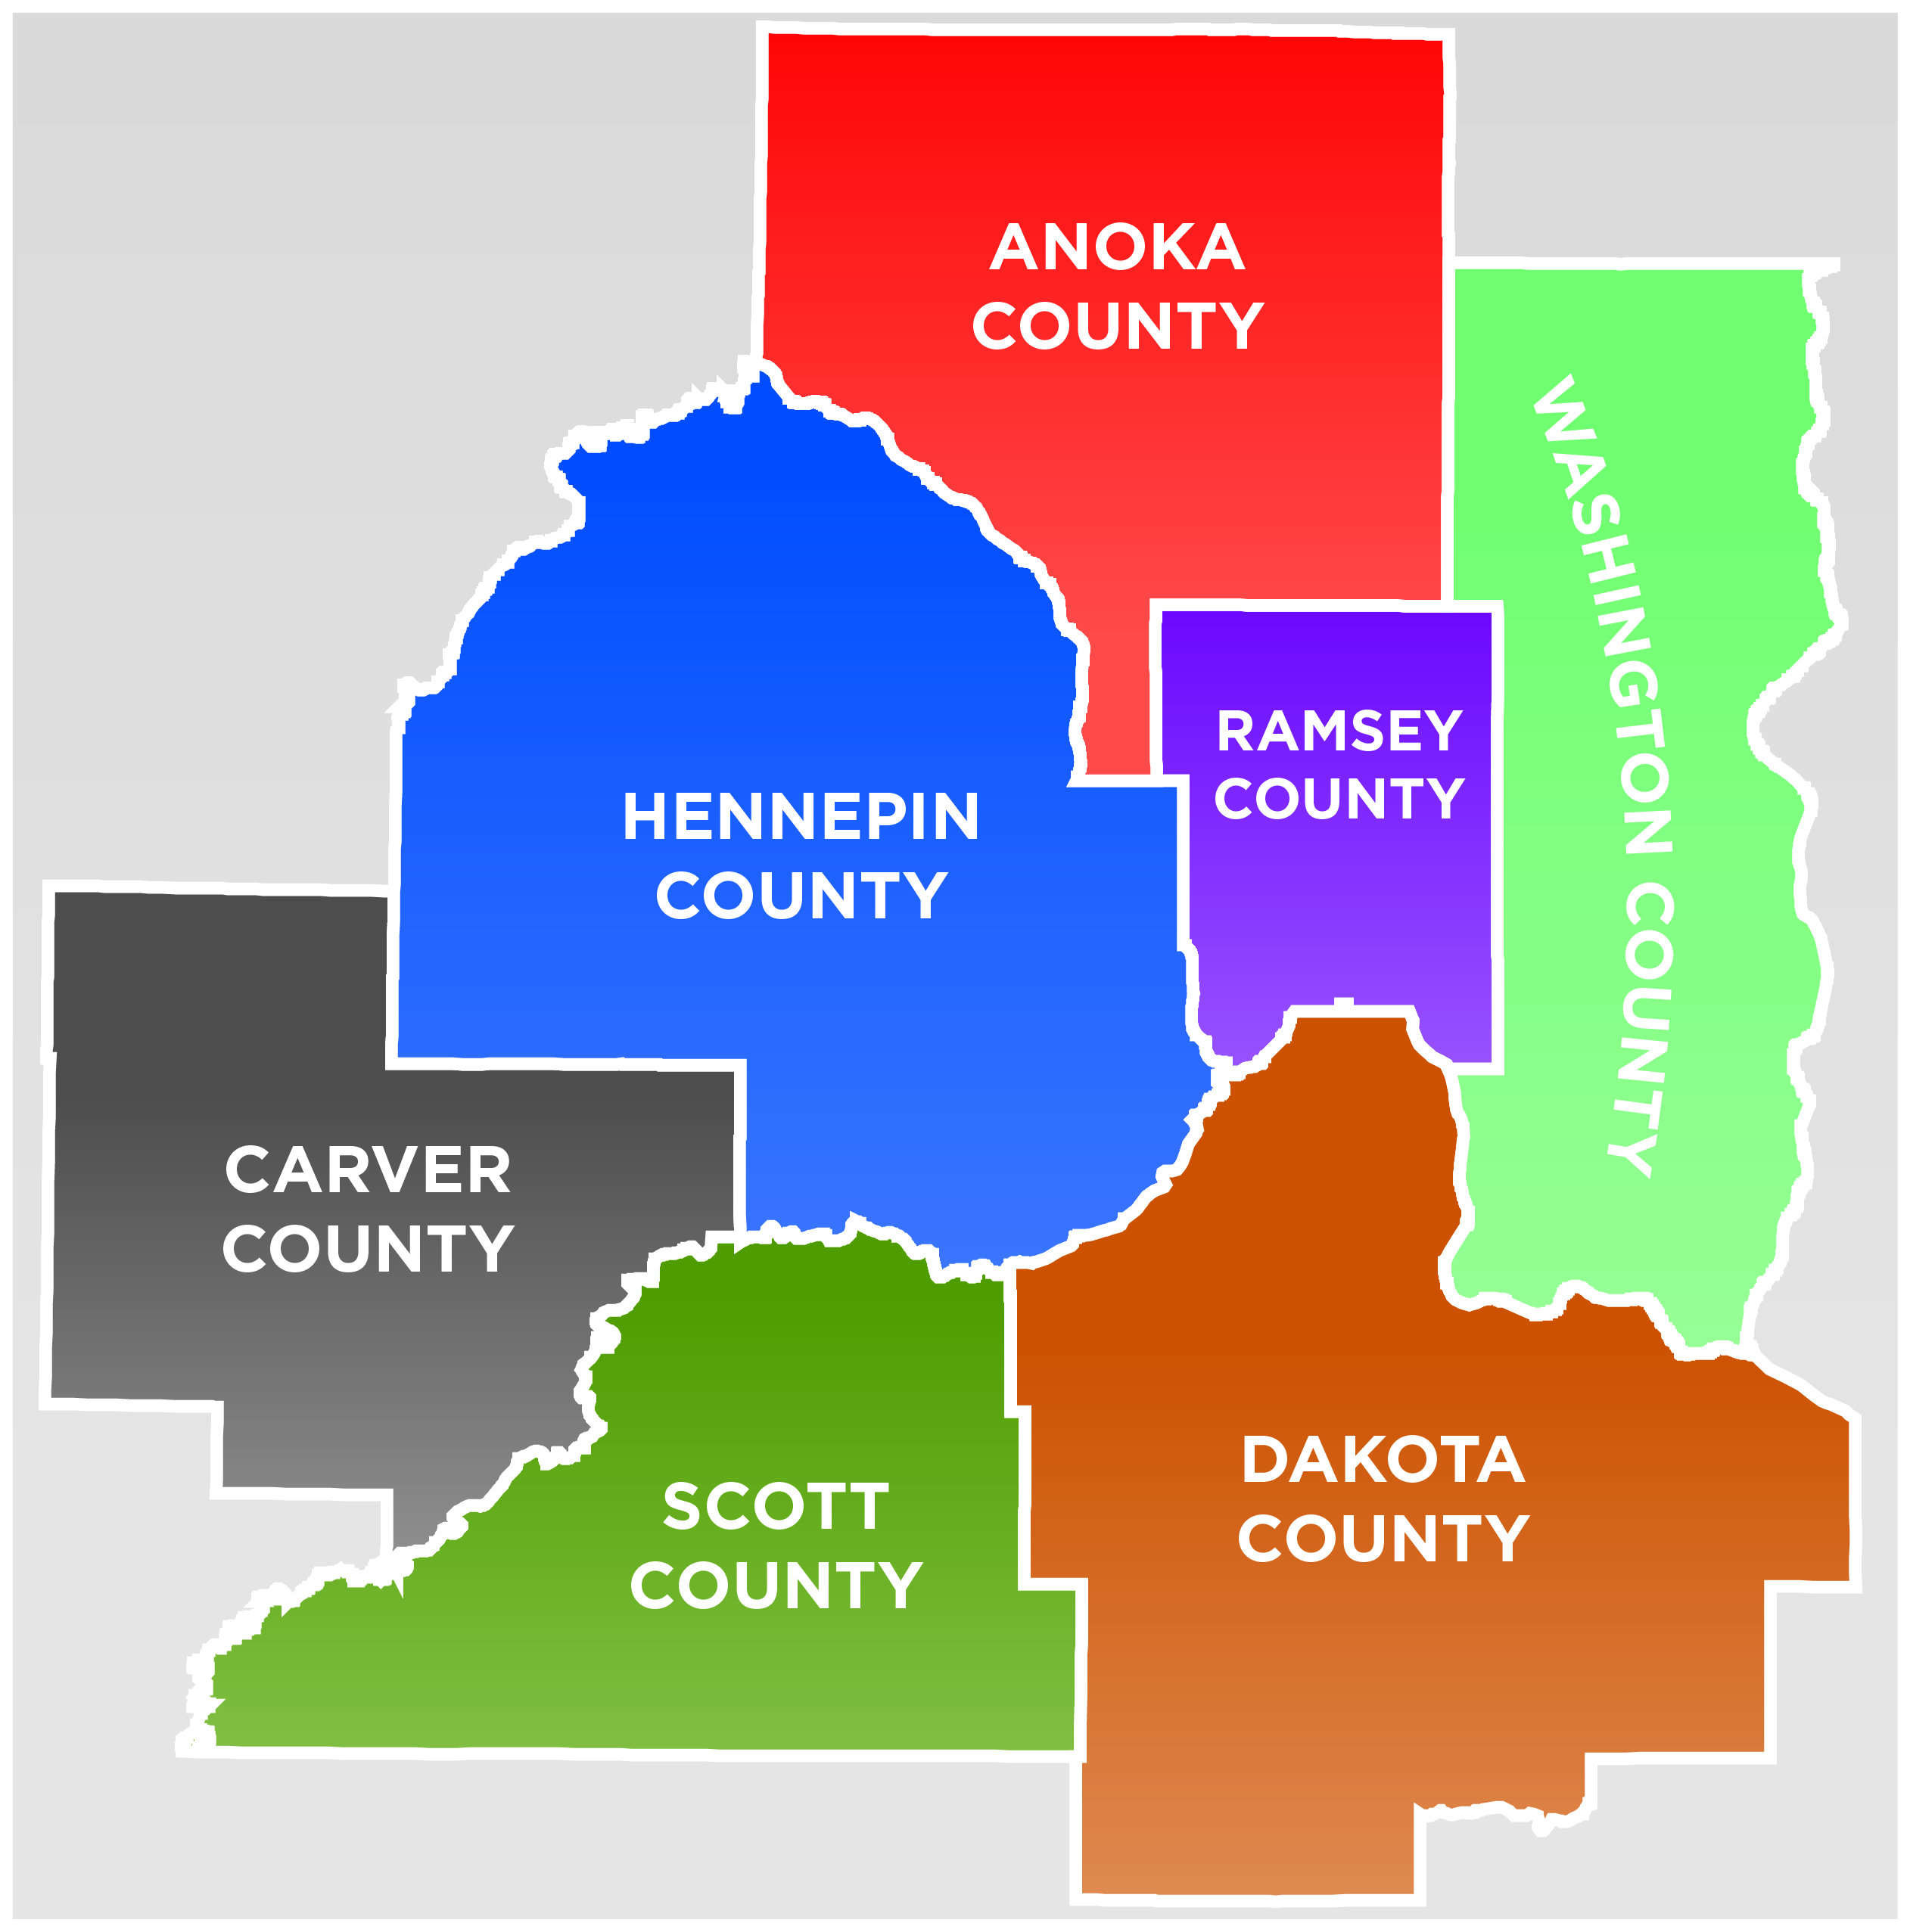
MetroGIS: Current Major Initiatives
Statewide Centerline Initiative
Partnering with MnDOT, MnGeo and ESRI to develop a statewide centerline dataset solution;
Address Points Editor and Address Point Dataset
Developed a set of free tools for any government in Minnesota to utilize to prepare and share their address point data;
Re-Launching metrogis.org website
Re-branding and re-launching website to
better serve the MetroGIS community;
Advocacy and Research
Partnering with county GIS staff to understand
the benefits and challenges of making non-
sensitive data freely available for public use;
Emphasis on fiscal and legal aspects;
Notes:
David Brandt

Slide 35
Metro County Activity
8 Metro County IT Collaboration
7 Metro Counties including Olmsted
Fiber Interconnect – Complete
GIS – In progress
Disaster Recovery – In progress
Public Health System – Not started
MetroGIS Policy Board - Free and open data
SF 1298
Liability language updated and includes public
Policy changes are needed to promote collaboration
Notes:
James Bunning

Slide 36
At-large – Will Craig
Community GIS issues
Open access to public GIS data
Applications that deliver products
National Geospatial Policies
Federal agencies fulfill their A-16 responsibilities
NSDI meets needs of all levels of government
States play coordination role
Nationwide parcel and address data
GIS Profession expanded
Add testing for GISCI certification
GIS used K-12 and all disciplines
Notes:
Will Craig

Slide 37
MN National Guard
From a National Guard perspective there is continued pursuit to develop and integrate geospatial capabilities in support of Domestic Operations. That has led to increased interest and awareness of federal, state and local initiatives for potential collaboration and data access. The following are current topics of interest:
Data sharing/security with Federal, State and Local Units of Government
Data interface and tool development for non-GIS personnel
Data standards - accommodating both Federal and State standards
Notes:
Craig Erickson

Slide 38
Headwaters RDC Perspective
Two Key Stakeholder Groups
Local Government, Community Groups, etc.
Other Non-Metropolitan Regional Development Orgs.
Two Key Issues
1) Access and Capacity
How do we make sure everyone has the appropriate level of access and capacity?
2) Innovation around consistently measuring objectives of Economic and Community Development activities
How do we make sure we’re comparing apples to apples across the State, and is the apple what we want to be measuring?
Notes:
Marcus Grubbs

Slide 39
Federal Government Sector Update
***Sequestration, fiscal calamity, and furloughs***
US Geological Survey (POC: Ron Wencl)
- Proposed FY14 Budget Highlights (subject to sequestration/congressional actions):
Increased budget for 3DEP - Enhanced Elevation for the Nation (i.e. LiDAR data)
Increased budget for Climate/Land Use Change - Landsat 8 (recent launch, transition from NASA to USGS ops)
Increases for other programs including WaterSmart, Ecosystems, "Big Data“
Decreased budget for FGDC (TBD impact on Cooperative Agreements Program)
- The National Map program will produce new USGS topographic maps (now referenced as US Topo) for Minnesota (and Wisconsin) in 2013 with additional features and symbology over the 2010 edition. USGS is also still working on incorporating Minnesota's LiDAR data into the National Elevation Dataset (NED) through a multi-year partnership agreement.
Notes:
Jon Gustafson

Slide 40
Federal Government Sector Update
***Sequestration, fiscal calamity, and furloughs***
US Army Corps of Engineers (POC: Jon Gustafson; Keith LeClaire)
- FY14 Budget Justification - MN River Watershed Study: watershed modeling and non-Federal Sponsor LiDAR data collection
- IENC Program: mobile terrestrial LiDAR of Locks and Dams for vector improvements
- Emergency Operations (GIS Cadre) – FEMA Emergency Support Function #5 (Planning and Information)
Support decision making of Crisis Management Team; mission status mapping and other cartographic and analysis products; and assist USACE operations when district or division resources are exhausted and also provide support directly to FEMA at the JFOs and AFOs
- Due to how USACE is funded, USACE cannot fund activities outside of USACE interests, i.e. project support, research and development, etc. However, USACE has policy that requires that to the extent possible, make geospatial data available to the public.
- Recent revised policy updating the Enterprise Geospatial Engineering System (CorpsMap, NLD, CEPD, NID, etc.), incorporating the DOLETA’s Geospatial Technical Competency Model, and removing geospatial stovepipes.
Notes:
Jon Gustafson

Slide 41
Federal Government Sector Update
***Sequestration, fiscal calamity, and furloughs***
US Fish & Wildlife Service (POC: Brian Huberty; Gary Kratz)
- Recommend MnGEO partner with Association of State Wetland Managers (ASWM) to continue wetland mapping/inventory initiatives. NWI funding is not looking good.
USDA – Farm Service Agency (POC: Jeff Bloomquist)
- NAIP is “up in the air” due to sequestration; still figuring out budgets and furloughs
USDA – Forest Service (POC: Josh Bixby; Jordan Ketola)
- No update.
Other
- FGDC is initiating a process to develop a new strategic plan for the NSDI driven by: OMB Circular A-16; GAO Report (GAO-12-94); NGAC Paper; Digital Government Strategy; Open Government Directive; Open Data Policy
Notes:
Jon Gustafson

Slide 42
Private Sector
Initiatives
Open Source Initiative
ZOO Project (WPS, geospatial web processing service)
Marble (Virtual Globe World Atlas)
MapServer 6.2.1
GeoMoose 2.6.1
Issues
Data sharing
Difficult for business to do large projects because of the lack of
access to big datasets (parcels)
Unleash the power of business for creating data
Reduce cost for giving back to open data. Many companies are giving back already
Activities
Collaboration
OpenStreetmap (iD map editor, MapBox)
OpenCycleMap
Notes:
Blaine Hackett

Slide 43

Mission:
The MCGISA is an association of county professionals whose mission is to advance GIS technology in Minnesota county governments by providing leadership, support and advocacy.
http://mcgisa.net
Goals:
Foster support and awareness among public officials.
Cultivate leadership and professional development through workshops, seminars, and meetings.
Provide a forum to share knowledge, information and experience among the members of the Association.
Advocate MCGISA positions to policy makers on regional, state, and federal issues.
Support the development and implementation of standards.
Initiatives:
Letter of support for Business Plan for Statewide Parcel Data Integration
Establish LinkedIn McGISA Group and SharePoint Collaboration Site
Association of Minnesota Counties (AMC) Affiliation
Activities:
McGISA Annual Summer Meeting
MCGISA Regional Meetings (10 Districts)
MnGEO committees
NG 911 Advisory
MN Association Assessing Officers (MAAO)
2012 AMC Conference – Booth to promote MCGISA and Business Plan for Statewide Parcel Data Integration
Notes:
Doug Hansen

Slide 44
Metro Regional Government
Met Council & MetroGIS Coordinator meeting with each county GIS manager
Address editor version 1 completed
Server based tool free to MN government
Version 2 being developed
Census blocks realigned to NCompass data - available on DataFinder.
Notes:
Mark Kotz

Slide 45
State Agency - MPCA Geospatial Initiatives
Public access to data and services
Regulatory Activities – current and historical
Surface Water Quality – status of water body condition
GeoCommons – single place for state users to find and share geospatial resources
Notes:
Mark Olsen

Slide 46

Notes:
Ben Richardson

Slide 47

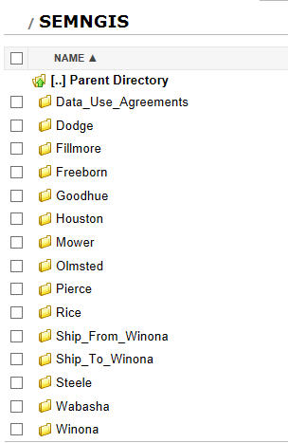
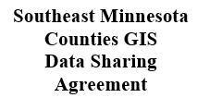



Non-Metro County Activity
Go Southeast MN
Working with the other counties in SE MN to
maintain and improve the website
www.gosoutheastmn.com
SE MN GIS User’s Group Data Agreement
Currently have an FTP site set up to easily
share data between counties
Working on a data sharing agreement
between SE MN Counties
MN GIS/LIS Spring Workshops Collaboration
Collaborated with the FOSS4G North America
Conference committee to coordinate workshops
on May 21, 2013 that included several open source options
Spring Workshops 2013
Notes:
Michelle Trager

Slide 48
GIS and the NonProfit Sector
Initiatives
Working with MCN and MAP to develop strategies to build GIS proficiency and use in the nonprofit sector
Activities
Awareness building – training, articles (print and web) and conference
MCN ED at FOSS4G
Accessibility – low cost software – ESRI
Growing user base
Issues
RESTRICTED ACCESS TO LICENSED DATA
Resources/dedicated staff/learning curve
NP often serve as a support/proxy for government, large growth potential
Notes:
Sally Wakefield

Slide 49
Hot Topic
Jason Ewert and Mark Olsen

Slide 50

Surface Water Dashboard: putting the pieces together
May 2013
Jason Ewert (MN.IT@MPCA)
Mark Olsen (MN.IT@MPCA)

Slide 51
AGENDA
the Data
the UI - designing for your audience
REST - an evolution of our data flow

Slide 52



“Provide timely access
to environmental data so that 100 percent of our environmental data that is located in databases is available publicly.”
MPCA 2008 Strategic Plan - Objective E4a
Notes:
In the bigger picture, this fits in the MPCA Strategic Plan

Slide 53
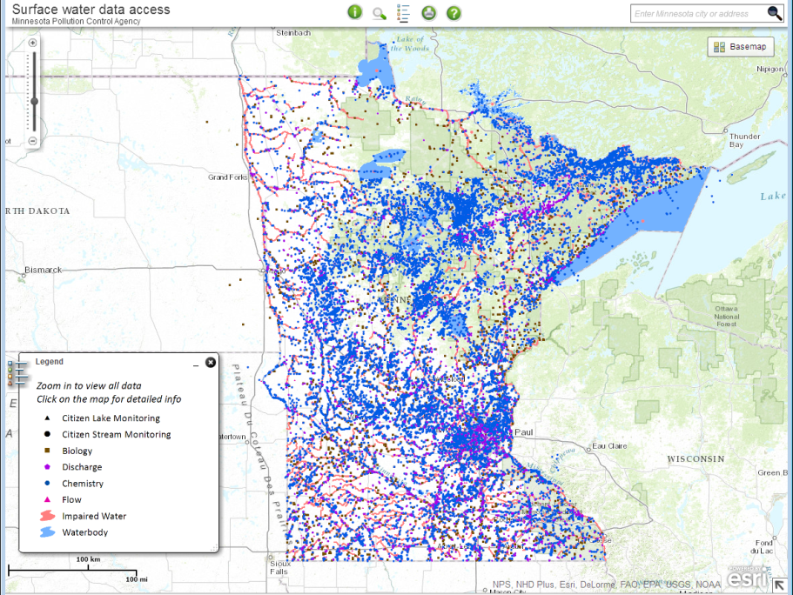
Notes:
12,225,548 monitoring results
31,040 monitoring sites across Minnesota
3,411 non-CMP monitors submit data
271 organizations submit data

Slide 54
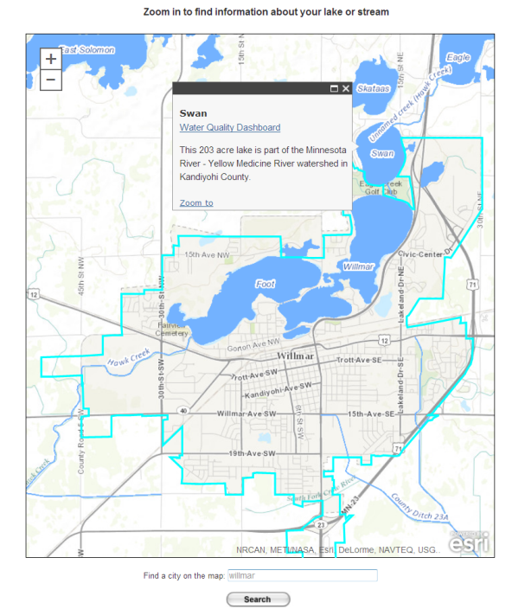
Notes:
12,225,548 monitoring results
31,040 monitoring sites across Minnesota
3,411 non-CMP monitors submit data
271 organizations submit data

Slide 55
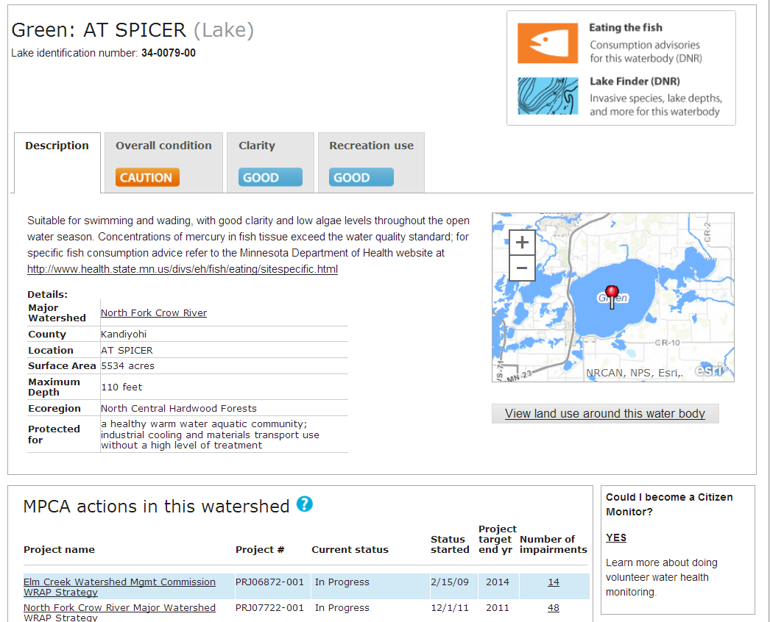
Notes:
We use data from the water quality assessments for the Impaired Waters list to tell people what they want to know:
Is my lake good?
If not, why not?
Can I eat the fish?
Is it getting better or worse?
What is the MPCA doing to protect or restore the water quality?

Slide 56
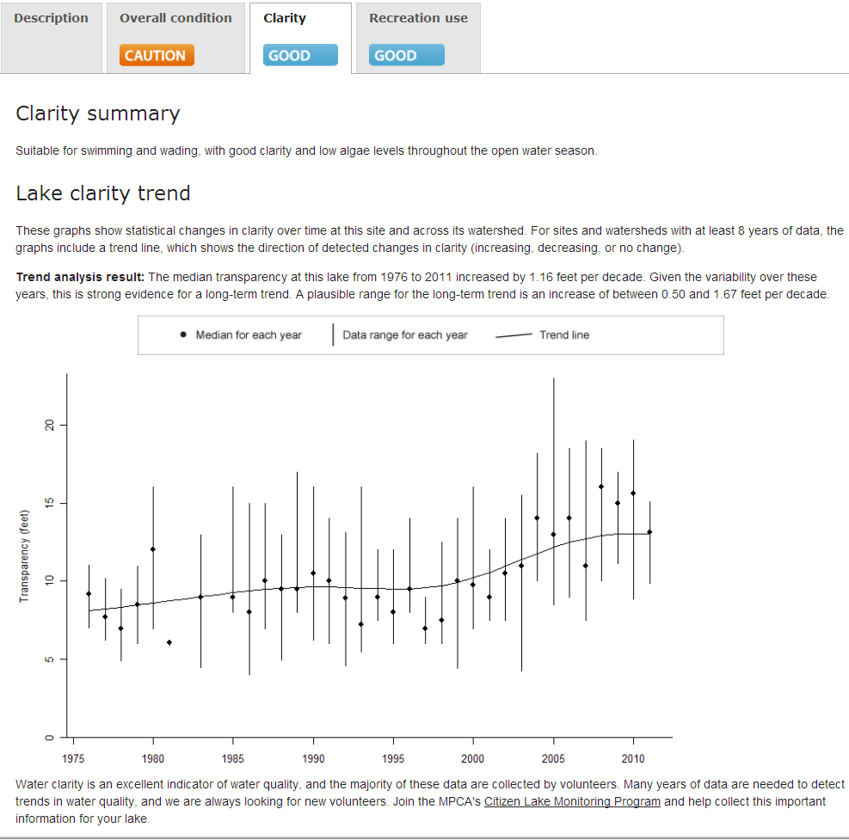
Notes:
We use data from the water quality assessments for the Impaired Waters list to tell people what they want to know:
Is my lake good?
If not, why not?
Can I eat the fish?
Is it getting better or worse?
What is the MPCA doing to protect or restore the water quality?

Slide 57
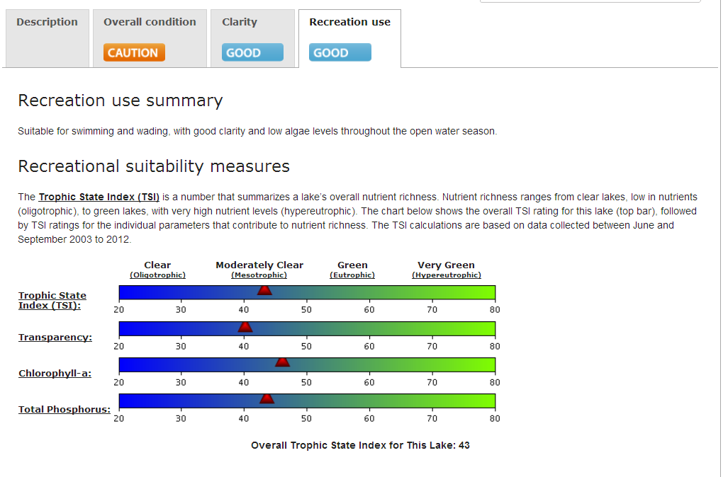
Notes:
We use data from the water quality assessments for the Impaired Waters list to tell people what they want to know:
Is my lake good?
If not, why not?
Can I eat the fish?
Is it getting better or worse?
What is the MPCA doing to protect or restore the water quality?

Slide 58

Show us the website, already!
http://cf.pca.state.mn.us/water/watershedweb/wdip/index.cfm

Slide 59
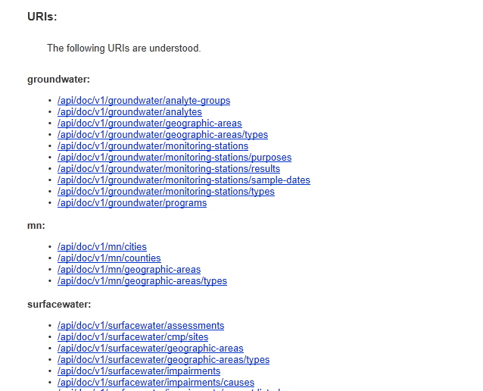
REST architecture
(the MPCA API)

Slide 60
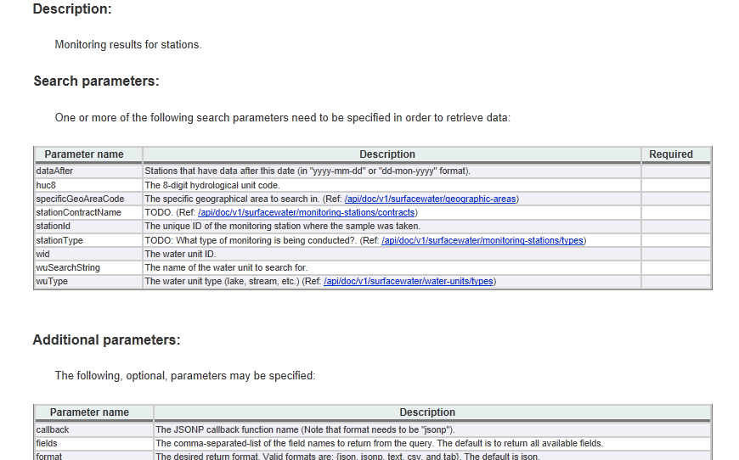
REST architecture
(the MPCA API)

Slide 61
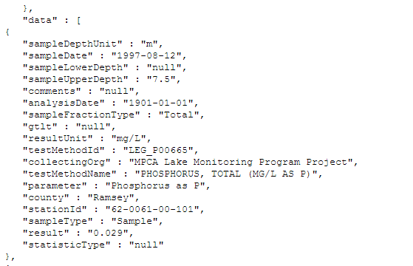
REST architecture
(the MPCA API)
http://petra/api/v1/surfacewater/monitoring-stations/results?stationId=62-0061-00-101&format=text

Slide 62
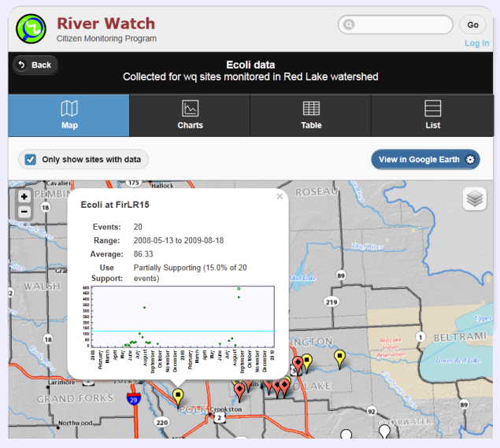
http://riverwatch.wq.io/

Slide 63
Summary
It’s not enough to give people “data” they need information
We have a bad habit of tying up our knowledge in PDF reports
Single function maps and “map portals” are equally important.
Separation of the data model (M) and the application (VC) using REST opens our data to third party development

Slide 64

Questions?

Slide 65
Feedback: Past Two Years of the Council
What went well?
What can be done better?
Have we missed something we need to do?
How do we get next Council off to good start?
How do we improve member/sector communications?
State agency representation on Council?

Slide 66
Current Member Representation
At-Large (4)
Business (2)
Education, K-12 (1)
Education, MnSCU (1)
Education, U of M (1)
City, Metro (1)
City, Non-Metro (1)
County, Metro (1)
County, Non-Metro (1)
Federal (1) +
MN GIS/LIS Consortium (1)
Non-Profit (1)
Regional, Metro (1)
Regional, MetroGIS (1)
Regional, Non-Metro (1)
State Government (3) +
Tribal (1)

Slide 67
Council Member Roles and Expectations
Proactively advise and assist MnGeo to:
Coordinate or improve geospatial technology, data and services statewide
Establish priorities
Understand needs and issues of geospatial community
Communicate with the community sectors
Identify opportunities and develop partnerships and collaboration
Create and use committees and workgroups
Develop council meeting agendas and participate at meetings

Slide 68

Update: State Geospatial Governance Going Forward
Efforts at this time:
Geospatial Technical Committee
Identify infrastructure and data optimization opportunities
MN Geospatial Commons
CKAN Example: OpenColorado.org
Notes:
Much like other MN.IT consolidation efforts, the initial focus is on making sure we use the same terms.
For Infrastructure and Data, a GeoCommons group led by Mark Kotz is meeting, defining requirements, and testing candidate solutions. An example candidate is CKAN, which Data.gov is going to migrate to soon.
For the Service Catalog, the group is taking MnGeo’s catalog, which revolves around the AppGeo 2009 study, and making sure @Agency services are either included or added on. Chris Buse tells us this is very much like an effort the Information Security teams took on a few years ago.
We have SharePoint sites set up and we are hiring a PM for these efforts

Slide 69
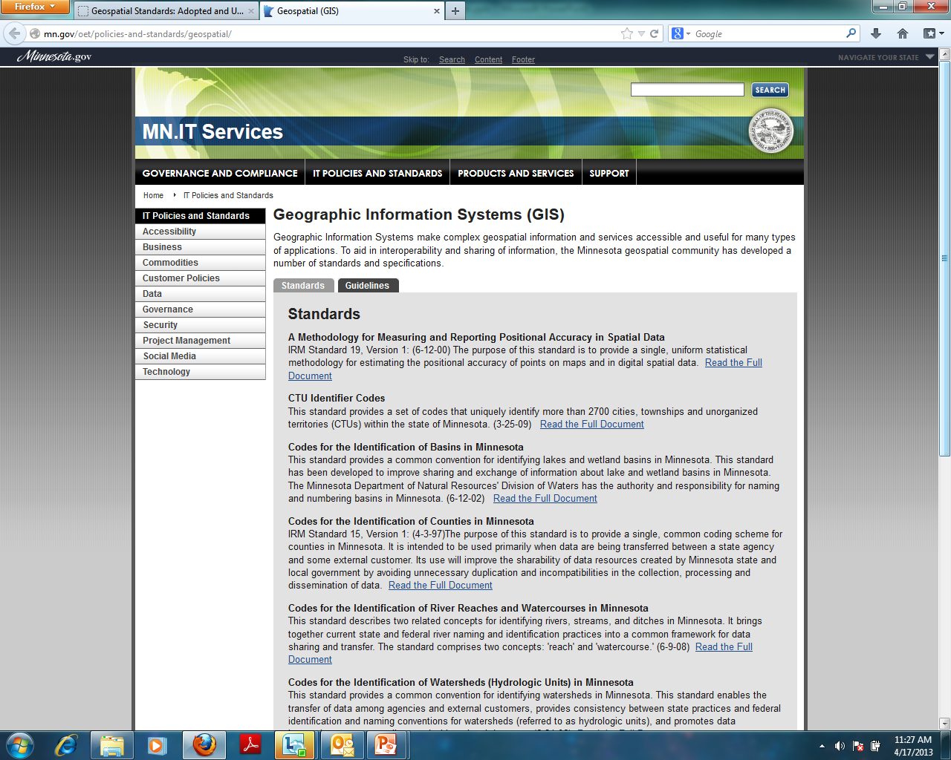
Click to add the caption or title for the picture
http://mn.gov/oet/policies-and-standards/data-management/#

Slide 70
Current Standards
Standard | Type | Source
Codes for Minnesota Counties | Code | ANSI
State Agency Coordinate Interchange | Coordinate | Various
Geographic Metadata | Content | FGDC
Positional Accuracy | Quality | FGDC
Codes for the Identification of States | Code | ANSI
Codes for Lake and Wetland Basins | Code | MN DNR
Codes for Watersheds | Code | MN DNR
Codes for River Reach/Water Course | Code | FGDC/DNR
Codes for City, Township and Unorganized Territory | Code | ANSI
U.S. National Grid | Coordinate | FGDC
Stormwater System Data Exchange | Data
Thoroughfare, Landmark, and Postal Address Data Standard | Data | URISA
Parcel Attribute Data Exchange | Data

Slide 71
Geospatial Technology Committee
The Geospatial Technology Committee is responsible for:
Approving geospatial policies, standards and planning initiatives
Approving exceptions to geospatial policies and standards
Recommending plans for transforming state agency-level geospatial operations and extending the technology to a broader community of customers
Overseeing the development and maintenance of a stable enterprise-level funding strategy for geospatial operations
ISRM Asst. Commissioner | Chris Buse | Member
State Enterprise Architect | Jeff Fanning | Member
GIS Architect | Hal Watson | Member
Chief Geospatial Officer | Dan Ross | Chair
Service Delivery Asst. Commissioner | Thomas Schaeffer | Member
Agency Support Asst. Commissioner | Tu Tong | Member
Agency CIO | Robert Maki | Co-Chair
State Agency Business Representative | Cassandra Isackson - MnDOT | Member
State Agency Business Representative | Jackie Mines - DPS | Member
State Agency Business Representative | Karen Schirle - DHS | Member
Geospatial SME | Mike Dolbow | Member
Geospatial SME | Mark Kotz ** | Member
Geospatial SME | Mark Olsen | Member
What’s next?
Meeting February 20th and every 3rd Wednesday thereafter
Intro to GIS first 2 meetings

Slide 72
Other Business?

Slide 73
Future Meetings
August 28, 2013
December 4, 2013

Slide 74
Thank you!

