Slide 1
Statewide Geospatial Advisory council
September 24, 2013

Slide 2
AGENDA
Call to order and introductions 40 min – 1:00
Approval of May 29, 2013 meeting minutes 5 min – 1:40
Review of mission for this council and roles, responsibilities, 30 min – 1:45 and expectations
Summary of meetings from last year
Would like to see this group drive the agenda
Formal or informal gathering
Membership discussion 15 min – 2:15
Break – Networking 15 min – 2:30
MnGeo governance mechanisms and where each fits 20 min – 2:45
Finalization of guidance documents for Committees and Workgroups
Update on MnGeo major efforts 20 min – 3:05 GeoCommons project update and demo 30 min – 3:25
Future Council Meeting Dates
December 11, 2013
March 12, 2014
June 18, 2014
Adjourn 4:00

Slide 3

Welcome of new members
Introductions
What folks want to get out of their time on the Council

Slide 4
May 29, 2013 Meeting Minutes http://www.mngeo.state.mn.us/councils/statewide/SWGAC_minutes_2013May29.pdf

Slide 5
Council mission Roles, responsibilities, and expectations

Slide 6
Mission
The mission of the council is to promote efficient and effective use of resources by providing leadership and direction in the development, management and use of geographic information in Minnesota. The council makes recommendations in areas including, but not limited to: policies, institutional arrangements, standards, education and stewardship.
Does this still fit?

Slide 7

GUIDING PRINCIPLES
The following guiding principles form the foundation for the council's activities and priorities.
Promote efficient investments in geographic information.
Promote geographic information as a public resource that should be widely shared with and available to interested parties.
Support the establishment and use of geographic data standards and guidelines to better exchange and share information resources.
Are these still correct?

Slide 8

GUIDING PRINCIPLES
Promote education and training in GIS.
Promote the beneficial uses of geographic information in the development of policy and the management of public resources.
Provide a major forum where ideas and issues of the GIS community in Minnesota can be brought forward, discussed and acted upon, as appropriate.
Are these still correct?

Slide 9
Roles and responsibilities as a member…
You are willing to be active in meetings and provide input, advice and guidance to MnGeo regarding issues and information of importance to your sector and the council regarding activities, governance, needs, and opportunities related to geospatial.
You currently have or are willing to obtain and engage contacts in the broad sector you represent.
You are willing to reach out to organizations and individuals in the sector you represent to obtain input and information regarding geospatial activities and opportunities and are also willing to provide information back to that sector to share activities from the meeting and information shared from other sectors.

Slide 10
Council Member Roles and Expectations
Proactively advise and assist MnGeo to:
Coordinate or improve geospatial technology, data and services statewide
Establish priorities
Understand needs and issues of geospatial community
Communicate with the community sectors
Identify opportunities and develop partnerships and collaboration
Create and use committees and workgroups
Develop council meeting agendas and participate at meetings

Slide 11
Communication – your most important role…
Keep stakeholders informed about Council activities.
Provide ongoing project updates.
Distribute major reports and findings.
Solicit and acquire input relating to Council activities.
Assist in converting GIS users to approved standards.
Educate people about the benefits of GIS.
Make people aware of the Council and the impact it is having.
Understand the needs of the Minnesota GIS community.
Provide sound policy advice to state and federal government.
Promote programs that the Council thinks are critical to sound GIS development.
Promote the use of GIS in meeting objectives of key stakeholders in local and State government.

Slide 12
Suggestion ….
Create a small group to….
Review and refine
Present back to the Council at the next meeting
Volunteers?

Slide 13
Member input…
Clarify the relationship between the SWGAC, MnGeo and committees/workgroups.
Q) The Geospatial Committee and Workgroup Guide states that only the Geospatial Technology Committee can create “MnGeo” committees and workgroups. So… can the SWGAC create its own committees and workgroups
A) MnGeo will create committees and workgroups based on advice from the SWGAC, GTC, or geospatial community

Slide 14
Focus of the SWGAC
Create a more nimble sub group of the SWGAC to focus on its strategic opportunities
Create a smaller group of very active members that get together a month or so before the meeting to discuss what should be on the agenda. This could be a very strategic level discussion, focusing on how the SWGAC could be the most effective and productive.
Thoughts?

Slide 15
What went well?
Easy accessibility of meeting documents (agendas, minutes, supporting docs) on the MnGeo site. Logistics. Keeping informed and in touch with current efforts.
Discussion of projects by council members, discussing the structure of the council and MnGeo, the process for parking passes, updates from committees and workgroups.
It was nice having a dialog with MnGeo. I truly believed you wanted to hear from us.

Slide 16

What can be done better?
Define roles and responsibilities for council members
Clarify responsibilities and identify where the council fits into the decision making process.
Help the council be more proactive, maybe send some information on topics to be discussed before the meeting so the council members can review
I didn’t get to know the other members well. Maybe 4 meetings a year is not enough. Maybe getting them to make presentations would help.

Slide 17
Have we missed something we need to do?
There needs to be a reason for non members to reach out to their reps, at this point there's no benefit in doing that.

Slide 18
How do we get next Council off to good start?
There needs to be some guidelines for participation and an understanding of where council members fit in the decision making / advisory process
Communicate the expectations and the topics before the meeting
Start with your priority projects and initiatives.
Invite people to say where their major interests are, what they hope to see as outcomes, and how they think they can help. (If none of the initiatives excite them, have them say what they’d like added)

Slide 19
How do we improve member/sector communications?
The sector reports we gave at the last meeting were a good idea.
If the reports are required periodically (annually?) it will prompt communication.
I enjoyed reading the paragraphs submitted by members. Keep it up.
Consider expanding communication methods
Maybe a SharePoint site and possibly LinkedIn and Facebook
We need to know what’s happening around the state. More blogging required.

Slide 20
Current Member Representation
At-Large (4)
Business (2)
Education, K-12 (1)
Education, MnSCU (1)
Education, U of M (1)
City, Metro (1)
City, Non-Metro (1)
County, Metro (1)
County, Non-Metro (1)
Federal (1) +
MN GIS/LIS Consortium (1)
Non-Profit (1)
Regional, Metro (1)
Regional, MetroGIS (1)
Regional, Non-Metro (1)
State Government (3) +
Tribal (1)

Slide 21
Membership
Should we add additional sectors to this Council that we are not currently engaged with?
The professional surveying community – we need to be much more engaged with them
Each of the organized geospatial user groups in the state – Pine to Prairie, NE, SE, SW
The Association of Minnesota Counties
The League of Minnesota Cities
Notes:
I am also looking at adding some new sectors to the Council as I believe it will provide for broader communication and input from sectors we are not currently engaged with. I am looking to add representatives from:
1. The professional surveying community – we need to be much more engaged with them
2. Each of the organized geospatial user groups in the state – currently we have Metro GIS representation but no representation from Pine to Prairie, or the organized groups in NE, SE,SW Minnesota. Including them would provide access to already organized communication stream and a broad representation of users.
3. The Association of Minnesota Counties
4. The League of Minnesota Cities

Slide 22

BREAK
+

Slide 23
Governance

Slide 25
Committees and Workgroups
Document templates
Charter
Workplan
Meeting minutes
Annual report
Status report
Announcement of deliverable
Final report

Slide 26
Update - MnGeo Priority Projects
Addresses
Aerial Imagery
Altered Watercourse
Geospatial Commons
LiDAR/Elevation
Hydrography
Parcels
Street Centerlines

Slide 27
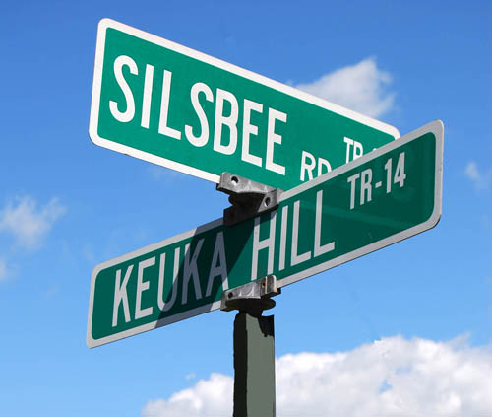
Addresses Future Project

Slide 28
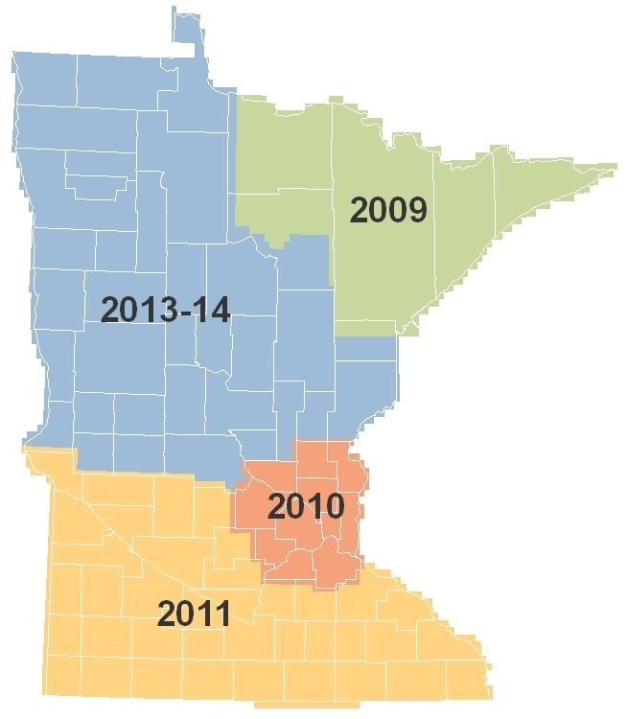
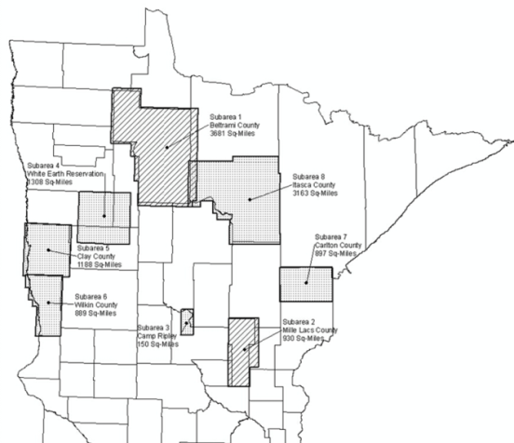
Spring Aerial Imagery Program (SAIP) – In Progress
Leaf-off, 4-band imagery
Despite adverse weather, much of 2013-14 area was flown at 50 cm resolution
Nine partners cost-shared for 30 cm (1-foot) resolution
This year’s imagery anticipated to be available Fall 2013
Remaining areas to be flown Spring 2014
Notes:
Statewide Aerial Imagery Program (SAIP)
Five Phases Planned
We’re beginning the 4th now:
Technical Proposals have been evaluated
A top-scoring vendor has been identified
Final negotiations are currently underway with that vendor
Plan is to have a contract fully executed later this month
There are 8 partners involved in this next phase:
Beltrami County
Carlton County
Camp Ripley
Clay County
Itasca County
Mille Lacs County
White Earth Nation
Wilkin County
About $1.2 in Legacy funds have been committed thus far
About a $51K spend for project administration
GF primarily for outreach in developing and managing partnerships
For every $100 of state money investing in this program, $67 are added by non-State partners

Slide 29
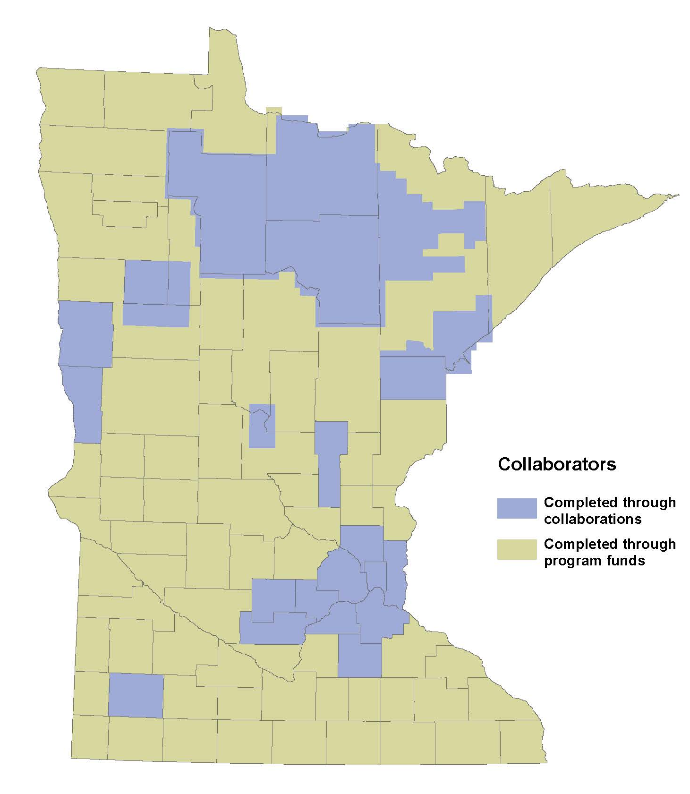
SAIP Investments
21 partnerships:
Federal (2)
State (1)
Counties (13)
Native American Lands (2)
Regional (2)
National Guard (1)
State Funds: $1,300,000
Partner buy-ups: $700,000

Slide 30
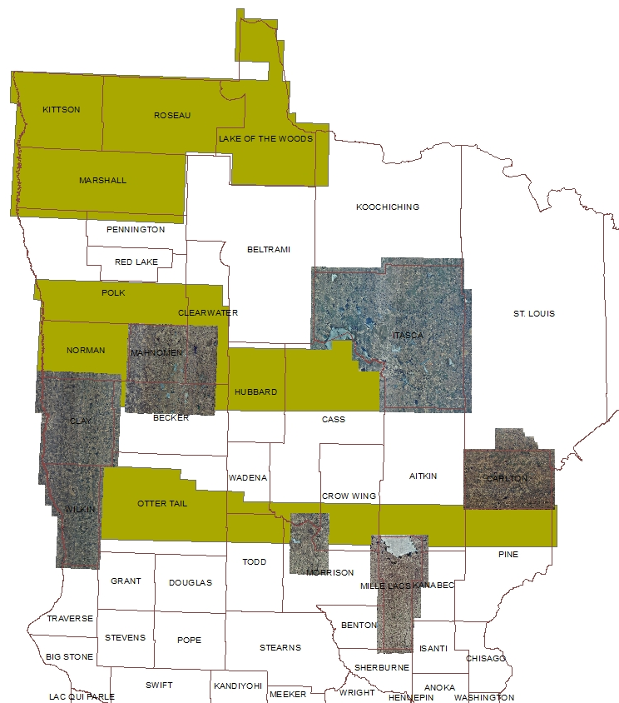
Status: 2013-14 Aerial Imagery Project
$750,000 project coordinated among DNR, MnGeo, MnDOT, 10 local partners
2013 hi res data being QCed for 8 partner areas
Lower res data expected Early October
Completion for 2013 collect: late fall
2014 Cos: Beltrami, Polk

Slide 31
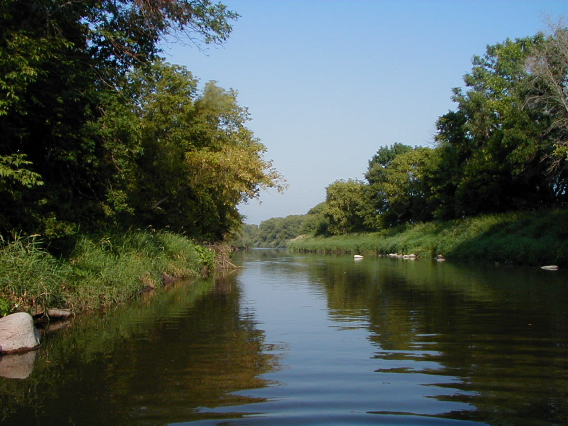
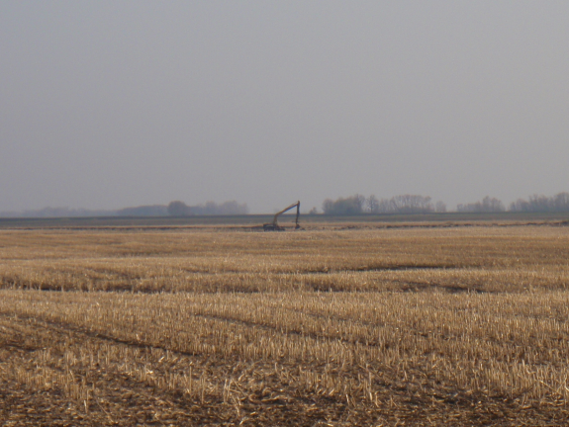
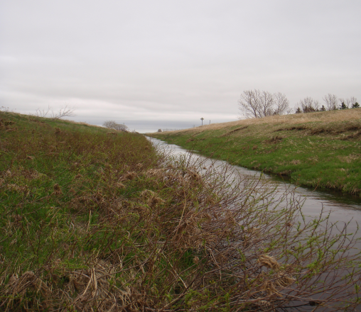
Altered Watercourse - Complete
An altered watercourse is a stream/river or portion of a stream/river that has been modified in such a way to alter its natural course
Channel alterations include:
Channelized streams, ditches and impoundments
Channel alterations do not include:
Beaver dams, dredging, rip-rap, removed snags and wetlands

Slide 32
MN Geospatial Commons – June 30, 2014
A single place we all go to find and share geospatial resources
Where are we?
Release 1 complete
Demo usability
Align infrastructure and data
Defining scope
Evaluate
Share
Administer
Find

Slide 33
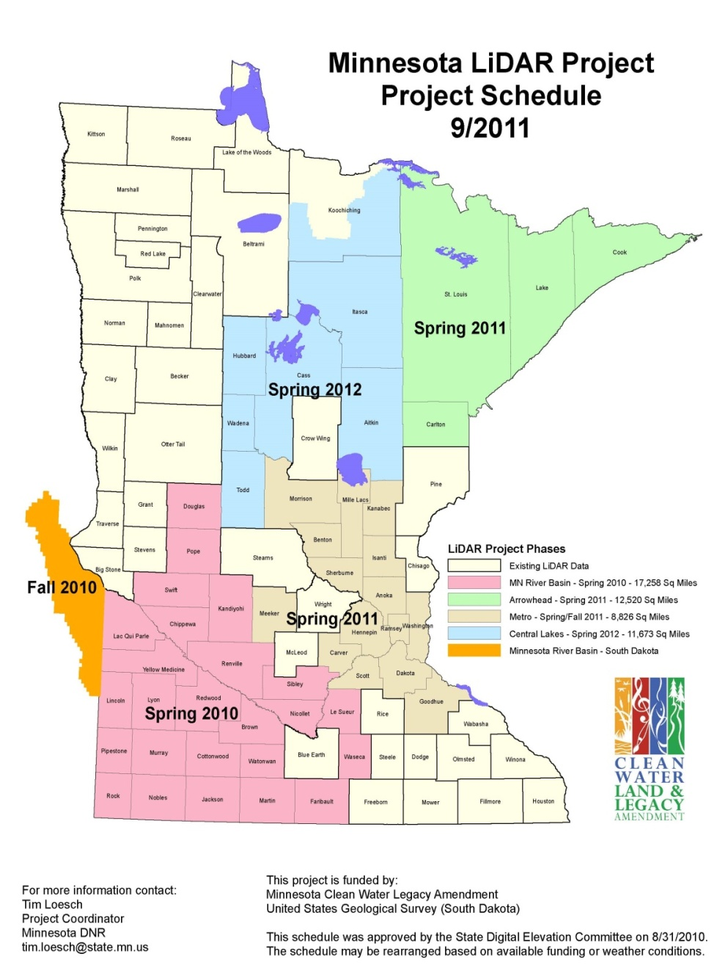
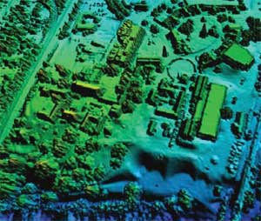
LiDAR Elevation – Fall 2013
Partnership with MN DNR to:
Provide FTP site
Improve data download
Develop browser viewer

Slide 34
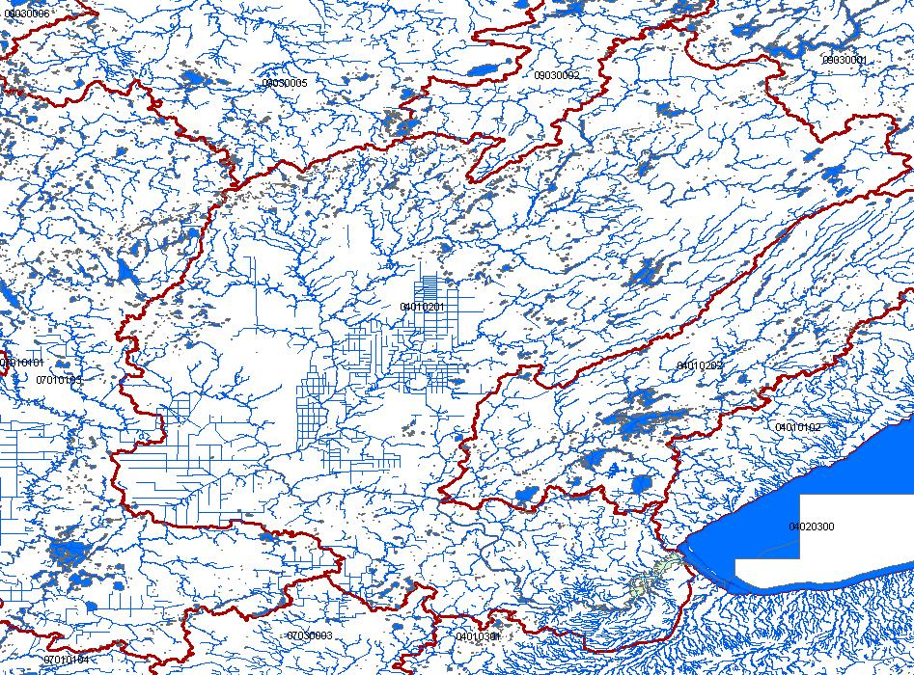
Hydrography – In progress
Hydrographic features for making maps
A national stream addressing system
A modeling network for navigating upstream/downstream
A maintenance infrastructure
Additional tools to enhance use of data
Move toward a single geo-representation for surface water
Notes:
Graphic – St. Louis River Basin is the central basin – emptying into Lake Superior. Hydro features include lakes, rivers for mapping (1-d, 2-d), rivers for networking (1-d); A system of Watershed Boundaries (WBD) is also included. Those are the red lines on this graphic.
Flow volume and velocity within catchments

Slide 35
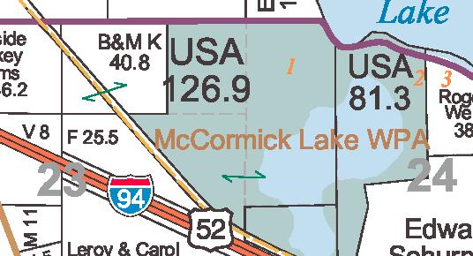
Statewide Parcel Integration Project – aligning with Revenue efforts
Legislation
License Agreement
Exchange Guideline
Regional Collaborations
MN Dept. of Revenue Project

Slide 36

Project Scope
To electronically collect data at a more detailed level.
UTA level sub-parcel level
Consolidation of the county data submissions into one standard format.
Currently 9 formats
Reporting/data extracts available to Revenue, counties and other stakeholders.
Improved data portal, messaging

Slide 37
Project Scope
Phase 1 – The technical model will be developed and the first file (valuation) will be submitted by all counties.
Phase 2 – More files will be submitted by all counties, including tax data. A more advanced portal will be developed and hopefully counties will be able to pull information and reports from the warehouse.
Phase 3 – Determination of what additional CAMA data is needed.

Slide 38
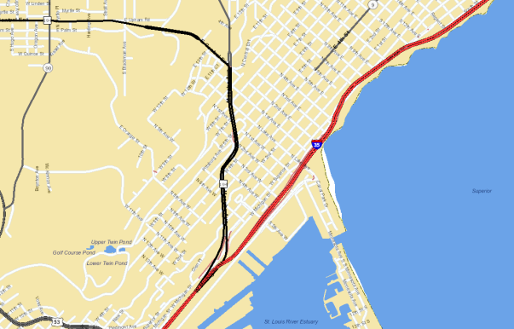
Street Centerlines
Multi government/agency
MnDOT, MnGeo, Met Council
Single authoritative centerline
Common tools
Roads and highways at MnDOT
Pilot and partners
Stearns, Benton, Carver, Ramsey, Mahnomen
White Earth Nation
NextGen 911

Slide 39
Demo and Dicsussion – Minnesota Geospatial Commons
David Fawcett

Slide 40

Questions?

Slide 41
Future Meetings – Suggested dates
December 11, 2013
March 12th, 2014
June 18th, 2014

Slide 42
Thank you!

