Slide 1
Statewide Geospatial Advisory Committee
January 28, 2015

Slide 2
AGENDA
Call to order and introductions
Approval of Sept. 24 meeting minutes
General fund proposal update
Next Generation 9-1-1 project
Parcel, centerlines, address points interim collect
Data sharing initiatives update
Break – Networking
Archiving issues
FSA NAIP 2015
Higher education GIS training/courses survey results
Discussion of enterprise services needed
MnGeo priority efforts updates
Adjourn

Slide 3
Introductions

Slide 4
Approval of September 24 minutes
Nancy Rader, MnGeo

Slide 5
General fund update and discussion…
Dan Ross, MnGeo

Slide 6
Key Points to the Proposal
No longer a Recorders Fee request
MN Geospatial Commons as a focal point for delivery and collaboration
Proposal identifies key items to pursue
Focuses on aggregation, standardization and statewide
Publicly available – data and services
This Council will guide investments
Focus on ongoing programs – not one-time projects

Slide 7
Request status…
Not in the Governor’s budget…
What does that mean?
It will not be included for review at the legislature this year
We will try again next year
Pursuing funding from other sources

Slide 8
Discussion: Where do go from here?
Identified items in the support documents for the request…
Parcels
Addresses
Centerlines
Next Generation 9-1-1 data layers
Aerial Imagery
LiDAR
Hydrography

Slide 9
Next Generation 9-1-1 project
John Hoshal and Adam Iten, MnGeo

Slide 10






GIS Data in Legacy 9-1-1 Environment
Call Originating
Networks
9-1-1 Service Provider Network
PSAPs
Subscribers
GIS
^{Wireline}
^{TDM}
^{Wireless}
^{SRDB}
^{ALI}
^{VoIP E9-1-1}
^{Service Providers}
^{VoIP}
Data Management
Data Management
TN Records, MSAG, Error Mgmt, ALI, SRDB
Subscriber

Slide 11

GIS Data in NG9-1-1
Call Originating Networks
-------------
Access Network Providers
ESInet
PSAPs
Subscribers
^{IP} ^{PSAP}
^{GIS}
ECRF
^{Wireline}
LIS
LVF
ERDB
^{Wireless}
VDB
^{GIS}
^{GIS}
^{VoIP E9-1-1}
^{Service Providers}
^{VoIP}
Data Management
Data Management
GIS, Policy Rules
Location and Subscriber Information

Slide 12
The NG9-1-1 GIS Project
DPS is the lead agency, providing overall coordination and oversight of the NG 9-1-1 program.
MnGeo will take on the principal role of coordinating the aggregation, development, standardization, quality assurance and maintenance of geospatial data needed for NG9-1-1.
Actively engage PSAPs, federal, tribal, state, regional and local jurisdictions in Minnesota in the collection, aggregation and maintenance of geospatial data required for NG9-1-1.
Identify “core” NG9-1-1 geospatial data that may be available from federal, tribal, state, regional and local jurisdictions in Minnesota.
Define a common data model and successfully transition collected data to the defined schema.

Slide 13
The NG9-1-1 GIS Project
Validate local data against statewide datasets and report findings back to local governments.
Identify and determine resources necessary for a repeatable process for gathering, aggregating, standardizing, and storing the data for the State of Minnesota.
Identify areas of the State where geospatial data and accuracy can be improved and identify funding to accomplish these improvements.
Make statewide geospatial data available to stakeholders and provision data to NG9-1-1 services.

Slide 14
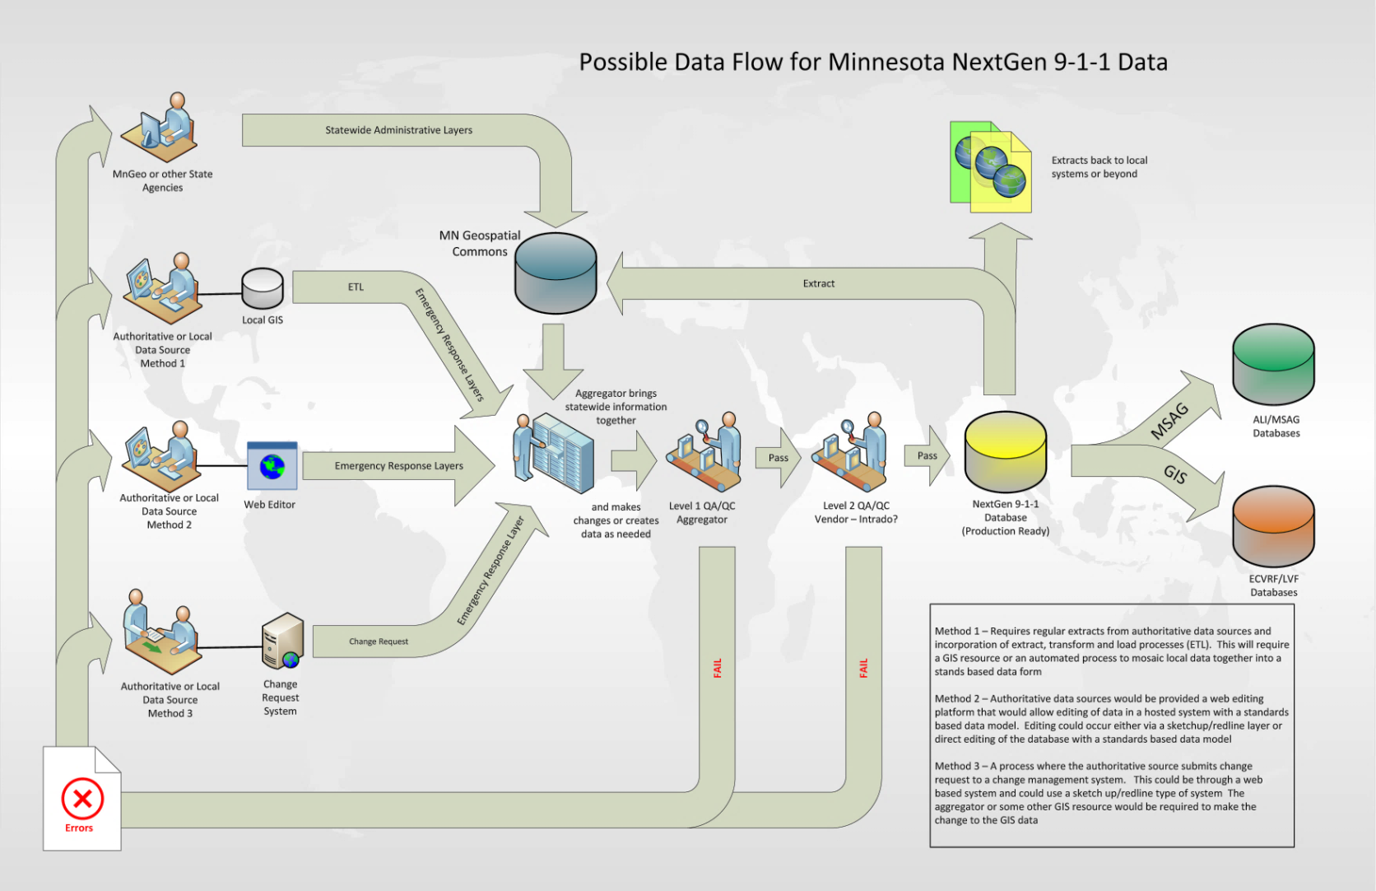
Possible Geospatial Data Flow
Notes:
We understand that there will be many data providers – not all using the same data model. Creating and adhering to basic data standards will allow us to harmonize data for state use.

Slide 15

GIS Data for NG9-1-1
Required
Street Centerlines
Address Points
Parcels
Emergency Service Boundaries
Fire
Law
Medical
PSAP
Community Boundaries
Authoritative Boundaries
Recommended
Water Features
Railroads
Trails
Driveways
Mile Markers
Common Places
Schools
Churches
Hospitals
Businesses
Landmarks
Cell Towers
AVL
Weather
Traffic
Camera Feeds
Imagery
3D Landscape and Buildings
Premise Info
Notes:
We understand that there will be many data providers – not all using the same data model. Creating and adhering to basic data standards will allow us to harmonize data for state use.

Slide 16

GIS in NG9-1-1
Who’s involved?
Government: Tribal, City, County, Regional, State, National
DPS, MnGeo, DOT, DNR
MESB, MetroGIS
City and County GIS Departments
PSAP Managers
Call takers, Dispatchers, and Responders
MSAG Coordinators
Addressing, Planning and Zoning, Assessor’s Office
Schools, Colleges, and Universities
Vendors and Contractors

Slide 17
Current Project Tasks
Project Plan
9-1-1 GIS Survey
Outreach to PSAPs and GIS sources
9-1-1 GIS Standards
NG9-1-1 GIS Committee

Slide 18

Thank you!
Adam Iten, Project Manager
Adam.Iten@state.mn.us
651-201-7559
John Hoshal
John.Hoshal@state.mn.us
651-201-2482

Slide 19
Parcel, centerline, address points interim collect update
Jim Krumrie, MnGeo

Slide 20
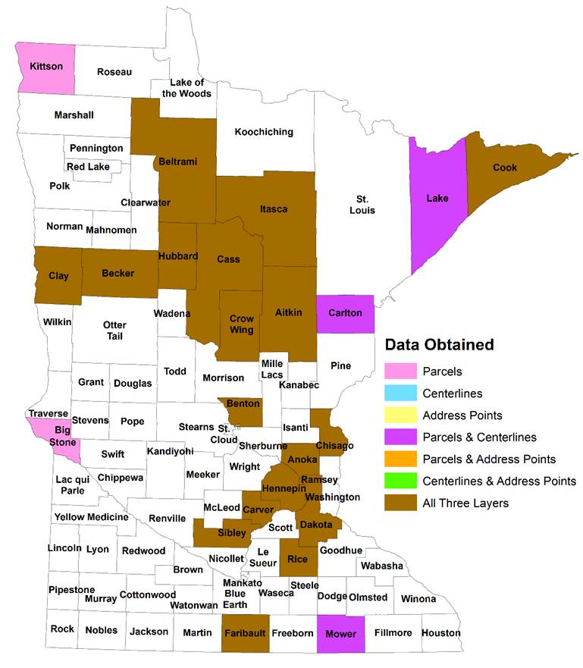
Status of County Data Collection
(as of 1/26/2015)
87 counties
50 counties contacted
Data collected from 24
3 cities
1 Indian Reservation

Slide 21
Schedule
Milestones | Target Date
Collect all available data | May 2015
Standardize the three layers | Oct 2015
Aggregate the three layers into single statewide datasets (likely to have gaps) | Jan 2016

Slide 22
Issues, Concerns and Risks
Limited resources available to work on this
Although most counties seem to have at least Parcels...
Many partners are reluctant to share especially with the public (i.e. require data release agreements)
Data content and quality varies between counties (and sometimes within counties)
Many partners do not respond quickly to the requests therefore requiring the need to contact multiple times
No established standards for data (although…)
Draft standard being discussed

Slide 23

MnGeo’s Proposal for Future Parcel Data Collection
Leverage Department of Revenue’s new property records system
To be implemented in September 2016 and then updated quarterly
Contains most attributes requested by Minnesota Parcels and Land Records Committee (more may be added after 2016)
Data already standardized
MnGeo would collect parcel boundaries and join with PRISM-supplied attributes

Slide 24
Data sharing Initiatives
Dan Ross/Geoff Maas

Slide 25





Free + Open Data: Recent Developments
Clay County
Adopted a ‘free and open’ resolution (Oct 28, 2014)
Washington County
Adopted a ‘free and open’ resolution (Nov 18, 2014)
Stearns County
Published their data on their website (Dec 2014)
Sherburne County
‘Zeroed out’ their fees for GIS Data (Jan 1, 2015)
Borchert Map Library Staff
(University of Minnesota)
Volunteered to track county by county data availability

Slide 26
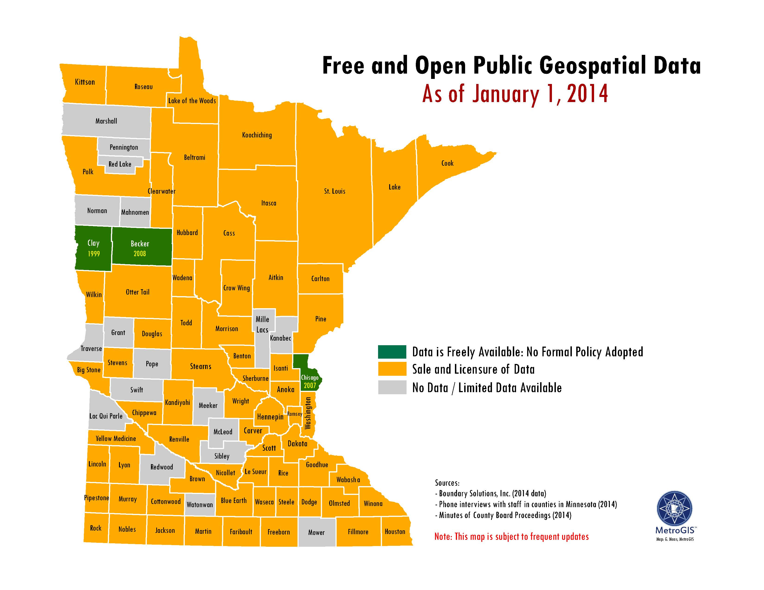

Slide 27
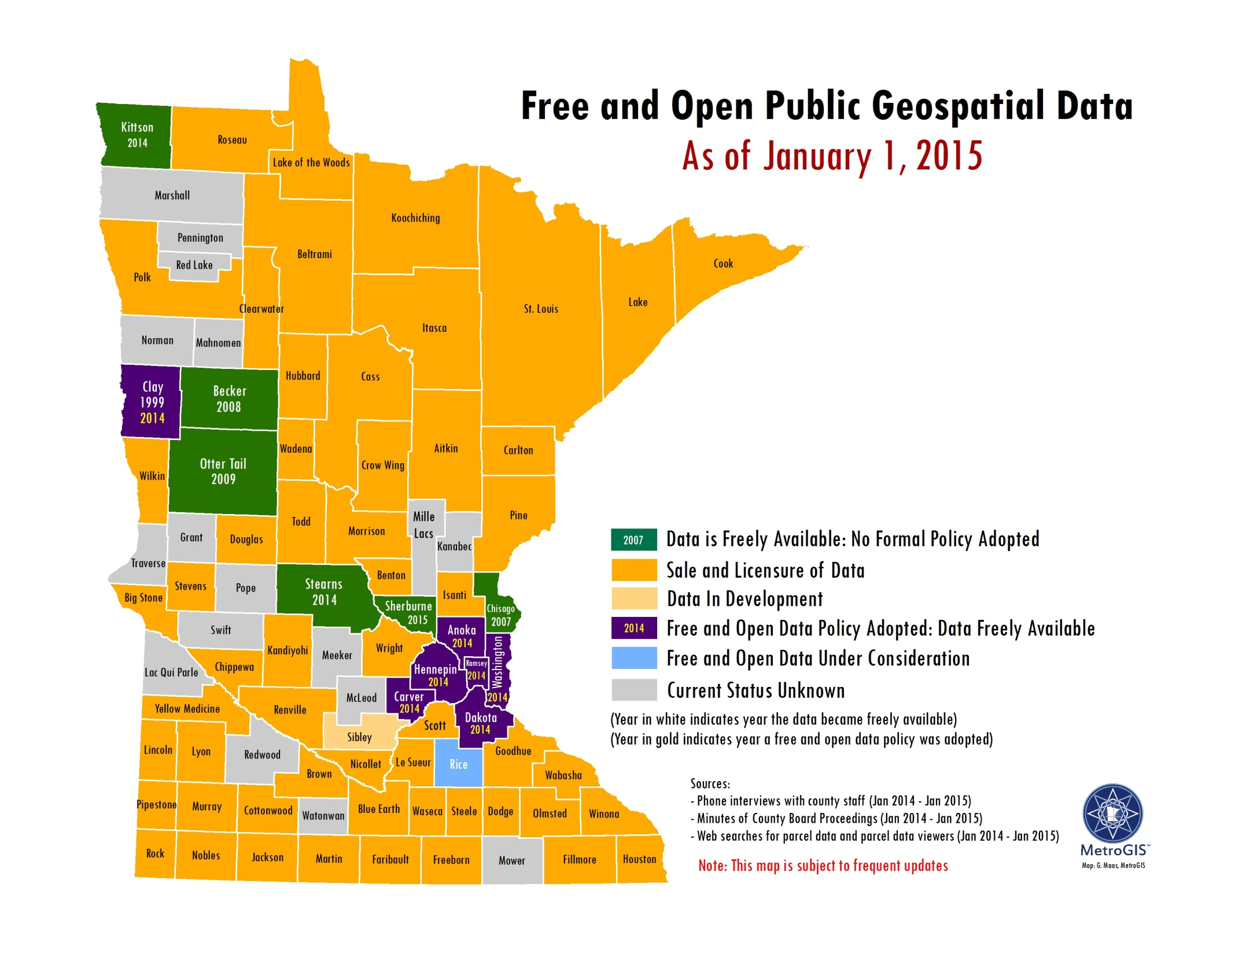

Slide 28

Data Sharing Agreements
Goal – single agreement with partners
Approach
MnGeo makes agreement, obtains and aggregates
Publishes, shares as needed
GeoCommons?, GDRS, Service
MN.IT makes agreements with individual agencies
Why is that needed?

Slide 29


30 minutes…
+

Slide 30
Archiving Minnesota Geospatial Data
Ryan Mattke
John R. Borchert Map Library
University of Minnesota

Slide 31
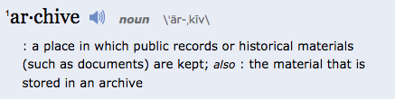
What is data archiving?
http://www.merriam-webster.com/dictionary/archive

Slide 32
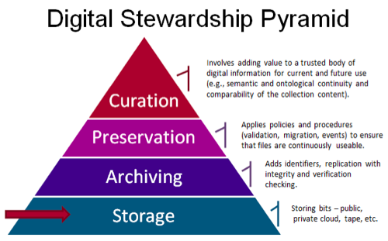

Slide 33
Historical (“Old”) Data
Parcels
Survey Info (plats, monuments, and benchmarks)
Aerial Imagery
Utilities
Permits (right-of-way, ordinance, utility, etc.)
Construction Plans/As-Builts
Easements, Openings, Vacations, CINU
Maps (street, parks, natural resources, transit, etc.)
Field Books and/or notes

Slide 34
Why archive? Why now?
Historical versions are useful to:
Researchers
Planners
Historians
Genealogists
Surveyors
The curious resident
Open Data Initiatives
Minnesota Geospatial Commons
GDRS node (coming soon)

Slide 35
University of Minnesota Libraries
Map Library is already de facto archive for aerial photographs and many state-produced paper maps
Preservation System (soon[ish])
For now, data is on disc or in the University Digital Conservancy (for MN Geological Survey)
Data Management & Curation Initiative
developing curation procedures for different type of data (including geospatial)
Data Repository for the University of Minnesota
self-deposit of datasets into repository that enables reuse, citation, and fulfills grant requirements

Slide 36
Minnesota State Archivist
Had a conversation with Shawn Rounds
State Archivist has a handful of geospatial data sets, but does not generally collect data
Since most/all geospatial data created by government agencies in MN is not directly related to the business of government, it would be out of scope for archiving with the State Archivist
As long as MnGeo and other major players are involved in the conversation, the State Archivist is fine with any decisions made

Slide 37
Geospatial Data Archiving in Minnesota
Possible analogy:
Minnesota Digital Library & Geospatial Commons
MDL aggregates, and facilitates access to, digital objects from 155 participating historical societies, special archives, libraries and other organizations.
Once objects are in one place, archiving and preservation is that much easier
http://mndigital.org

Slide 38
Geospatial Data Archiving in Minnesota
Question:
What is the level of interest in the concept of a centralized/aggregated service model?

Slide 39
Geospatial Data Archiving in Minnesota
Question:
Is the University of Minnesota the appropriate location for this kind of work?

Slide 40
Geospatial Data Archiving in Minnesota
Question:
Data curation and retention
Who decides what is kept?
How is that decision made?
Funding?
Legal issues?

Slide 41
FSA NAIP 2015 update
Jeff Bloomquist, Farm Service Agency, USDA

Slide 42


Slide 43
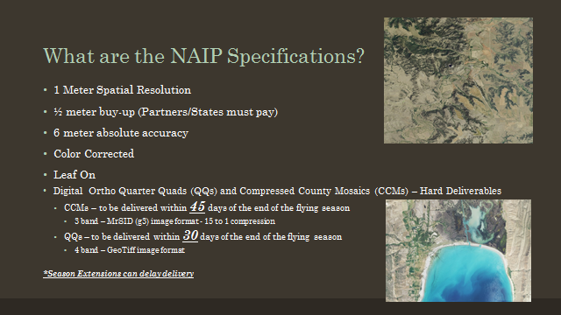

Slide 44


Slide 45
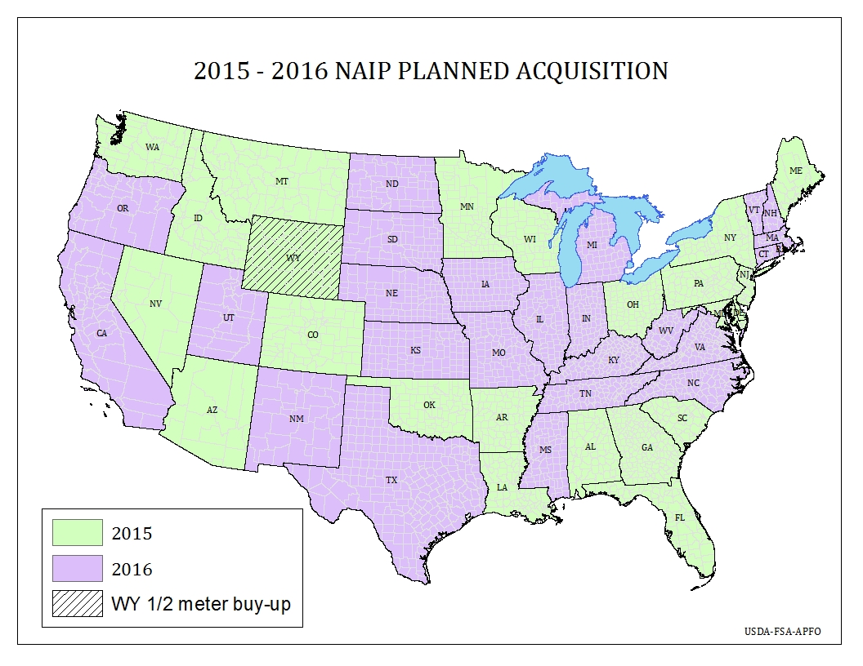

Slide 46
Higher education GIS training/courses survey results
Ben Richason, St. Cloud State University

Slide 47

HIGHER EDUCATION
GEOSPATIAL COURSES

Slide 48
COURSE CATEGORIES
MAPS & CARTOGRAPHY
SURVEYING / GPS
REMOTE SENSING & PHOTOGRAMMETRY
GEOGRAPHIC INFORMATION SCIENCE
SPATIAL ANALYSIS

Slide 49
MAPS
AND
CARTOGRAPHY

Slide 50

Maps & Cartography
MnSCU Totals

Slide 51
Maps & Cartography
MnSCU – 4 Yr vs. 2 Yr
4 Yr
2 Yr

Slide 52
Maps & Cartography
U of M Totals

Slide 53
Maps & Cartography
U of M - Twin Cities vs. Regional
Twin Cities
Regional

Slide 54
Maps & Cartography
Private Colleges & Univ. - Totals

Slide 55
Remote Sensing
MnSCU Totals

Slide 56
Remote Sensing
MnSCU – 4 Yr vs. 2 Yr
4 Yr
2 Yr

Slide 57
Remote Sensing
U of M Totals

Slide 58
Remote Sensing
U of M - Twin Cities vs. Regional
Twin Cities
Regional

Slide 59
Remote Sensing
Private Colleges & Univ. - Totals

Slide 60
SURVEYING / GPS

Slide 61
SURVEYING / GPS
MnSCU Totals

Slide 62
SURVEYING / GPS
MnSCU – 4 Yr vs. 2 Yr
4 Yr
2 Yr

Slide 63
SURVEYING / GPS
U of M Totals

Slide 64
SURVEYING / GPS
U of M – TWIN CITIES vs. REGIONAL
Twin Cities
Regional

Slide 65
SURVEYING / GPS
PRIVATE COLLEGES & UNIV.

Slide 66
GEOGRAPHIC INFORMATION
SCIENCE

Slide 67
GEOGRAPHIC INFORMATION SCIENCE
MnSCU Totals

Slide 68
GEOGRAPHIC INFORMATION SCIENCE
MnSCU – 4 Yr vs. 2 Yr
4 Yr
2 Yr

Slide 69
GEOGRAPHIC INFORMATION SCIENCE
U of M Totals

Slide 70
GEOGRAPHIC INFORMATION SCIENCE
U of M – TWIN CITIES vs. REGIONAL
Twin Cities
Regional

Slide 71
GEOGRAPHIC INFORMATION SCIENCE
PRIVATE COLLEGES & UNIV.

Slide 72
SPATIAL
ANALYSIS

Slide 73
SPATIAL ANALYSIS
MnSCU Totals

Slide 74
SPATIAL ANALYSIS
MnSCU – 4 Yr vs. 2 Yr
4 Yr
2 Yr

Slide 75
SPATIAL ANALYSIS
U of M Totals

Slide 76
SPATIAL ANALYSIS
U of M – TWIN CITIES vs. REGIONAL
Twin Cities
Regional

Slide 77
SPATIAL ANALYSIS
PRIVATE COLLEGES & UNIV.

Slide 78

TOTAL CLASSES
Private
U of M
MnSCU

Slide 79
DEPARTMENTS and PROGRAMS
WHERE GEOSPATIAL COURSES ARE TAUGHT
ALL COURSES

Slide 80
Discussion of enterprise services that are needed
Dan Ross, MnGeo

Slide 81

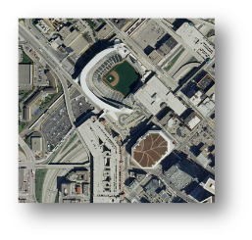
Examples of Enterprise Services
Existing
MN Geospatial Commons
Imagery
Geocoding
MnTopo
Under consideration
USPS verification
Web map services
Shared Code Repository

Slide 82
Discussion
What enterprise services are needed by the Geospatial Community?
Example – coordinate statewide data for the Census Bureau?

Slide 83
MnGeo priority efforts and updates
Dan Ross, MnGeo

Slide 84
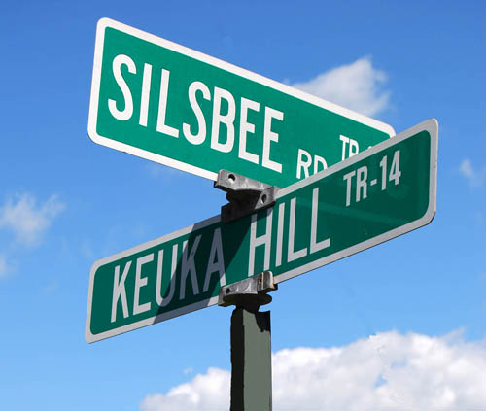
Statewide Addresses
Developed as part of NG9-1-1
Shaping the project now
Collaboration with DPS, State Patrol, MnDOT, local partners
Aligned with Street Centerlines
Will begin moving forward this spring

Slide 85
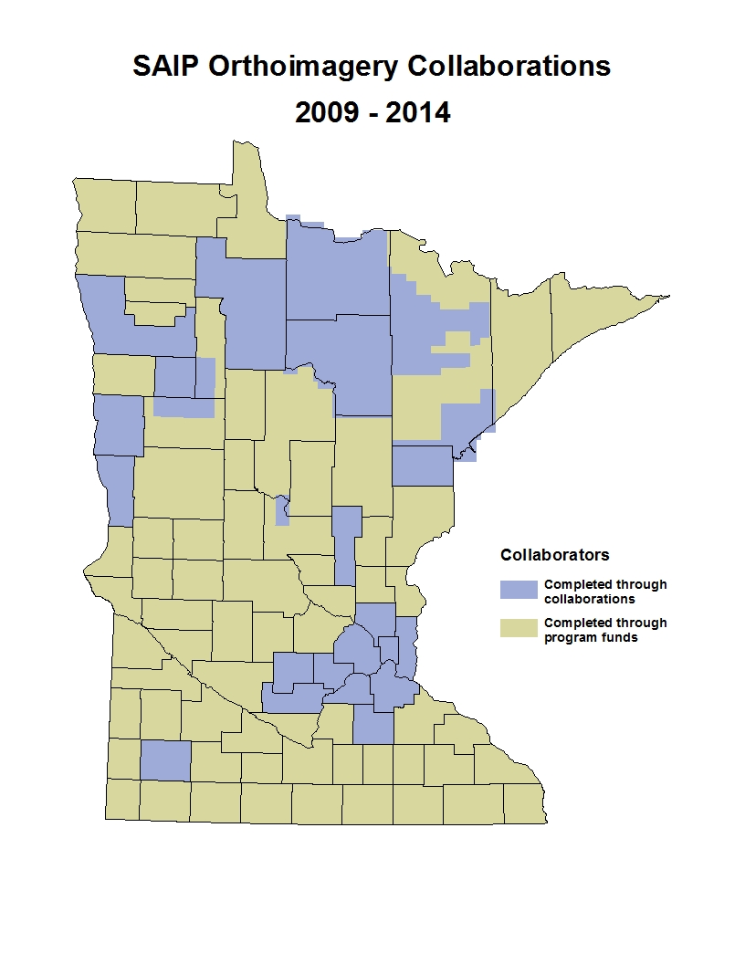
Spring Aerial Imagery Project 2009-2014
SAIP
6-year project
4-band & stereo imagery
0.5-meter resolution
Funded: ENRTF at $1.1-million
Purpose: Update National Wetland Inventory
Strategy: individual, annual contracts
Partnerships Offered
To counties, tribes, federal agencies
22 partnerships developed
Most bought up from 0.5-meter to 1-foot
Over an area representing 33% of MN
Total project budget increase: ~$1-million

Slide 86
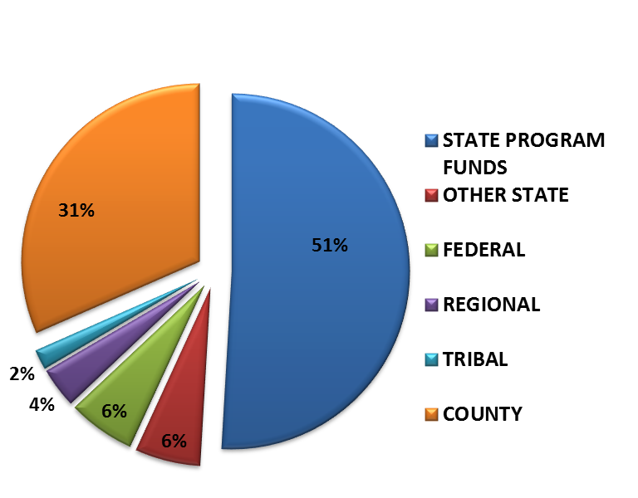
Spring Aerial Imagery Project 2009-2014
Roles
DNR: Primary customer, funding source, ID technical specs
MnGeo: project/contract mgmt; liaison with partners; imagery QC
MnDOT: Tech specialists; positional accuracy assessment
Counties, Tribes, Feds: partners engaged through JPAs and POs; involvement varied
Future
Project ending in first quarter 2015
Interest in continuing partnership program, but no dedicated state $$
State would dedicate resources to develop and execute a new contract

Slide 87

Master Services Contract (MSC)
Identify specifications for a set of products and/or services
Pre-approve a number of qualified vendors
Contract in force for multiple years
When products are desired, they are pooled and a work order is prepared
Vendor responses evaluated; best value selected
As new needs arise, new work orders can be issued over the life of the contract
For this contract, the primary product would be imagery:
4-band; Resolution from 3- or 4-inch to ½-meter

Slide 88
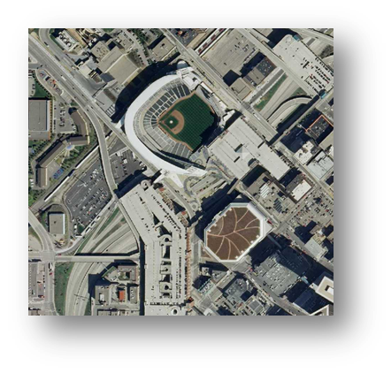
2016 Imagery
Met Council is in the process of securing funding
1-foot imagery
7-county Metro
If an MSC is in place, there is an opportunity for partners to buy up
Additional partnerships would increase leverage, decrease costs

Slide 89
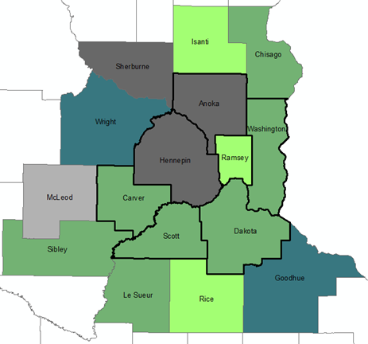

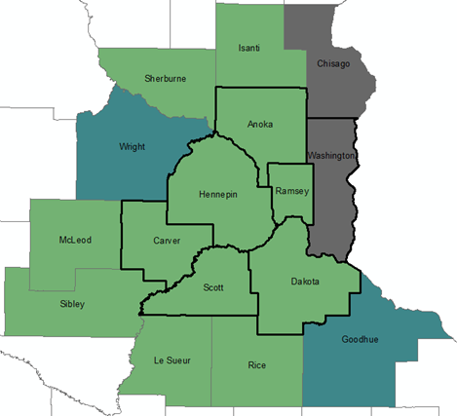

2016 Imagery Plans
14 Counties Responded
Imagery Plans
Yes: 4 metro 3 collar
Maybe: 1 2
No/Doubtful 2 2
Cost Share Interest
Yes: 6 metro 6 collar
No: 1 1
Interest in Cost Share Opportunity

Slide 90
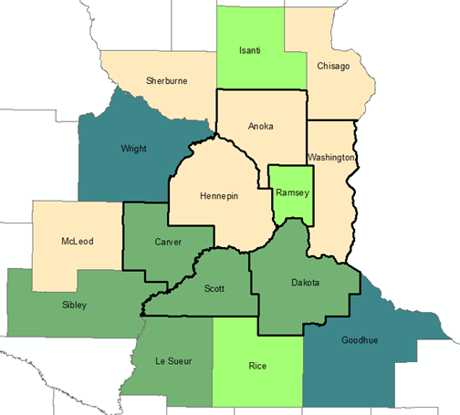
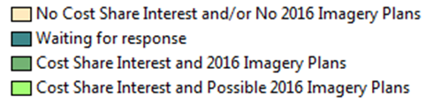
Imagery Survey
2016 Imagery Plans and Cost Share Interest
Additional Responses
Primary resolution: 6-inch
Spring, leaf-off
Other related products to consider:
Stereo
Elevation data from stereo
Planimetrics

Slide 91
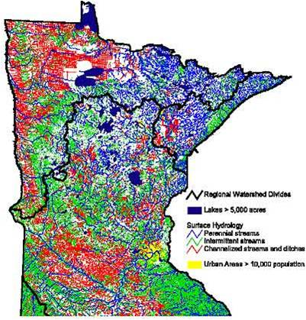
Drainage Records Modernization
Project Goal: Develop a GIS database template along with data standards and a web-based data portal for Minnesota’s public drainage system records.
Project Status: A project plan has been written and a Service Authorization (SA) between the Board of Water and Soil Resources (BWSR) and MnGeo has been written but not yet executed.
Project Funding: $230,000

Slide 92
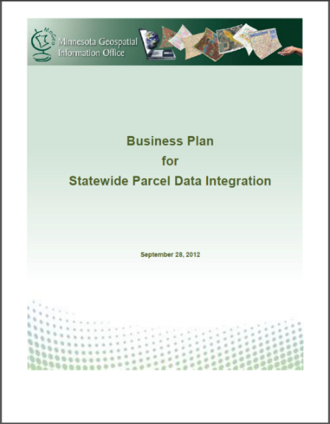
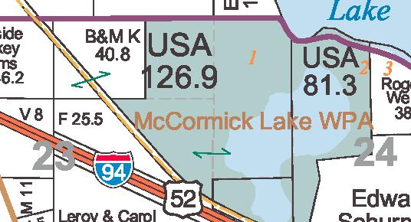

Statewide Parcels
Align with Revenue efforts
Exchange Guideline - shared
Regional Collaborations - happening
MnGeo to do parcel collect 2014-15
Will obtain, aggregate, standardize, make available to state agencies

Slide 93









The experiment…
Build a place that users see as the place of choice to go to find, evaluate, access and follow (stay connected with) the best data to meet their needs…
Create a place that publishers want to put their geospatial resources for others to discover...
Notes:
Hypothesis – If we build it, they will come?
Users
Publishers
Community will drive it
While the focus of this common system is geospatial this could apply to any data form

Slide 94

Status
Migration of all significant state geospatial resources currently provided in the Data Deli, Minnesota Geographic Data Clearinghouse, DataFinder and other independent state agencies taking place
Published resources accessible through the Commons has reached nearly 200
Participation of remaining state agencies and external partners will be pursued beginning in March 2015

Slide 95
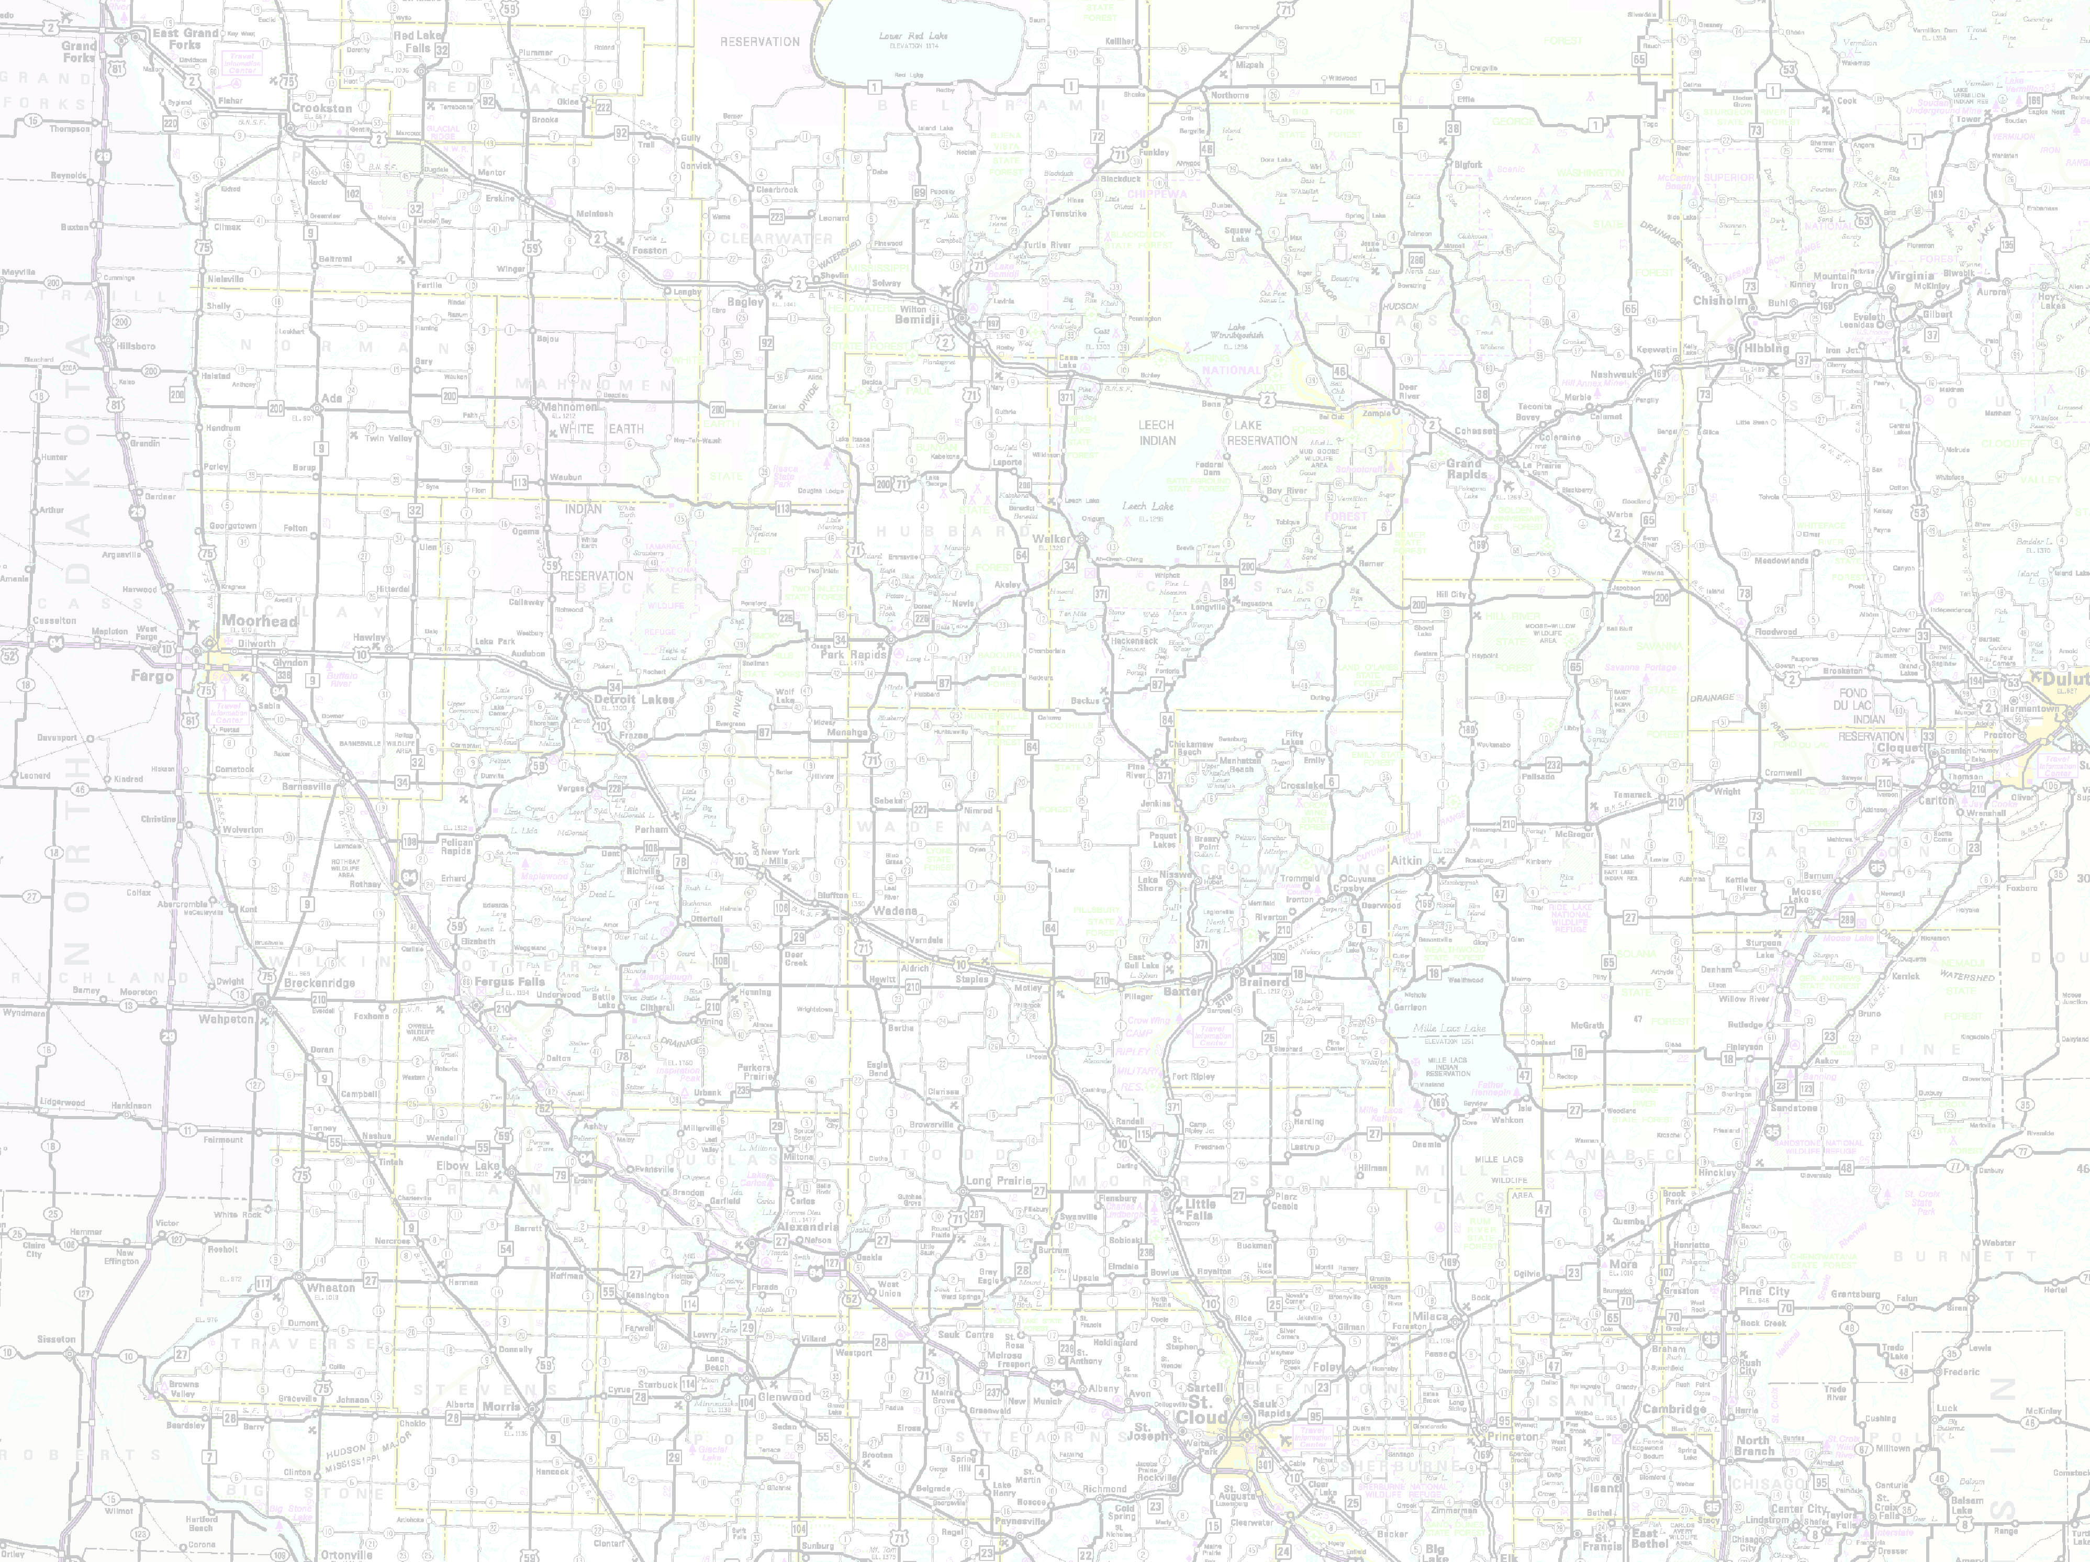









Delay…..
Set up - MnGeo instance of Esri Roads and Highways for the partners
Conflation of non-state data
Align with Metro counties GIS Centerlines, Next Generation 9-1-1 efforts
Statewide Centerline Initiative
To develop, test, refine, publish and perpetuate a single state- wide roadway dataset that meets the needs of a diverse user community…

Slide 96
Adjourn… See you next meeting, April 1 (no fooling!)

