Slide 1
Statewide Geospatial Advisory Council
September 23, 2015

Slide 2
AGENDA
Call to order and introductions
Approval of June 24, 2015 meeting minutes
New council leadership team
Purpose of new leadership team
Clarifying the mission and role of the council
Discussion: Role of committees and workgroups
Break – Networking 30 min
Legislative update
Updates on major initiatives
  Next Generation 9-1-1
  Vegetation buffer strip legislation/project
  Parks and trails projects
  MnGeo priority projects
Conference updates
Announcements or other business
Adjourn

Slide 3
Welcome to the new term!
Introductions
Where are you from?
What do you hope to bring to the Council?
What do you hope to get out of participation?

Slide 4
Approval of June 24 minutes
Nancy Rader, MnGeo

Slide 5
New Council Leadership Team

Slide 6
New Council Leadership Team
Based on input from the members
3-5 members
Set agenda and direction
Will meet between Council meetings
Elect Council Chair & Vice Chair

Slide 7
Leadership Team - Roles
Chair
  Chair leadership team & Council
  Work with CGIO & Council to set direction
  Work with leadership team, CGIO & members’ input to set meeting agendas

Slide 8
Leadership Team - Roles
Vice Chair
  Serve as lead to obtain input from Council members and Committees and Workgroups
  Assist and fill in for Chair as needed
  Provide input to help set direction
  Provide input to help develop agendas

Slide 9
Leadership Team - Roles
Member
  Provide input
  Assist in gathering input from Council members, Committees and Workgroups and the broader community in defining topics and setting agendas

Slide 10
Leadership Team Purpose
GAC too big to be nimble
Representative group of the GAC to set agenda and direction
Identify and discuss other strategic opportunities
Coordinate with committees & workgroups

Slide 11
Clarifying the Mission and Role of the Council

Slide 12
Mission and Role of GAC
Background on GCGI
Background on GAC creation
What GAC has been and could be
Language
Feedback and discussion

Slide 13
Mission and Role of GAC
Governor’s Council on Geographic Information
Predecessor to the SWGAC
1993 to 2009
Mission
The mission of the council is to promote efficient and effective use of resources by providing leadership and direction in the development, management and use of geographic information in Minnesota. The council makes recommendations in areas including, but not limited to: policies, institutional arrangements, standards, education and stewardship.

Slide 14
Mission and Role of GAC
Statewide Geospatial Advisory Council
2009-
  Mission = advise MnGeo
  Led and directed by MnGeo
Opportunity…
  Coordinate for geospatial community
  Be more self directed

Slide 15
SWGAC Legislation
(a) The chief information officer must utilize a governance structure that includes an advisory council to provide recommendations for improving the operations and management of geospatial technology within state government and also on issues of importance to users of geospatial technology throughout the state.
(b) The Geospatial Advisory Council must advise the Minnesota Geospatial Information Office regarding the improvement of services statewide through the coordinated, affordable, reliable, and effective use of geospatial technology.

Slide 16
SWGAC Mission
Advise, support and make recommendations to MnGeo for improving services statewide through the coordinated, affordable, reliable, and effective use of geospatial technology.

Slide 17
SWGAC Guiding Principles
Promote effective investments in geospatial information
Promote geospatial information as a shared public resource
Support the establishment and use of geospatial standards and guidelines
Champion collaboration among geospatial practitioners and related stakeholders
Educate and inform policymakers related to the value and use of geospatial technology
Provide a forum for ideas and issues to be shared and acted upon by the geospatial community
Encourage all council sectors to contribute to the state geospatial infrastructure
Encourage all council members to communicate outcomes with relevant stakeholders
Encourage geospatial education at all levels

Slide 18
SWGAC Mission – concept language
Advise, support and make recommendations to MnGeo and act as a coordinating body for the Minnesota geospatial community, for improving services statewide through the coordinated, affordable, reliable, and effective use of geospatial technology.
Examples of work:
setting and endorsing standards
defining policy requirements and driving policy decisions
representing the geospatial community
advocating for project priorities

Slide 19
SWGAC Mission
Discussion
Advise, support and make recommendations to MnGeo and act as a coordinating body for the Minnesota geospatial community, for improving services statewide through the coordinated, affordable, reliable, and effective use of geospatial technology.
Examples of work:
setting and endorsing standards
defining policy requirements and driving policy decisions
representing the geospatial community
advocating for project priorities

Slide 20
Role of Committees and Workgroups

Slide 21
Committees and Workgroups
What are they?
Reporting relationship
Status

Slide 22
Committees and Workgroups
Committees and Subcommittees
Parcels and Land Records
Digital Elevation
  LiDAR Research and Education
Emergency Preparedness
Hydrography
Outreach (inactive)
Standards (active as needed)
Workgroups
Geocoding (currently inactive)
Geospatial Commons (now a project)
Metadata (active as part of the Commons project)
Are new ones needed?
Free + Open GIS Data

Slide 23
Committees and Workgroups
Reporting relationships
Who do/should committees and workgroups report to?
MnGeo?
SWGAC?
State Geospatial Technical Committee?
One? Some? All?

Slide 24
Current Geospatial Governance

Slide 25
Committees and Workgroups
Current Status

Slide 26


30 minutes…
+

Slide 27
Legislative Update

Slide 28
Legislative happenings related to GIS
Three legislative actions…
Buffer strips along waterways
U of M Parks and Trails effort
9-1-1 – Increase in fees to support the build out of Next Generation 9-1-1

Slide 29
Status – Buffer Strips Along Public Waters
Tim Loesch, MN.IT @ DNR

Slide 30
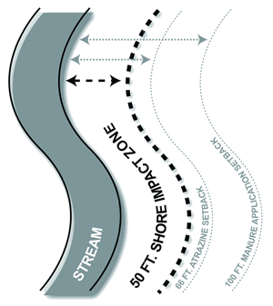
Legislation - Water Quality Improvement
(1) for all public waters, the more restrictive of:
(i) a 50-foot average width, 30-foot minimum width, continuous buffer of perennially rooted vegetation; or
(ii) the state shoreland standards and criteria adopted by the commissioner under section 103F.211; and
(2) for public drainage systems established under chapter 103E, a 16.5-foot minimum width continuous buffer of perennially rooted vegetation on ditches within the benefited area of public drainage systems.

Slide 31
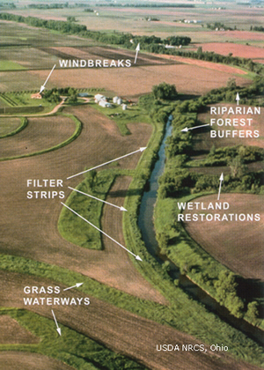
Legislation - Water Quality Improvement
Buffer Strips
$325,000 the first year and $325,000 the second year are for analysis and mapping in each county related to compliance with riparian buffer or alternate practice requirements and to provide statewide coordination and guidance to local units of government for implementation of buffer requirements. Maps must be provided to local units of government and made available to landowners on the Department of Natural Resources' Web site.

Slide 32
Minnesota Parks and Trails
74.7 (e) $536,000 the first year and $555,000 the
74.8 second year are for coordination and projects
74.9 between the department, the Metropolitan
74.10 Council, and the Greater Minnesota Regional
74.11 Parks and Trails Commission; enhanced
74.12 Web-based information for park and trail
74.13 users; and support of activities of the Parks
74.14 and Trails Legacy Advisory Committee. Of
74.15 this amount, $260,000 the first year shall
74.16 be used for a grant to the University of
74.17 Minnesota Center for Changing Landscapes
74.18 to complete a legacy tracking project and
74.19 to implement a survey on use patterns, user
74.20 needs, and perceptions related to parks and
74.21 trails in Minnesota. The tracking project and
74.22 survey work must be done in collaboration
74.23 with the Department of Natural Resources,
74.24 Metropolitan Council, and Greater Minnesota
74.25 Regional Parks and Trails Commission.

Slide 33
Minnesota Parks and Trails
Multiple projects
  Three aspects
    Informational website
    Legacy Fund tracking
      Survey of Use - user needs, and perceptions related to parks and trails in Minnesota
Status – planning for moving all three forward is in process

Slide 34
9-1-1 – Increase in fees to support the build out of Next Generation 9-1-1
Project is moving forward

Slide 35
Preparing for the 2016 Legislative Session
Is there new legislation needed?

Slide 36
Updates on major initiatives

Slide 37


Next Generation 9-1-1 GIS Project
Status Update
9/22/2015
Adam Iten, MnGeo

Slide 38
Current Tasks
Public Safety Answering Point (PSAP) Request for Information – Summary Report
Initial NG9-1-1 GIS Data Collection
NG9-1-1 GIS Data Assessment and Preparation
Minnesota NG9-1-1 GIS Standards
Communication Plan

Slide 39
PSAP RFI – Summary Report
  RFI purpose: to assess the status of GIS data and software at every PSAP in Minnesota
  Response status: 95 of 105 PSAPs (90%)
  Summary Report
    Distributed to stakeholders on 8/20
    Available on ECN website: https://dps.mn.gov/divisions/ecn/programs/911/Pages/gis-information.aspx

Slide 40
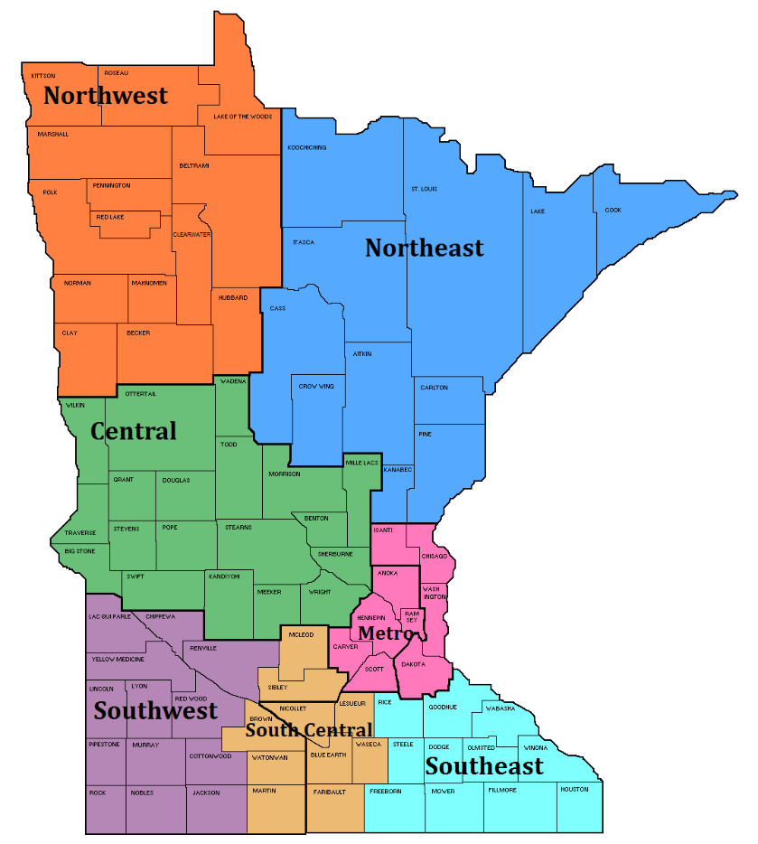
Initial NG9-1-1 GIS Data Collection
    Metro and NE Regions
      Street centerlines with address ranges
      Address points
    All Regions
      PSAP boundaries
      Emergency Service boundaries
        Fire
        Law Enforcement
        Emergency Medical Service

Slide 41
NG9-1-1 GIS Data Assessment and Preparation
  NG9-1-1 GIS data request
    FirstNet – needs all Public Safety Entity boundaries for reporting purposes
    MnGeo – inventory existing NG9-1-1 GIS data, build internal processes, field mapping (local vs NENA schemas)
  New GIS data workflow and repository
  Document MESB’s current 9-1-1 GIS data preparation processes in Metro region
  Plan for NE region

Slide 42
Minnesota NG9-1-1 GIS Standards
  GIS data requirements for NG9-1-1 in Minnesota
  Align with NENA Standards
  Standards Workgroup
  Review and approval
    GIS Subcommittee
    NG9-1-1 Committee
    Statewide Emergency Communications Board (SECB)
    Statewide Geospatial Advisory Council (SWGAC)
    MN.IT
  Other States

Slide 43
Communication Plan
  ECN website
  Monthly
    Project newsletter
    GIS Subcommittee meeting
    NG9-1-1 Committee meeting
    SECB meeting
  Quarterly
    Regional PSAP/GIS meetings
    Statewide Geospatial Advisory Council

Slide 44
Aerial Imagery Master Services Contract
MN Department of Administration preparing an RFP for aerial imagery and planimetric mapping as a MSC
  Goal: pre-select 3 to 5 qualified vendors to bid on work orders issued by government organizations
  As needs arise, new orders can be issued over the life of contract
  Available to all CPV members and state agencies
  Active between 2016 and 2020
Tentative Schedule
  RFP expected to be issued around October 1
  Work orders expected to be accepted by year’s end
  Metropolitan Council preparing to fly in Spring 2016
Update will be given at Consortium Conference
  Session 9: Thursday 1:30 – 3:00

Slide 45

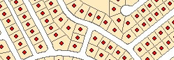
Address Points
Multiple efforts going on…
MetroGIS – develop and implement a workflow and technical solution for gathering address point data from the seven metro counties, aggregating the data into one file and distributing the points, metadata and other supplementary information to the user community.
Next Generation 9-1-1 – create and perpetuate a standards-based statewide address point file suitable for meeting the needs of NextGen 9-1-1
Where we are at – Comparing data models and assessing data received by counties
Goal – Choose a standard and understand the need for supporting tools and processes by the end of October 2015

Slide 46
Parcels
Background
In the works for some time
www.mngeo.state.mn.us/committee/standards/parcel_attrib/parcel_attrib.html
Business plan developed some time ago
Multiple standards have slowed the approval process
Data sharing beginning to open up thus bringing forward the need to move forward on a standard
Recent statewide data collection efforts require that a standard needs to be agreed upon

Slide 47
Status of current effort….
Recently met with Parcels and Land Records Committee and State Agencies to move discussion forward
  Agreed on the DCDATS proposed standard with new ownership characteristics from NE MN work www.mngeo.state.mn.us/committee/cadastral/index.html

Slide 48
DCDATS +
Proposal is to have DCDATS include a new attribute representing Generalized Ownership
Proposed domain:
1 = County Fee
2 = Tax Forfeit
3 = State of Minnesota
4 = United States of America
5 = Municipal
6 = Unknown
7 = No Value
8 = Tribal
9 = Private

Slide 49
Next Steps
Compile input from State Agencies – Complete
Meet with Land Records and Parcels Committee to gather their input – Complete
Propose a direction
  DCDATS + in short term – PRISM long term if can more closely meet agency needs
  Parcel Fabric template to improve adoption
Standards Committee
Vet the direction – multiple groups

Slide 50
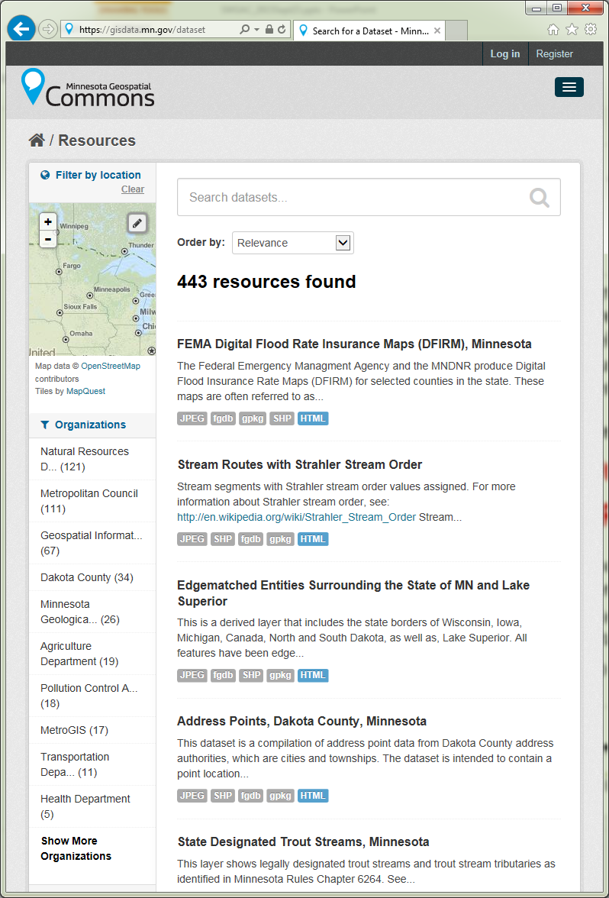















MN Geospatial Commons
Status
Focus - Migration of all significant state geospatial resources to the Geospatial Commons
Published resources accessible
  15 Organizations
  443 Resources
The site is now open to broader participation
  Integrating partners who want to represent their data via the Geospatial Commons
Setting up Metadata Training

Slide 51
Conference Updates

Slide 52


Big take-aways from the FOSS4G Big Bang!
GeoForAll – “Our key aim is to make it possible for students in developing and poor developing and poor countries to be also able to get geospatial education”
http://www.geoforall.org/
Internet of Things – SensorThings API: OGC standard to provide open and unified way to interconnect IoT devices, data and apps over the Web
http://ogc-iot.github.io/ogc-iot-api/
OpenAerialMap – Distributed Commons for Searching and Hosting Free Imagery
http://openaerialmap.org/
OpenDroneMap – Open Source Toolkit for processing Civilian Drone Imagery.
http://opendronemap.github.io/odm/ http://2015.foss4g.org/
GeoServer, PostGIS
http://2015.foss4g.org/

Slide 53

MN GIS/LIS Conference Update
To develop and support the GIS professional in
Minnesota for the benefit of our state and its citizens.

Slide 54

NACIS – Conference and Annual Meeting

Slide 55
La Crosse GIS Conference – May 2016
Explore mid-level and above GIS manager (city, county, state) emerging and hot button issues which typically do not receive in-depth consideration at either state or local events.
Program Committee is considering (full or partial tracks):​
  Open data issues
  Open source software solutions
  Recent LiDAR developments
  UAS/UAV/Drone technology explosion and related information
  Big Data
  Government collaborative efforts and issues
  Utility and building information management developments
  Smart Grid
A joint event hosted by the following organizations:
Geospatial Information & Technology Association (GITA)
American Society for Photogrammetry and Remote Sensing – Western Great Lakes Region (ASPRS-WGLR)
Illinois GIS Association (ILGISA)
Iowa Geographic Information Council (IGIC)
MN GIS/LIS Consortium (MN GIS/LIS)
Wisconsin Land Information Association (WLIA)
SharedGeo (SG)

Slide 56
Announcements or other business

Slide 57
Adjourn…
Next meeting dates:
December 2, 2015
March 2, 2016
June 1, 2016

